Slide 1
Introduction into transparency in NLP
Julia Ive

Slide 2
Session Outline
What is transparency?
How to understand an NLP model?
Do we want to understand model predictions overall or just for some examples?
How do we get the explanations?
What to explain?
How do we present the explanations?
Keep human in the loop
Key Takeaways
Learning Outcomes
Awareness of the transparency requirement
Knowledge of the transparency workflow
Ability to distinguish types of transparency methods

Slide 3

What is transparency?
Ethically permissible design, implementation and outcome of the AI system -> Design lectures
Ability of the AI system to explain its decisions :
Understanding the rationale behind model’s decision
We often use the metaphor “opening the black box”
https://www.reuters.com/article/uk-health-coronavirus-italy-robots-idUKKBN21J68H?edition-redirect=uk/

Slide 4
What is transparency?
Data-driven methods are not intuitive
Learning from experience without clearly defined human-readable relations
State-of-the-art neural models are black box
Approximation given by the neural network does not provide insights on the function being approximated
https://www.reuters.com/article/uk-health-coronavirus-italy-robots-idUKKBN21J68H?edition-redirect=uk/

Slide 5

What is transparency?
Data-driven methods are not intuitive
Learning from experience without clearly defined human-readable relations
State-of-the-art neural models are black box
Approximation given by the neural network will not give you any insight on the function being approximated
How to make the model transparent?
https://www.reuters.com/article/uk-health-coronavirus-italy-robots-idUKKBN21J68H?edition-redirect=uk/

Slide 6
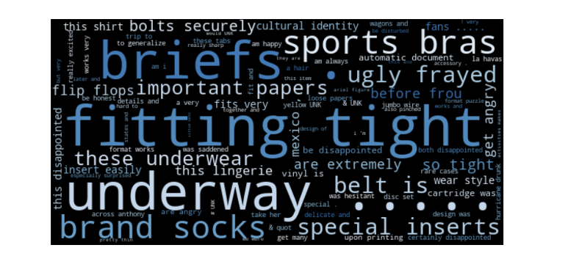
Do we want to understand model predictions overall or just for some examples?
Global explanations explain the model overall
They are not intuitive for humans
Work for significant problems (such as gender bias)
Local explanations explain model predictions for individual inputs
Costly human help to inspect explanations for every single example
We can also generating explanations for a group of predictions
However, we need to choose right groups of examples
Topic: Clothing & Jewelry
I love this necklace.
Topic: Clothing & Jewelry

Slide 7
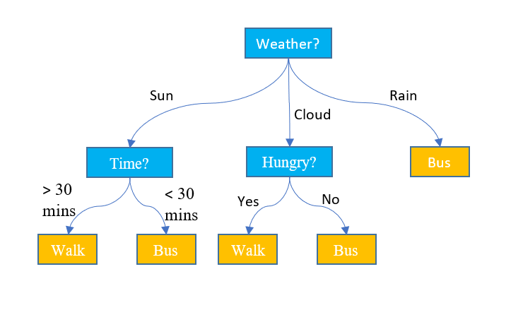
How do we get the explanations?
Self-explaining methods
Interpretable techniques Machine Learning techniques (e.g., Naive Bayes, Logistic regression, Decision Trees)
Post-hoc (after-the-fact) explanation methods
Model-agnostic
Deduce explanations from a trained model or using prediction results

Slide 8
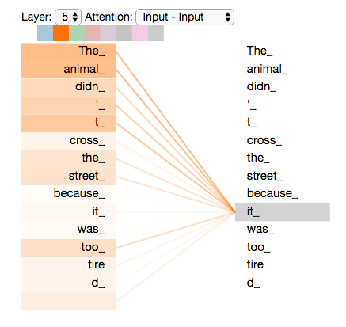
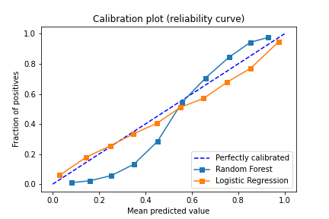
How do we get the explanations?
We can analyse attention scores
Attention layers present or can be added to most neural architectures
It can help indicate where the model is “focusing”
Calibration of machine learning models compares the distribution of the probability predicted by models with the distribution of probabilities observed in real data
Gradient (rate of change) of the output with respect to the input words
Attention correctly refers “It” to “animal”

Slide 9
How do we get the explanations?
With no access to the model parameters, we train another explainer model that predicts important input words given the input to the target model and its prediction
Training
Inference
I hate this movie
NLP model
I hate this book
Negative
Negative
I hate this movie
Negative
I hate this movie
Positive
Explainer model
Explainer model
I hate this book

Slide 10
What to explain?
Input feature importance
Identify parts of the input that are important for the prediction
Explanation could be a list of importance (aka attribution) scores
Essential properties:
Compactness
Sufficiency: they suffice for prediction as a substitute of the original text
(Often) Comprehensiveness

Slide 11
What to explain?
Influence of training examples
Select influential examples from the training set to explain model’s prediction
Model misbehavior
Adversarial inputs reveal changes in the inputs that could change the predictions
NLP model
I think the food not good
Negative
I think the food not good
Negative

Slide 12
How do we present the explanations?
Example | Explanation
Premise: A white race dog with a number runs on the track | Highlight Premise: A white race dog with a number runs on the track. Hypothesis: A white race dog runs around his yard
Hypothesis: A white race dog runs around his yard | Free-text A race track is usually not in the yard.
Label: Contradiction
Highligths (aka rationales)
Mark input elements (words, phrases, or sentences) that explain a prediction
Free-text (textual or natural language explanations)
Not constrained to input words
More expressive and more readable than highlights

Slide 13
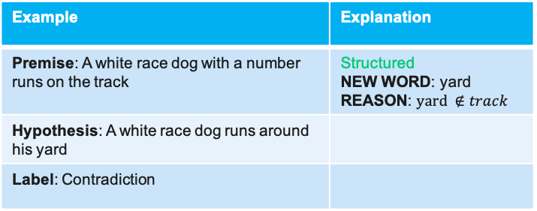
How do we present the explanations?
Structured (template-like) explanations
Template creation is costly
Example | Explanation
Premise: A white race dog with a number runs on the track | Structured NEW WORD: yard REASON: $yard ∉track$
Hypothesis: A white race dog runs around his yard
Label: Contradiction

Slide 14
Keep human in the loop
I really hated the movie. It was long and boring.
NLP models can make correct predicts for bad reasons
Humans can to improve the model by confirming or correcting model explanations
Form of feedback defines how to update the model
Humans can provide free-text explanations to show how the humans would reason about the models’ failure cases
For example, feedback for a hate speech detection model is “Because X is the word dumb, Y is a hateful word, and X is directly before Y, the attribution scores of both X and Y as well as the interaction score between X and Y should be increased”
Special training for feedback providers

Slide 15
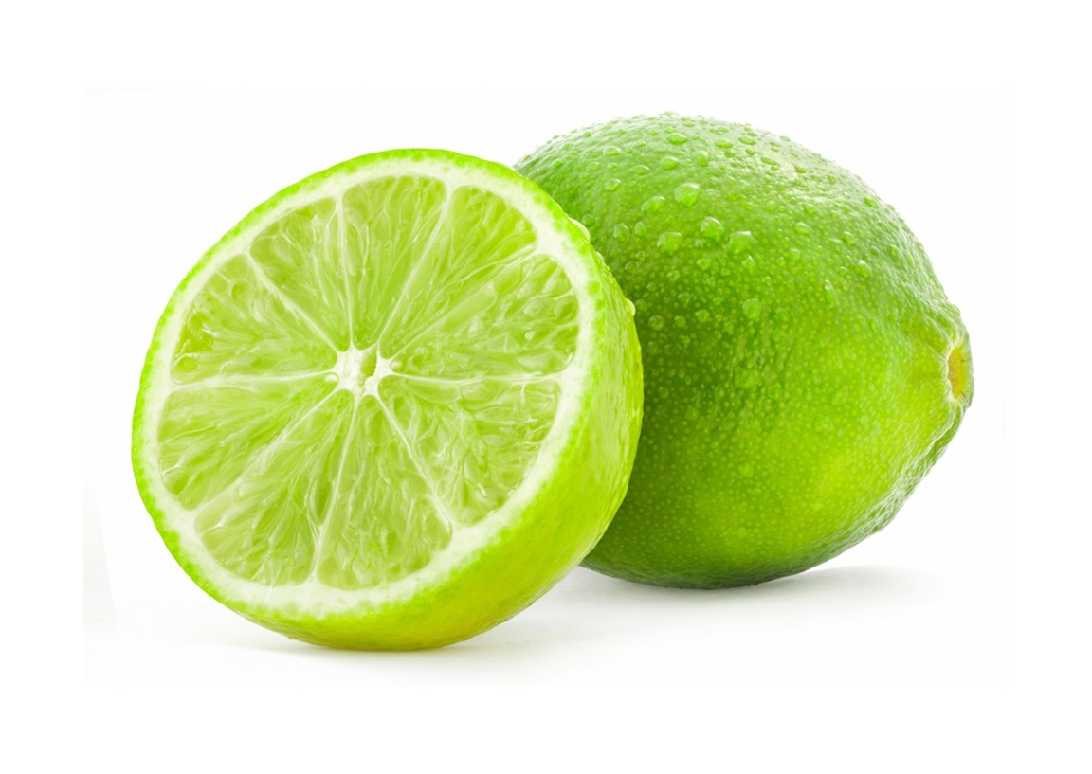
LIME
LIME (Local Interpretable Model-Agnostic Explanations) perturb the input around its neighbourhood and observe predictions
Local post-hoc local transparency with attribute scores:
Learn an explainer model to predict important words that influence the predictions the most
We will read the LIME paper in Lesson AI2.2. LIME / SHAP transparency approach
https://neptune.ai/blog/ml-model-interpretation-tools

Slide 16
SHAP
SHAP (SHapley Additive exPlanations) based on the algorithm was first published in 2017 by Lundberg and Lee
SHAP measures the contribution of each feature brings to the prediction made by the model
Train a separate model for each possible combination of the available features, always with the same hyperparameters and training data
Average performance difference between models that can be attributed to the presence of the target feature (marginal contribution)
Use approximations and sampling to make the computation tractable
We will read the SHAP paper in Lesson AI2.2. LIME / SHAP transparency approach

Slide 17
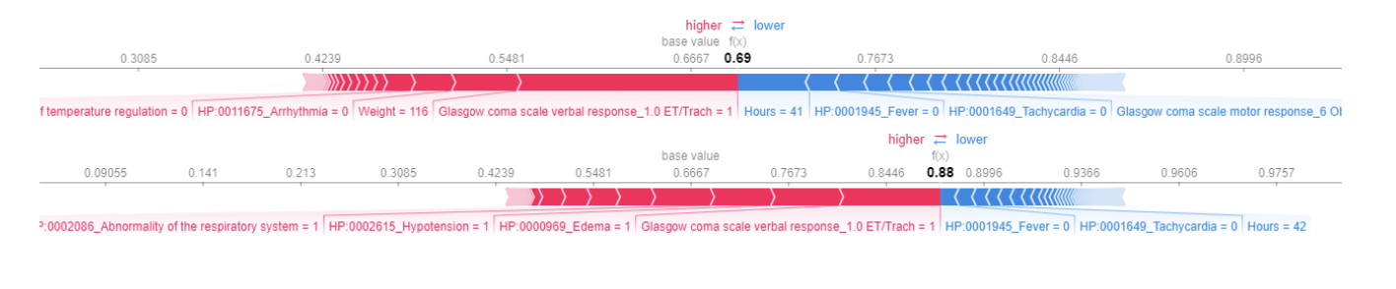
SHAP
SHAP diagrams for the prediction of the ICU stay length
Each row of the heatmap represents one of the features
Each feature can contribute positively (red) or negatively (blue)
Length of each row represents the importance of the feature contribution
(Zhang et. al , 2022)

Slide 18
Key Takeaways
There are multiple ways to make an NLP model transparent
Choice of methods depends on the use-case
Generating explanations for a group of predictions seems an optimal trade-off between utility and cost as compared to global explanations and local per example explanations
Post-hoc explanation models can provide explanations for any model
Explanations in natural language are human-friendly and are capable to efficiently generalise over groups of examples
Human feedback is needed to make models more comprehensible

