Slide 1
Sequence-to-Sequence Modelling
Julia Ive

Slide 2
Session Outline
Conditional Language Modelling
Principles Seq2Seq Modelling
Architecture Types
RNN Encoder-Decoder
RNN Encoder-Decoder with Attention
Transformer Encoder-Decoder
Key Takeaways
Learning Outcomes
Being familiar with principles of Seq2Seq modelling
Being familiar with the Transformer architecture

Slide 3
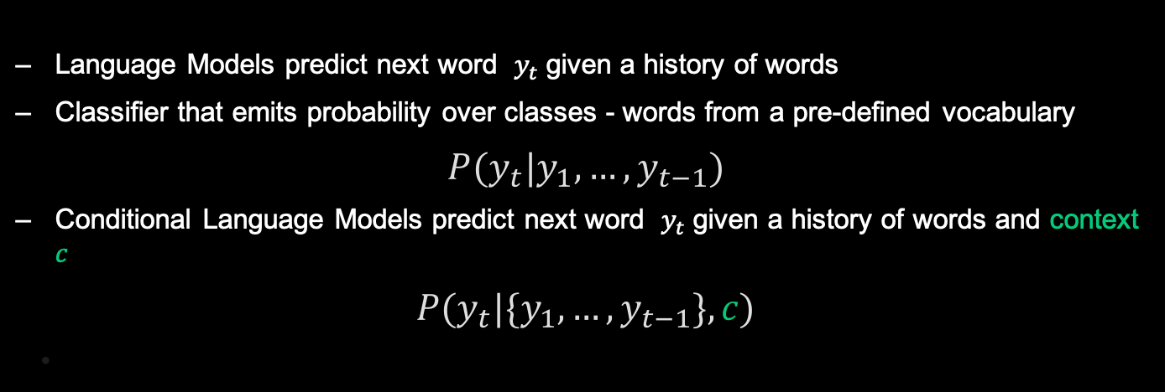
Language Models - Recap
Language Models predict next word $y_{t}$given a history of words
Classifier that emits probability over classes - words from a pre-defined vocabulary
$$P(y_{t}|y_{1},…,y_{t−1})$$
Conditional Language Models predict next word $y_{t}$given a history of words and context $c$
$$P(y_{t}|{\{y}_{1},…,y_{t−1}\},c)$$

Slide 4
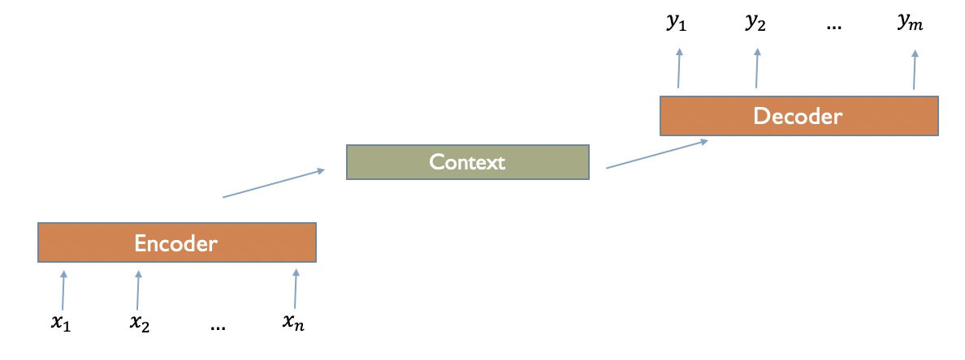
Seq2Seq Modelling
Sequence2sequence (aka. seq2seq, encoder-decoder architecture) generate contextually appropriate output sequences of arbitrary length
Applied to a very wide range of applications including machine translation, summarisation, question answering, etc.
Encoder network that takes an input sequence and creates a contextualized representation (context, c)
This representation is then passed to a decoder which generates a task-specific output sequence

Slide 5
Seq2Seq Modelling
Some notations:
Encoder is a neural network that encodes the context
Encoder function - 𝐸()
Decoder is a conditional language model
Decoder function - 𝐷()
Source language sentence (context) with 𝑆 tokens 𝑋={𝑥1,…, 𝑥𝑆} encoded by the Encoder
Target sentence with 𝑇 tokens 𝑌={𝑦1,…, 𝑦𝑇} generated by the Decoder

Slide 6
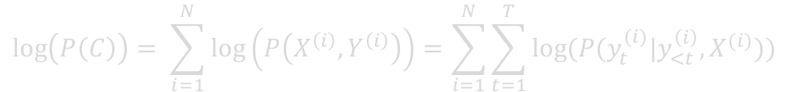
Seq2Seq Modelling
Joint log-probability of the corpus is given by:
Maximum likelihood estimation (MLE)
or minimise negative log-likelihood
$$\log\left(P\left(C\right)\right)= \sum_{i=1}^{N}{\log\left(P\left(X^{\left(i\right)},Y^{\left(i\right)}\right)\right)=\sum_{i=1}^{N}{\sum_{t=1}^{T}{log⁡(P({y_{t}^{(i)}|y}_{<t}^{\left(i\right)}, X^{(i)}))}}}$$
Decoder predicts the target word
given the words predicted so far and …
the source sentence

Slide 7
Seq2Seq Modelling
Design choices:
Design choices
What to use as an encoder / decoder?
How do we represent the source sentence?
How does the decoder refer to that representation?

Slide 8
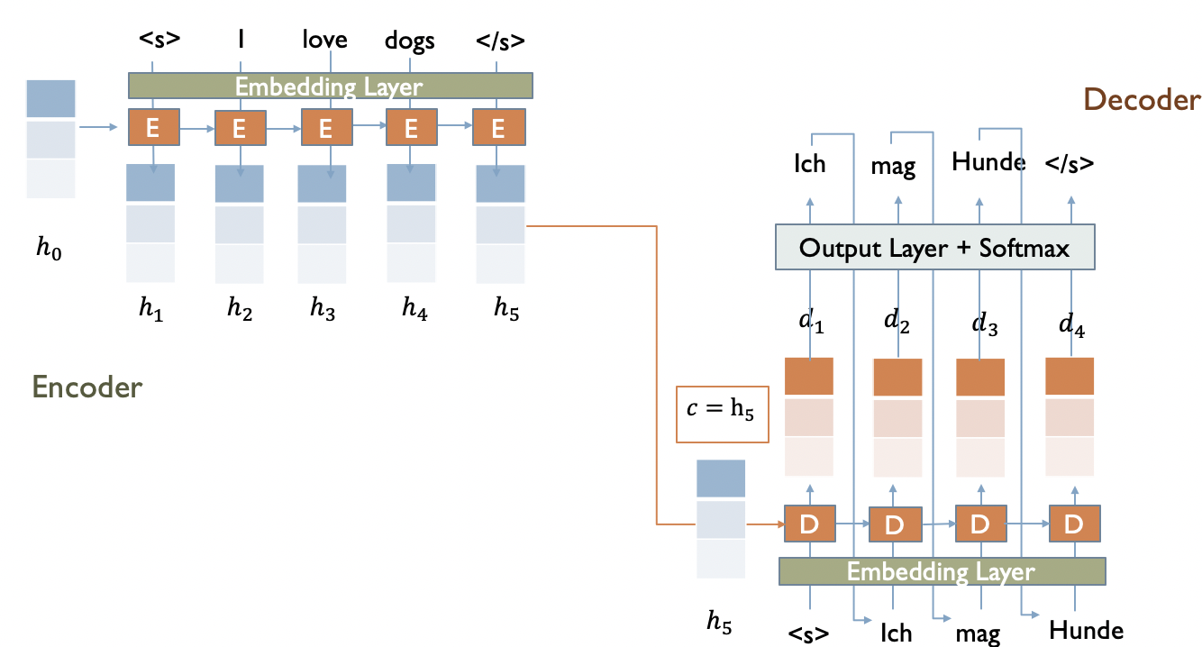
Encoder-Decoder with RNNs

Slide 9
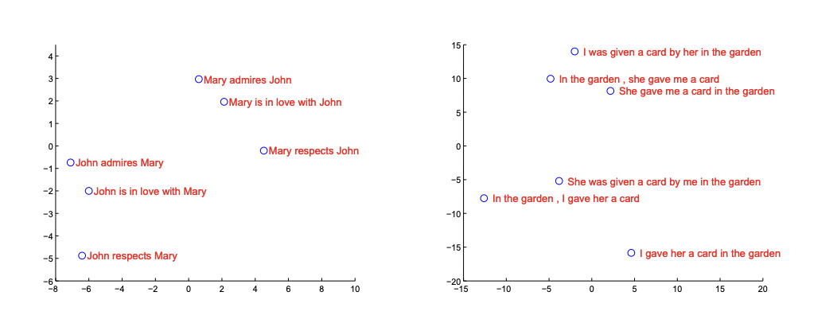
Encoder-Decoder with RNNs
Bottleneck (sentence length) problem:
"You can't cram the meaning of a whole %&!$# sentence into a single $&!#* vector!” – Ray Mooney, Invited talk at the ACL 2014 Workshop on Semantic Parsing
2-dimensional PCA projection of the hidden states for the LSTM Seq2Seq
Sentences are clustered by meaning, which in these examples is primarily a function of word order
Sutskever. 2014. Sequence to Sequence Learning with Neural Networks

Slide 10
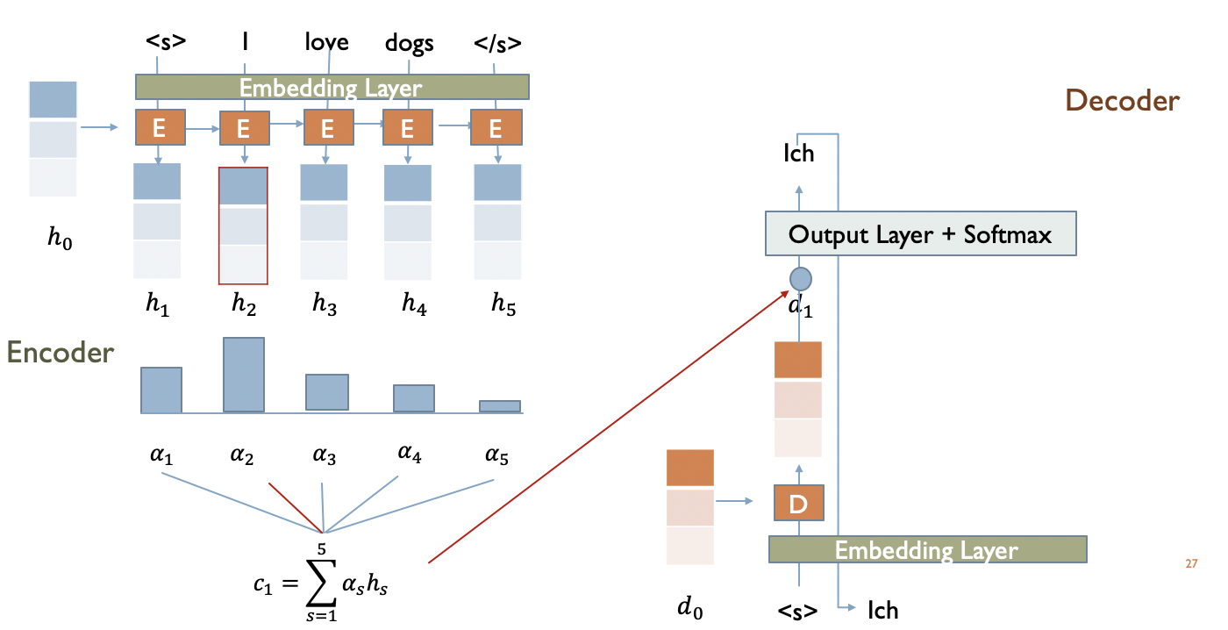
RNN Encoder-Decoder with Attention
Improves performance
Solution to the bottleneck problem
Provides some insight into model: we can see what decoder is focusing on

Slide 11
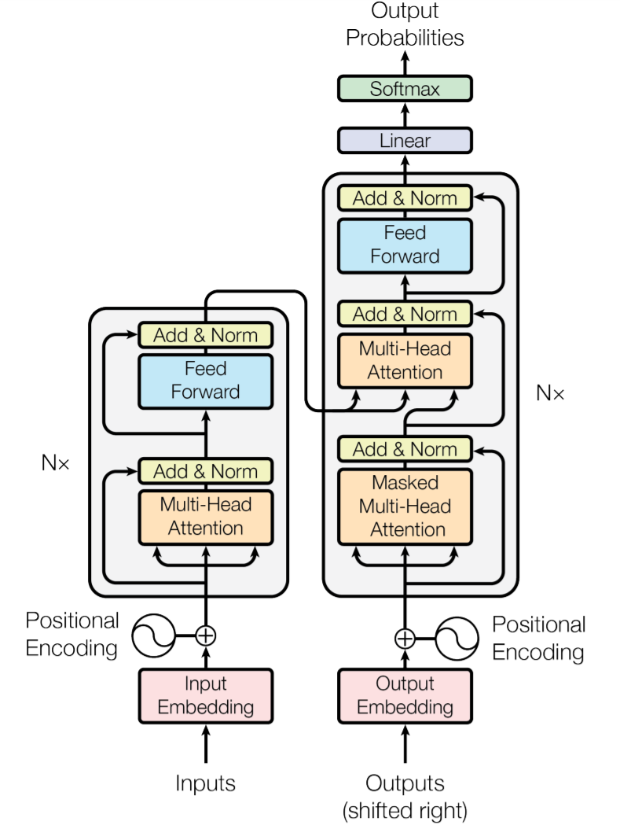
Transformer
ENCODER
DECODER
Transformer paper “Attention is all you need” (Vaswani et al. 2017)
Stack of N (6) identical layers
8 attention heads
Really nice video: https://towardsdatascience.com/illustrated-guide-to-transformers-step-by-step-explanation-f74876522bc0

Slide 12
Transformer Encoder-Decoder
Encoder-decoder attention - every position in the decoder can attend over all positions in the input sequence
Encoder self-attention - each position in the encoder can attend to all positions in the encoder sequence
Decoder self-attention similarly, each position in the decoder can attend to all positions in the decoder up to the current position

Slide 13
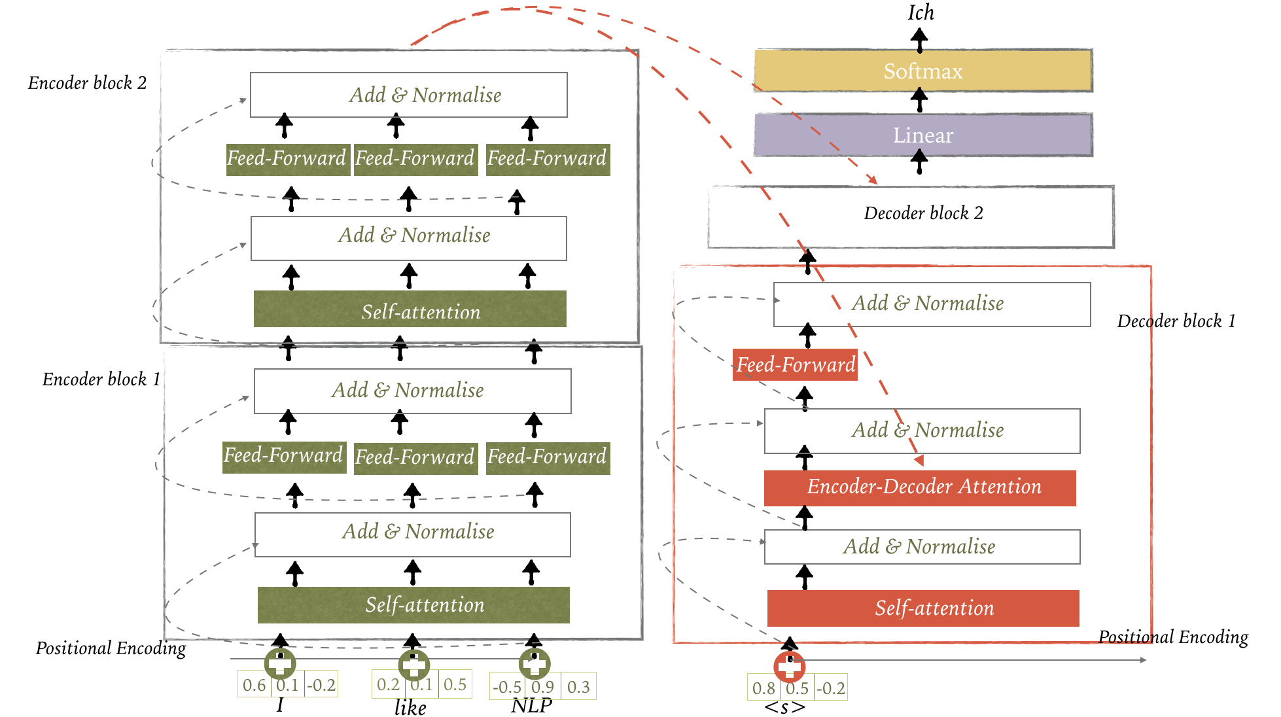
Transformer Encoder-Decoder

Slide 14
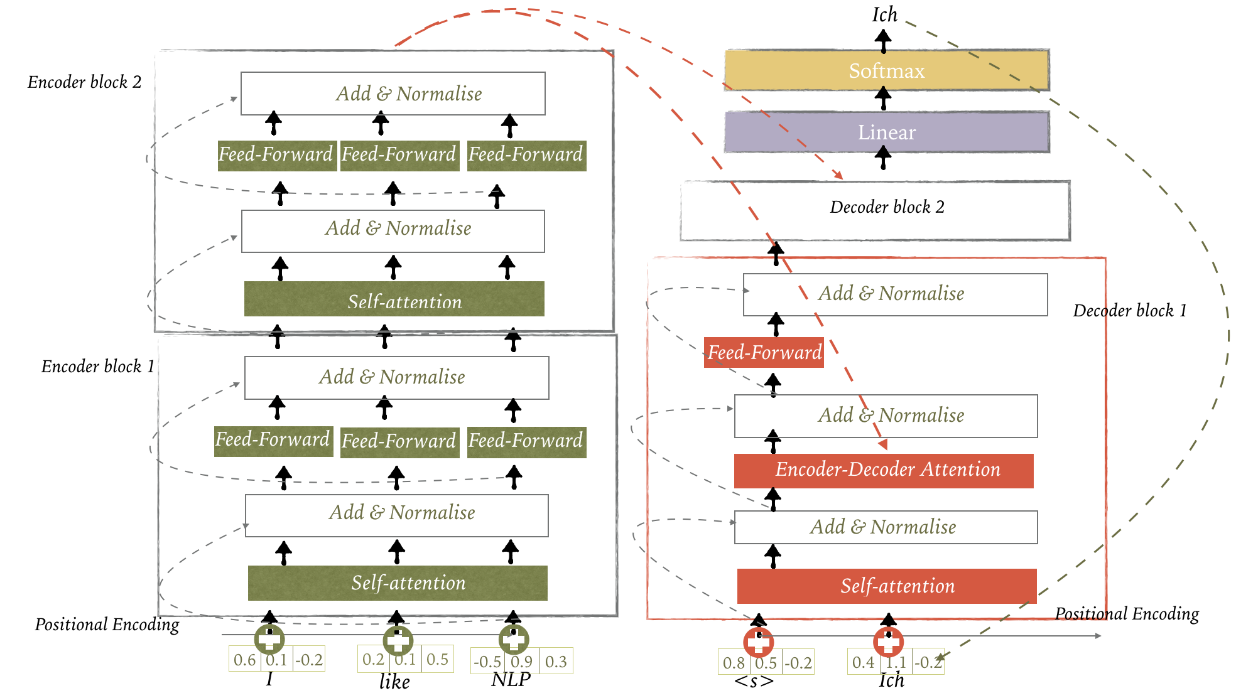
Transformer Encoder-Decoder

Slide 15
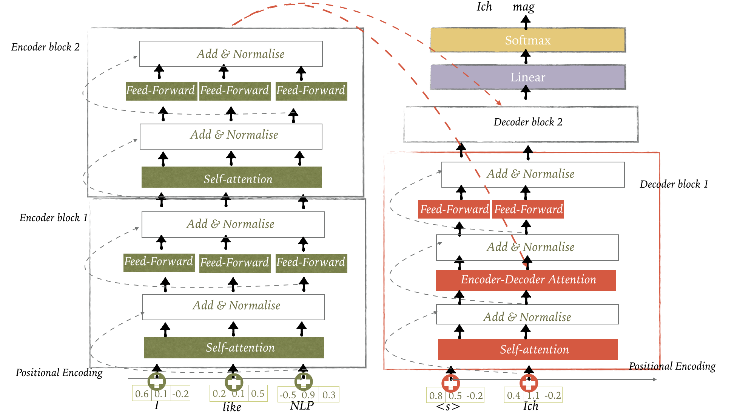
Transformer Encoder-Decoder

Slide 16
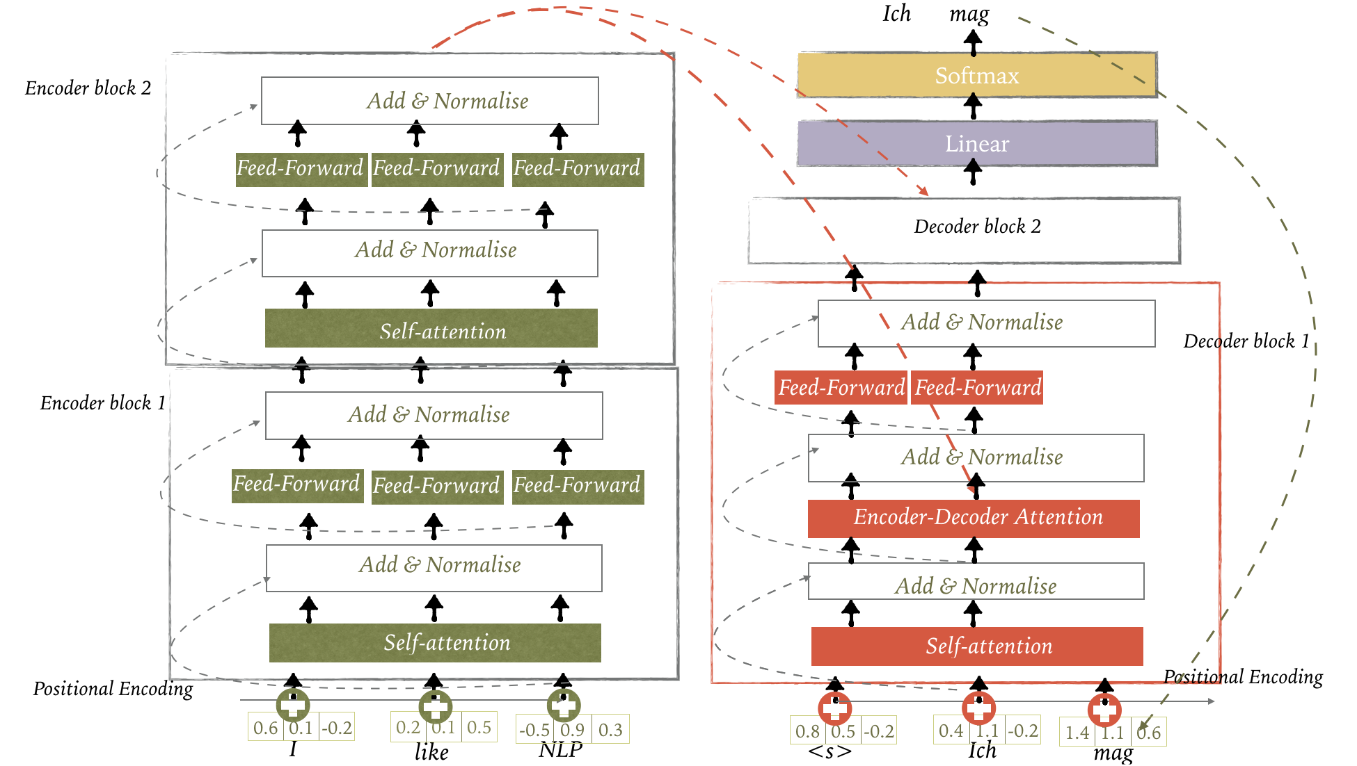
Transformer Encoder-Decoder

Slide 17
Role of Encoder-Decoder Architecture
Standard algorithm for MT
Used for a different kind of sequence modeling in which the output sequence is a complex function of the entire input sequence
State of the art for many other tasks where complex mappings between two sequences are involved, such as summarisation, data2text, dialogue, semantic parsing, etc.

Slide 18
Key Takeaways
Seq2seq (aka encoder-decoder) is a standard algorithm coming from Machine Translation applicable to a wide range of problems where output sequence is a complex function of the entire input sequence
Encoder-decoder networks are composed of an encoder network that takes an input sequence and builds its context vector
Context representation is used by a decoder to generate an output sequence relevant to a specific task
Cross-attention in transformers enable the decoder to consider information from all of the hidden states of the encoder when generating the output sequence

