Slide 1
Introduction into Classification
Julia Ive

Slide 2
Session Outline
NLP Classification Tasks
Rumour Verification Task
Neural Architectures for NLP Classification
Classification with BERT
Key Takeaways
Learning Outcomes
Familiarity with the classification task in NLP using the example of rumour verification
Familiarity with the BERT fine-tuning process

Slide 3



Classification
Given a set of texts label each of them with a category
Lies at the core of human intelligence and linguistic thinking:
chair - a separate seat for one person, typically with a back and four legs
https://en.oxforddictionaries.com
https://www.boredpanda.com/creative-chair-design

Slide 4
Text Classification
A common end-user task in NLP
Sentiment analysis
Spam filtering
Document categorisation
Language identification
Author attribution
Types of classification tasks
Binary: positive / negative
Multi-class: sports / politics / gossip
Multi-label: disease codes (can have more than one)
Units: word, phrase, sentence, document

Slide 5
Rumour Verification
Social media allows rumours (claims made by social media users) to be spread at a large scale
NLP can accelerate verification to gain control over the rumour spread
Rumours are items of information that are unverified at the time of posting (Zubiaga et al., 2018)
Note:
Hoaxes are intentionally published by news outlets
Hoax is a false story are used to disguise the truth (to hocus = to cheat)
Fake news is a specific type of hoax spread for political or financial benefit
In fact-checking sources of evidence are given (e.g., such as Wikipedia)

Slide 6
Rumour Types
Veracity value: true, false or unresolved
Degree of credibility: high or low
According to their timeline (Zubiaga et al., 2018):
Long-standing:
Discussed for long periods of time
Might be known a priori
No real-time processing needed
For example, Barack Obama is Muslim
New rumours that emerge during breaking news:
Usually quickly resolved
Need for automatic detection in real-time
For example, identity of a suspected criminal

Slide 7
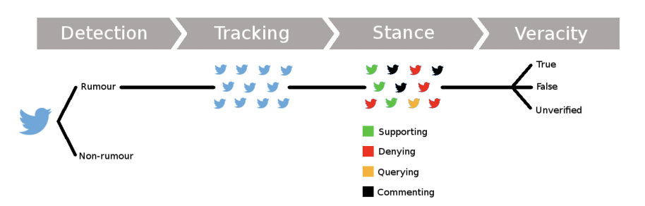
Rumour Verification Pipeline
Zubiaga et al. 2018. Detection and Resolution of Rumours in Social Media: A Survey

Slide 8
Rumour Detection & Tracking
Detection:
Input: stream of social media posts
Output: binary judgement, rumour / non-rumour
Not necessary for known rumours
Tracking:
Collect and filter posts discussing the rumour
Input: rumour itself
Output: collection of posts discussing the rumour

Slide 9
Rumour Stance Classification
Rumours usually provoke discussions between users on their likely veracity
For example, it has been shown that false rumours cause larger numbers of denying tweets than true ones (Procter et al., 2013)
Input: set of posts associated with the same rumour
Output: label per post from a pre-defined set of stances (e.g., supporting, denying, querying or commenting)

Slide 10
Veracity Classification
Rumours usually provoke discussions between users on their likely veracity
For example, it has been shown that false rumours cause larger numbers of denying tweets than true ones (Procter et al., 2013)
Input: set of posts associated with the same rumour
Output: label per post from a pre-defined set of stances (e.g., supporting, denying, querying or commenting)

Slide 11
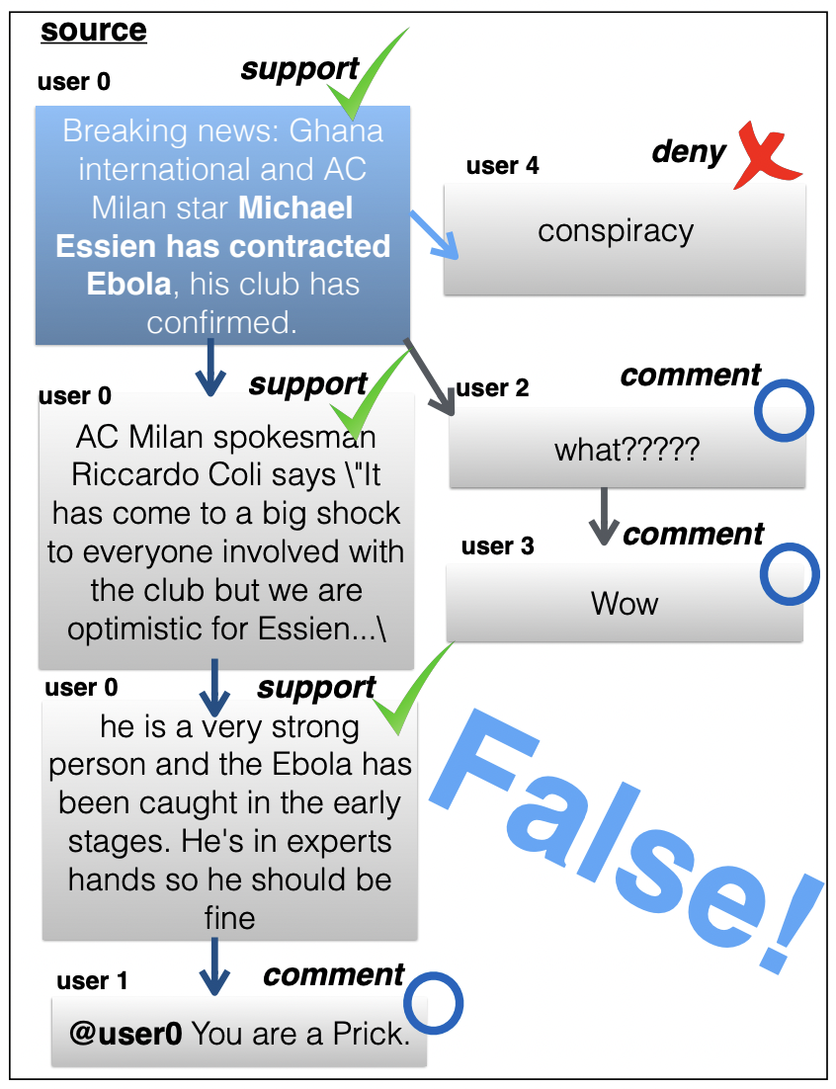
Datasets
PHEME
Twitter conversations about news breaking events (Zubiaga et al., 2016): Charlie Hebdo, Ferguson, Sydney siege, etc.
Three levels of annotations: detection (binary), stance (supporting, denying, querying or commenting) & veracity (true, false or unverified)
Annotated by professional journalists from full conversations
Kochkina. 2019. Rumour Stance and Veracity Classification in Social Media Conversations

Slide 12
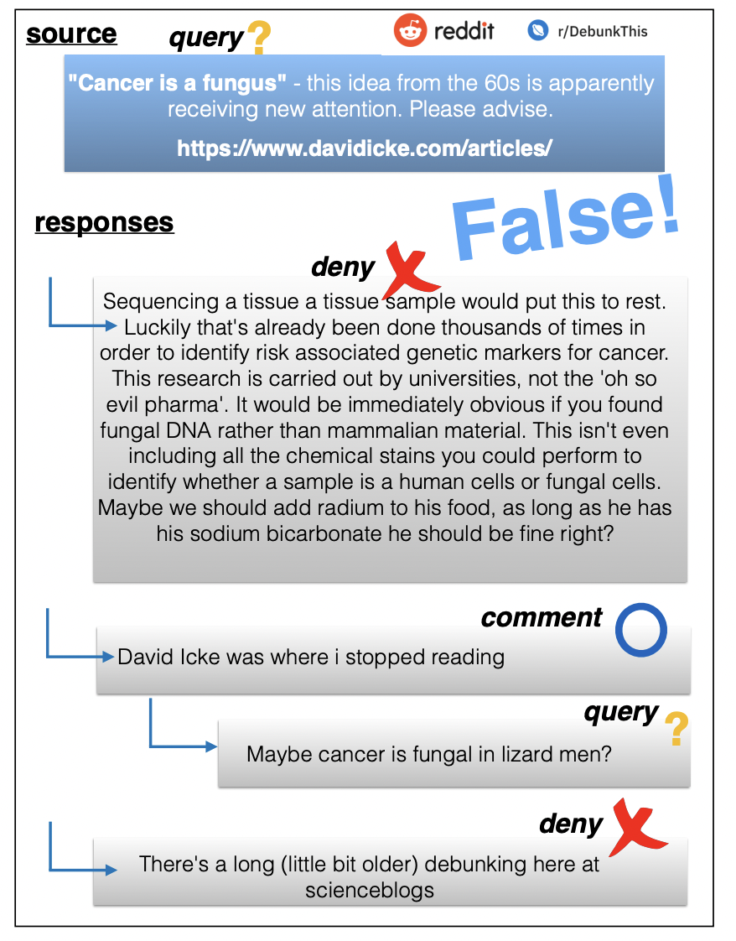
Datasets
RumourEval 2019
Shared task at the annual SemEval competition
Twitter & Reddit conversation trees associated with different news breaking events (extended subset of PHEME)
Stance & veracity classification
Kochkina. 2019. Rumour Stance and Veracity Classification in Social Media Conversations

Slide 13
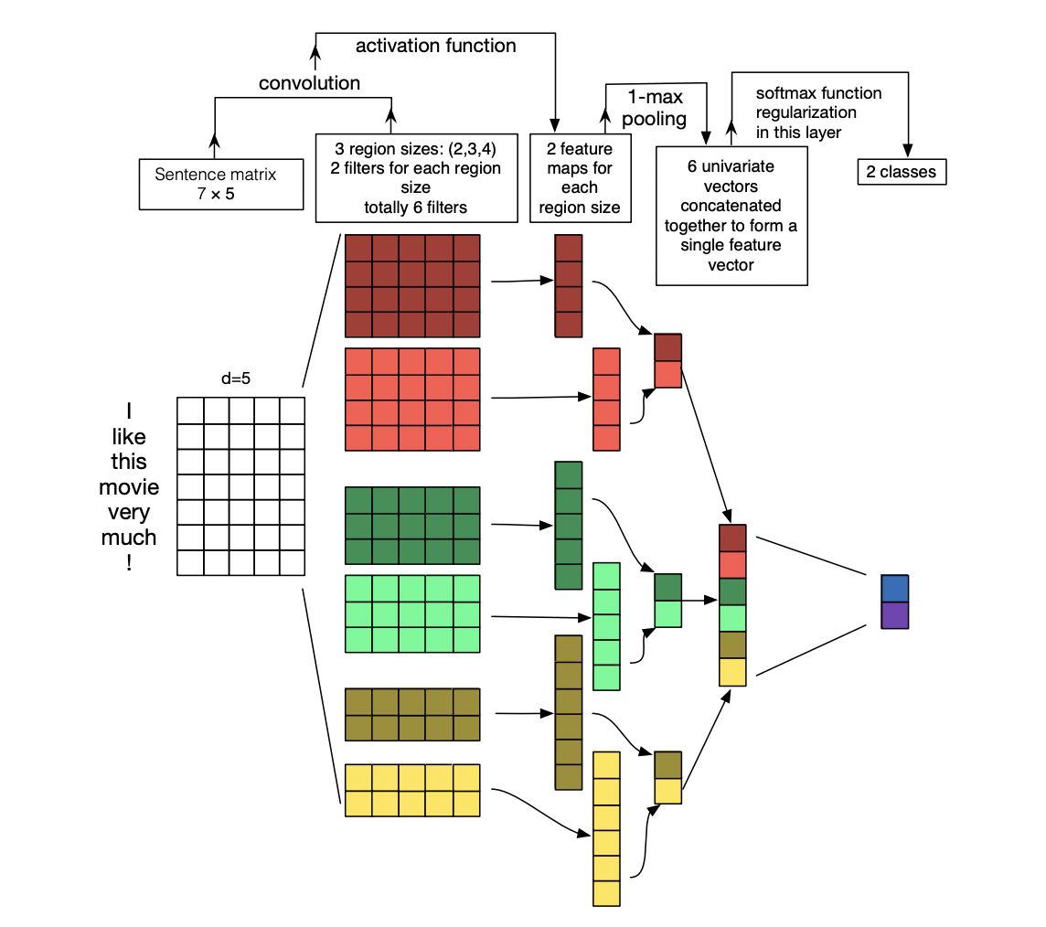
Neural Architectures for Classification
RNNs:
Encode global sequence, poor for long/structured text
Short text, lots of training data
CNNs:
Encode local sequence; but misses longer-distance dependencies
Long text, outputs depend on local patterns
BERT:
Captures dependencies between words (better than CNNs) and sequence information as well
Current NLP state of the art
Zhang et Wallace. 2016. A Sensitivity Analysis of (and Practitioners’ Guide to) Convolutional Neural Networks for Sentence Classification

Slide 14
BERT
Non-contextualised (static) embeddings do not distinguish between meanings of the same word
Bidirectional Encoder Representations from Transformers
Reuses core ideas:
Contextualised (dynamic) embeddings from language modelling
Semi-supervised learning
Pre-train a model on a large amount of unlabelled data to “grasp” language patterns

Slide 15
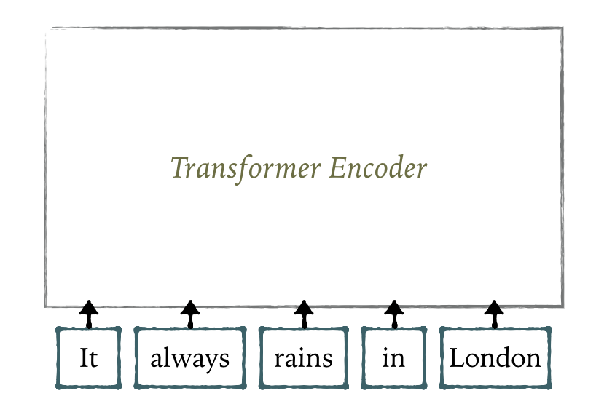
Masked Language Model

Slide 16
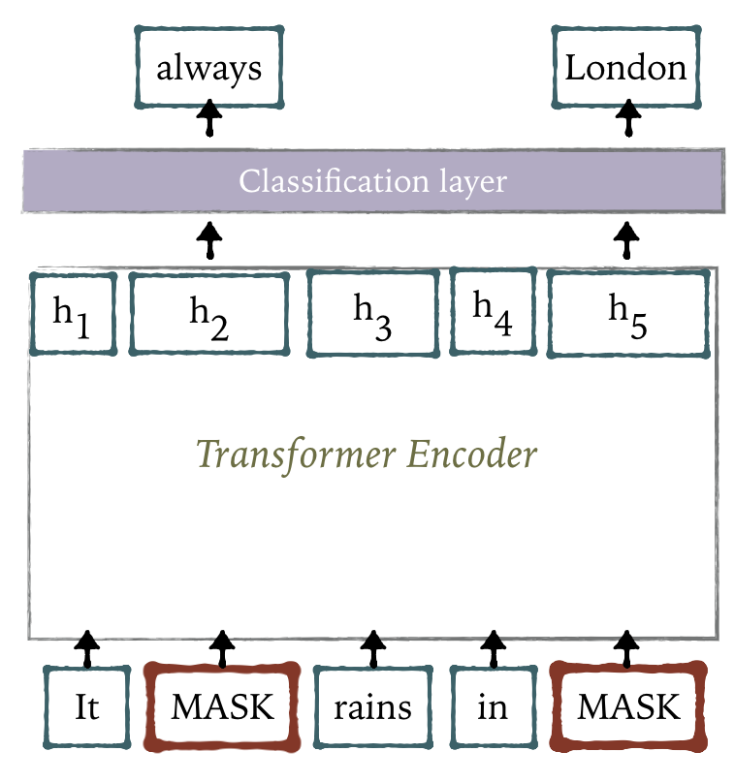
Masked Language Model

Slide 17
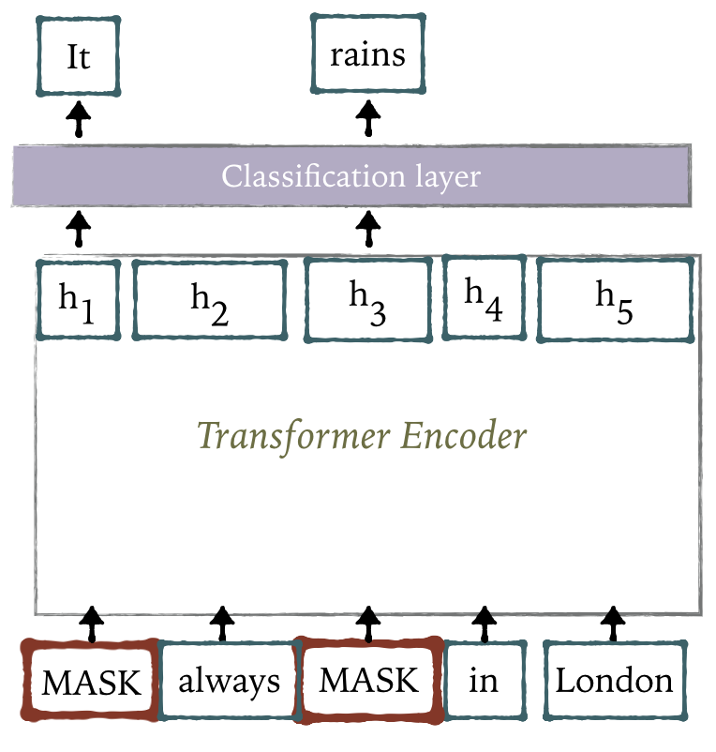
Masked Language Model

Slide 18
Masked Language Model
[CLS] token is inserted at the beginning of each sentence
Mask out 15% of the input words, and then predict the masked words
Less masking - cost of training increases
More masking - not enough context

Slide 19
Masked Language Model
Do not always replace with [MASK]:
80% of the time, replace with [MASK]
Rains in London → rains in [MASK]
10% of the time, replace with a random word
Rains in London → rains in dogs
10% of the time, keep same
Rains in London → rains in London

Slide 20
Masked Language Model
Address the pre-training and fine-tuning mismatch: [MASK] token does not appear during fine-tuning
Force the model to keep a distributional contextual representation of every input token

Slide 21
Masked Language Model
Intuition: learn relationships between sentences
No labelled data required
Predict whether Sentence B is actual sentence that follows Sentence A (50% for training), or a random sentence (50% for training)
Representation of [CLS] token is taken as the representation of the input sequence
This representation is fed to the classification layer

Slide 22
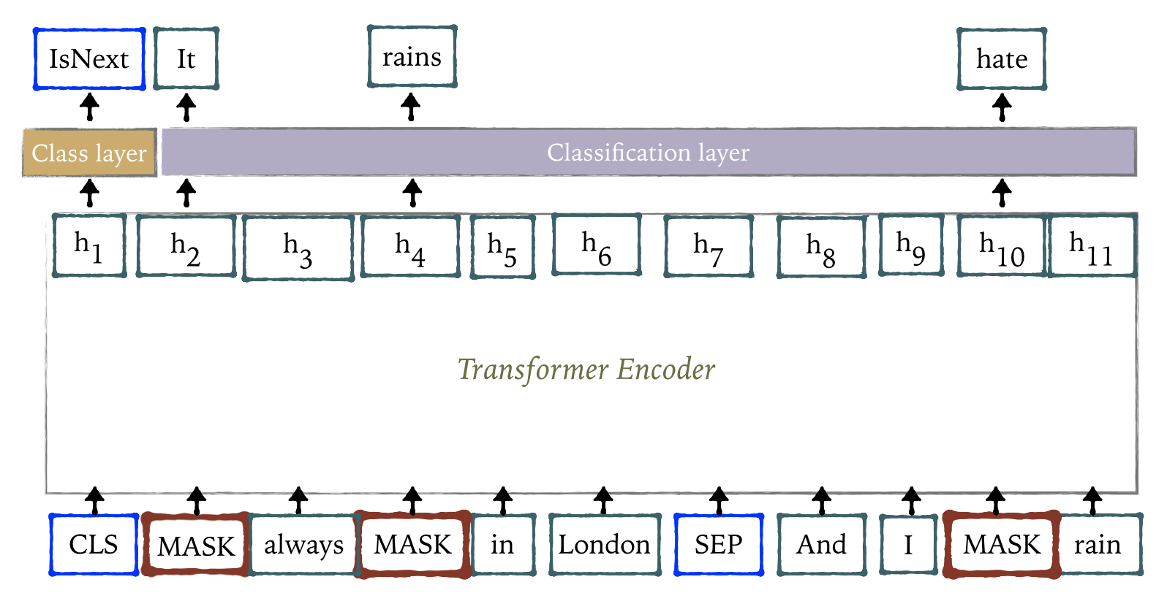
Pre-Training

Slide 23
Fine-Tuning
Minimal changes to the BERT model
Plug in the task-specific inputs and outputs and just change the classification layer
Most hyper-parameters stay the same (except learning rate, batch size, etc.)
Fine-tuning step is fast - typically hours

Slide 24
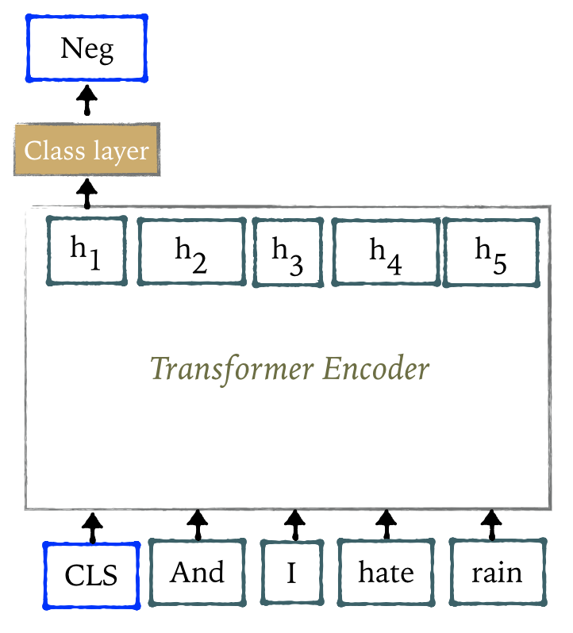
Fine-Tuning: Classification

Slide 25
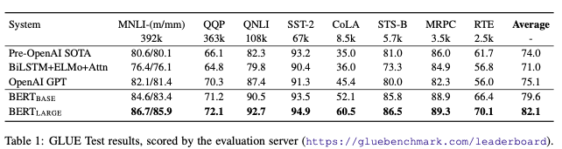
BERT Performance
Initially achieved state-of-the-art performance in 11 natural language understanding tasks
State-of-the-art results in a wide variety of NLP tasks
Publicly available pre-trained models
Not only English: multilingual BERT trained on 104 languages

Slide 26
Relatives of BERT
RoBERTa - dynamic masking; [MASK] changes during training epochs
XLNet - permutation LM; all the tokens are predicted but in random order
DistilBERT - uses distillation to approximate the large neural network by a smaller one
ALBERT - sharing parameters across layers
ELECTRA - two Transformers: Generator generates tokens from [MASK]; Discriminator predicts if the generated token was the original one

Slide 27
Key Takeaways
Text classification is a core NLP task
Spread of rumours via social media poses a real threat to the veracity of the information and hence automatic rumor detection has become necessary
Different types of neural networks are fit for different types of classification tasks
Large pre-trained transformer-based models are the current state-of-the-art that handle both long-dependency and sequence information within text
Such models (e.g., BERT) can be fine-tuned for specific applications by adding lightweight classifier layers on top of their outputs

