Slide 1
GU calibration process – the problem
Data (t)
Calculate likelihoods
t => t+1
Re-sample
GP emulator
(run prior to calibration)
Start
t = 0
N particles
Model prediction
Replace with concurrent simulation
How to do this?
Approach (1) Call simulation, run for each of the N particles for time period leading up to new value of t and output model prediction – not sure this would work for sudden value change?
1000 particles for 10 days (proposed minimum burn-in time) would take ~ 1hr on MATLAB, ~ about the same on python
Approach (2) Call simulation run for a 10 days with a range of parameter values and fit GP emulator to results. Previously ran 60 pairs of values – would take ~ 3 minutes per data point including calibration step – use this approach
Approach(3) Don’t call simulation run concurrently but run prior and fit GP emulator to results. This emulator can then be used to infer model output from external T, RH and light state concurrently

Slide 2
step = 0
t = time(step)
(3am/3pm)
weather(t-240):weather(t)
weather
(External T, RH)
Run GES model over X
Calibration parameters, X
(60 x (ACH,IAS))
GP emulator
Model prediction for each particle, N
N particles
Calculate likelihood of each particle, N given Data(t)
Data(t)
(monitored RH mid-farm)
N particles (ACH,IAS)
Re-sample N particles weighted by likelihood
step => step +1

Slide 3
t = time(step)
(3am/3pm)
weather(t-240):weather(t)
weather
(External T, RH)
from database
Run GES model over X
Calibration parameters, X
(60 x (ACH,IAS))
X.csv
GP emulator
Model prediction for each particle, N
Calculate likelihood of each particle, N given Data(t)
Data(t)
(monitored RH)
from database
Output values 1000x(ACH,IAS,length)
N particles (ACH,IAS,length)
Re-sample N particles weighted by likelihood
step => step +1

Slide 4
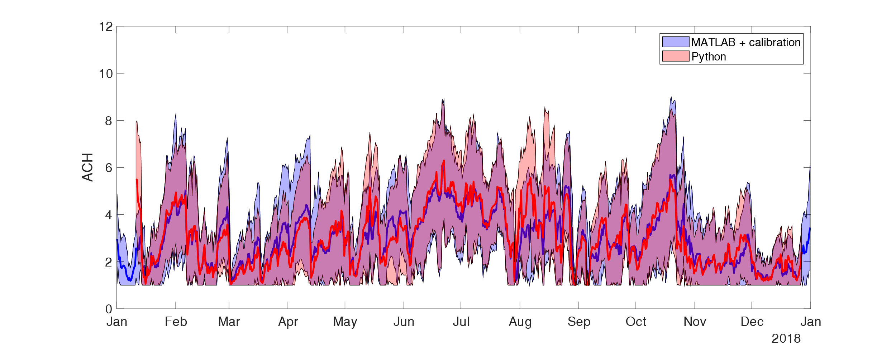
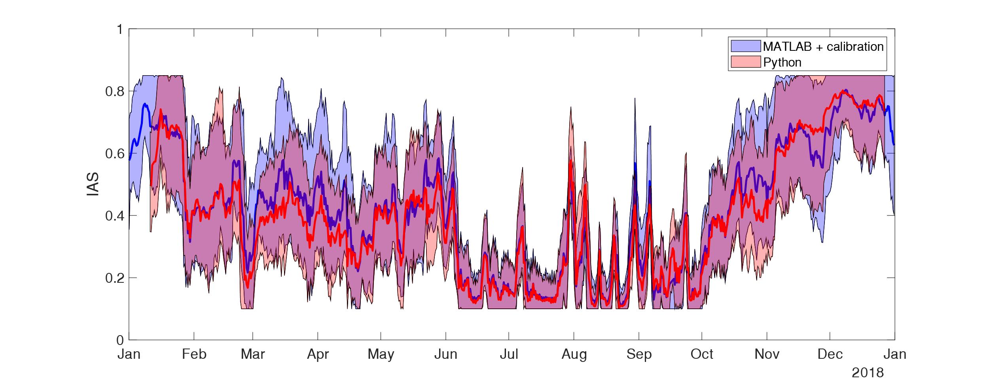
Calibrated parameters
Comparison between MATLAB calibration runs followed by sequential python calibration and complete python sequential model

Slide 5
Scenario evaluation
Change to ACH
Change to number of dehumidifiers
Methodology
Take previous 10 days calibrated data
Repeat last 24 hrs weather 3 times and add to weather file
Create scenario data – either add 3 days of dummy ACH values, or change number of dehumidifiers
Run model with and without scenario (without assumes constant ACH/IAS at final calibrated values)
Plot results with and without scenario

Slide 6
Methodology
N particles (ACH,IAS,length)
Output from calibration run
1000 values at each calibration point
Take mean values => input parameters
10 days data => 20 calibration points (every 12 hours)
Scenario 2
BAU + change to number of dehumidifiers
BAU
Repeat final calibrated ACH value for 3 days and append to input parameters
Scenario 1
Create dummy 3 days of ACH data and append to input parameters
Repeat last 24 hours weather 3 times and append to weather file
Run model with ACH, IAS changing every 12 hours

Slide 7
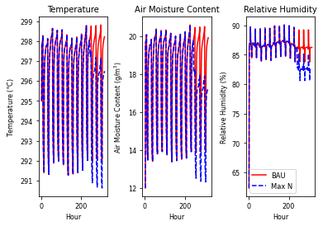
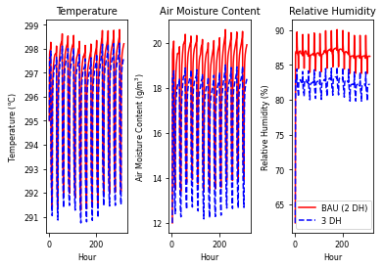
BAU + Scenario 1
BAU + Scenario 2

