Slide 1
Part 4 Impact Assessments
Notes:
Part 1: Legislation and Regulatory Contexts
Part 2: Intellectual Property Rights
Part 3: Personal Data Concepts: the GDPR and AI
Part 4: GDPR in practice: RoPA
Part 5: GDPR in practice: Impact Assessments
Part 6 Case-Study: AI-driven Recruitment
Part 7: Future gazing: ePrivacy and AI regulation
Activities and Readings

Slide 2

Impact Assessments
Impact assessment (IA) is a structured a process for considering the implications, for people and their environment, of proposed actions while there is still an opportunity to modify (or even, if appropriate, abandon) the proposals. It is applied at all levels of decision-making, from policies to specific projects.
Data Protection Impact Assessments (DPIA) are a legal requirement of the GDPR for all potentially high-risk activities, including “new technologies” and “innovative processes”
AI would fall under both requirements –
a DPIA is encouraged for all AI projects which involve personal data
This Photo by Unknown Author is licensed under CC BY-NC
Lomas & Almeida 2021

Slide 3
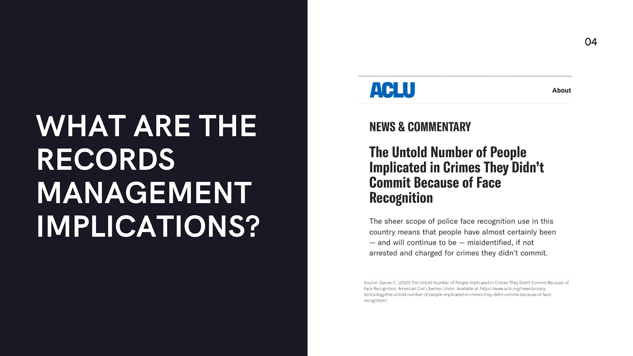
Records Management Implications
Issues of inaccuracy, particularly exacerbated when the data relates to people belonging to minority groups (see Fairness and AI module);
Lack of accountability and explainability: records not kept or accessible following a match, giving no recourse to individuals;
Keeping track of lawful basis of processing;
For archives management, specifically, the use of algorithms for the appraisal of archives also needs to be addressed from an ethical standpoint, as human biases can be built into the algorithms in question.
Lomas & Almeida 2021

Slide 4
Part 4 - Readings
On issues of global governance:
Digital Platforms Require a Global Governance Framework (2019) Centre for International Governance Innovation. Available at: https://www.cigionline.org/articles/digital-platforms-require-global-governance-framework
On impact assessments as a framework for auditing:
Kazim, E., Denny, D. M. T. and Koshiyama, A. (2021) ‘AI auditing and impact assessment: according to the UK information commissioner’s office’, AI and Ethics. doi: 10.1007/s43681-021-00039-2.
Lomas & Almeida 2021

