Slide 1
Part 5 Case-Study: AI-driven Recruitment
Notes:
Part 5: GDPR in practice: Impact Assessments
Part 6 Case-Study: AI-driven Recruitment
Part 7: Future gazing: ePrivacy and AI regulation
Activities and Readings

Slide 2
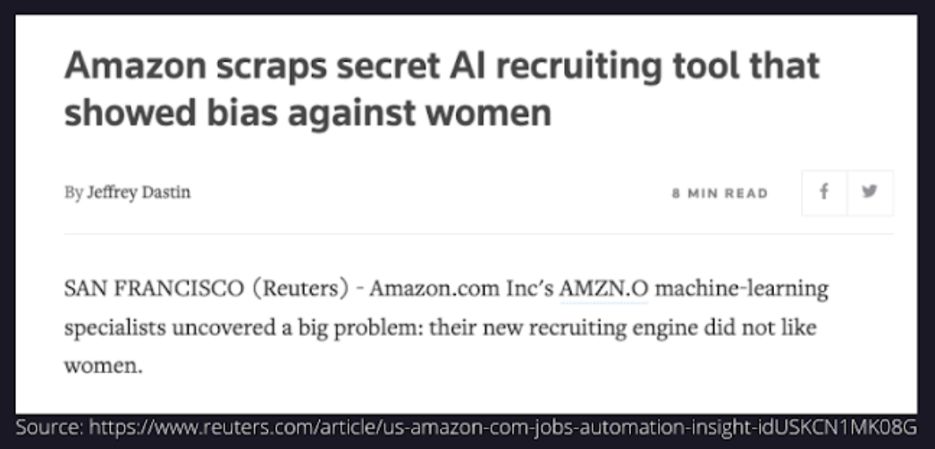
Recruitment
What went wrong?
Special category data collected without enough consideration or legal basis for processing;
No privacy assessment conducted to consider the privacy implications of the use of the algorithm;
No considerations for algorithmic bias and bias associated with the input data.
Lomas & Almeida 2021

Slide 3
Part 5 - Readings
Reuters article on the Amazon AI recruitment tool: https://www.reuters.com/article/us-amazon-com-jobs-automation-insight-idUSKCN1MK08G
On job seekers attitudes towards AI driven recruitment: Friedrich-Alexander-University, Schöller Endowed Chair for Information Systems, Erlangen-Nuremberg, Germany, Ochmann, J. and Laumer, S. (2020) ‘AI Recruitment: Explaining job seekers’ acceptance of automation in human resource management’, in heine, M., Poustcchi, K., and Krasnova, H., WI2020 Zentrale Tracks. GITO Verlag, pp. 1633–1648. doi: 10.30844/wi_2020_q1-ochmann.
Lomas & Almeida 2021

