Slide 1
Part 6 Future gazing: ePrivacy and AI regulation
Notes:
Part 5: GDPR in practice: Impact Assessments
Part 6 Case-Study: AI-driven Recruitment
Part 7: Future gazing: ePrivacy and AI regulation
Activities and Readings

Slide 2
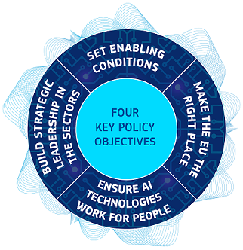
Incoming regulations
The EU regulatory proposal aims to provide AI developers, deployers and users with clear requirements and obligations regarding specific uses of AI.
The EU's strategy on AI is focused on 3 goals:
place Europe ahead of technological developments and encourage the uptake of AI by the public and private sectors
prepare for socio-economic changes brought about by AI
ensure an appropriate ethical and legal framework
The long-awaited ePrivacy regulation should also provide a​ helpful regulatory context to enforce on online privacy issues associated with AI, such as real-time bidding.

Slide 3

A new legislative paradigm?
Responsibilities?
1. How have you controlled the development, testing, rollout and then implementation in context of AI systems ensuring the management and challenge of bias?
2. What specific consents, notices and checks and balances are in place for fairness and transparency for these purposes?
3. On what basis have the data banks been built and used in relation to which purposes?
4. What specific consents, notices and checks and balances are in place for fairness and transparency for data bank accrual and use and what should not be allowable in terms of data scraping etc?
Lomas & Almeida 2021
This Photo by Unknown Author is licensed under CC BY-SA-NC

Slide 4

A new legislative paradigm?
5. What are the limitations of AI performance capabilities for different purposes taking into consideration the design context?
6. What accountability is in place for different use?
8. How can this accountability be explicitly exercised, explained and audited for a range of stakeholder needs?
9. How are complaint and challenge processes enabled and afforded to all?
10. Can counter-AI initiatives be conducted to challenge and test law enforcement and audit systems?
Lomas & Almeida 2021
This Photo by Unknown Author is licensed under CC BY-NC-ND

Slide 5

Thank you!

Slide 6
Part 6 - Readings
European Union's Coordinated Plan on Artificial Intelligence 2021 (https://digital-strategy.ec.europa.eu/en/policies/plan-ai) alongside point 1 (Explanatory Context) of the proposed Artificial Intelligence Act: https://eur-lex.europa.eu/legal-content/EN/TXT/?qid=1623335154975&uri=CELEX%3A52021PC0206
EU proposal for an ePrivacy Regulation: https://digital-strategy.ec.europa.eu/en/policies/eprivacy-regulation
Veale, M. and Borgesius, F.Z., 2021. Adtech and Real-Time Bidding under European Data Protection Law. Available at: https://osf.io/preprints/socarxiv/wg8fq/
Lomas & Almeida 2021

