Slide 1
Part 3 GDPR in Practice: Records of Processing Activities (ROPA)
Notes:
Part 1: Legislation and Regulatory Contexts
Part 2: Intellectual Property Rights
Part 3: Personal Data Concepts: the GDPR and AI
Part 4: GDPR in practice: RoPA
Part 5: GDPR in practice: Impact Assessments
Part 6 Case-Study: AI-driven Recruitment
Part 7: Future gazing: ePrivacy and AI regulation
Activities and Readings

Slide 2

Records of Processing Activity (ROPA)
Defined in art. 30 of the GDPR,
Records detailing all of the processing activities of controllers or processors:
Details of controller and/or processor
Purpose of the processing
Description of the categories of data subjects and data recipients
Details on transfers to third-countries or international organisations
Description of technical and organisational security measures
Lomas & Almeida 2021

Slide 3

What can the records be used for?
Provide evidence of accountability;
Assist in breach investigations and/or responding to individual rights requests;
Highlighting areas of risk which require Data Protection Impact Assessments;
Inform policy and procedure development;
Facilitate the maintenance of retention schedules.
"Europe GDPR PD" by Harakir is marked with CC0 1.0
Lomas & Almeida 2021

Slide 4
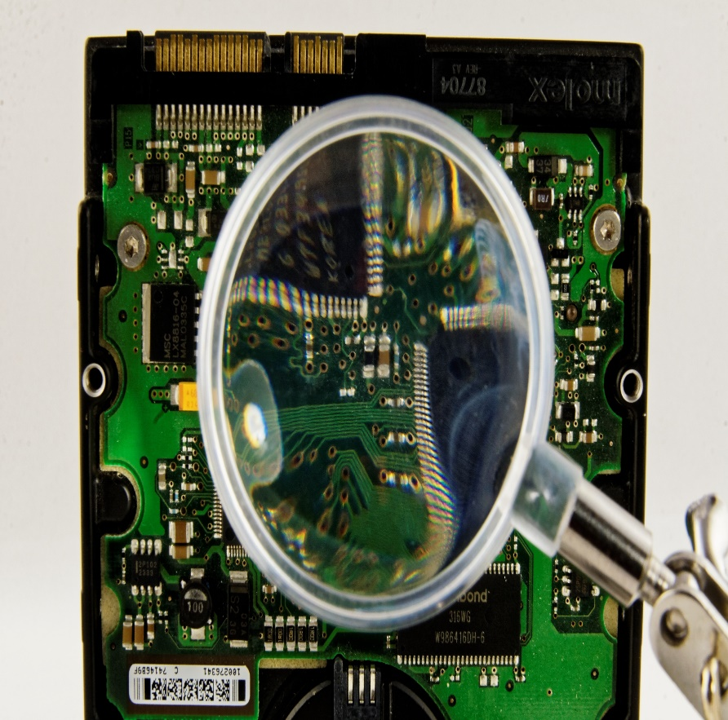
ROPA and AI
Aid transparency by keeping detailed records of processes, procedures and data used for AI applications
Highlight high risk areas which require further impact assessments and, potentially, mitigation strategies and changes to the product
Lomas & Almeida 2021

Slide 5
Part 3 – Activity and Readings
Using the provided ICO Records of Processing Template, create records for an AI/ML driven process within your organization.
Read through the ICO guidelines on Records of Processing Activities and the ICO and The Alan Turing Institute's guidance on explainable AI, particularly task 2 of part 2, for further support in this activity.
Lomas & Almeida 2021

