Slide 1
DyME-CHH Overview

Slide 2
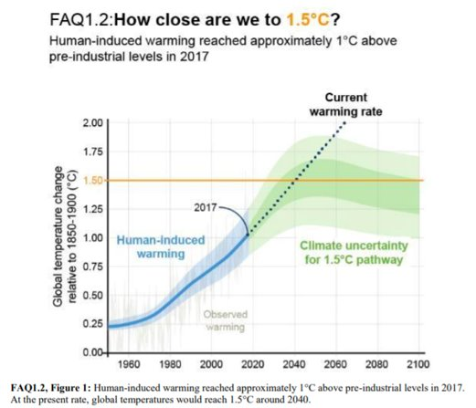
Motivation
The UK climate projections indicate “a greater chance of warmer, wetter winters and hotter, drier summers”.
Health and well-being will be challenged in the face of increased temperatures
There will be great inequalities in the effects experienced by different people
Image source: https://www.ipcc.ch/sr15/faq/

Slide 3
DyME- CHH background
Dynamic Microsimulation for Environment – Climate, Heat and Health’
Previous work on rising temperature & health uses aggregate measures of heat and exposure - but different members of the population will spend different amounts of time in different locations.
Using a synthetic population, we can estimate how behaviours and vulnerabilities interact with exposure

Slide 4
Heat & health related outcomes
Heat related mortality
Heat related hospitalisation
Residential discomfort – thresholds for comfort in day and night
Vulnerability modifies risk

Slide 5
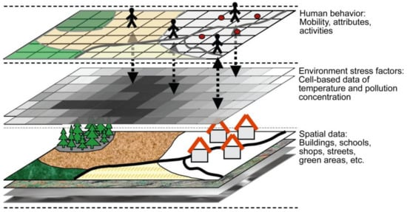
Model framework: Background on Agent Based Models
Yang et al., 2018:
https://www.mdpi.com/2413-8851/2/2/36

Slide 6
Model framework: DyME CHH
Define the space and time
Simulate the population (SPC)
Activities (behaviour)
Micro- envrionments
Estimate personal exposures to heat
Estimate personal risk of heat

Slide 7
Model framework: DyME CHH
Define the space and time
Simulate the population (SPC)
Activities (behaviour)
Micro- envrionments
Estimate personal exposures to heat
Estimate personal risk of heat
20, 30, 40, 50 years + in the future
Key regions to begin, then UK

Slide 8
Model framework: DyME CHH
Define the space and time
Simulate the population (SPC)
Activities (behaviour)
Micro- envrionments
Estimate personal exposures to heat
Estimate personal risk of heat
SPC – included demographic, health data,
Time use data and route information
Projected demographic data - for small areas within a region. Using the Synthetic Population Catalyst (SPC), we can project the demographics of an area

Slide 9
Model framework: DyME CHH
Define the space and time
Simulate the population (SPC)
Activities (behaviour)
Micro- envrionments
Estimate personal exposures to heat
Estimate personal risk of heat
Create a vector of activities across 24hours (e.g. using transport, exercising outside, sleeping)

Slide 10
Model framework: DyME CHH
Define the space and time
Simulate the population (SPC)
Activities (behaviour)
Micro- envrionments
Estimate personal exposures to heat
Estimate personal risk of heat
Where the activities take place (e.g. bedroom, main road, park)

Slide 11
Model framework: DyME CHH
Define the space and time
Simulate the population (SPC)
Activities (behaviour)
Micro- envrionments
Estimate personal exposures to heat
Estimate personal risk of heat
Combining where, what and when → estimate max temperature exposures, how many times an individual passes a threshold

Slide 12
Model framework: DyME CHH
Define the space and time
Simulate the population (SPC)
Activities (behaviour)
Micro- envrionments
Estimate personal exposures to heat
Estimate personal risk of heat
An individual's exposure is then combined with their vulnerability to give the risk (probability) of adverse health outcomes to heat (mortality, hospitalisation, residential discomfort)

Slide 13
Outputs
Individual risk – Estimation of how behaviours interact with health risk and how this might interact with future temperature increase.
Area level risk – this measure can reflect ‘hotspots’ of individuals within an area who are most at risk (due to vulnerabilities, behaviour and location) of adverse health outcomes (death, hospitalisation) and residential discomfort from increased temperature (and later other climatic hazards).
Mitigation identification and adjustment – Using the individual and area risk identified by the model we can identify where and what mitigation might be most effective. We will also be able to provide estimates of how risk will vary depending on the extent & type of mitigation

Slide 14
Useful references
General overview of climate change – health – inequalities: https://ehjournal.biomedcentral.com/articles/10.1186/s12940-017-0328-z
The initial DyME model (for epidemics):https://pubmed.ncbi.nlm.nih.gov/34717286/
DyME-CHH will use the same framework as DIMEX:, a model for air pollution exposures. This work I don’t believe is published yet/the repo is not yet public, but flagging here for future ref (the lead is Matthew Thomas, who worked with Gavin Shaddick as his post-doc at Exeter). It’s based on: https://onlinelibrary.wiley.com/doi/abs/10.1002/env.716?casa_token=dMi-noKG81MAAAAA:0W1yHjMSTNY25Rwg1AYGbuvSJ9qcxKrqKdhgyzRwpdd8YbCc-XqgvAtKb71d6dPdg5_6qXAo-e9dvWXm
Background on Agent Based Models for personal exposures https://www.sciencedirect.com/science/article/pii/S019897151830156X?casa_token=2OFLGEclUBgAAAAA:YWaNRUgs8hdRZYyKn8fVn_2vvDYCow6K42sry0PcimIWeqiFIOp1n5tQKU9vASDIXvM5Yf634T0
UHI and health (Mark Birkin in a PI on DyME-CHH) https://link.springer.com/article/10.1007/s10584-014-1105-4

Slide 15
CLIM-RECAL

Slide 16
Model framework: DyME CHH
Define the space and time
Simulate the population (SPC)
Activities (behaviour)
Micro- envrionments
Estimate personal exposures to heat
Estimate personal risk of heat
20, 30, 40, 50 years

Slide 17
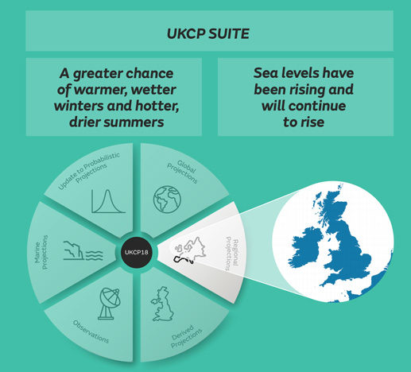

Climate data - UKCP18
Image source: https://www.carbonbrief.org/in-depth-qa-the-uk-climate-projections-2018/

Slide 18
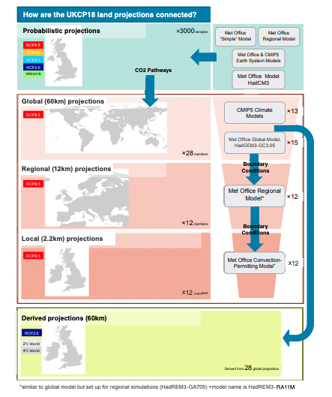
Different UKCP scales

Slide 19
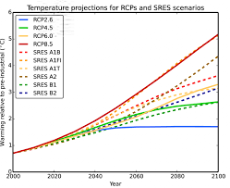
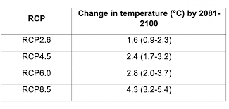
Different RCPs
Images from: https://www.metoffice.gov.uk/binaries/content/assets/metofficegovuk/pdf/research/ukcp/ukcp18-guidance---representative-concentration-pathways.pdf
And

Slide 20
Bias Adjustment/Recalibration
Climate models have systematic errors (biases) in their output Errors or biases are due to limited spatial resolution simplified thermodynamic processes and physics or incomplete understanding of the global climate system (REF:
Range of bias adjustment methods – some work better for different climate variables
Require an observational dataset (HADs)

Slide 21
Outputs of CLIM-RECAL
CLIM-RECAL, an open climate projections data repository with:
Creating documentation for existing Met Office climate projections datasets
Systematic review of calibration methods and recommendations for when to choose a particular method & usage best practices
UKCP18 2.2km will be the dataset we focus on
Hosting local slices of bias-adjusted data that can feed into other applications

Slide 22
Useful references
Climate projections data
UKCP18 2.2km data: https://www.metoffice.gov.uk/pub/data/weather/uk/ukcp18/science-reports/UKCP18-Overview-report.pdf and https://www.metoffice.gov.uk/binaries/content/assets/metofficegovuk/pdf/research/ukcp/ukcp18_local_update_faq.pdf
RCPs: https://www.metoffice.gov.uk/binaries/content/assets/metofficegovuk/pdf/research/ukcp/ukcp18-guidance---representative-concentration-pathways.pdf
HADs data (observational dataset): https://www.metoffice.gov.uk/research/climate/maps-and-data/data/haduk-grid/haduk-grid
All data we have downloaded so far is via CEDA (and also see script re downloading the data in the dyme-chh repo): https://catalogue.ceda.ac.uk/uuid/d5822183143c4011a2bb304ee7c0baf7
Bias adjustment
Met office bias adjustment FAQ: https://www.metoffice.gov.uk/binaries/content/assets/metofficegovuk/pdf/research/ukcp/ukcp18-guidance---how-to-bias-correct.pdf
An example of the type of comparison of methods we would like to do: https://www.sciencedirect.com/science/article/pii/S0022169412004556?casa_token=_69GivQT-UAAAAAA:IqCNTnY6get1xNDIQ6taxenWg5q1r3YJut3tQSFrn2EfO0-JbYdKifGomtpxOO9BBrWmmgPFS-o
Quantile Delta Mapping – we have implemented this one as univariate, soon to https://journals.ametsoc.org/view/journals/clim/28/17/jcli-d-14-00754.1.xml
The corresponding R library:https://cran.r-project.org/web/packages/MBC/MBC.pdf
Scaled distribution mapping – similar to the above, this is what the met office use: https://hess.copernicus.org/articles/21/2649/2017/hess-21-2649-2017.pdf
The corresponding python library (this is not well maintained to my untrained eyes, but we have installed it and are just testing it works):https://pycat.readthedocs.io/en/latest/
ISI-MIP – this method was flagged for inclusion in the work by our met office contact https://esd.copernicus.org/articles/4/219/2013/esd-4-219-2013.pdf
The Santander group’s R package offers an implementation of this: https://github.com/SantanderMetGroup/downscaleR/wiki/bias-correction

