Slide 1



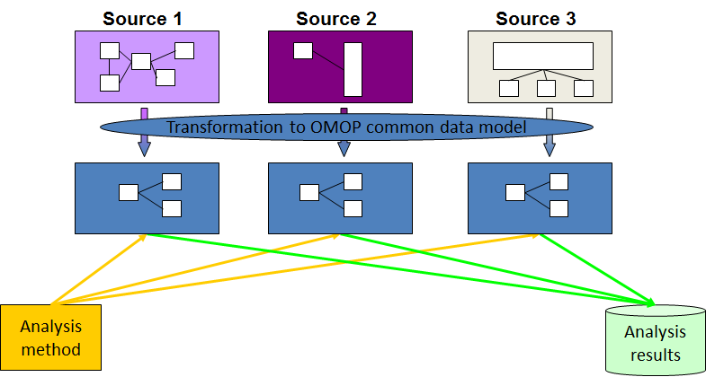




Azure Linux VM
Azure Blob
MS SQL Server
Week 1
Populate DB from blob
Week 1 + 2
OMOP Data Model
Week 2 + 3
Week 3 + 4
Port 1433
Analysts

