Slide 1



Learning Machines
 | Learning Machines
 | Safe Haven
 | Repro-Catalogue
 | Research Engineering
 |  | Team
 |  | Bowler, Louise
 |  | Chalstrey, Edward
 |  | Daub, Eric
 |  | Hadjitofi, Anna
 |  | Hobson, Tim
 |  | O’Reilly, Martin
 |  | Roberts, Jack
 |  | Robinson, James
 |  | Whitaker, Kirstie
 |  | Wilson, Alan (PI)
 |  | Steyn, Jannetta
 |  | Strickson, Oliver
 |  | Yip, Gordon
 |  | Yong, May
Monitoring and adapting for DECOVID

Slide 2



Notations
z
$θ$ - Model trained using data up to time $T$
$x_{t}$ - Patient’s features up to and at time $t>T$
${\overset{̂}{y}}_{t},σ_{t}$ - Prediction ${\overset{̂}{y}}_{t}$ and its associated uncertainty $σ_{t}$ from model
$I_{t}$ - Interpretation of model decision
$y_{t}$ - Practitioner’s decision
$r_{t}$ - Treatment outcome

Slide 3












Machines cannot stay static - things change
Interpreter $ℐ$
$$I_{t}$$
$$(x_{t},{\overset{̂}{y}}_{t},θ)$$
Preprocessing
$$x_{t}$$
Model
$$θ$$
$$(x_{t},{\overset{̂}{y}}_{t},σ_{t})$$
$$y_{t}$$
Performance
Monitoring
Practitioner
Update
$$(x_{t},{\overset{̂}{y}}_{t},σ_{t},y_{t},r_{t},θ)$$
$$θ$$
Y/N
Patient history
Model Dataset
$$(x_{t},y_{t},r_{t})$$
Analyst
EHR

Slide 4



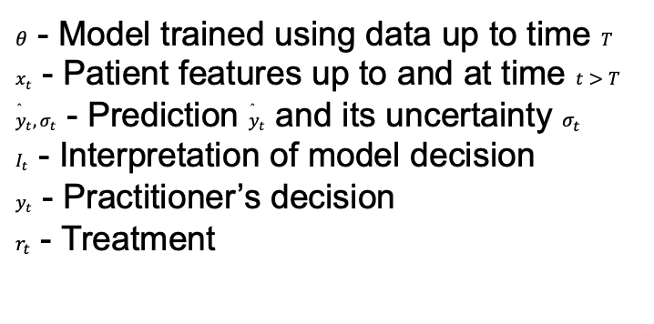







Machines cannot stay static –
things change
$θ$ - Model trained using data up to time $T$ $x_{t}$ - Patient features up to and at time $t>T$ ${\overset{̂}{y}}_{t},σ_{t}$ - Prediction ${\overset{̂}{y}}_{t}$ and its uncertainty $σ_{t}$ $I_{t}$ - Interpretation of model decision $y_{t}$ - Practitioner’s decision $r_{t}$ - Treatment outcome
Interpreter $ℐ$
$$I_{t}$$
$$(x_{t},{\overset{̂}{y}}_{t},θ)$$
Preprocessing
$$x_{t}$$
Model
$$θ$$
$$(x_{t},{\overset{̂}{y}}_{t},σ_{t})$$
$$y_{t}$$
Practitioner
Update
Performance
Monitoring
$$(x_{t},{\overset{̂}{y}}_{t},σ_{t},y_{t},r_{t},θ)$$
$$θ$$
Y/N
Patient history
Model Dataset
$$(x_{t},y_{t},r_{t})$$
EHR

Slide 5
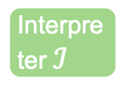








$θ$ - Model trained using data up to time $T$ $x_{t}$ - Patient features up to and at time $t>T$ ${\overset{̂}{y}}_{t},σ_{t}$ - Prediction ${\overset{̂}{y}}_{t}$ and its uncertainty $σ_{t}$ $I_{t}$ - Interpretation of model decision $y_{t}$ - Practitioner’s decision $r_{t}$ - Treatment outcome
Machines cannot stay relevant if data changes.
Who is responsible for keeping models updated?
z
Interpreter $ℐ$
$$I_{t}$$
$$(x_{t},{\overset{̂}{y}}_{t},θ)$$
Preprocessing
$$x_{t}$$
Model
$$θ$$
$$(x_{t},{\overset{̂}{y}}_{t},σ_{t})$$
$$y_{t}$$
Performance
Monitoring
Practitioner
Update
Patient history
$$θ$$
Y/N
Model Dataset
$$(x_{t},y_{t},r_{t})$$
Analyst

Slide 6





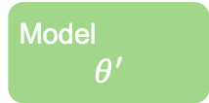
Monitoring performance for DECOVID
EHR
Data Monitoring
$$I_{t}$$
Patient histories
$$(X_{t},{\overset{̂}{Y}}_{t},Σ_{t})$$
$$X_{t}$$
Model
$$θ$$
Performance
Monitoring
Y/N
Preprocessing
Analyst
Practitioner
Patient history
Update?
$$θ$$
Model
$$θ^{′}$$
Model Database

Slide 7


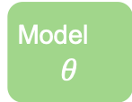

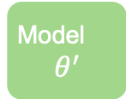

Responsibility is jointly shared by data provider, analyst and user
z
Data Monitoring
$$I_{t}$$
Patient histories
$$(X_{t},{\overset{̂}{Y}}_{t},Σ_{t})$$
$$X_{t}$$
Performance
Monitoring
Y/N
Preprocessing
Model
$$θ$$
Analyst
Practitioner
Patient history
Update?
$$θ$$
Model
$$θ^{′}$$
Model Database

Slide 8
DECOVID Challenges
Reproducibility
Relevance

Slide 9
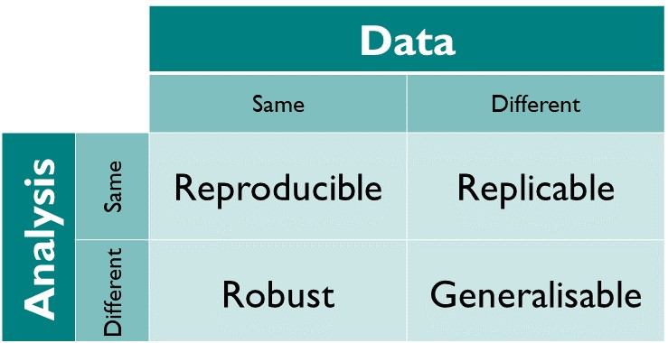
Reproducibility in DECOVID
Everything else that is not in the control of the analysts
Choices made by the analysists, represented in a piece of software to perform the analysis
The Turing Way
DOI: 10.5281/zenodo.3233986

Slide 10
Reproducibility tooling
How do we help the analysts to quickly identify problems reproducing their work?
Need a tool that is…
Language agnostic
Low effort
Flexible
Considers all the “ingredients” of an analysis
Data
Code
Outputs

Slide 11

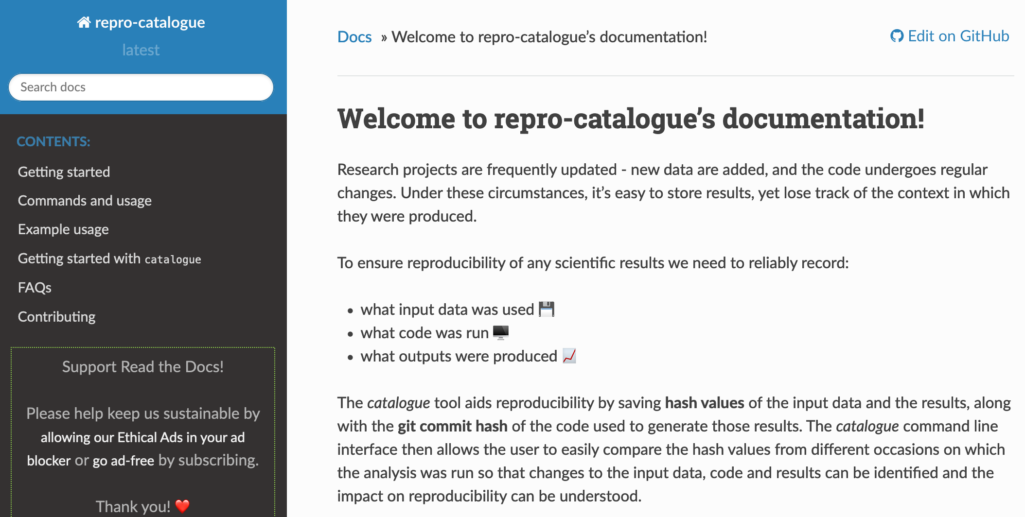
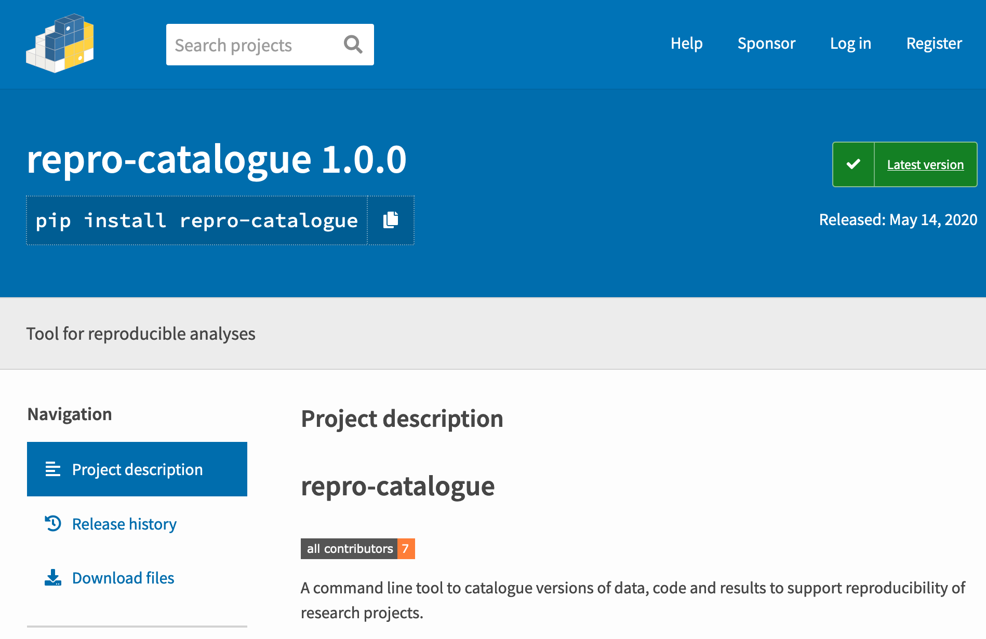
repro-catalogue
Python package
Integrates into existing scripted workflow
Identifies changes in input data, code and outputs
Produces a short report

