Slide 1




Learning Machines
Monitoring and adapting for

Slide 2
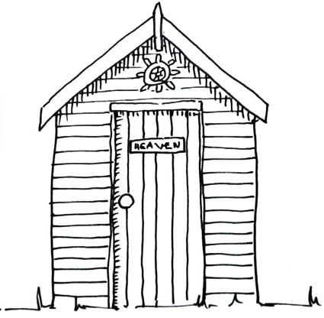
Research Engineering
Monitoring and Adapting for

Slide 3





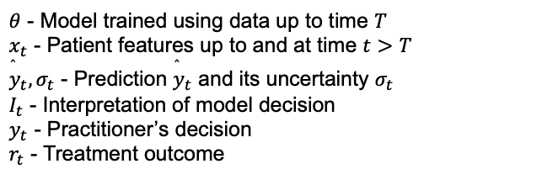


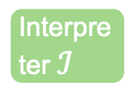


Machines cannot stay relevant if data changes.
$θ$ - Model trained using data up to time $T$ $x_{t}$ - Patient features up to and at time $t>T$ ${\overset{̂}{y}}_{t},σ_{t}$ - Prediction ${\overset{̂}{y}}_{t}$ and its uncertainty $σ_{t}$ $I_{t}$ - Interpretation of model decision $y_{t}$ - Practitioner’s decision $r_{t}$ - Treatment outcome
Interpreter $ℐ$
$$I_{t}$$
$$(x_{t},{\overset{̂}{y}}_{t},θ)$$
Preprocessing
$$x_{t}$$
Model
$$θ$$
$$(x_{t},{\overset{̂}{y}}_{t},σ_{t})$$
$$y_{t}$$
Performance
Monitoring
Practitioner
Update
Patient history
$$θ$$
Y/N
Model Dataset
$$(x_{t},y_{t},r_{t})$$
Analyst
Learning Machines

Slide 4







DECOVID data changes over time. What are the implications for model development?
Increasing data sizes, change in prevalence and distribution, uncertainty about underlying data features
Data collection
Data
Pre-processing
Analysis
Coarsening/Extract
Age > 45, <= 45
NEWS2
Here there be dragons
Coarsening/Extract
Age = X
NEWS2
Master database
Coarsening/Extract
COPD

Slide 5








How do we keep models updated?
Build infrastructure for monitoring changes.
This is the infrastructure as built by Turing REG for DECOVID.
Safe Haven
Descriptive Statistics
Preprocessing
Performance
Monitoring
Model $θ$
Model $θ$
Reproducibility
Checks
Update $θ$?
Model $θ^{′}$
Learning Machines

Slide 6




What are the major components of this infrastructure?
Safe Haven
Descriptive Statistics
Performance Monitoring
Reproducibility
Pipelining
Safe Haven
Descriptive Statistics
Preprocessing
Performance
Monitoring
Model $θ$
Model $θ$
Reproducibility
Checks
Update $θ$?
Model $θ^{′}$
Learning Machines

Slide 7



Why is the Turing best placed for leading this?
A diversity of research engineering skills to support heterogeneous research cultures and requirements
 | Bowler, Louise
 | Chalstrey, Edward
 | Daub, Eric
 | Hadjitofi, Anna
 | Hobson, Tim
 | O’Reilly, Martin
 | Roberts, Jack
 | Robinson, James
 | Whitaker, Kirstie
 | Wilson, Alan (PI)
 | Steyn, Jannetta
 | Strickson, Oliver
 | Yip, Gordon
 | Yong, May
Safe Haven
Descriptive Statistics
Preprocessing
Performance
Monitoring
Model $θ$
Reproducibility
Checks
Update $θ$?
Model $θ^{′}$
Learning Machines

Slide 8

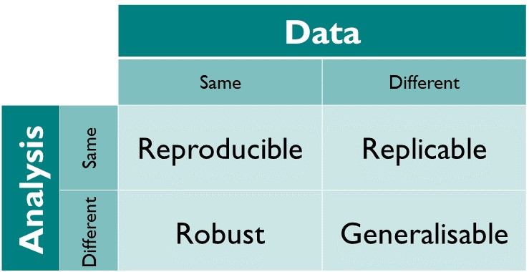
Challenges - Reproducibility
Reproducibility Checks
Choices made by the analysists, represented in a piece of software to perform the analysis
Everything else that is not in the control of the analysts
The Turing Way
DOI: 10.5281/zenodo.3233986

Slide 9
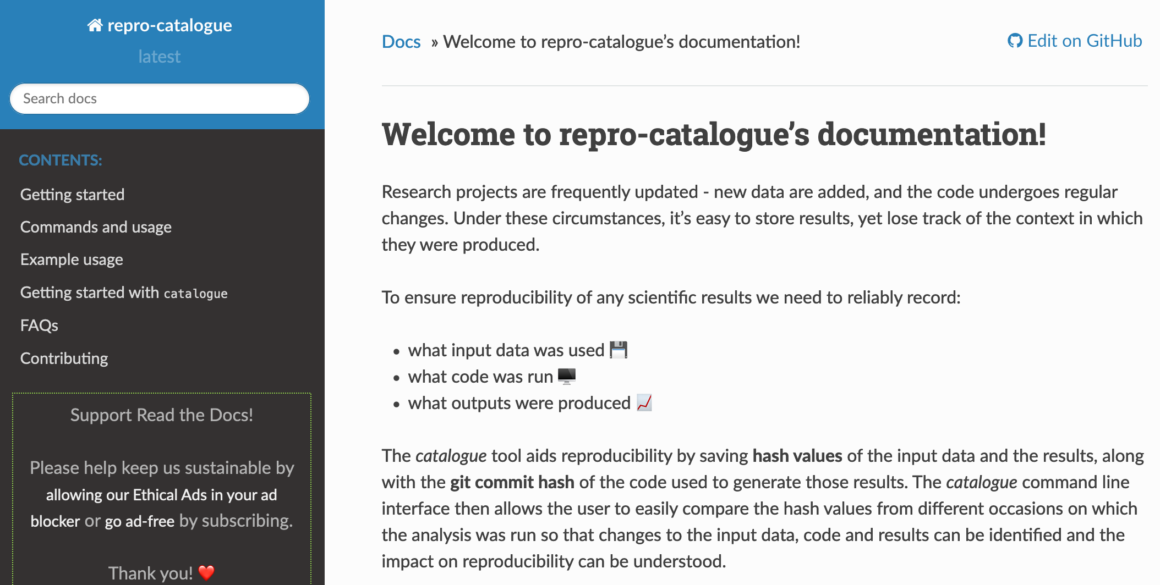
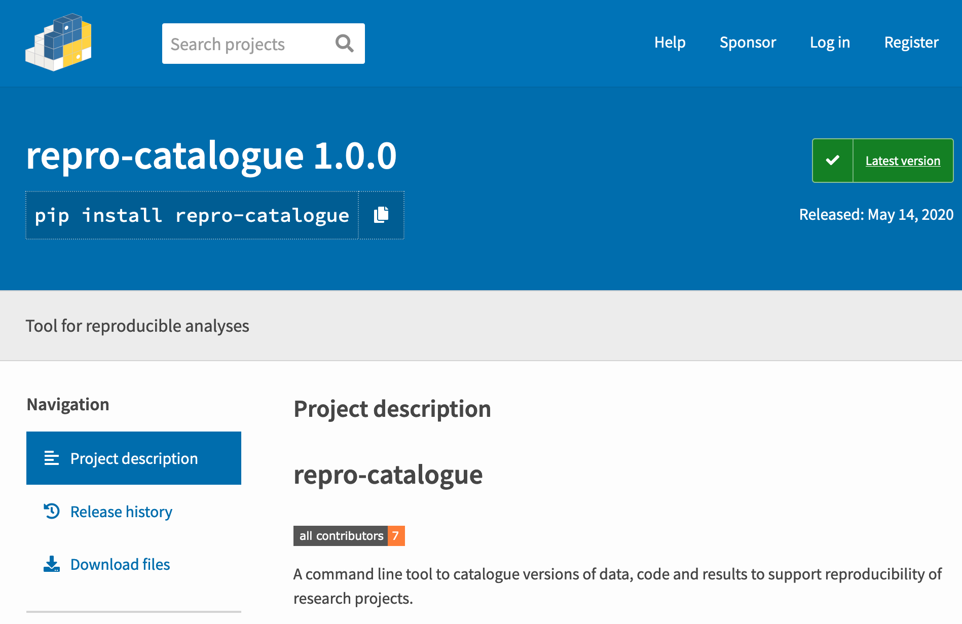
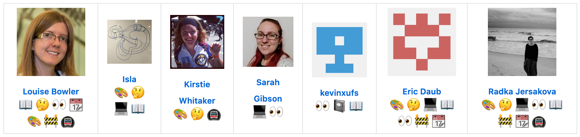
repro-catalogue
Reproducibility Checks
Challenges - Reproducibility
Python package
Integrates into existing scripted workflow
Identifies changes in input data, code and outputs
Produces a short report

Slide 10
Over to you Jack ☺
Performance Monitoring
SRE

Slide 11
For Descriptive Stats ☺
Data Monitoring

