Slide 1
Arduino Workshop

Slide 2
Aims
Simple activity to teach basic Arduino programming in 1-2hr workshop.
More advanced activity that could take up an afternoon.

Slide 3
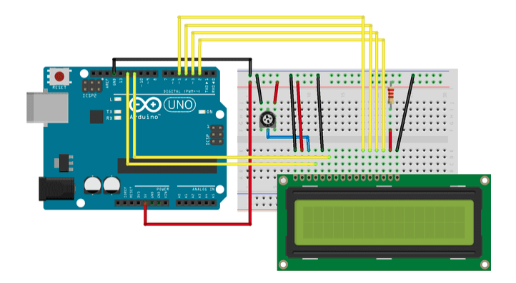
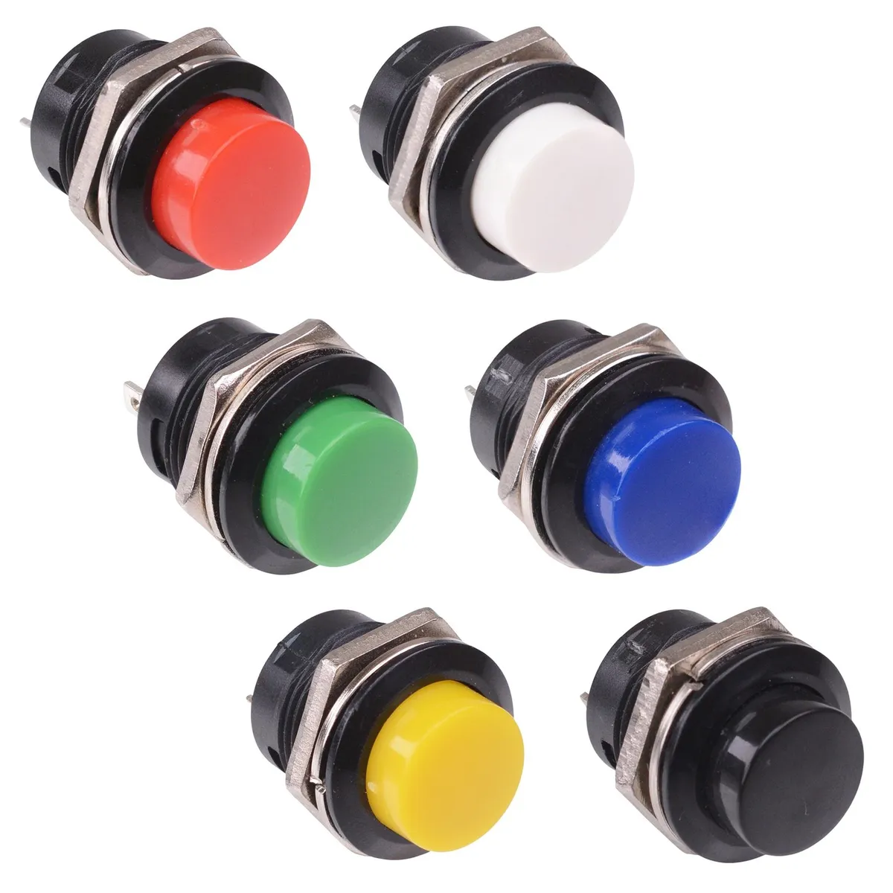

Setup (Short workshop) : Safe cracking!
The ”Safe”
Already built for students
”Enter password: “
”Password Incorrect...”
“Password Correct!”
Switches

Slide 4
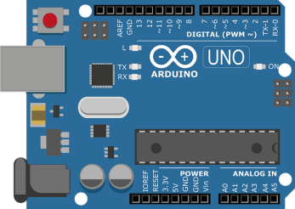
Setup (Short workshop) : Safe cracking!
The ”Cracker”
The ”Safe”
Already built for students
Aim: Write code to crack the safe
Learning Objs: Basic Arduino wiring, Programming (variables, if/else, logic, digital IO pins)
”Enter password: “
”Password Incorrect...”
“Password Correct!”
Switches

Slide 5
Setup (Long workshop) : Build the safe!
Aim: Write code to crack the safe
Learning Objs:
More advanced Arduino wiring
Programming (variables, if/else, logic, digital IO pins)
finite state machines
Using LCD screens
The ”Safe”
”Enter password: “
”Password Incorrect...”
“Password Correct!”
Switches

Slide 6
Costings
Item | Unit cost | Total per kit
Arduino Boards (x2) | 20.45 | 40.90
LCD screen | 6-9 (Depending on supplier) | 6-9
Buttons (x4) | 0.5 | 2
Total cost approx. (£50-£60) per kit.

Slide 8
Switches

