Slide 1
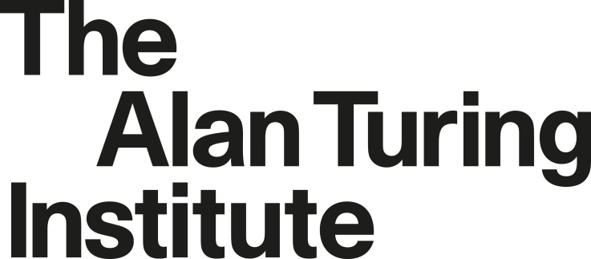

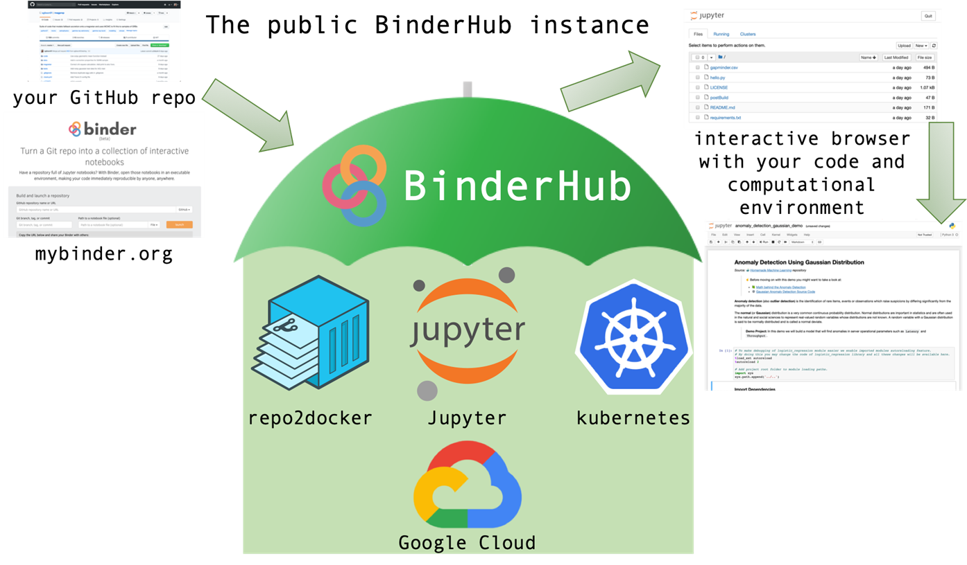
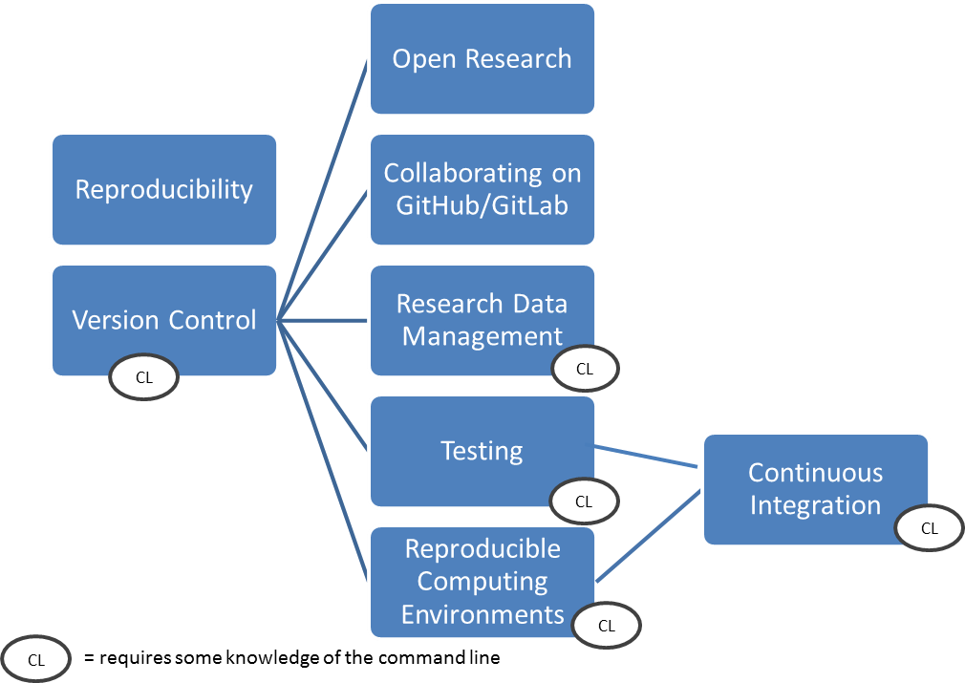



The Turing Way: A guide for reproducible data science
Turing Way Project, Rebecca Arnold, Louise Bowler, Sarah Gibson, Patricia Herterich, Rosie Higman, Anna Krystalli, Alexander Morely, Martin O’Reilly & Kirstie Whitaker.
https://github.com/alan-turing-institute/the-turing-way
Writing the Book
Reproducible research is necessary to ensure that scientific work can be trusted. This requires access to the underlying data and the analysis code. The goal is to ensure that all results can be independently verified and built upon in future work. This is often easier said than done.
The Turing Way is a handbook to support students, their supervisors, and funders to learn the skills to make reproducible data science "too easy not to do".
Checklists for researchers, their supervisors and grant administrators.
Case studies & personal experiences.
A Turing Hosted BinderHub
Binder allows you to create custom computing environments that can be shared and used by many remote users. It is powered by BinderHub, an open-source tool that deploys the Binder service in the cloud.
The Turing Way team is building a Turing Hosted BinderHub to support private code and data and to give Turing researchers enhanced computational resources.
Schematic of the building blocks that BinderHub uses to support a reproducible workflow.
Initial chapters for the Turing Way showing those that are prerequisites for the others.
Building the Community
The Turing Way is openly developed and licenced (CC-BY and MIT). It actively seeks to build its community by making it easy to contribute to the project.
Project is openly managed using GitHub issues and pull requests (15 contributors to date).
Community discussion is open by default, as closed as necessary.
Workshops: two for researchers, one for IT professionals and research engineers.
Mailing list (170 subscribers to date).
Contact
#TuringWay and @kirstie_j
github.com/alan-turing-institute/the-turing-way
gitter.im/alan-turing-institute/the-turing-way

