Slide 1
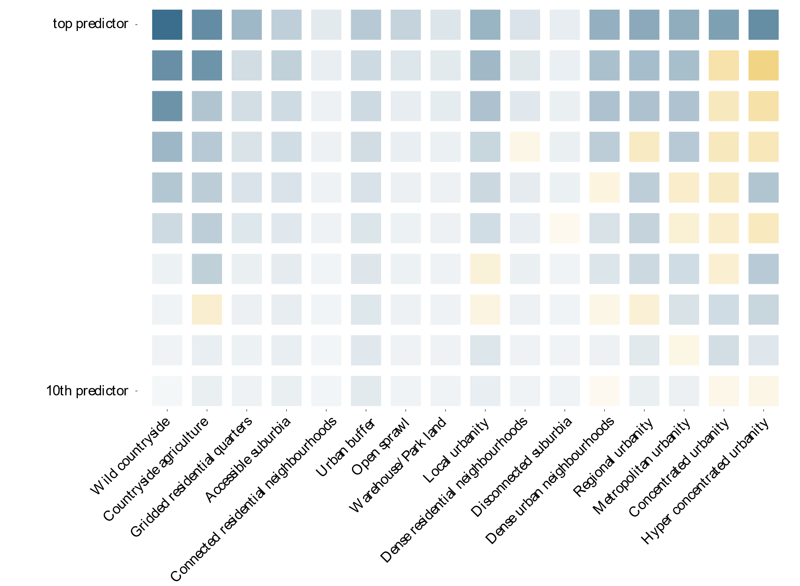

More “urban”
Form
Function
More predictive power

