Slide 1
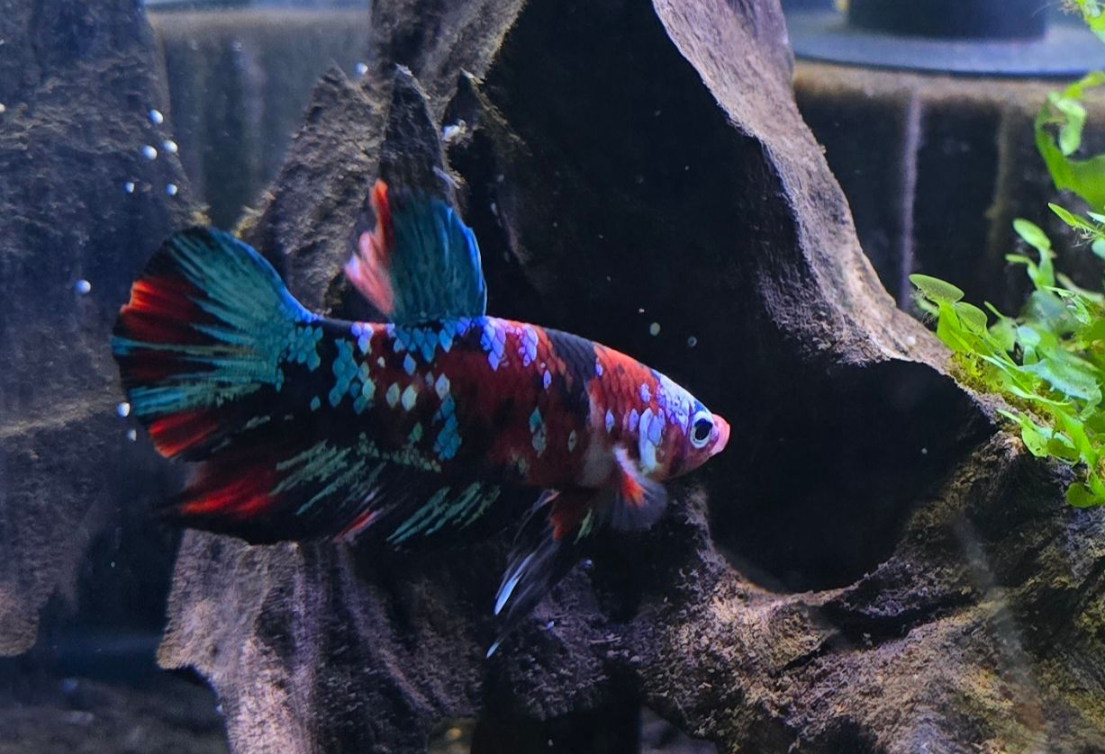
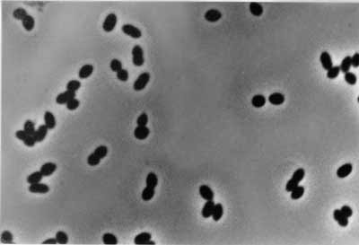
Nitrosomonas sp. Ls35
Whole Genome
Alan Vinzant
Asw-hamburg, CC BY 3.0, via Wikimedia Commons

Slide 2
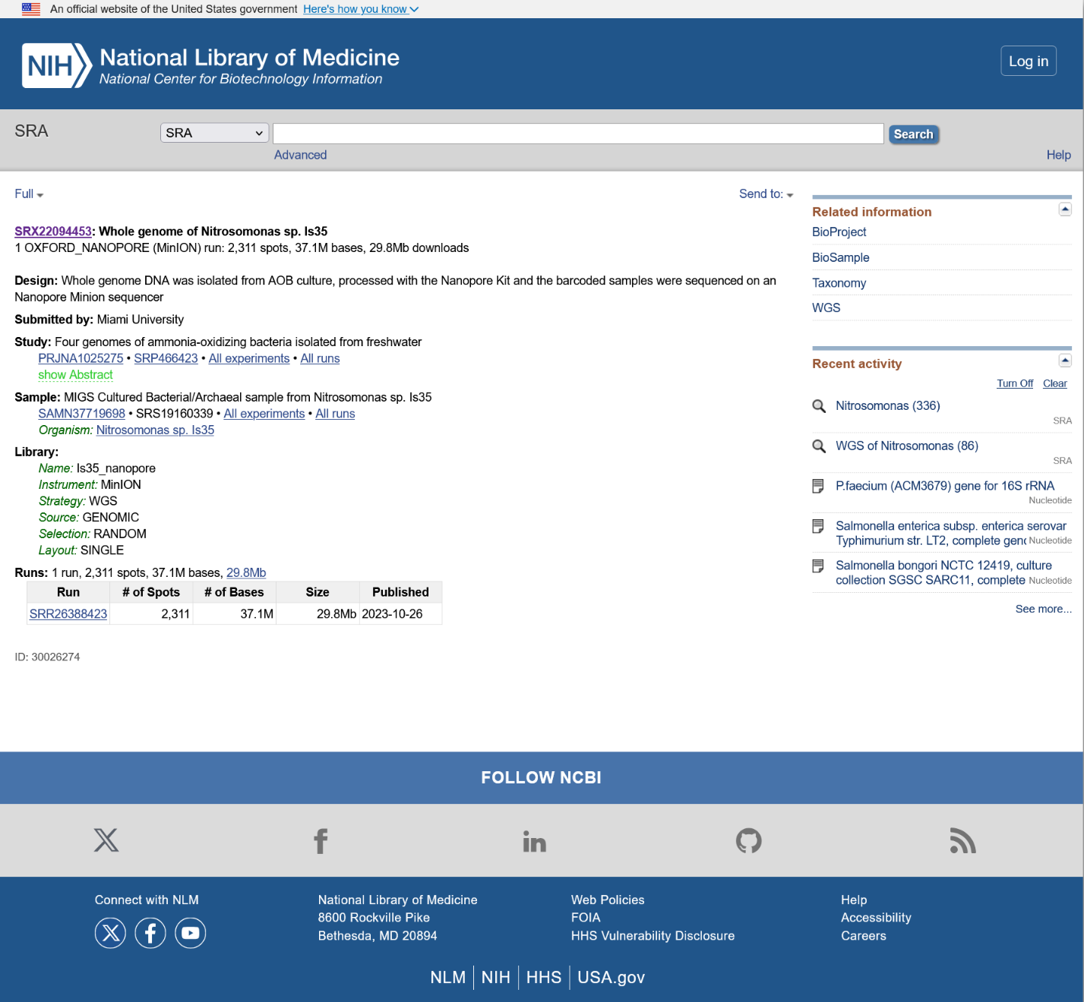
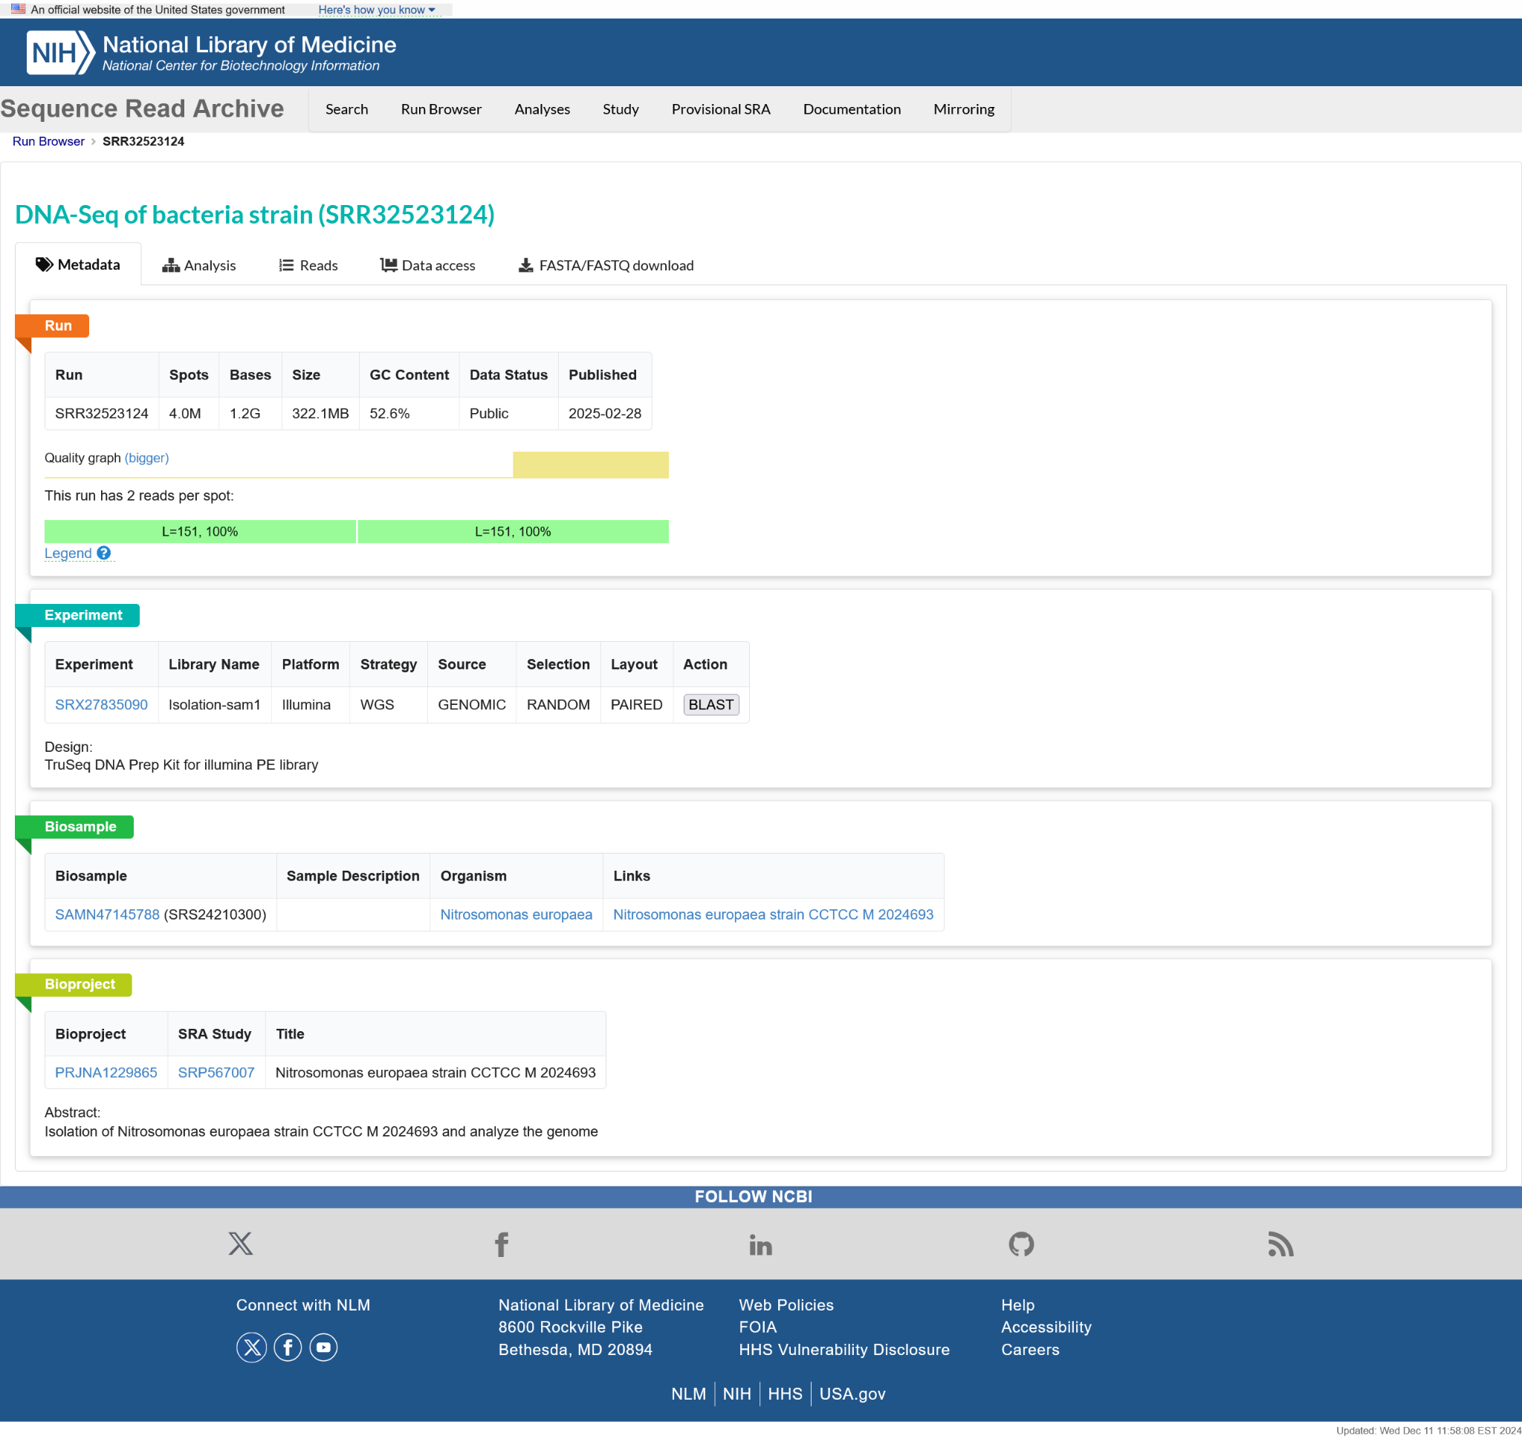
Nitrosomonas sp. Ls35 genome
Genome sequenced with nanopore
Genome sequenced with Illumina

Slide 3
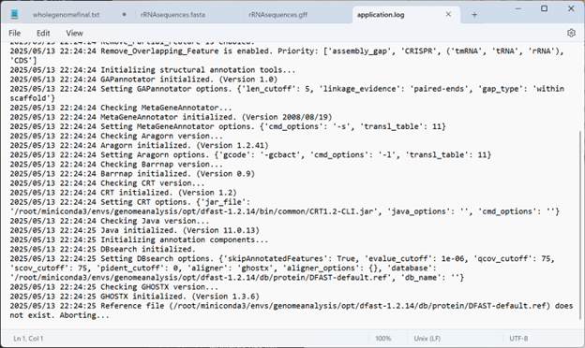
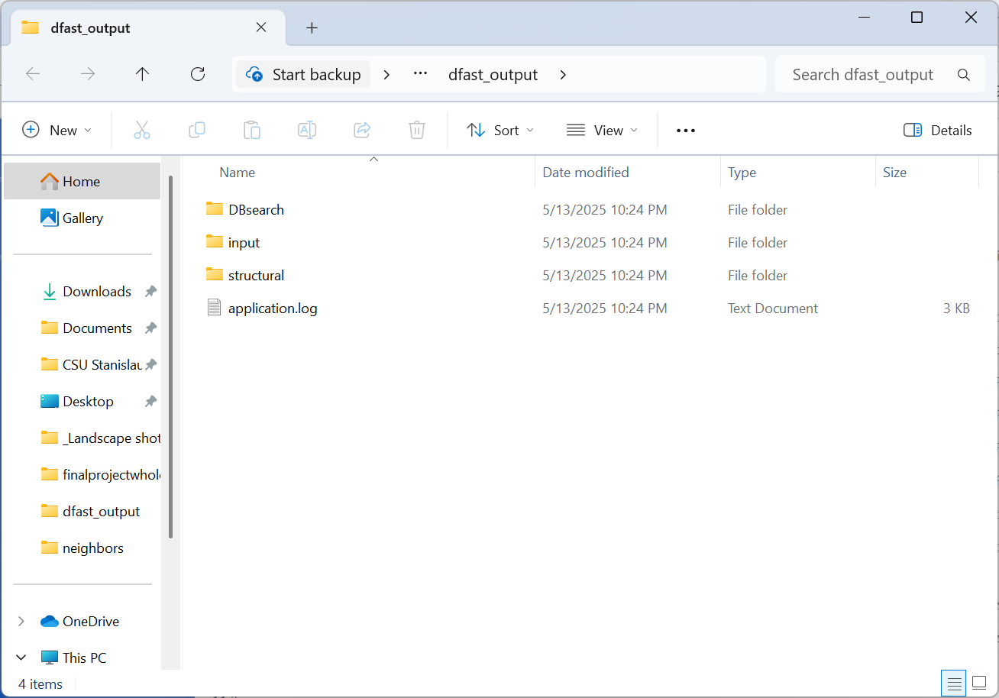
DFAST Annotation

Slide 4
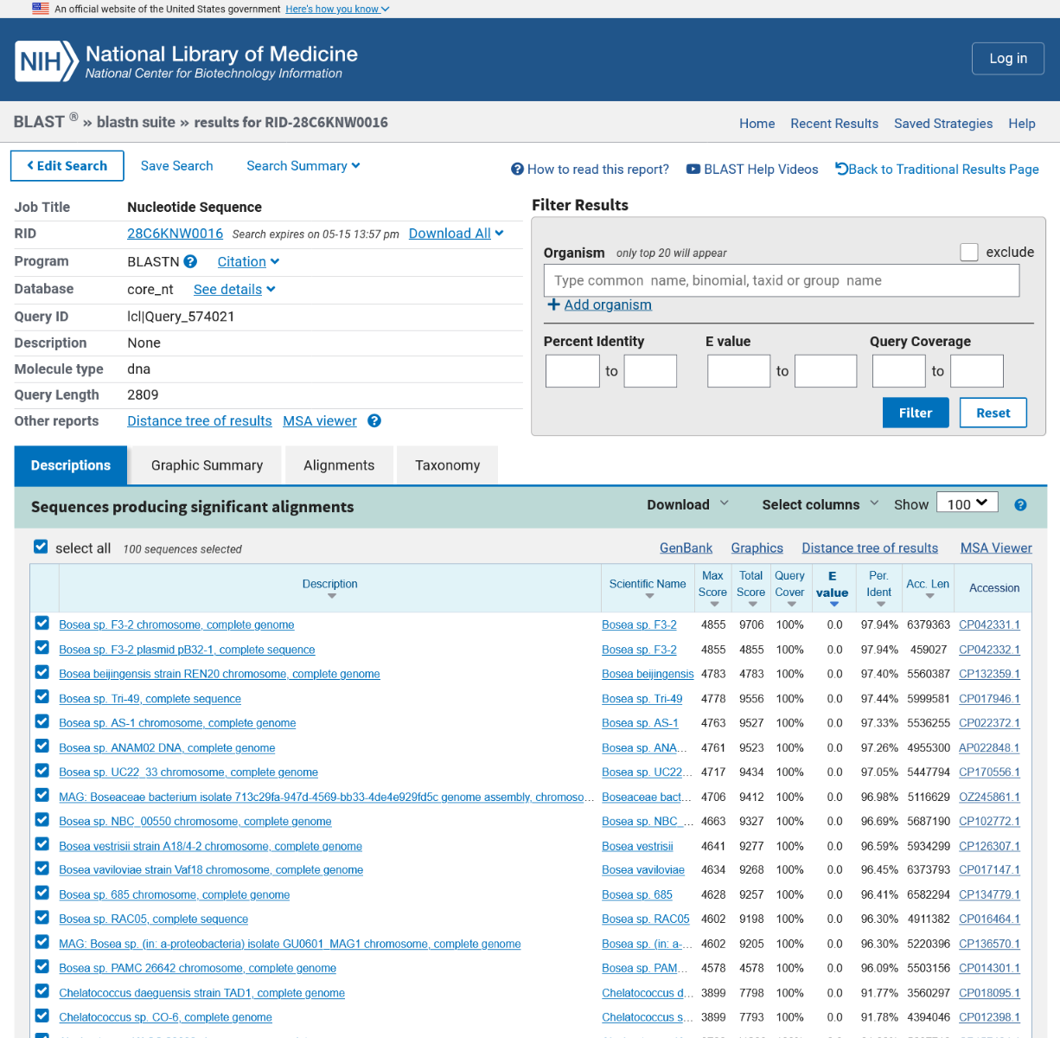
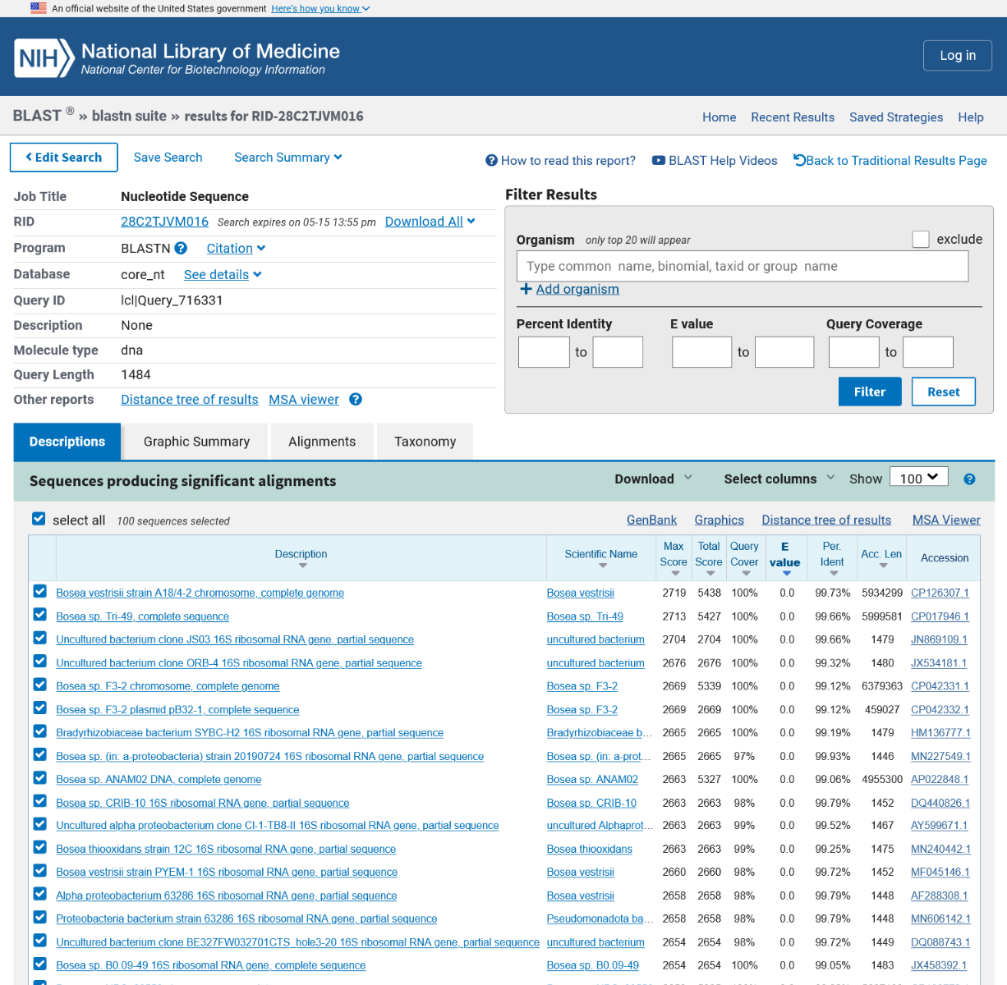
BLASTn results for 16S and 23S rRNA
16S rRNA matches
23S rRNA matches

Slide 5
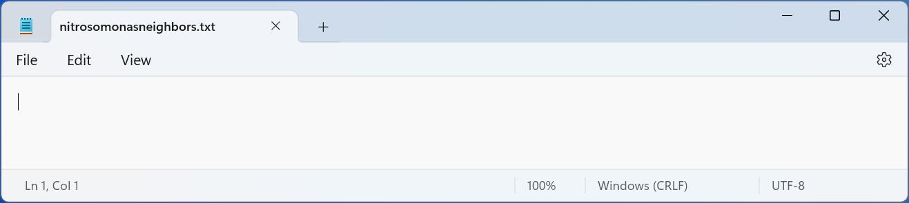
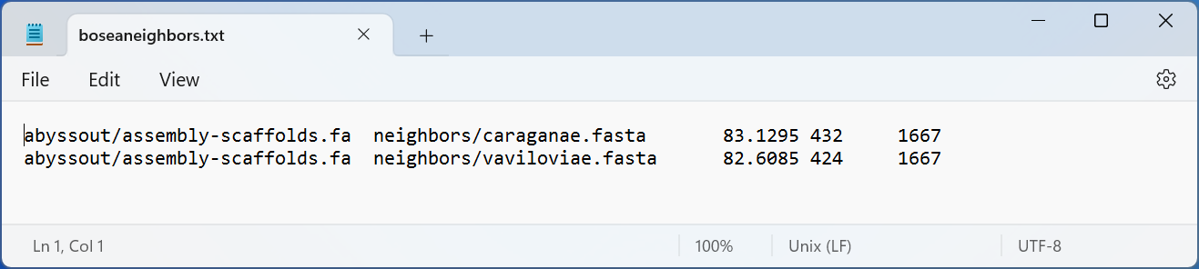
Average nucleotide identity using fastANI

