Slide 1
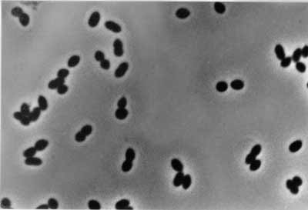
Nitrosomonas sp. Ls35
Genome Assembly and Analysis
Alan Vinzant
Asw-hamburg, CC BY 3.0, via Wikimedia Commons
Notes:
For my final project, I did a full genome assembly and analysis of Nitrosomonas sp. Ls35. On the bottom of this slide is a picture of N. eutropha from Wikimedia Commons.

Slide 2
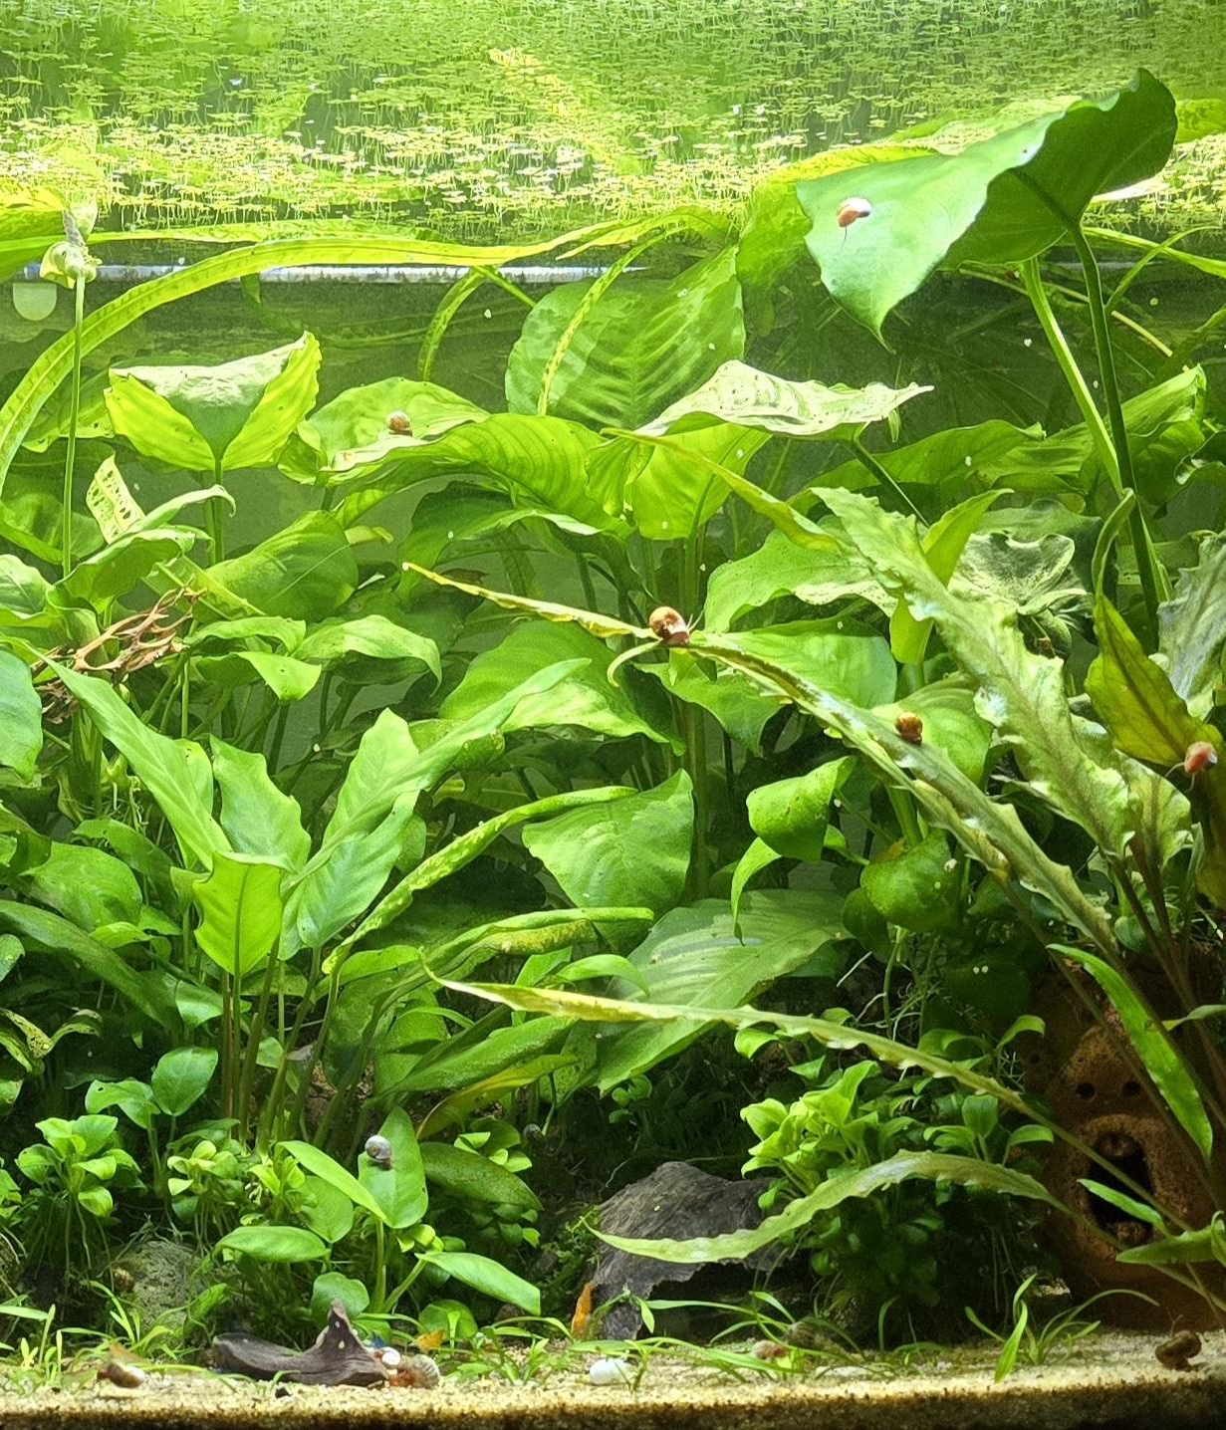
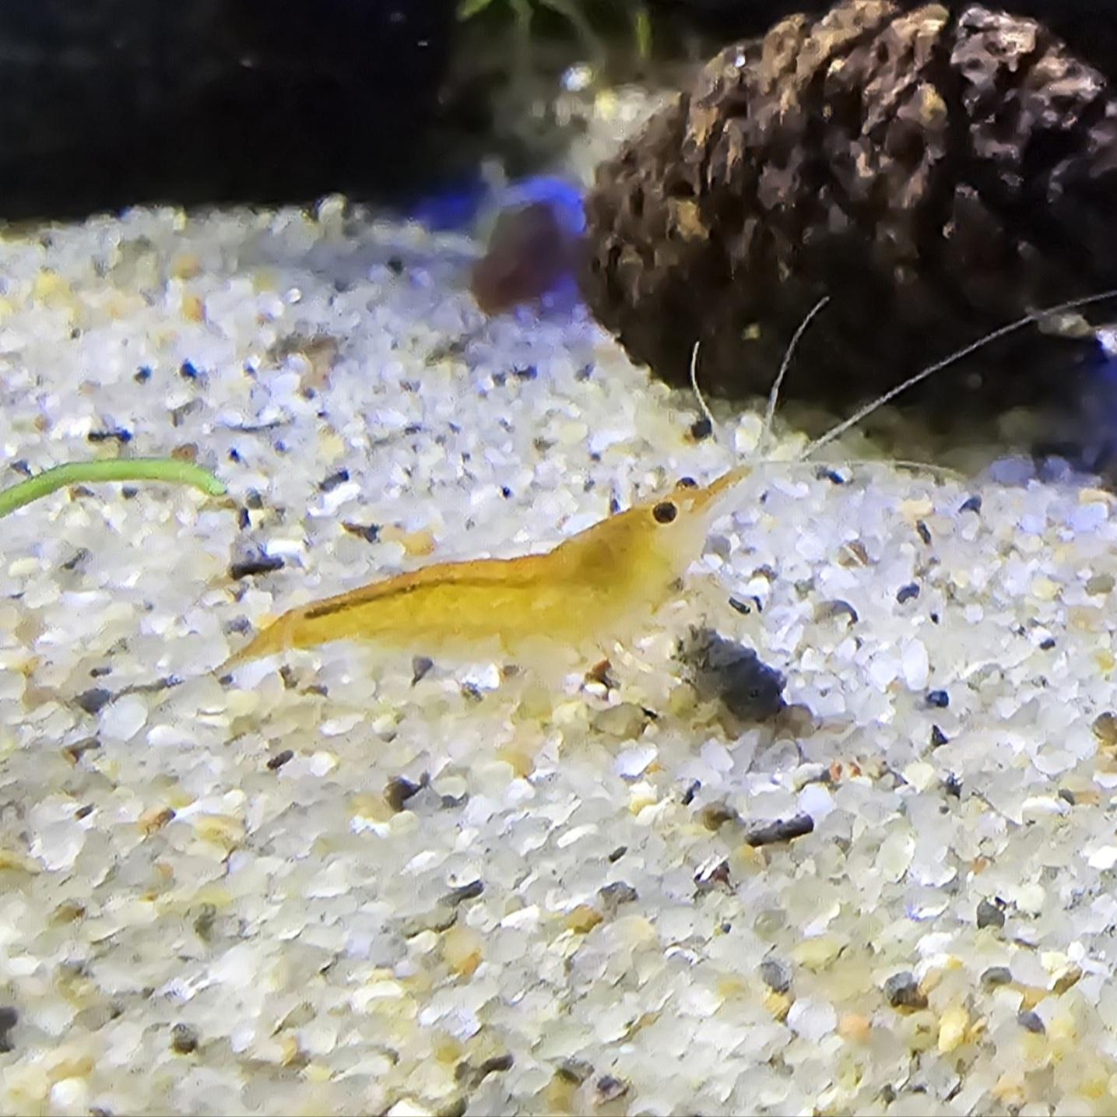
Introduction
Genome assembly
Genome analysis
Reasoning for choosing species
Aquatic nitrifying bacteria
Notes:
The scope of this study will include:
Genome assembly, in which many smaller reads of DNA are combined into a smaller number of larger scaffolds, and
Genome annotation and analysis, in which individual genes and their locations are identified.
The reason I chose this organism is that Nitrosomonas is a name that comes up frequently in the aquarium hobby. It is a nitrifying bacteria that, along with other species, convert ammonia into less toxic and more bioavailable forms of nitrogen. Without it, aquarium keeping wouldn’t be possible.

Slide 3
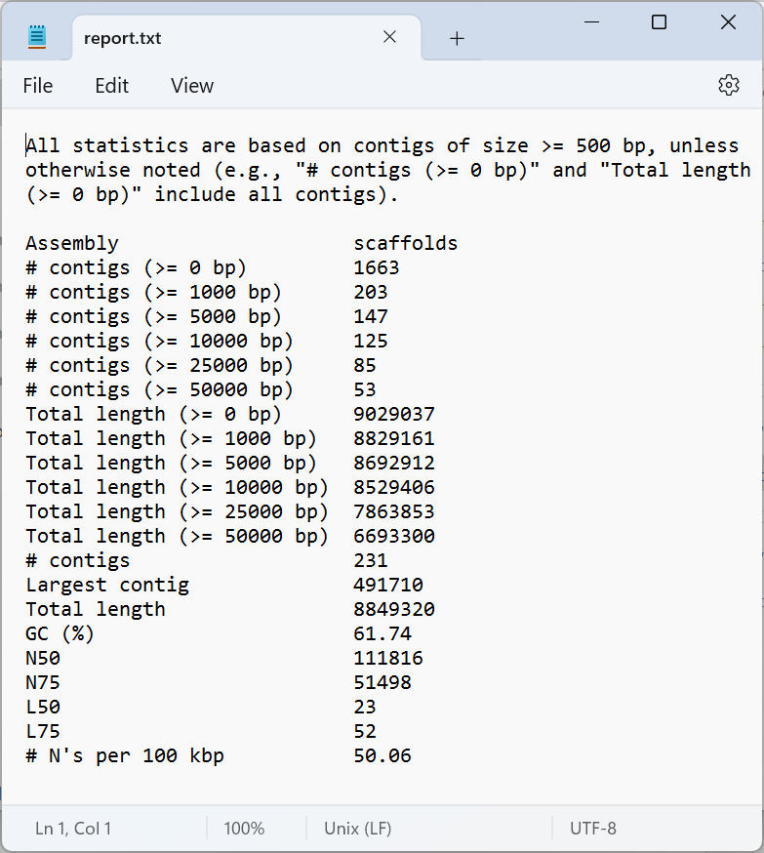
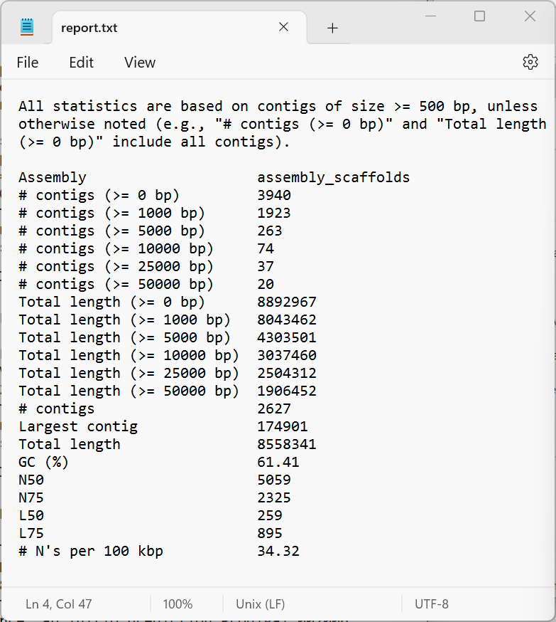
01
Assembly
SPAdes
v3.15.5
ABySS
v2.3.7
QUAST
v5.0.2
SPAdes
ABySS
Notes:
The first step was assembly. SPAdes and ABySS are two different genome assemblers that were used on the forward and reverse reads provided. QUAST was then used to analyze the quality of the assemblies.
SPAdes returned a greater number of errors, but it was able to assemble the genome into a significantly fewer number of larger contigs, so I used the SPAdes output for the following steps.

Slide 4
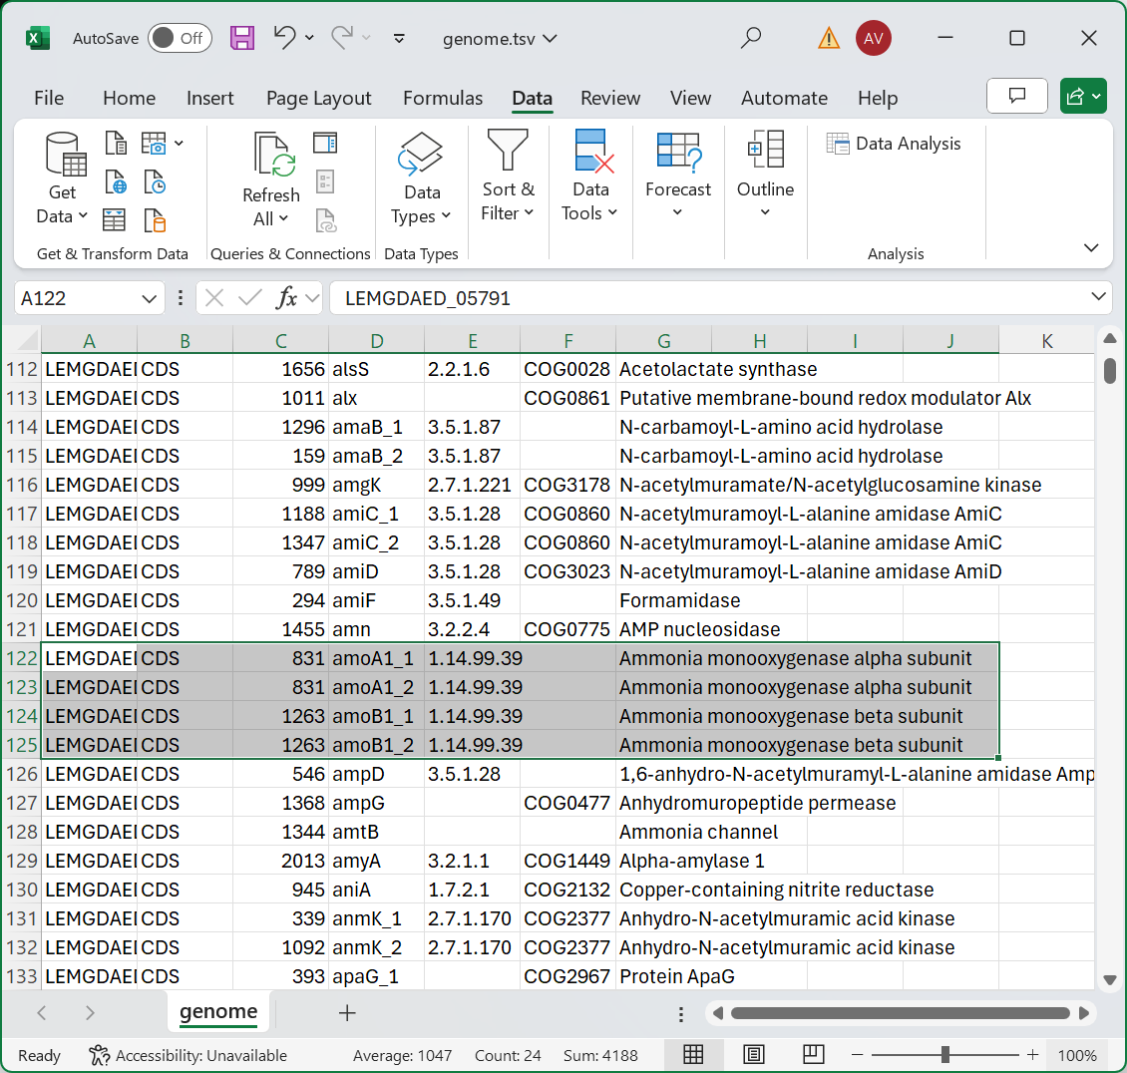
02
Nitrification
amoA, amoB, amoC (absent)
Ammonia monooxygenase
NH₃ → NH₂OH
Annotation
Prokka
Galaxy Version 1.14.6+galaxy1
Notes:
Genome annotation was used to identify genes and their locations within the genome.
Of note, we have the genes amoA and amoB, which code for the alpha ad beta subunits of ammonia monooxygenase enzyme. This converts ammonia into hydroxylamine, the first step in its eventual conversion to nitrate.
Other genes associated with nitrifying bacteria, such as amoC and hzo, are not necessarily present in every species of Nitosomonas, and were not found here.

Slide 5
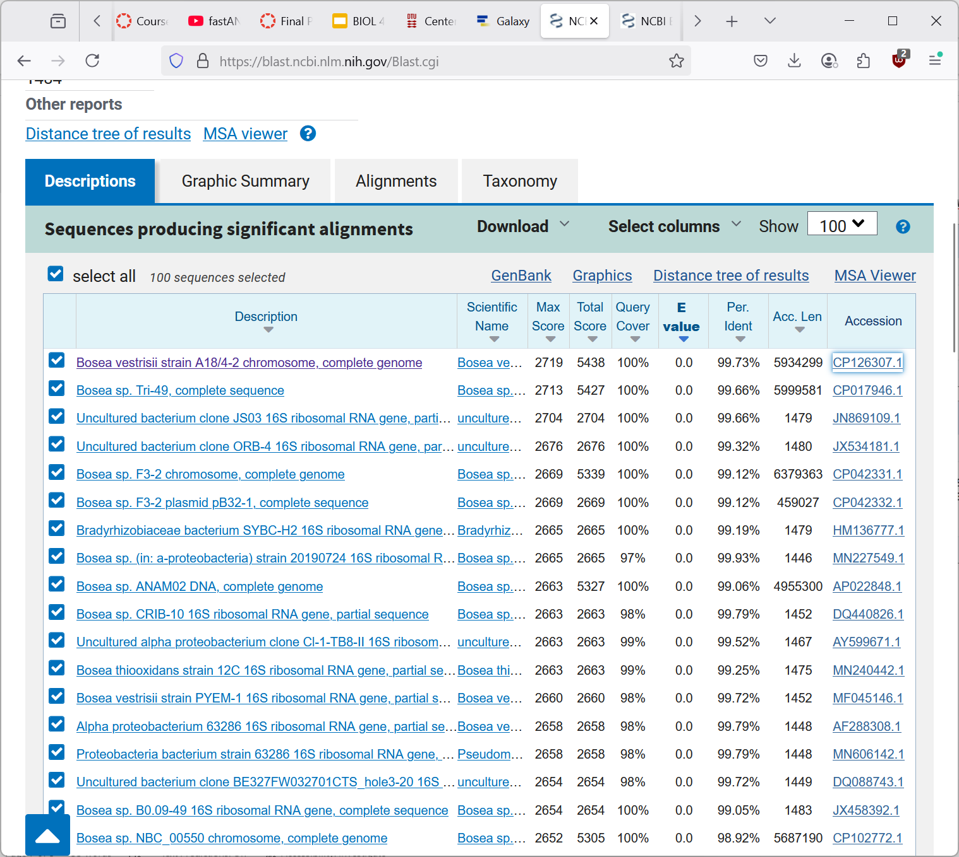
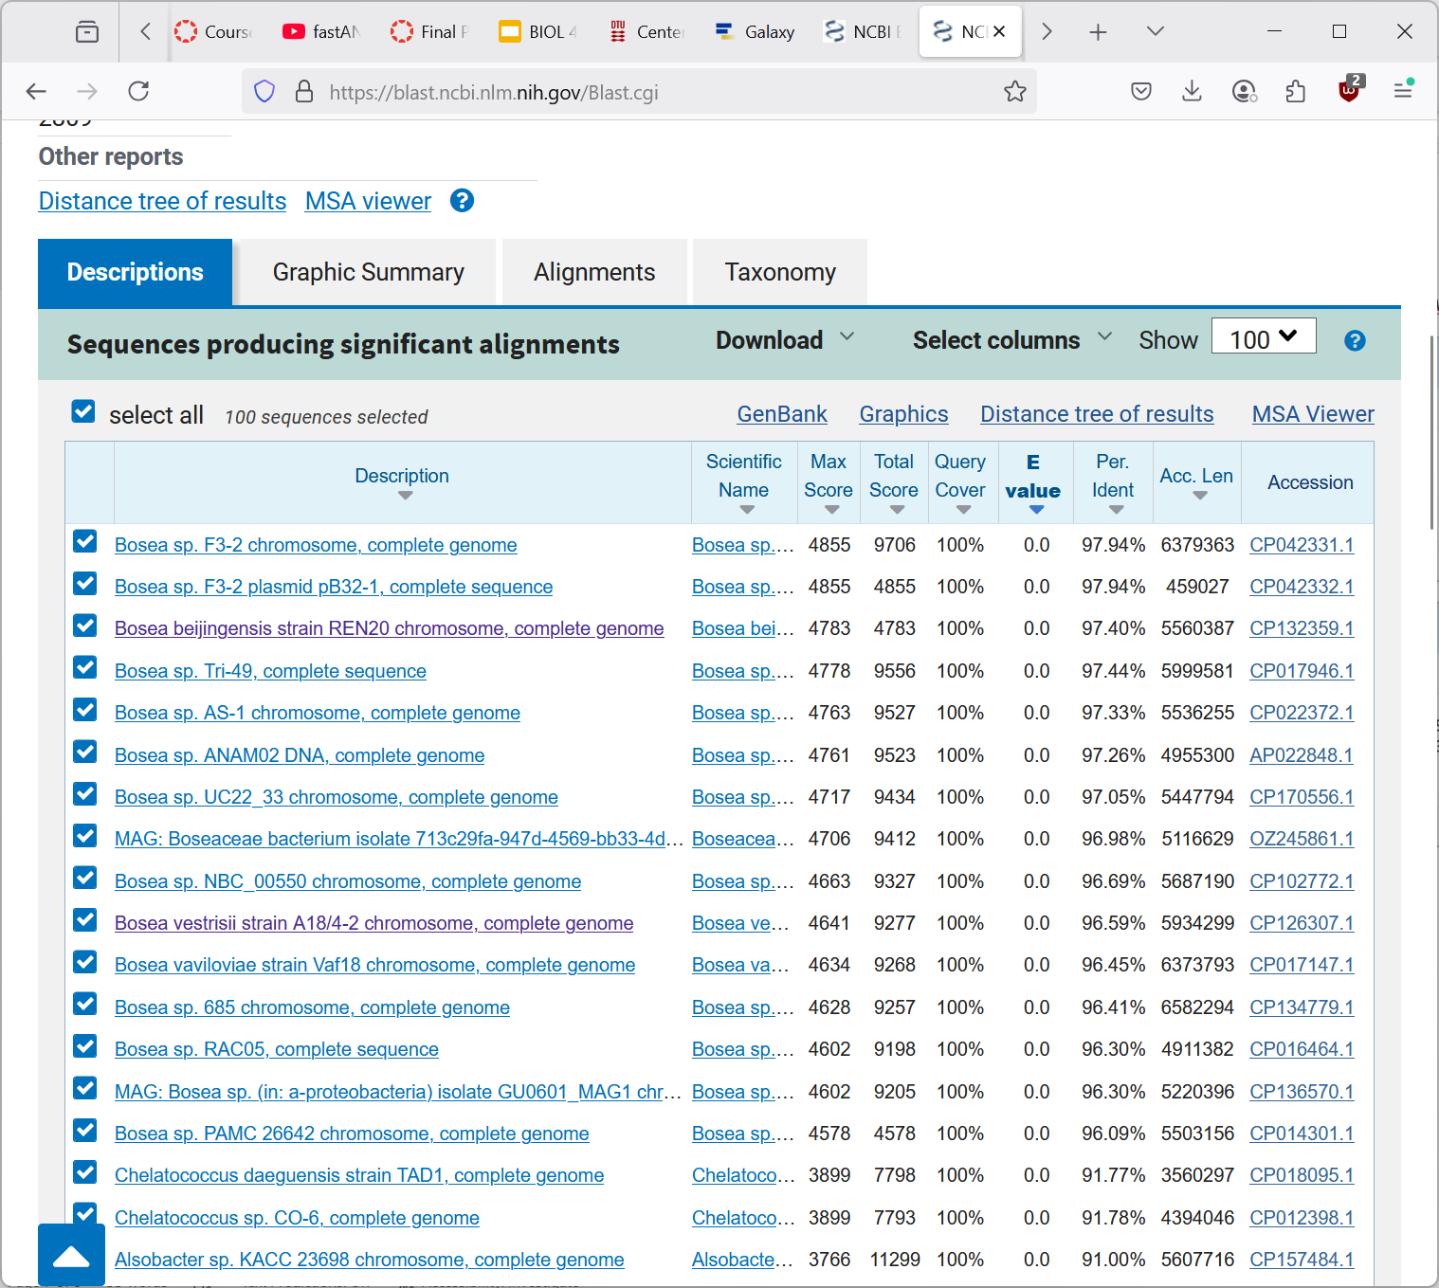
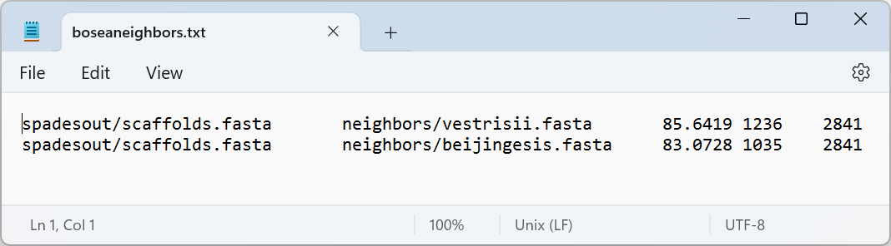
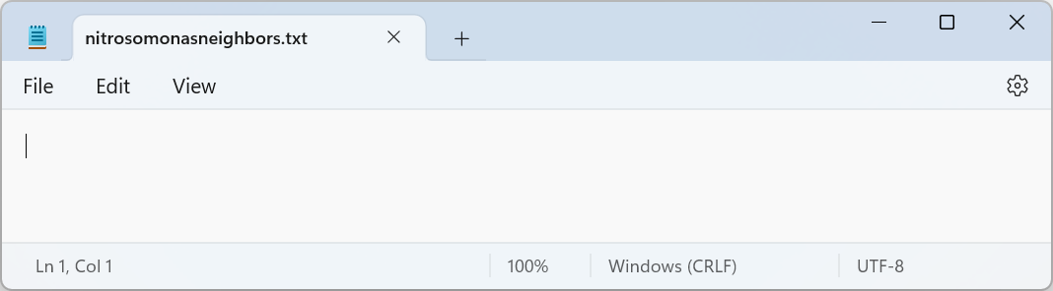
03
Identification
Barrnap
v0.9
bedtools
V2.27.1
BLASTn
v2.16.0
FastANI
v1.33
Notes:
To identify the genome to an organism, I first had to locate and identify its 16S rRNA sequence.
Barrnap finds the location of multiple nucleotide sequences, including those associated with 16S and 23S rRNA.
Bedtools provides the actual nucleotide sequences, which are the input to nucleotide BLAST to match them to an organism.
The 16S rRNA sequence returned results for Bosea, a genus that I had never heard of, so I tried again with the 23S rRNA sequence, and again retrieved Bosea spp. Results.
Working with the topr results from BLAST, I downloaded the genomes for Bosea vestrisii and B. beijingensis. FastANI was used to determine average nucleotide identity (basically, genetic similarity) between my genome and those of given “neighbors.”
FastANI found average nucleotide identities in the mid-80s for both species of Bosea. When I attempted to run it with Nitrosomonas neighbors, it returned a blank file, meaning there was little similarity between the genomes.

Slide 6
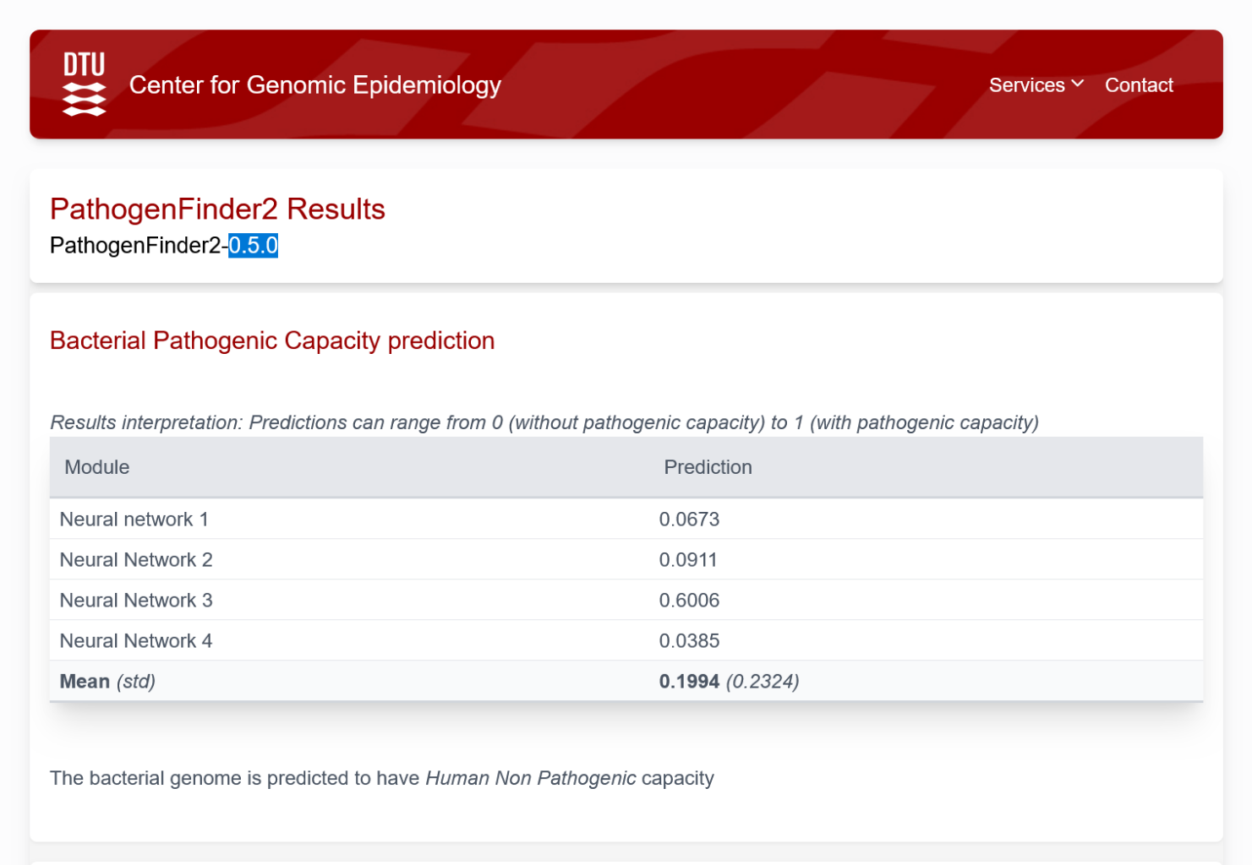
04
Pathogenicity
PathogenFinder2
0.5.0
Notes:
Finally, I ran my genome through PathogenFinder2 to see the probability that the organism was pathogenic to humans. Nitrosomonas doesn’t interact with humans, but I’ve never heard of Bosea, so I thought it might be interesting to run it. The numbers were a little higher than expected, but overall, my Bosea sp. was determined to have human nonpathogenic capacity.

