Slide 1
Assessing the impact of a temporary class drug order on ethylphenidate-related infections among people who inject drugs in Lothian, Scotland
An interrupted time-series analysis
Dr. Alan Yeung
Health Protection Scotland
BBV/STI Team

Slide 2
Outline
Background
What are NPS?
Ethylphenidate
Conditions conducive to an outbreak
Lothian outbreak
Public health responses
Was the TCDO effective?
Study design considerations
Simple analyses
Interrupted Time Series and GLARMA
Conclusions and limitations

Slide 3
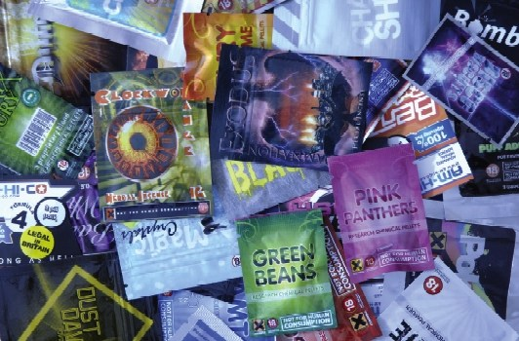
What are NPS?
Novel Psychoactive substances
Appeared around 2008/09 and rapid rise in popularity
Designed to replicate established recreational drugs
Previously ‘legal highs’
‘not for human consumption’
Perceived as safer but not true
Were sold in ‘headshops’ or online
Also newsagents and vaping shops
Notes:
Designed deliberately to circumvent existing laws
NPS perceived as safer
Prior to 2009, NPS were not reported as a factor, causative or not, in any deaths related to drugs in Scotland. Since then there has been an increasing number seen, with 113 deaths in 2013 mentioning NPS as a factor

Slide 4
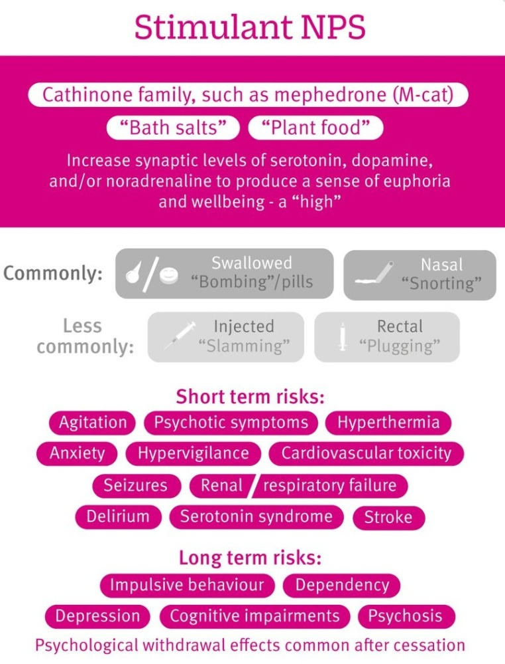
Ethylphenidate
Mimics amphetamine, cocaine, ecstasy
Induces a ‘high’
Sold as Crystals/powder
Many NPS brands (‘street names’) contain ethylphenidate
Tracy, D.K., Wood, D.M. and Baumeister, D., 2017. Novel psychoactive substances: types, mechanisms of action, and effects. BMJ, 356, p.i6848.
doi:10.1136/bmj.i6848
Notes:
Among PWID, some NPS are referred to as ‘bath salts’ due to their visual similarity. ‘Burst’ is a NPS that was popular in Lothian

Slide 5
Conditions: Availability in Lothian
Ethylphenidate (Burst/Blue stuff) was easily accessible
Headshops more prevalent in Lothian, particularly City Centre, Leith and Musselburgh
Highly unique situation in Lothian
NPS injecting despite usually being taken orally
Many heroin injectors switched to NPS
Cheaper: £60 vs. £10 per gram
Shops offered multiple buying discounts, loyalty schemes, buying on credit
Notes:
NPSs are generally cheaper than heroin with a gram of Burst costing £10, compared to £60 for the same quantity of heroin.

Slide 6
Conditions: Injecting Ethylphenidate
Extreme intense initial high with severe ‘comedown’
Urge to redose
Injecting ethylphenidate corrosive
Injection sites ‘used up’ leading some to use high risk areas – groin, neck, forehead, tongue
Easily dissolved without heating
Most common infections
Staphylococcus aureus (S. aureus)
Group A Streptococcus pyogenes (S. pyogenes)
Risk behaviours
Needle sharing, dirty equipment, bad living conditions
Notes:
Some individuals reported injecting up to 30 times daily
About 1 in 3 carries staph bacteria harmlessly on their skin, usually inside their nose and on the surface of their armpits and buttocks
Staph can cause problems if they enter the body through a break in the skin, spread through close skin contact or sharing contaminated objects.
Usually minor problems, skin abscess but invasive infection serious, e.g. endocarditis: infection of the heart
Strep A often found on the surface of the skin and inside the throat
Spread in coughs/sneezes or through direct contact with an infected person or contaminated object
Usually minor problems, throat infections but invasive infection serious, e.g. Necrotising fasciitis, severe pain and swelling
Domestic chaos is common, and many users are living in states of self-neglect
Experience symptoms such as restlessness, panic attacks, insomnia, depression, pain
Hallucinations have been reported with users scratching and picking at their skin

Slide 7
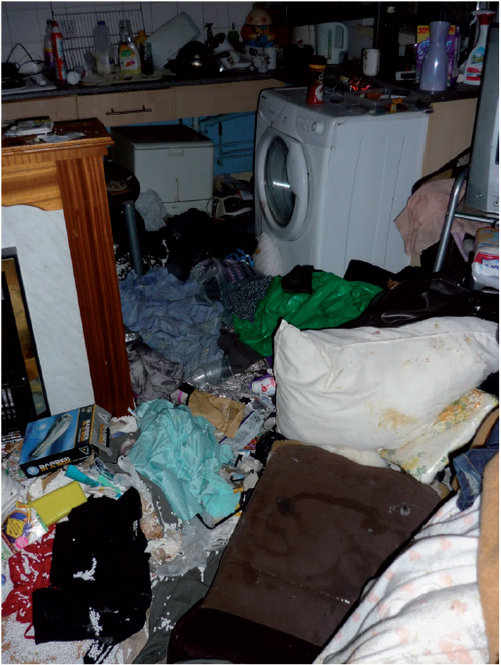
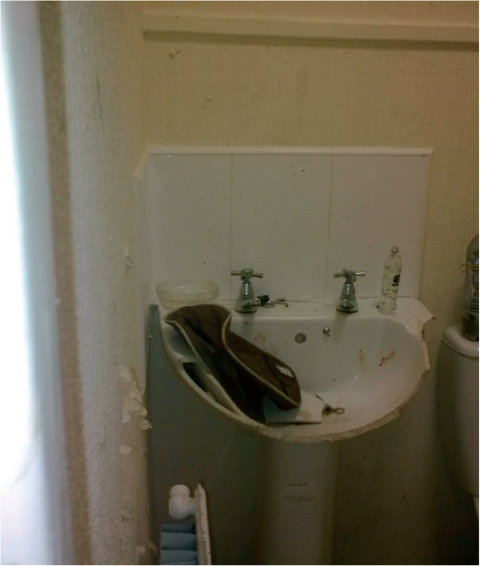
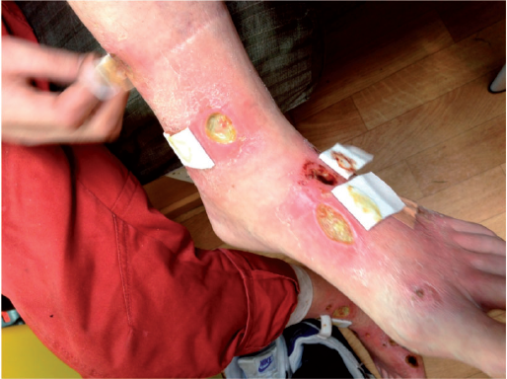
Lafferty, C., Smith, L., Coull, A. and Shanley, J., 2016. The experience of an increase in the injection of ethylphenidate in Lothian April 2014–March 2015. Scottish medical journal, 61(2), pp.74-83. doi: 10.1177/0036933016649871

Slide 8
Lothian Outbreak
Early as 2013, increase in complicated S. aureus infections among PWID
Many injecting ‘Burst’
29 Sept 2014: Cluster of PWIDs with Group A S. pyogenes infections presenting at Edinburgh Royal Infirmary for surgical intervention
Enhanced surveillance:
Enquiries on NPS use
Lab testing for S. pyogenes emm types
Important finding: many were emm76.0 (uncommon)
Notes:
injectors of NPS appeared to have a higher rate of SAB recurrence than with other drugs which further adds to the S. aureus-associated morbidity with NPS injection and the impact on inpatient services for optimal treatment.
There was considerable morbidity and mortality linked to this outbreak: a significant degree of illness severity was seen with a proportion of cases requiring major surgical intervention and high levels of hospital care. The burden to health care services, in both primary and secondary care, was significant with 83% of cases requiring hospital admission.

Slide 9
Public Health Responses
March 2015: Director of Public Health sent letters to head shops requesting to cease trading NPS
10 April 2015: TCDO (temporary class drug order) enacted prohibiting distribution of ethylphenidate lasting 12 months
15 October 2015: General Product Safety Regulation Forfeiture order obtained to cease trading NPS (Lothian)
26 May 2016: Psychoactive Substances Act
Notes:
From 10 April 2015 the sale and distribution of ethylphenidate is banned and it will remain illegal for up to 12 months while drug experts consider its full range of harms.
Police Scotland pursed TCDO with Home Office. The legislation was the result of extensive work by Police Scotland leading up to a presentation in respect of the Lothian injecting situation to the ACMD in March 2015.
ACMD: advisory council on the misuse of drugs

Slide 10
Research Questions
Was the ethylphenidate TCDO effective in reducing the ‘most common’ infections among PWID?
Important as many critics to use of legislation
Is there a link between S. pyogenes emm76.0 infections with NPS-injecting?
Note: Only self-reported NPS-use available

Slide 11
Study Design Considerations
Create ‘pre-intervention’ and ‘post-intervention’ periods
TCDO week 15 2015 but post-intervention period was set to start on week 17
NPS bought up to week 15 but delay needed for NPS to be consumed and then present with infection
Pre-intervention: week 34 2014 to week 16 2015 (35 weeks)
Post-intervention: week 17 2015 to week 42 2015 (26 weeks)
Notes:
Start of when PWID presenting almost every week
End of the week closest to the forfeiture order

Slide 12
Epidemic Curve: Strep and/or Staph

Slide 13
Average Weekly Infections
 | Pre-TCDO |  |  | Post-TCDO
Infection Group | n | Weekly Rate |  | n | Weekly Rate
S. pyogenes (all emm types) and/or S. aureus | 171 | 4.9 |  | 51 | 2.0
S. pyogenes (emm76.0) | 56 | 1.6 |  | 10 | 0.4
S. pyogenes (emm types other than emm76.0) | 21 | 0.6 |  | 11 | 0.4
S. aureus (excluding coinfection with S. pyogenes) | 94 | 2.7 |  | 30 | 1.2
Notes:
This is about as far as many policy assessment studies go

Slide 14
Modelling: Interrupted Time Series
Use regression model to assess for changes in level and trend pre/post intervention
Dummy variable for pre/post intervention periods
Variable for week number post-intervention
Adjust for self-reported NPS use
Negative binomial model to account for overdispersion
Two main models:
S. pyogenes and/or S. aureus
S. pyogenes with factor to distinguish emm76.0
Interaction between NPS use and emm type
Notes:
Interaction is to compare the risk of NPS use for getting emm76 compared with the risk of NPS use for other emm types

Slide 15
Full Interaction ITS Model
Intervention
Response
Change in level
Change in trend
Time

Slide 16
GLARMA Models
Assessed autocorrelation by inspecting PACF of regression model residuals
Autocorrelation at lag 1
Generalised linear autoregressive moving average
Accounted for autocorrelation using GLARMA model
Note: Not required for S. pyogenes model
Dunsmuir W. T., Scott D. J., others. The glarma package for observation driven time series regression of counts. Journal of Statistical Software 2015;67:1–36.
Dunsmuir W. Generalized linear autoregressive moving average models. Handbook of Discrete-Valued Time Series CRC Monographs 2015;
Notes:
Glarma package currently supports Poisson, Negative Binomial and Binomial response
An autoregressive process operates under the premise that past values have an effect on current values.
A process considered AR(1) is the first order process, meaning that the current value is based on the immediately preceding value
An AR(2) process has the current value based on the previous two values

Slide 17
GLARMA AR(1) Model
 | RR | 95% CI | p
S. pyogenes (all emm types) and/or S. aureus
Intercept | 1.12 | 0.59 – 2.11 | 0.728
Trend: Pre-TCDO | 1.02 | 0.99 – 1.05 | 0.229
Level change following TCDO | 1.11 | 0.46 – 2.70 | 0.820
Trend change following TCDO | 0.88 | 0.82 – 0.94 | <0.001
NPS User | 1.81 | 1.12 – 2.93 | 0.016
ϕ(x_{t-1}) | 0.10
Relative to the pre-intervention trend, 12% decrease in rate of infections per week
Easier to interpret as pre-intervention trend ≈ 1
Notes:
Could remove the level change
NPS users more at risk
LRT suggests GLARMA model needed (p = 0.0108)
Φ < 1 represents a stationary series that varies around its mean, randomly wandering away from the mean and never ‘exploding’ away for
more than a short time

Slide 19
Negative Binomial Model
 | RR | 95% CI | p
S. pyogenes
Intercept | 0.36 | 0.18 – 0.72 | 0.004
Trend: Pre-TCDO | 1.00 | 0.97 – 1.02 | 0.762
Level change following TCDO | 0.97 | 0.39 – 2.45 | 0.956
Trend change following TCDO | 0.93 | 0.87 – 1.00 | 0.037
NPS User | 1.14 | 0.55 – 2.35 | 0.726
S. pyogenes emm76.0 | 0.86 | 0.40 – 1.87 | 0.708
Interaction: NPS User with emm76.0 | 3.49 | 1.32 – 9.21 | 0.012
Complicated interpretation: compares RR of NPS use within emm76.0 (≈ 3.972) against RR of NPS use within other emm types (≈ 1.138)

Slide 20
Conclusions
TCDO was effective
Temporary legislation to swiftly limit access to addictive NPS probably key to disrupting transmission
Outbreak management difficult
Erratic lifestyles, poor treatment compliance
NPS-injecting appears to have been associated with S. pyogenes emm76.0 infections
GLARMA models and ITS analyses powerful and flexible for assessing effectiveness of interventions

Slide 21
Limitations
Modelling limitations:
Uncertainty around start of post-intervention period
Sensitivity analyses with consistent results
Accuracy of self-reported data
Found that some heroin was adulterated with ethylphenidate-based NPS
Challenging to isolate TCDO impact
Looks effective in short term but what about long term?
NPS sales moved to black market and dark web
Now need to assess Psychoactive Substances Act

Slide 22
Acknowledgements
Con Lafferty (NHS Lothian) and the Lothian Harm Reduction Team for use of images showing NPS-injecting wounds
Kathy Evans (Edinburgh Council) for use of images showing a property where NPS-injecting was taking place
Derek Tracy (Oxleas NHS Trust/Kings College) for use of figure from BMJ paper describing ‘stimulant NPS’
Co-authors, especially Amanda Weir (HPS) and Andy McAuley (HPS/Glasgow Caledonian University)
Yeung, A., Weir, A., Austin, H., Morrison, K., Inverarity, D., Sherval, J., Henderson, N., Joshi, S., Ure, R., and McAuley, A. (2017) Assessing the impact of a temporary class drug order on ethylphenidate-related infections among people who inject drugs in Lothian, Scotland: an interrupted time-series analysis. Addiction, doi: 10.1111/add.13898.

Slide 23
Questions?
alan.yeung@nhs.net
Dr. Alan Yeung
Health Protection Scotland
BBV/STI Team

