Slide 1
My Post-PhD Experience
Dr Alan Yeung

Slide 2

About Me
Undergraduate in maths, stats, accounting at Strathclyde
PhD in statistics
Statistical Applications in the analysis of vaccine preventable diseases
Finished in 2016, while already working full-time (not recommended!)
Fun fact: winner of the 2011 UK postgraduate maths football championships (with Sean... I think!)

Slide 3




My Career
1.5 years as an analyst at ISD Scotland (Information Services Division of the NHS)
Few years as an analyst at HPS
Blood-borne viruses and STI team
Since this year: 2 days per week at HPS 3 days per week at GCU
Mix of data analysis, data management, reporting and research
Often not as complex as PhD work
But growing interest/hype in machine learning

Slide 4
Why This Career Path?
Focussed on statistics / data science
Enjoy working in healthcare / areas that have societal impact
Variety:
Statistical analysis
Programming
Problem solving
Research
Relatively easy transition to statistics for applied mathematicians
Ability to interpret results is very important

Slide 5
Some Advice
Ideally apply 3-6 months before submitting (or end of your funding)
Can take a while to secure job and can negotiate start date
Apply to more than one job (but don’t go crazy!)
Application: check essential requirements in the person specification carefully
Back up what you say with examples
Can describe training/interest towards developing skills
Use a clear structure
Interview: follow the STAR method (Situation-Task-Action-Result)
Questions often focussed on how you are as a person
Mock interviews
Can seek advice from staff with links to industry
Review your interviews
Balance not undervaluing your skills against ‘getting a foot in the door’
PhD experience should help accelerate and shape your career

Slide 6
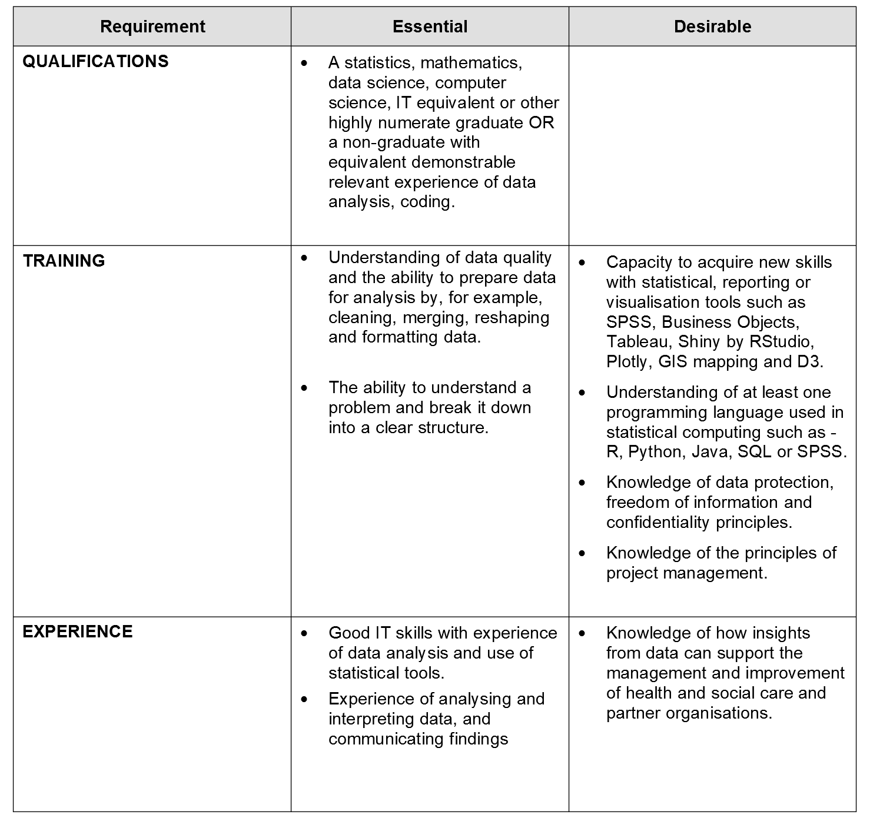
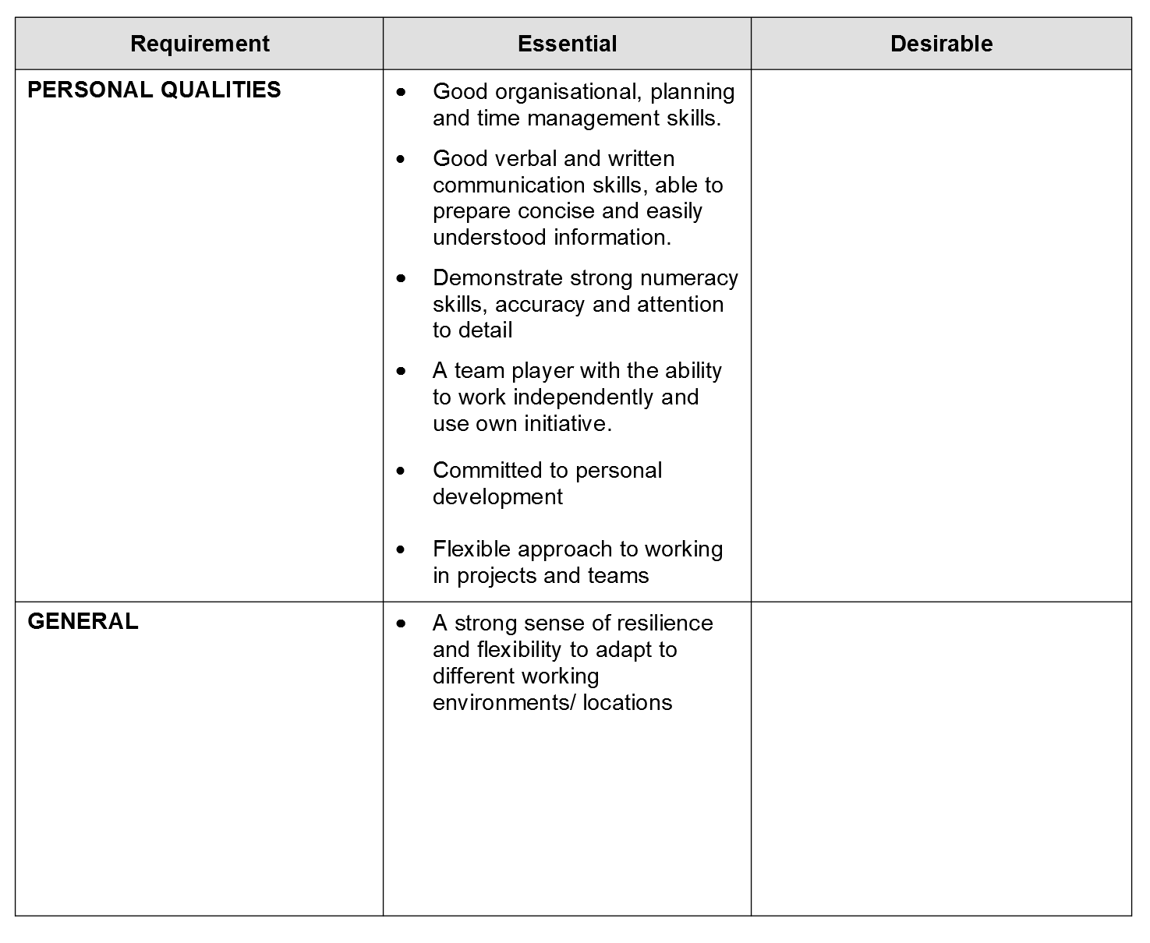
Example Person Spec for Analyst

Slide 7
Questions? (and links)
https://www.isdscotland.org
https://www.hps.scot.nhs.uk
https://jobs.scot.nhs.uk
https://www.thedatalab.com/jobs
https://www2.gov.scot/Topics/Statistics/About/Recruitment
https://gss.civilservice.gov.uk/vacancies
https://alan-y.netlify.com
alan.yeung at nhs dot net

