Slide 1
My Post-PhD Experience
Dr Alan Yeung

Slide 2

About Me
Undergraduate in maths, stats, accounting
PhD in statistics
Statistical Applications in the analysis of vaccine preventable diseases
Finished in 2016, while already working full-time (not recommended!)
Fun fact: winner of the 2011 UK postgraduate maths football championships (with Sean... I think!)

Slide 3




My Career
1.5 years as an analyst at ISD Scotland (Information Services Division of the NHS)
Few years as an analyst at HPS
Blood-borne viruses and STI team
Since this year: 2 days per week at HPS 3 days per week at GCU
Mix of data analysis, data management, reporting and research
Often not as complex as PhD work
But growing interest/hype in machine learning

Slide 4
Why This Career Path?
Focussed on statistics / data science
Enjoy working in healthcare / areas that have societal impact
Variety:
Statistical analysis
Programming
Problem solving
Research
Relatively easy transition to statistics for applied mathematicians
Essential to get good at interpreting results

Slide 5
Some Advice
Ideally apply 3-6 months before submitting
Can take a while to secure job and can negotiate start date
Apply to more than one job
For the application, check you meet all essential requirements in the person specification
Back up what you say with examples
Use a clear structure
Interview: follow the STAR method (Situation-Task-Action-Result)
Questions often focussed on how you are as a person
Mock interviews
Review your interviews

Slide 6
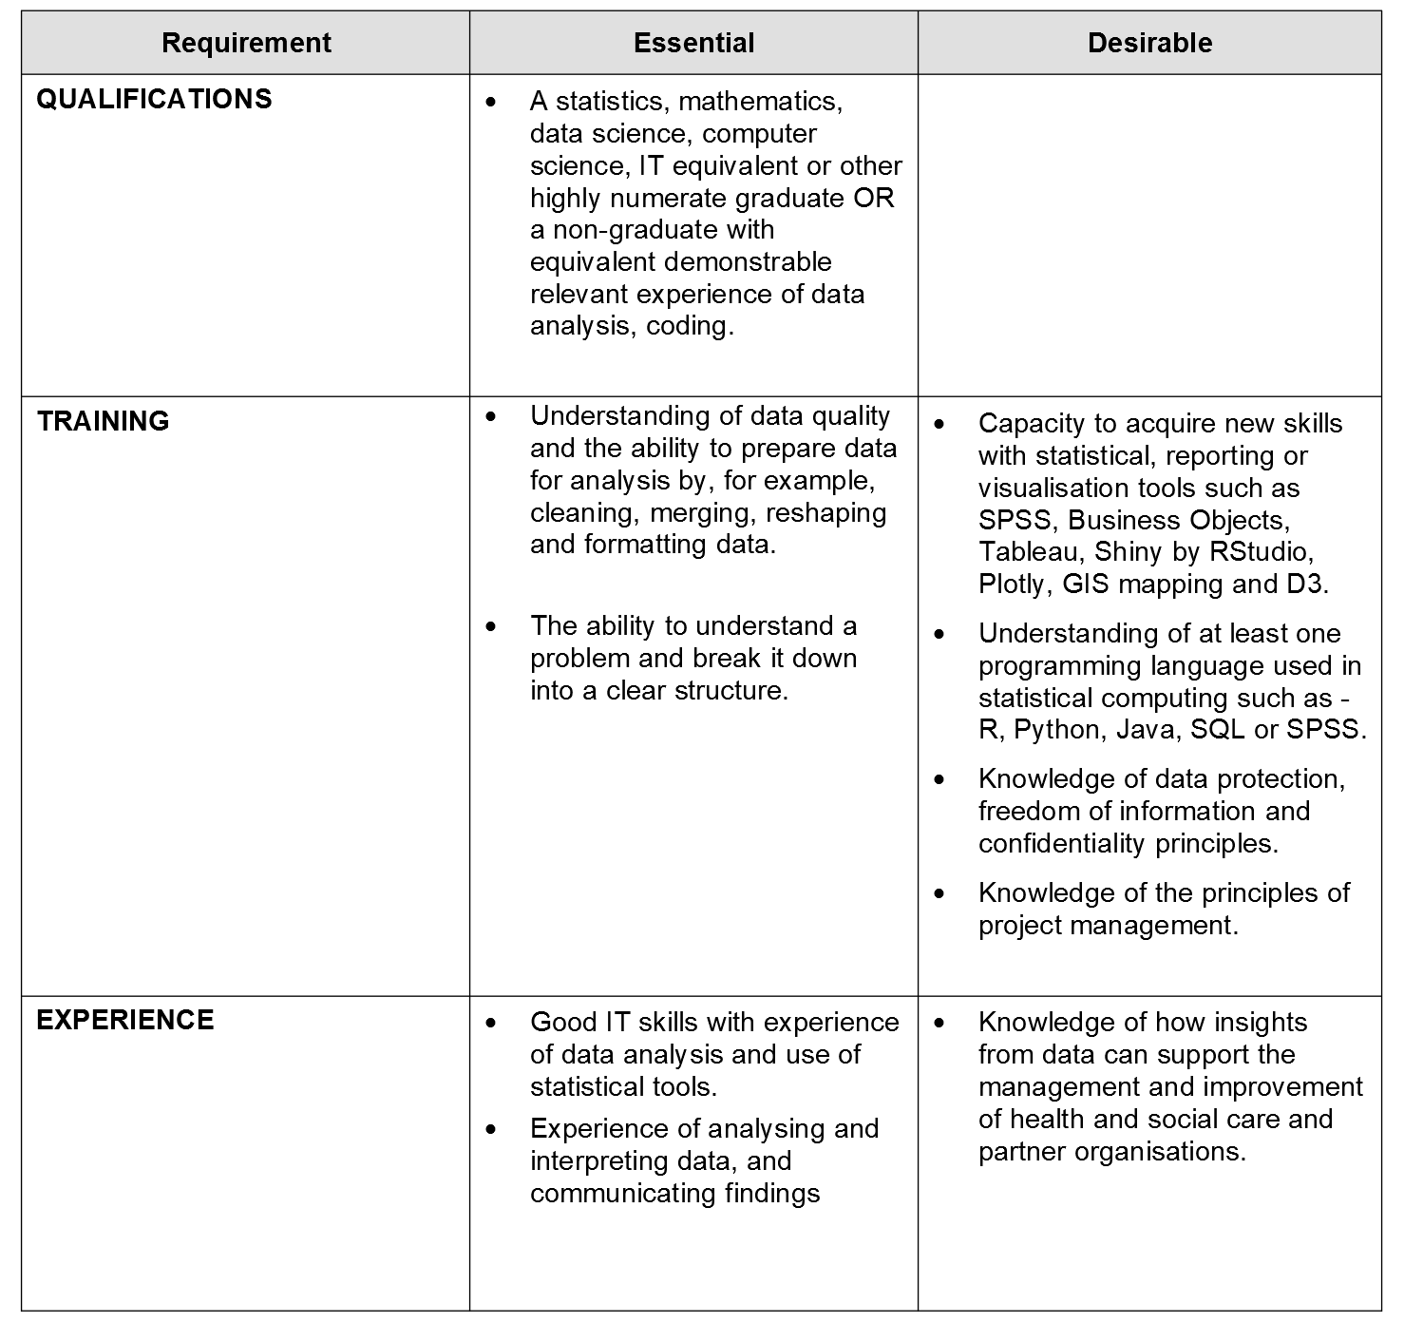
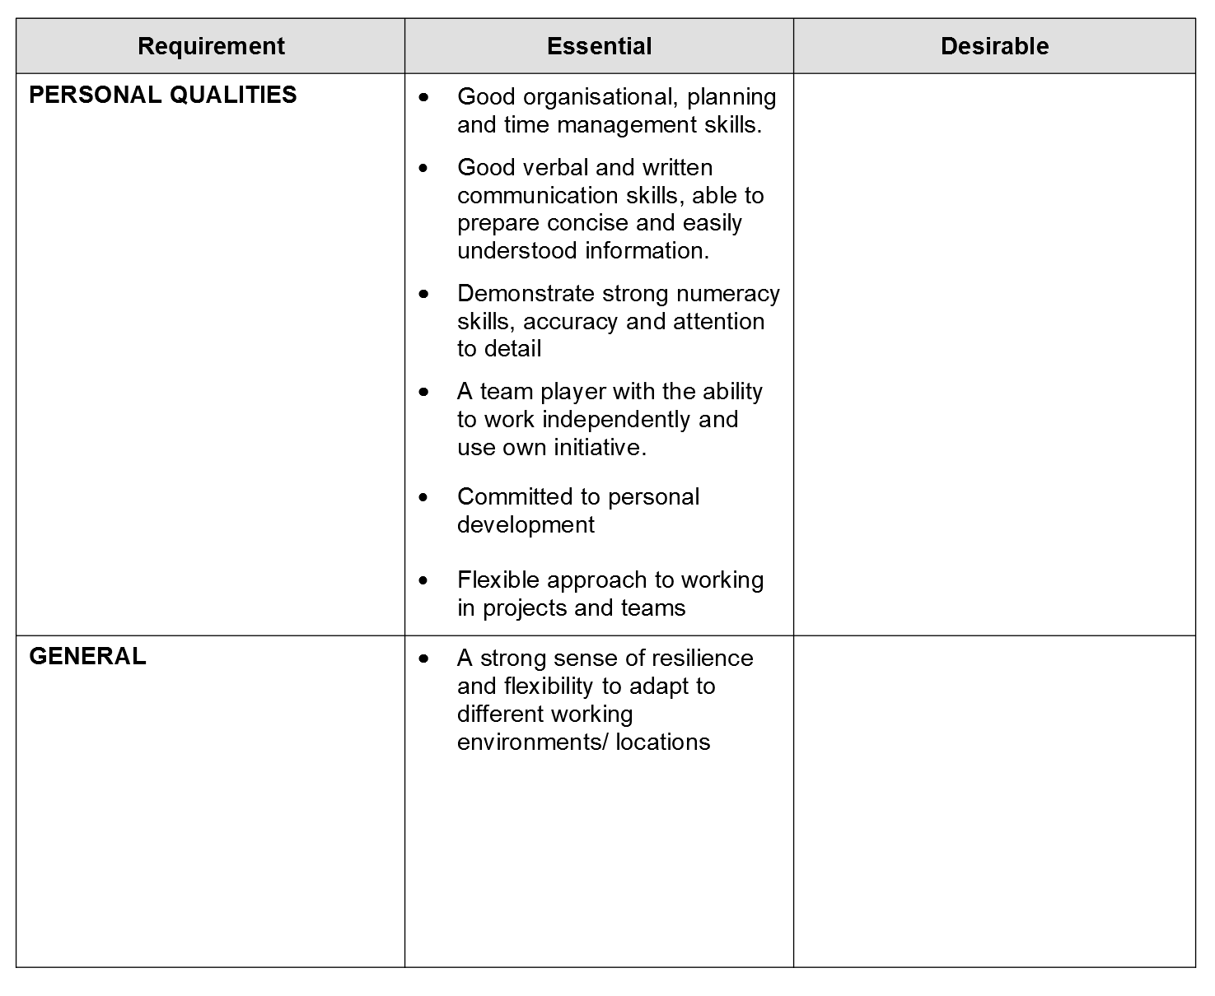
Example Person Spec for Analyst

