Slide 1
phiproject and planned developments
PHI useR Group Meeting Alan Yeung

Slide 2
Acknowledgements
Anna Price and the TPP team who developed the actual content of this work
I just wrote some R code around it

Slide 3
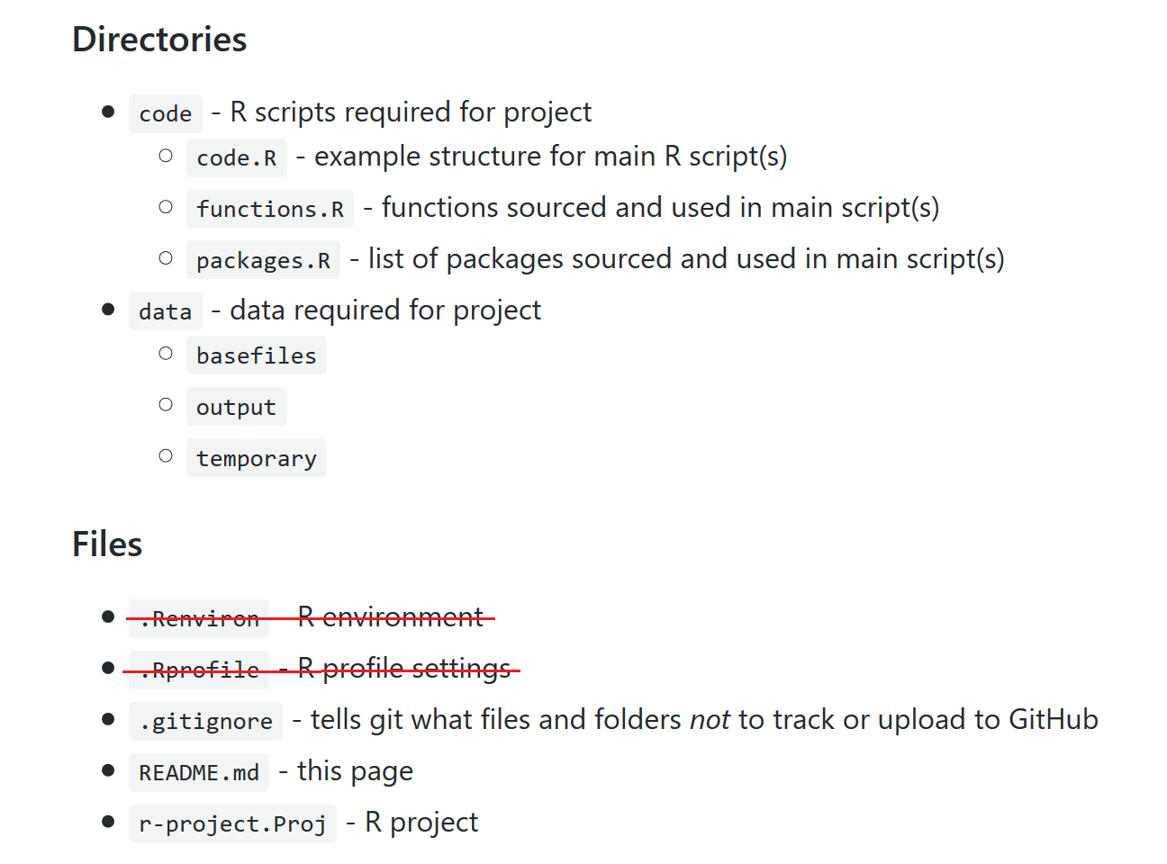
Project Template
Project template and R script template that aims to instil best practice
Intended to be flexible
https://github.com/Health-SocialCare-Scotland/phiproject
Figure: phiproject folder structure.

Slide 4
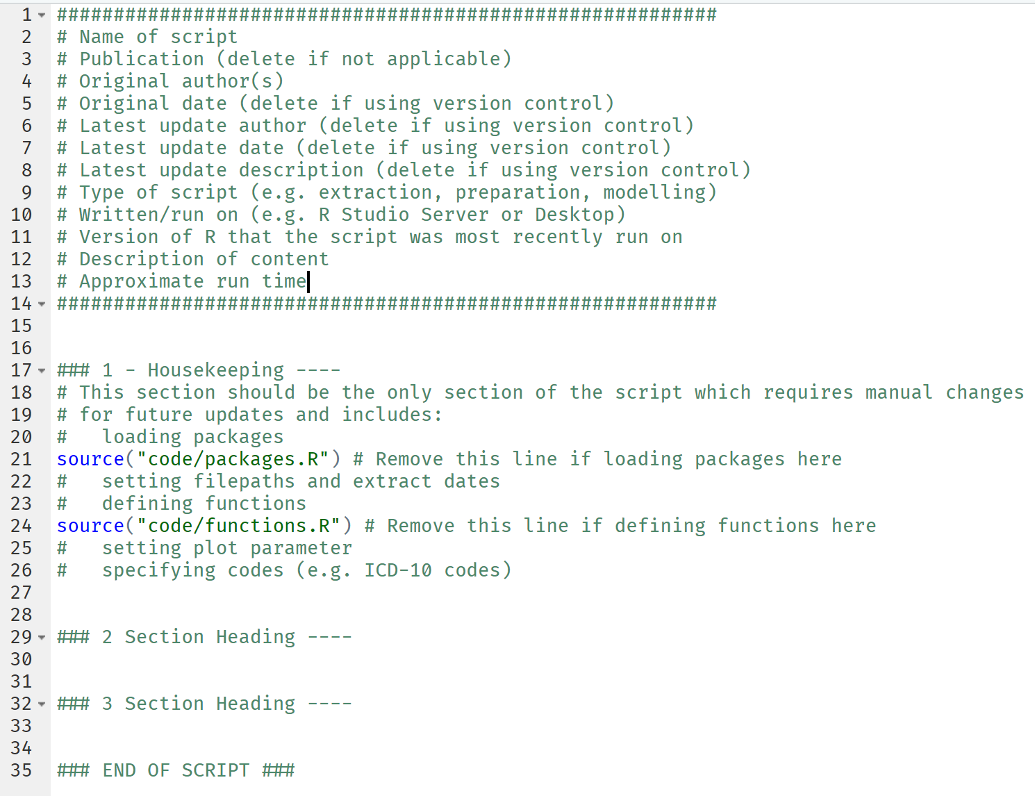
R Script Template
Figure: R script template.

Slide 5
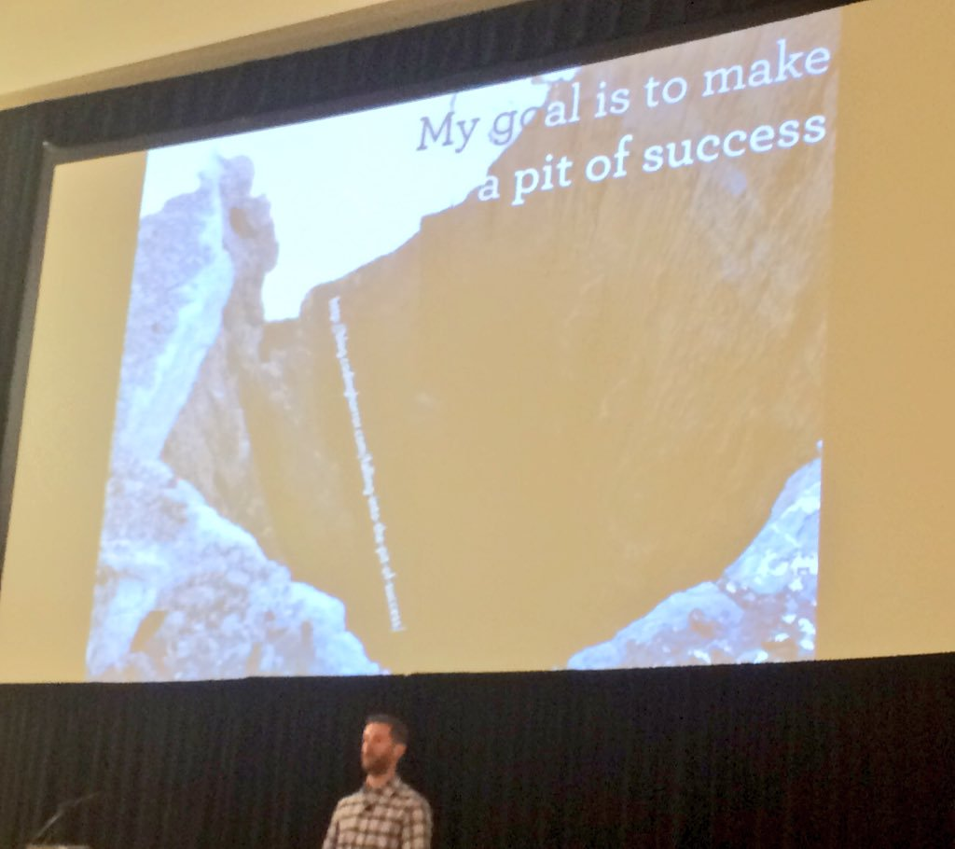
Why phiproject?
Remove some of the pain of adopting best practice (particularly for beginners)
Make it easier to follow a reproducible workflow
Collaboration, portability, resilience
Security
Improve discoverability of R work/tools being developed in PHI
Figure: Hadley and the pit of success.

Slide 6
The R code to create phiproject
Mostly very simple
dir.create()
writeLines()
dcf file to interact with RStudio

Slide 7
Demo
Create new project with phiproject template
New features
RMarkdown templates
RStudio 1.2 vs RStudio < 1.2

Slide 8
Planned Developments
Polishing up:
Vignettes for RMarkdown templates
Unit tests, code coverage, etc
Continuous integration with Travis
Additional features/templates:
ioslides template
shiny template
Leaflet template for making maps
More stats templates
Updating MS Word templates with flextable

Slide 9
Contributing
This is an open-source project so all contributions welcome! e.g. documentation, issues, feature suggestions, adding templates
Clone the repo using git
Create your own branch
Add your input
Push to Github
Put in a pull request on git
For creatives, a hex logo might be nice!

Slide 10
Package Updates
Package hosted on Github and not CRAN
R will not tell you about package updates
RStudio Package Manager may help

Slide 11
Thanks for listening
https://github.com/Health-SocialCare-Scotland/phiproject
Note: these slides were created in RMarkdown (requires Pandoc v2 which comes with RStudio 1.2) https://bookdown.org/yihui/rmarkdown/powerpoint-presentation.html

