Slide 1
Solving the Overproduction Problem in Reactive Programming using Feedback Control

Slide 2
Interactive vs. Reactive
Interactive program
“interacts at its own speed with users or with other programs”
consumer in charge
Reactive program
“maintains a continuous interaction with its environment, but at a speed which is determined by the environment, not by the program itself ”
producer in charge

Slide 3
Interactive vs. Reactive
Interactive program
val it = Iterable(0, 1, 2, 3)
val iterator = it.iterator while (iterator.hasNext) println(iterator.next())
for (i <- it)
println(i)
it.foreach(println)
Reactive program
val obs = Observable(0, 1, 2, 3)
obs.subscribe(println(_))

Slide 4
The four effects of programming
 | Single item | Multiple items
Synchronous (interactive) | getItem: T | getItems: Iterable[T]
Asynchronous (reactive) | getItemsAsync: Future[T] | getItemsAsync: Observable[T]

Slide 5
Fast producer, slow consumer

Slide 6
Fast producer, slow consumer
producer
time = 7
time = 8
time = 0
time = 1
time = 2
time = 3
time = 4
time = 5
time = 6
consumer

Slide 7
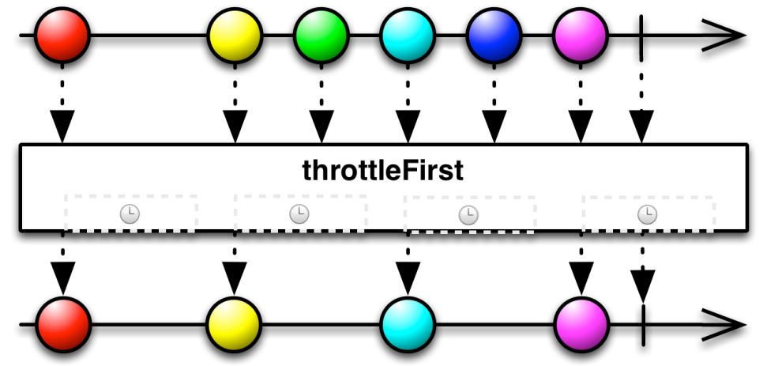
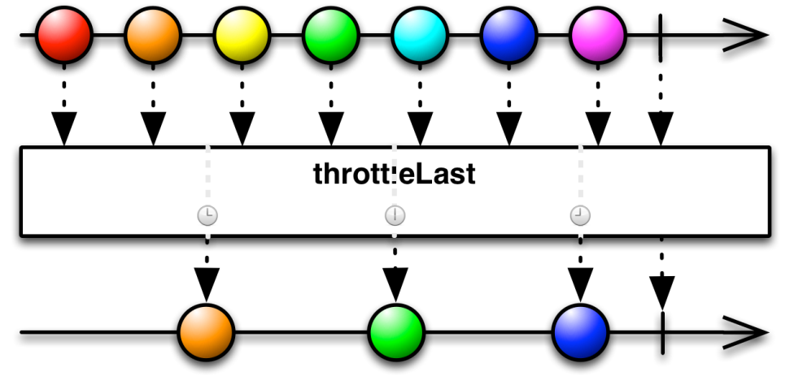
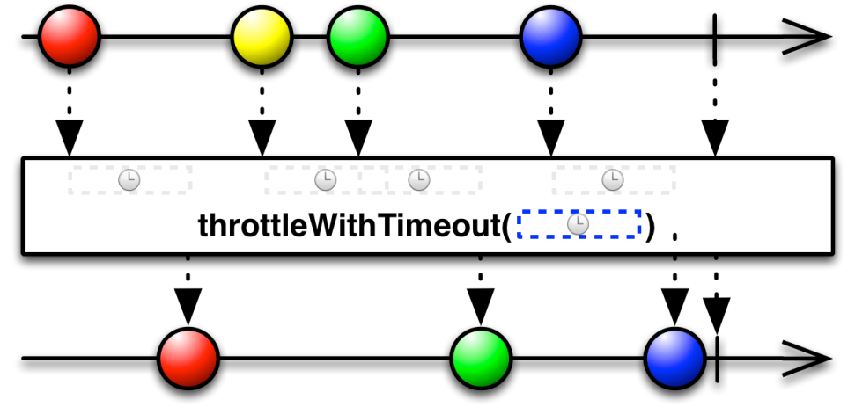
Lossy operators

Slide 8
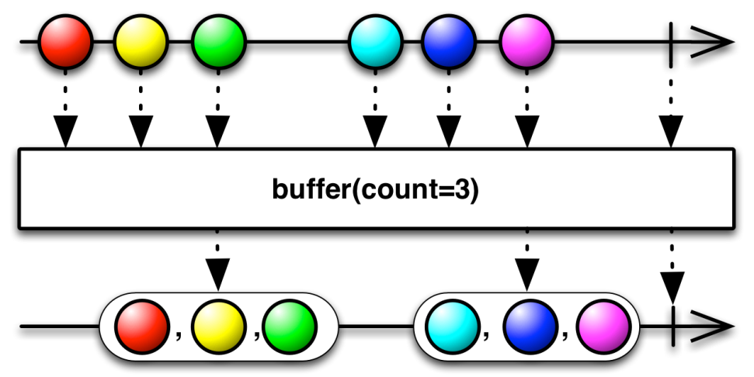
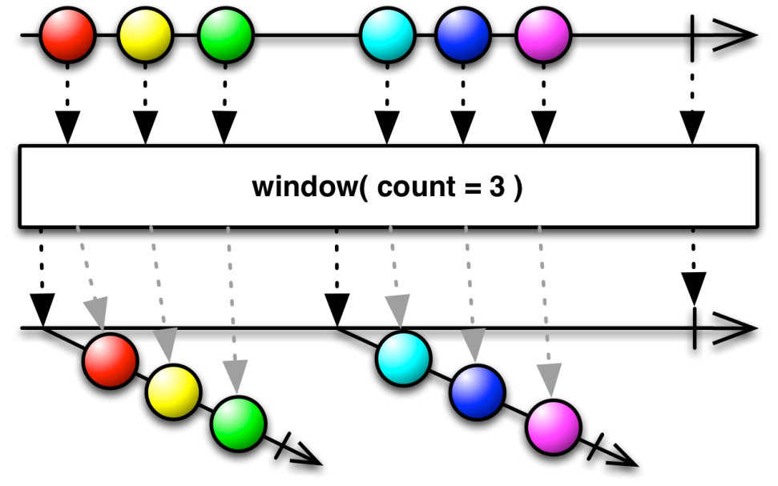
Loss-less operators

Slide 9
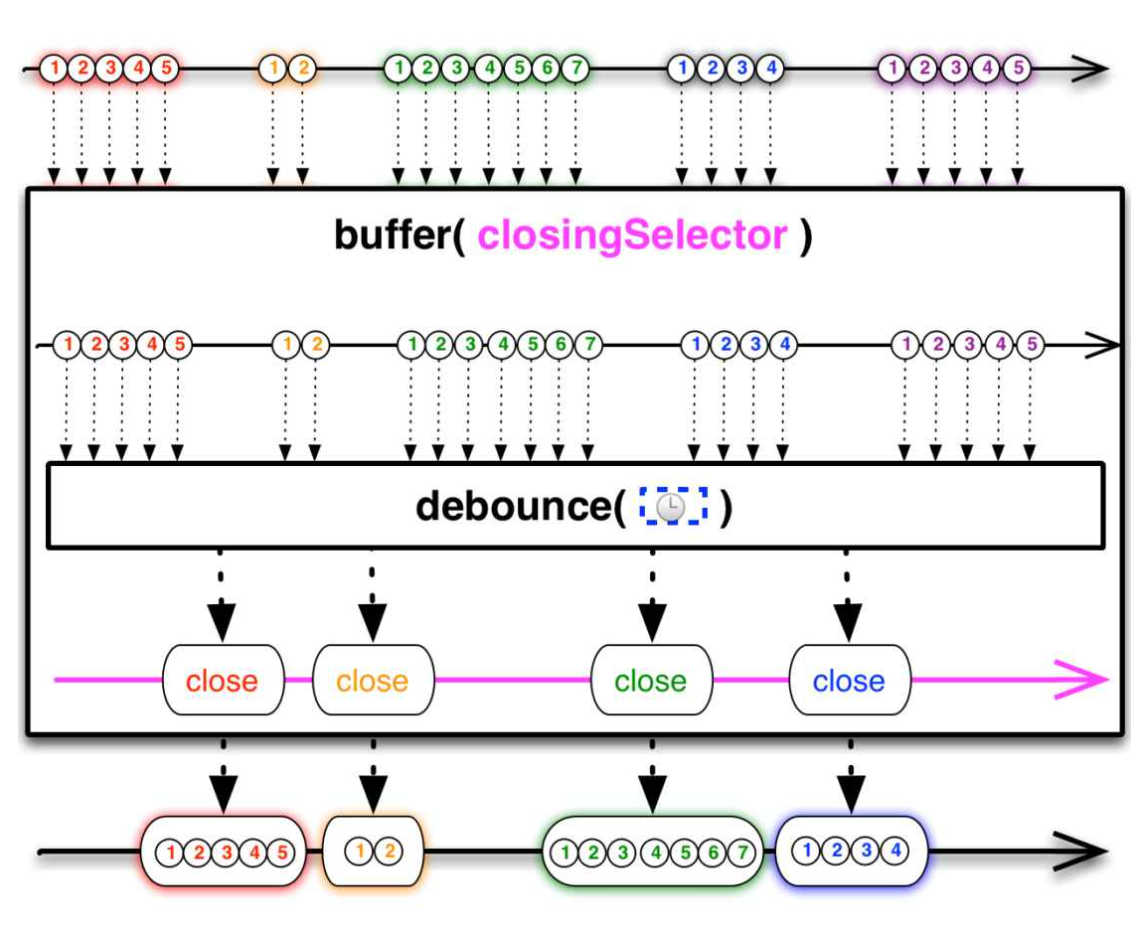
Combined lossy & lossless operators

Slide 10
The source matters!
Cold source
Hot source
Can be interacted with
Multiple subscribers: stream duplicates
Examples:
Database query result
Network response
In-memory list of data
Can’t be interacted with
Multiple subscribers: stream continues (broadcast)
Examples:
Mouse events
Stock tickers
Clocks

Slide 11
The four effects of programming
 | Single item | Multiple items
Synchronous (interactive) | getItem: T | getItems: Iterable[T]
Asynchronous (reactive) | getItemsAsync: Future[T] | getItemsAsync: Observable[T]

Slide 12
The five effects of programming
 | Single item | Multiple items
Synchronous (interactive) | getItem: T | getItems: Iterable[T]
Asynchronously interactive | getItemsAsync: Future[T] | getItems: Publisher[T]
Asynchronous (reactive) |  | getItemsAsync: Observable[T]

Slide 13
Backpressure

Slide 14
Interactive vs. Reactive
Interactive program
“interacts at its own speed with users or with other programs”
consumer in charge
Reactive program
“maintains a continuous interaction with its environment, but at a speed which is determined by the environment, not by the program itself ”
producer in charge

Slide 15
Introduction slide feedback control

Slide 16
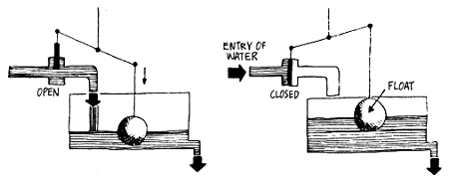

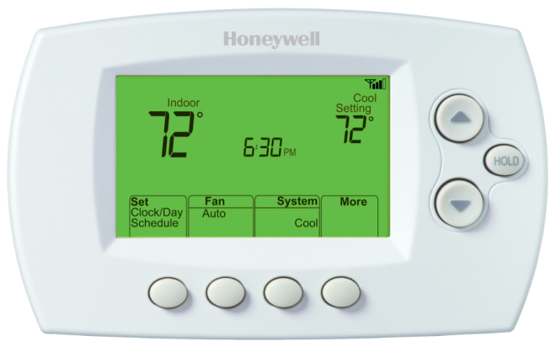

Slide 17


Slide 18
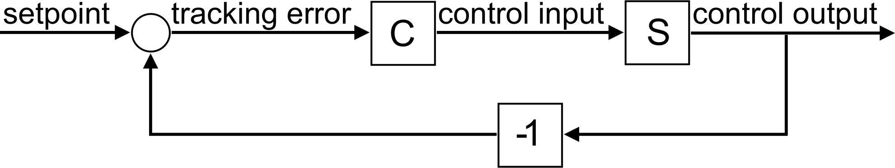
Feedback system

Slide 19
feedback4s

