Slide 1
Solving the Overproduction Problem in Reactive Programming using Feedback Control
Master Thesis Defense
Richard van Heest

Slide 2
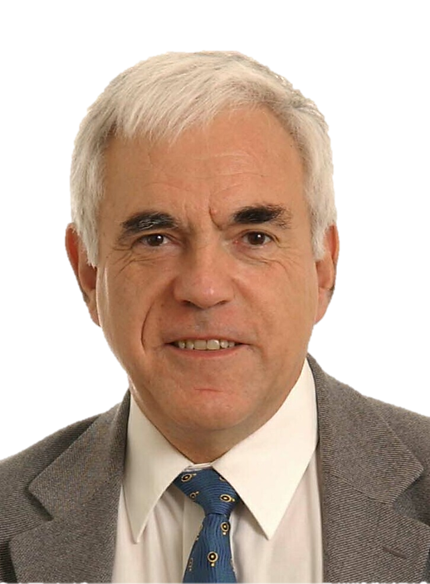

Interactive vs. Reactive
Interactive program
“interacts at its own speed with users or with other programs”
consumer in charge
Reactive program
“maintains a continuous interaction with its environment, but at a speed which is determined by the environment, not by the program itself ”
producer in charge
Gerard Berry

Slide 3
Interactive vs. Reactive
Interactive program
val it = Iterable(0, 1, 2, 3)
val iterator = it.iterator while (iterator.hasNext) println(iterator.next())
for (i <- it)
println(i)
it.foreach(println)
Reactive program
val obs = Observable(0, 1, 2, 3)
obs.subscribe(println(_))

Slide 4
Interactive vs. Reactive
Interactive program
val it = Iterable(0, 1, 2, 3)
val iterator = it.iterator while (iterator.hasNext) println(iterator.next())
for (i <- it)
println(i)
it.foreach(println)
it.map(i => i + 1)
.filter(i => i % 2 == 0)
.foreach(println)
Reactive program
val obs = Observable(0, 1, 2, 3)
obs.subscribe(println(_))
obs.map(i => i + 1)
.filter(i => i % 2 == 0)
.subscribe(println(_))

Slide 5
Fast producer, slow consumer
producer
time = 7
time = 8
time = 0
time = 1
time = 2
time = 3
time = 4
time = 5
time = 6
consumer

Slide 6
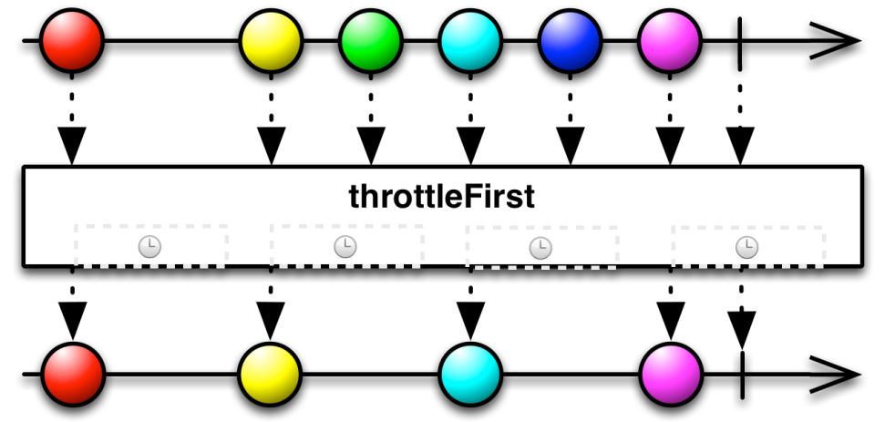
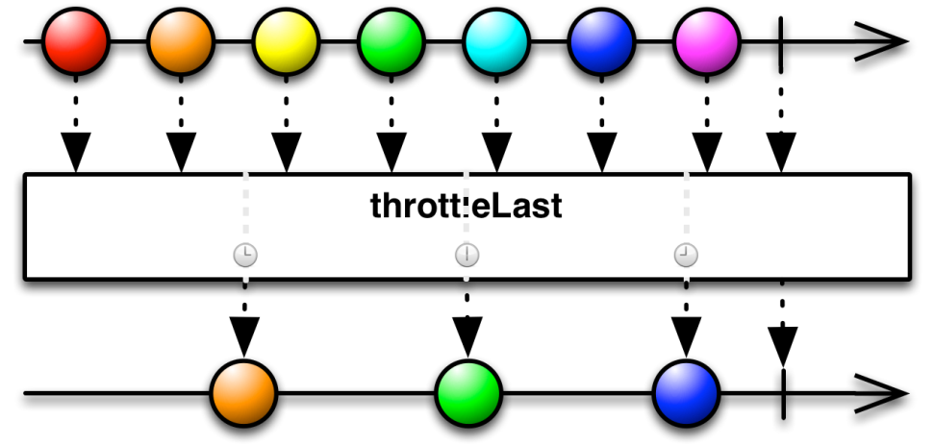
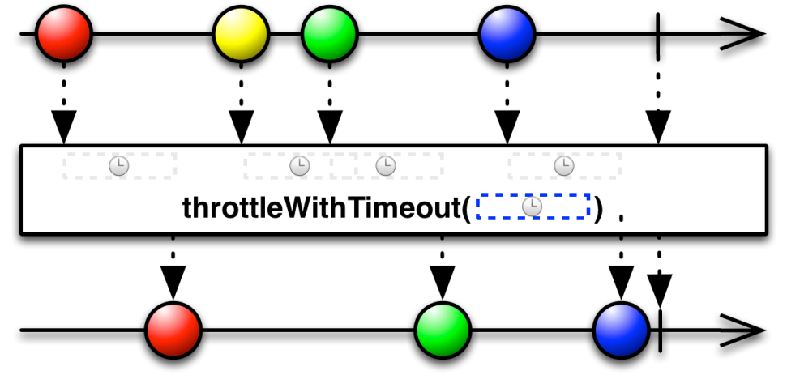
Lossy operators

Slide 7
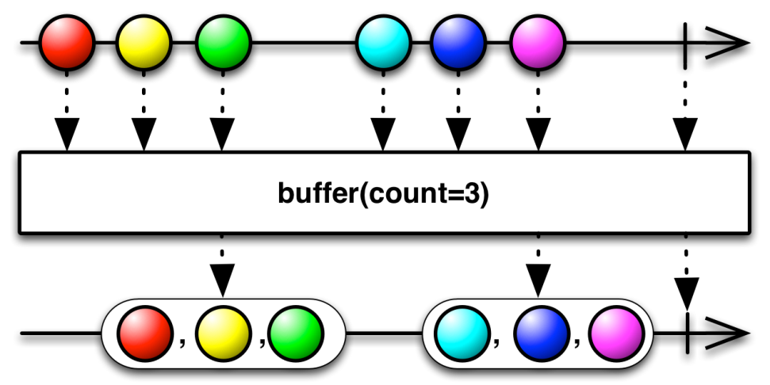
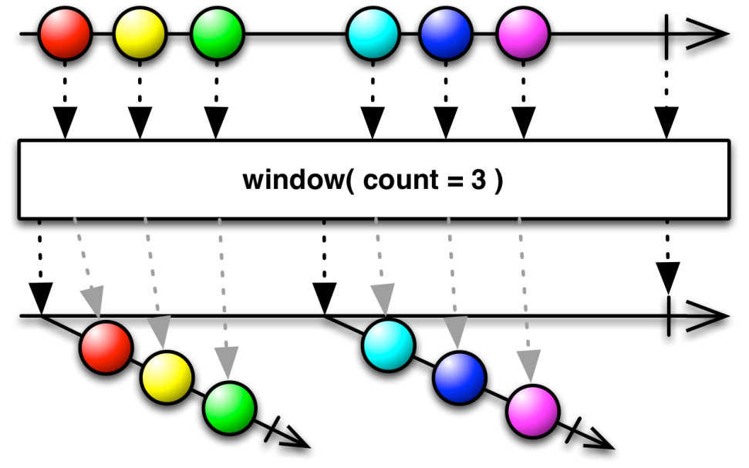
Loss-less operators

Slide 8
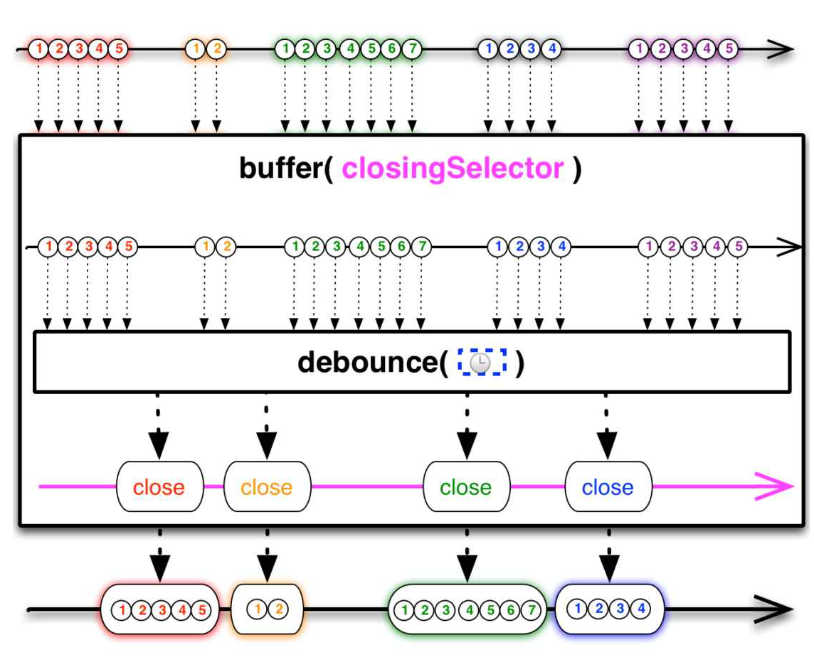
Combined lossy & lossless operators

Slide 9
The source matters!
Cold source
Hot source
Can be interacted with
Multiple subscribers: stream duplicates
Examples:
Database query result
Network response
In-memory list of data
Can’t be interacted with
Multiple subscribers: stream continues (broadcast)
Examples:
Mouse events
Stock tickers
Clocks

Slide 10
The source matters!
Cold async source
Cold sync source
Can be interacted with
Dependent on a notion of time
Examples:
Database query result
Network response
Can be interacted with
Not dependent on a notion of time
Examples:
In-memory list of data
Observable(0, 1, 2, 3)

Slide 11
Backpressure/Reactive Streams
producer
data
operator 1
data
operator 2
data
operator n
data
consumer
request(5)
request(5)
request(5)
request(5)
producer 1
producer 2
producer1.merge(producer2)
.subscribe(println(_))
merge
request(5)
consumer

Slide 12
Interactive vs. Reactive
Interactive program
“interacts at its own speed with users or with other programs”
consumer in charge
Reactive program
“maintains a continuous interaction with its environment, but at a speed which is determined by the environment, not by the program itself ”
producer in charge
Gerard Berry

Slide 13
Let’s backtrack
Cold source
Hot source
Can be interacted with
Maybe dependent on time
Backpressure
Not reactive
Affects operators
Our solution
Move overproduction control to source
Keep the operators reactive
Automatically calculate how much data to produce
Can’t be interacted with
Dependent on time
Lossy and lossless operators

Slide 14
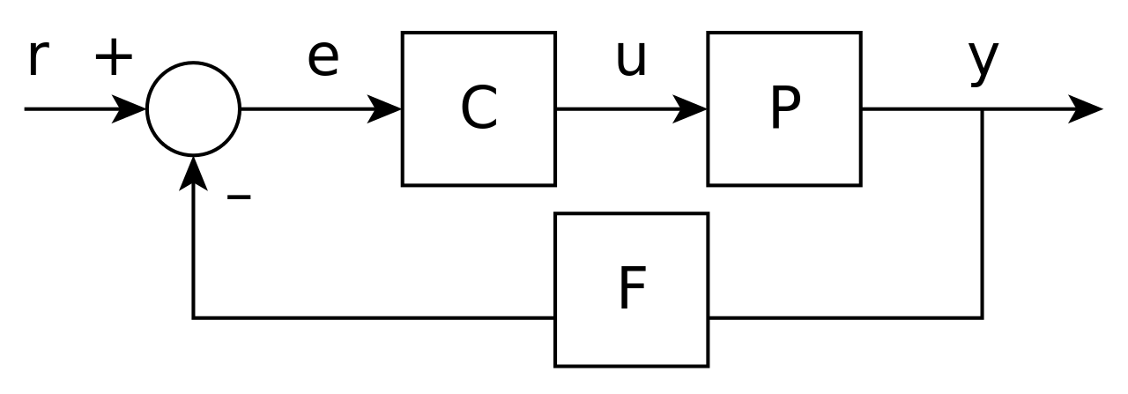
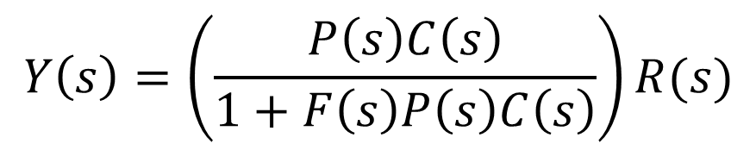
Feedback Control
Laplace transformation
$$Y\left(s\right)=\left(\frac{P\left(s\right)C\left(s\right)}{1+F\left(s\right)P\left(s\right)C\left(s\right)}\right)R(s)$$

Slide 15
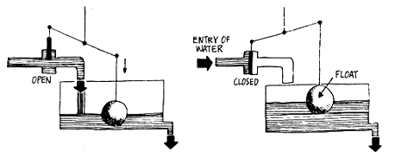
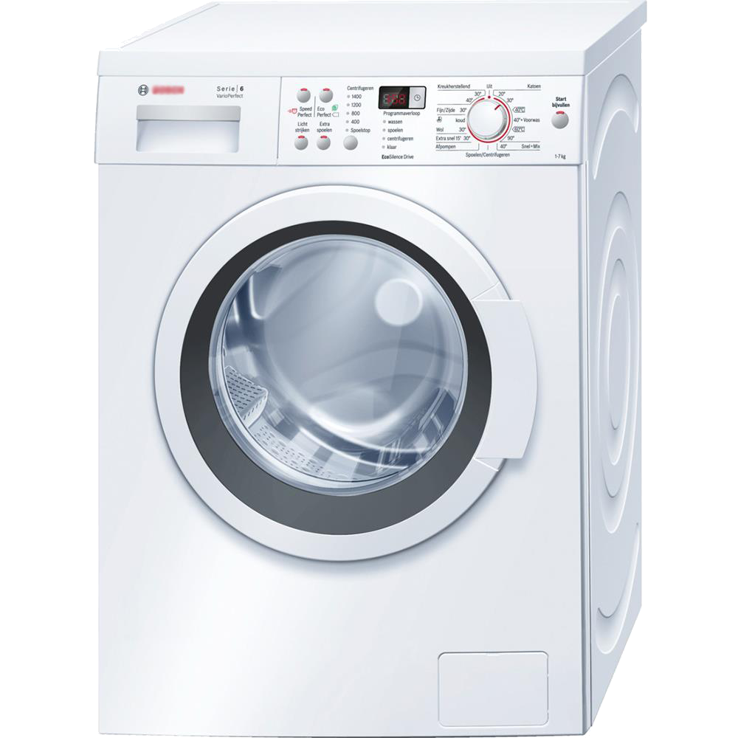
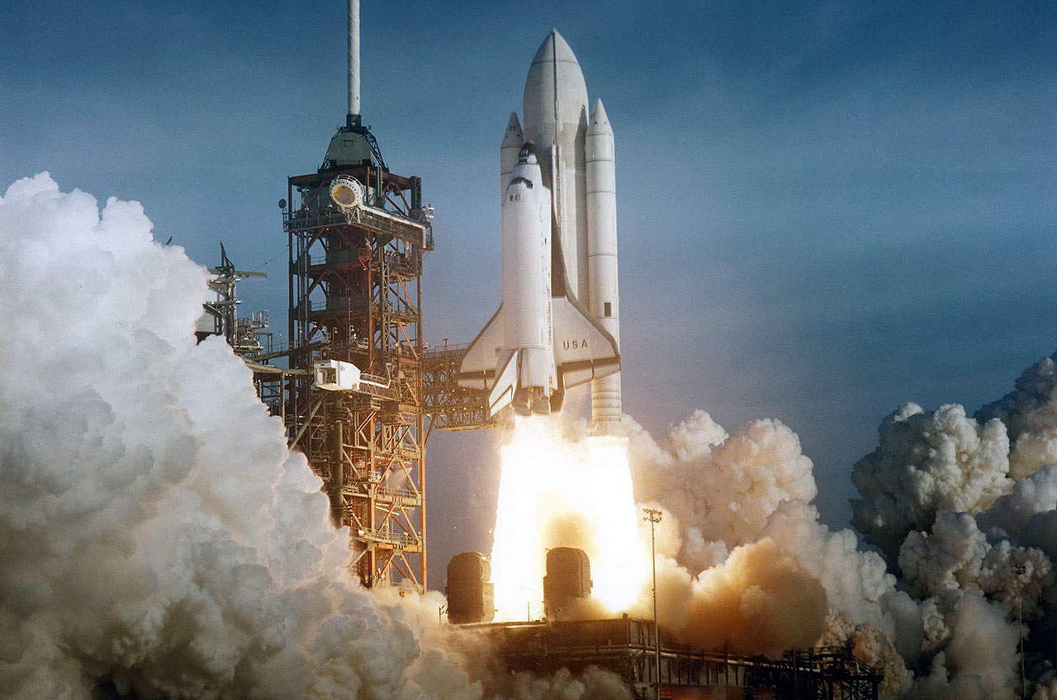
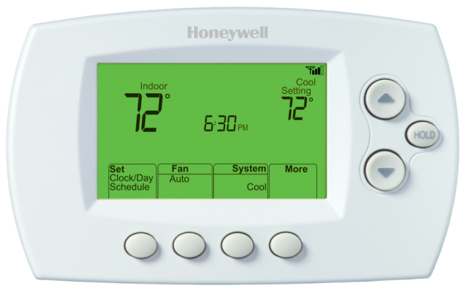

Slide 16


Slide 17
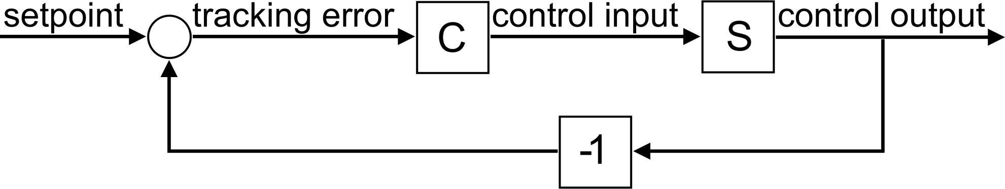
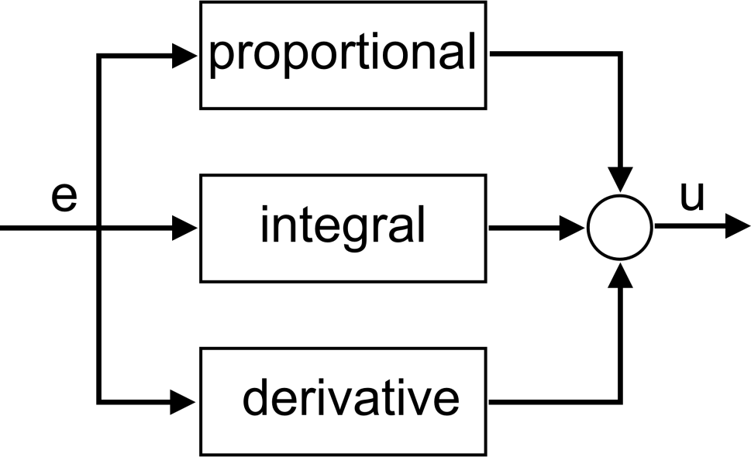
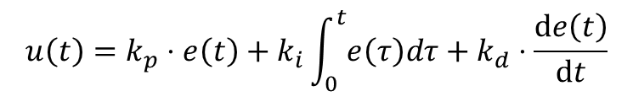
Feedback system
PID controller
$$u\left(t\right)=k_{p}⋅e\left(t\right)+k_{i}\int_{0}^{t}{e\left(τ\right)dτ}+k_{d}⋅\frac{\text{d}e\left(t\right)}{\text{d}t}$$

Slide 18
feedback4s
Components are transformations over Observables:
class Component[I, O](transform: Observable[I] => Observable[O]) {
def run(is: Observable[I]): Observable[O] = transform(is)
def >>>[X](other: Component[O, X]): Component[I, X] =
Component(other.run _ compose this.run)
def map[X](f: O => X): Component[I, X] = this >>> create(f)
// many more operators
}
object Component {
def create[I, O](f: I => O): Component[I, O] =
new Component(_ map f)
}

Slide 19
feedback4s
<dependency> <groupId>com.github.rvanheest</groupId> <artifactId>feedback4s</artifactId> <version>1.0</version> </dependency>
https://github.com/rvanheest/feedback4s
http://doi.org/10.5281/zenodo.169095

Slide 20
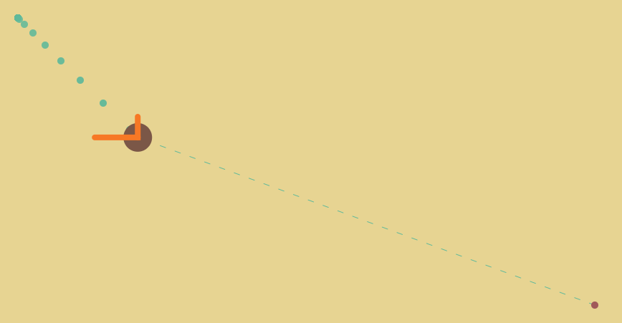
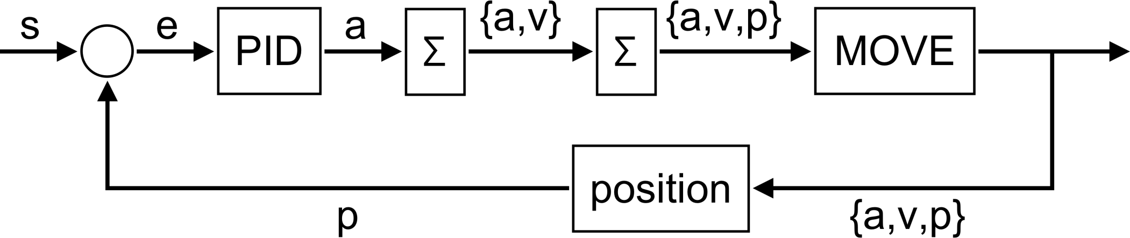
Demo

Slide 21
Feedback applied to overproduction
Overproduction: fast producer, slow consumer
Hot source: can’t be interacted with
Lossy & lossless operators
Cold source: can be interacted with
Backpressure

Slide 22
Backpressure/Reactive Streams
producer
data
operator 1
data
operator 2
data
operator n
data
consumer
request(5)
request(5)
request(5)
request(5)
producer 1
producer 2
producer1.merge(producer2)
.subscribe(println(_))
merge
request(5)
consumer

Slide 23
‘Backpressure’ in the source
cold producer
overproduction control
operator 1
operator n
consumer
Overproduction control where it is handled best:
In the source
Everything after that is considered to be hot!

Slide 24


Overproduction feedback system
cold source
operators & consumer
request(n)
data
1.0
error
controller
n
source control
data
buffer
$$τ$$
$$τ$$
Metrics
#elements in buffer
throughput

Slide 25
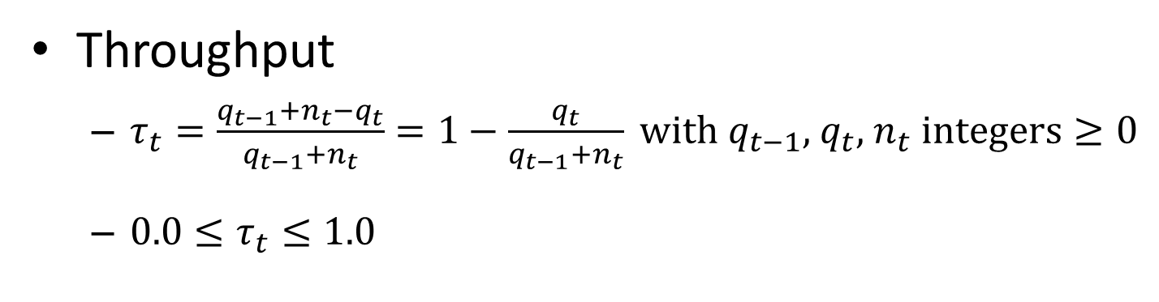
Overproduction feedback system
cold source
operators & consumer
request(n)
data
1.0
error
controller
n
source control
data
buffer
$$τ$$
$$τ$$
Throughput
$τ_{t}=\frac{q_{t−1}+n_{t}−q_{t}}{q_{t−1}+n_{t}}=1−\frac{q_{t}}{q_{t−1}+n_{t}} \text{with} q_{t−1}\text{, }q_{t}\text{, }n_{t} \text{integers}≥0$
$0.0≤τ_{t}≤1.0$

Slide 26
Overproduction in Rx
trait Requestable[T] { protected final val subject = PublishSubject[T]() final def results: Observable[T] = subject def request(n: Int): Unit }
object Requestable {
implicit class ReqObs[T](val requestable: Requestable[T]) {
def observe(timeout: Duration = 1 milli): Observable[T] = …
}
}

Slide 27
Overproduction in Rx
Requestable.from(0 until 133701)
.observe
.filter(_ % 2 == 0)
.map(2 *)
.drop(10)
.take(20)
.subscribe(i => println(s"> $i"))

Slide 28
Overproduction in Rx
> 40
> 44
> 48
> 52
> 56
> 60
> 64
> 68
> 72
…

Slide 29
Compared to backpressure
Wrap cold source in reactive programming model
Overproduction safety
Source + feedback system = hot
Operators can be implemented purely reactively

Slide 30
Main achievements
Analysis of sources and existing solutions for overproduction
feedback4s
Reactive solution to overproduction for cold sources

Slide 31
Solving the Overproduction Problem in Reactive Programming using Feedback Control
Master Thesis Defense
Richard van Heest

