Slide 1
Solving the Overproduction Problem in Reactive Programming using Feedback Control
Master Thesis Defense

Slide 2
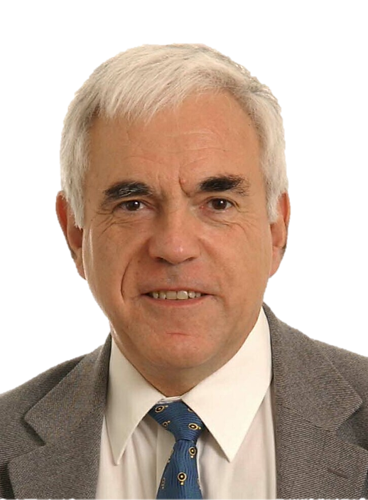

Interactive vs. Reactive
Interactive program
“interacts at its own speed with users or with other programs”
consumer in charge
Reactive program
“maintains a continuous interaction with its environment, but at a speed which is determined by the environment, not by the program itself ”
producer in charge
Gerard Berry

Slide 3
Interactive vs. Reactive
Interactive program
val it = Iterable(0, 1, 2, 3)
val iterator = it.iterator while (iterator.hasNext) println(iterator.next())
for (i <- it)
println(i)
it.foreach(println)
Reactive program
val obs = Observable(0, 1, 2, 3)
obs.subscribe(println(_))

Slide 4
Interactive vs. Reactive
Interactive program
val it = Iterable(0, 1, 2, 3)
val iterator = it.iterator while (iterator.hasNext) println(iterator.next())
for (i <- it)
println(i)
it.foreach(println)
it.map(i => i + 1)
.filter(i => i % 2 == 0)
.foreach(println)
Reactive program
val obs = Observable(0, 1, 2, 3)
obs.subscribe(println(_))
obs.map(i => i + 1)
.filter(i => i % 2 == 0)
.subscribe(println(_))

Slide 5
The four effects of programming
 | Single item | Multiple items
Synchronous (interactive) | getItem: T | getItems: Iterable[T]
Asynchronous (reactive) | getItemsAsync: Future[T] | getItemsAsync: Observable[T]

Slide 6
Fast producer, slow consumer
producer
time = 7
time = 8
time = 0
time = 1
time = 2
time = 3
time = 4
time = 5
time = 6
consumer

Slide 7
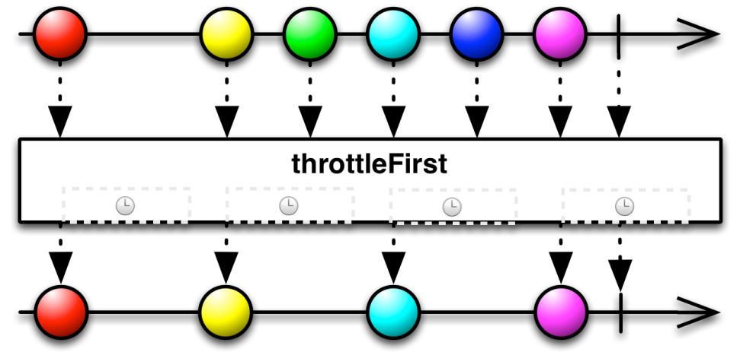
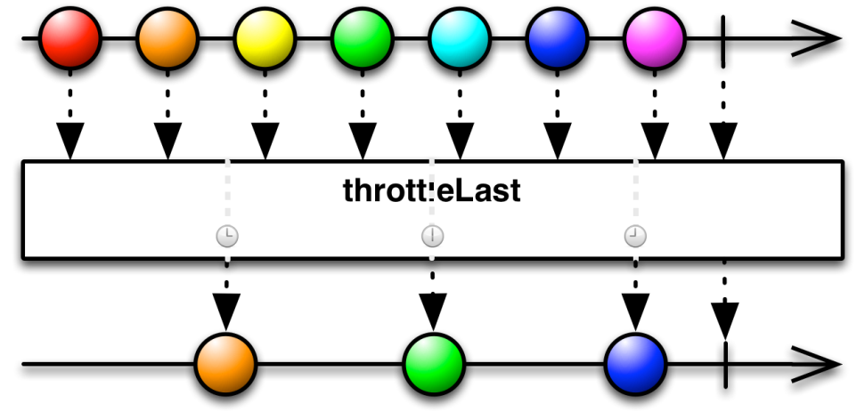
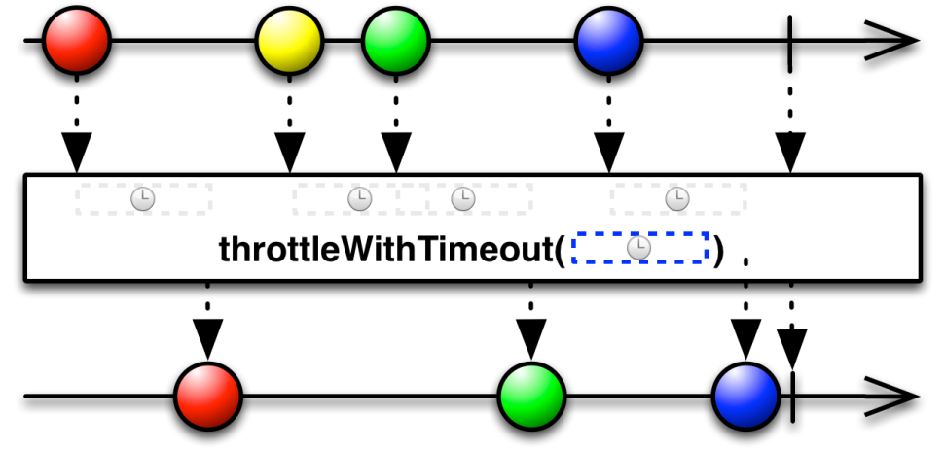
Lossy operators

Slide 8
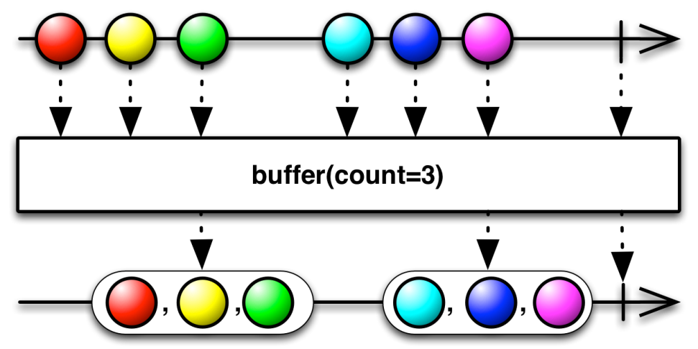
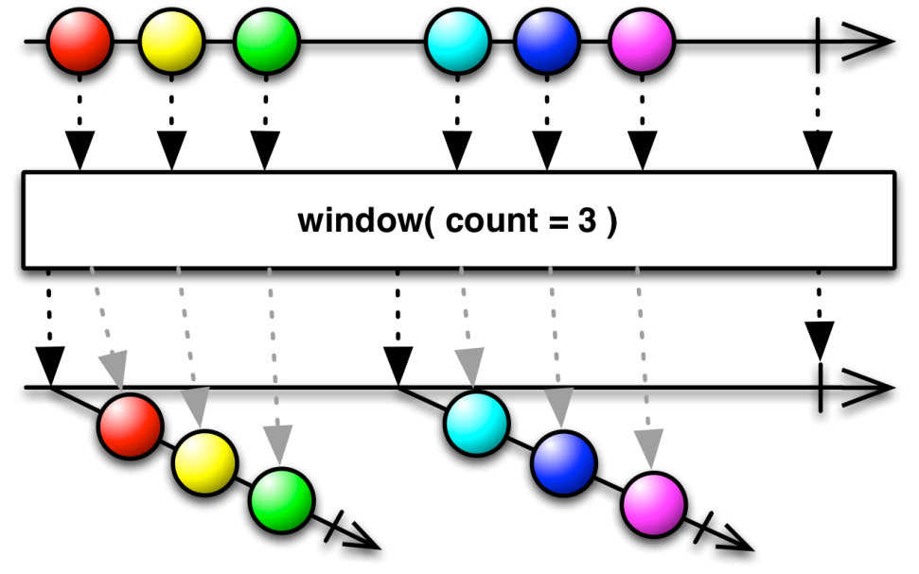
Loss-less operators

Slide 9
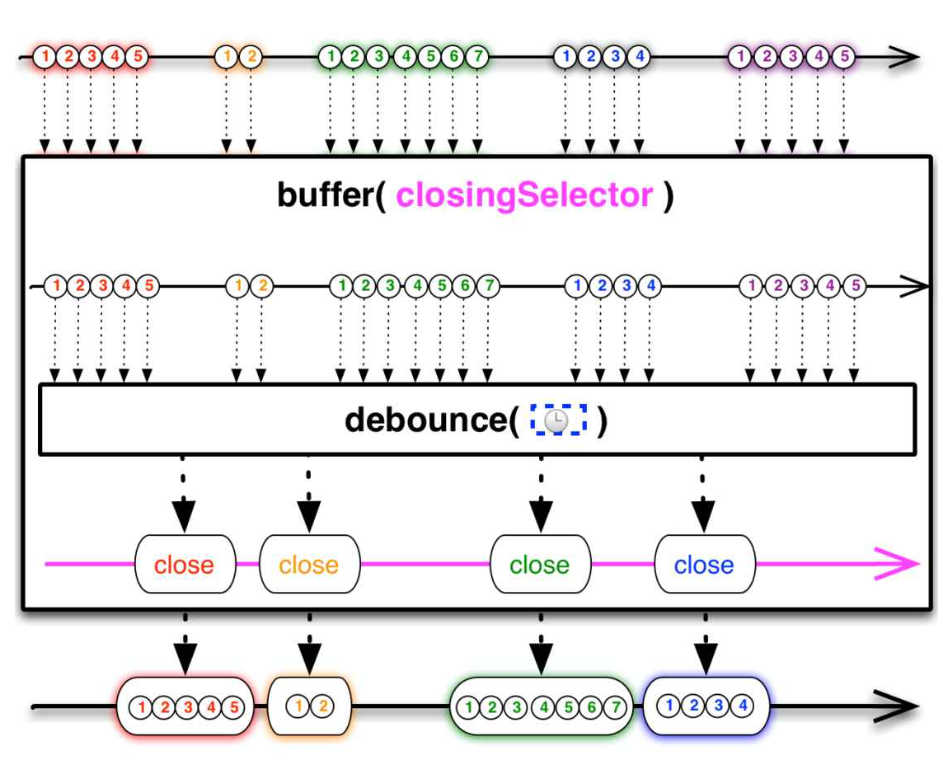
Combined lossy & lossless operators

Slide 10
The source matters!
Cold source
Hot source
Can be interacted with
Multiple subscribers: stream duplicates
Examples:
Database query result
Network response
In-memory list of data
Can’t be interacted with
Multiple subscribers: stream continues (broadcast)
Examples:
Mouse events
Stock tickers
Clocks

Slide 11
The source matters!
Cold async source
Cold sync source
Can be interacted with
Dependent on a notion of time
Examples:
Database query result
Network response
Can be interacted with
Not dependent on a notion of time
Examples:
In-memory list of data
Observable(0, 1, 2, 3)

Slide 12
Backpressure/Reactive Streams
producer
data
operator 1
data
operator 2
data
operator n
data
consumer
request(5)
request(5)
request(5)
request(5)
producer 1
producer 2
producer1.merge(producer2)
.subscribe(println(_))
merge
request(5)
consumer

Slide 13
Interactive vs. Reactive
Interactive program
“interacts at its own speed with users or with other programs”
consumer in charge
Reactive program
“maintains a continuous interaction with its environment, but at a speed which is determined by the environment, not by the program itself ”
producer in charge
Gerard Berry

Slide 14
Let’s backtrack
Cold source
Hot source
Can be interacted with
Maybe dependent on time
Backpressure
Not reactive
Affects operators
Our solution
Move overproduction control to source
Keep the operators reactive
Automatically calculate how much data to produce
Can’t be interacted with
Dependent on time
Lossy and lossless operators

Slide 15
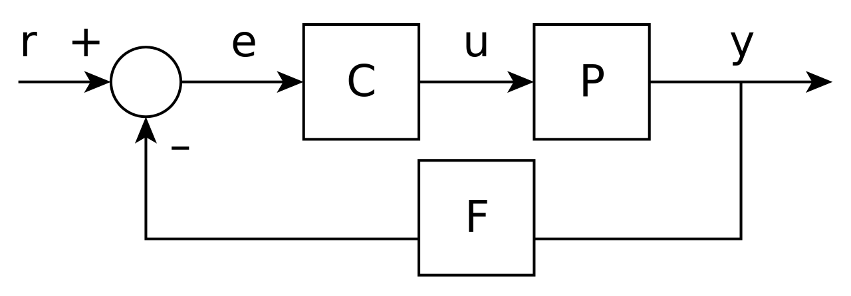
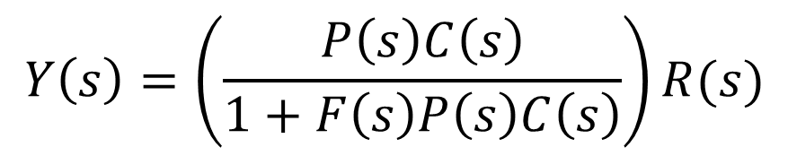
Feedback Control
Laplace transformation
$$Y\left(s\right)=\left(\frac{P\left(s\right)C\left(s\right)}{1+F\left(s\right)P\left(s\right)C\left(s\right)}\right)R(s)$$

Slide 16
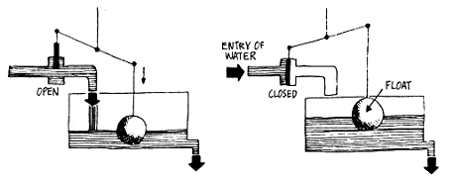
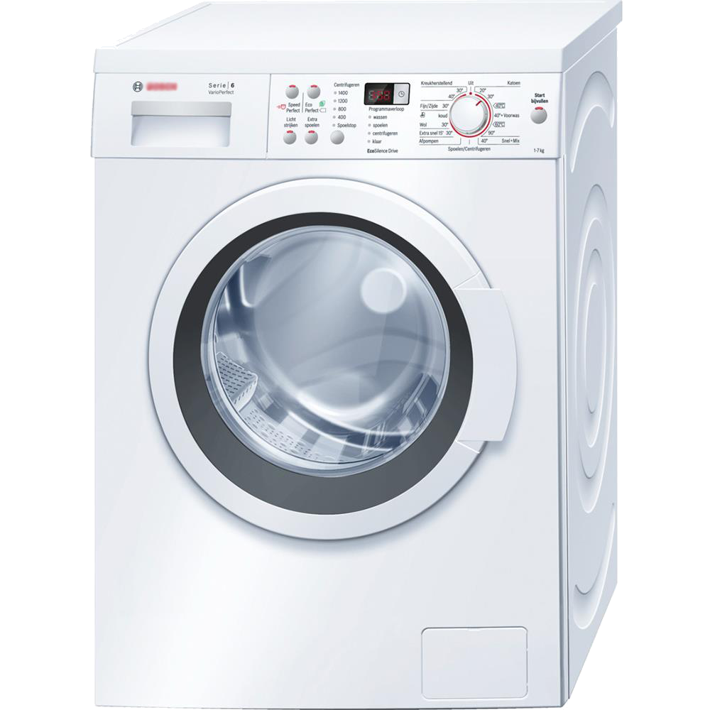
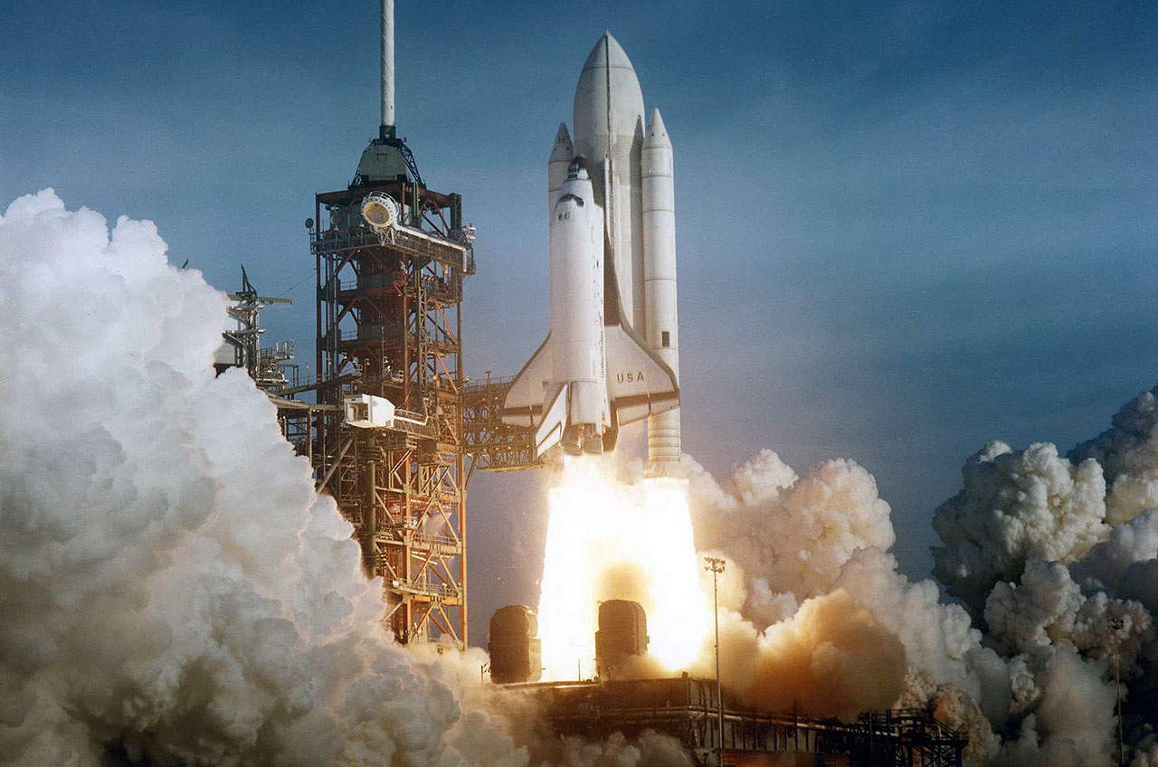
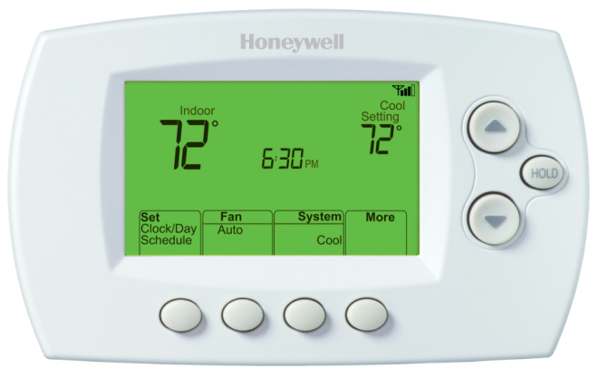

Slide 17


Slide 18
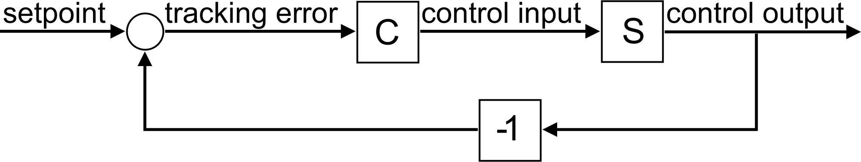
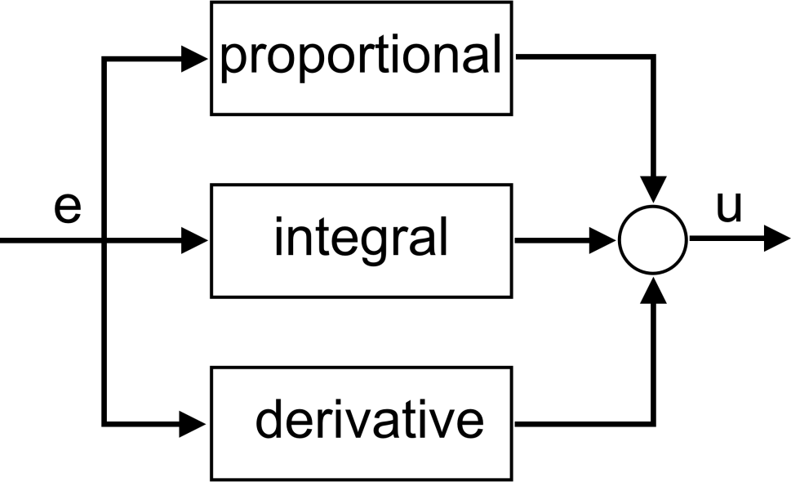
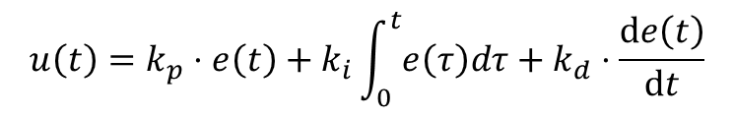
Feedback system
PID controller
$$u\left(t\right)=k_{p}⋅e\left(t\right)+k_{i}\int_{0}^{t}{e\left(τ\right)dτ}+k_{d}⋅\frac{\text{d}e\left(t\right)}{\text{d}t}$$

Slide 19
feedback4s
Components are transformations over Observables:
class Component[I, O](transform: Observable[I] => Observable[O]) {
def run(is: Observable[I]): Observable[O] = transform(is)
def >>>[X](other: Component[O, X]): Component[I, X] =
Component(other.run _ compose this.run)
def map[X](f: O => X): Component[I, X] = this >>> create(f)
// many more operators
}
object Component {
def create[I, O](f: I => O): Component[I, O] =
new Component(_ map f)
}

Slide 20
feedback4s
<dependency> <groupId>com.github.rvanheest</groupId> <artifactId>feedback4s</artifactId> <version>1.0</version> </dependency>
https://github.com/rvanheest/feedback4s
http://doi.org/10.5281/zenodo.169095

Slide 21
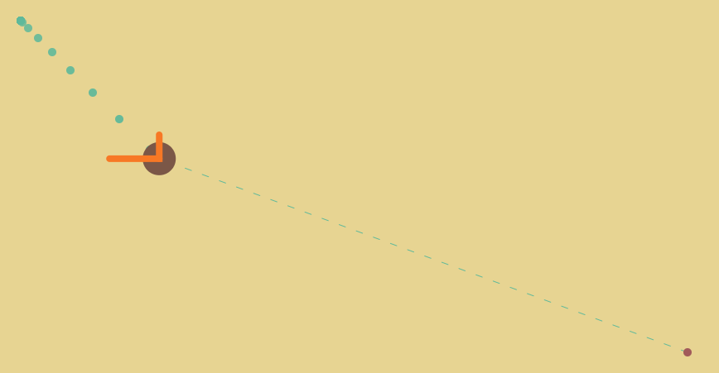
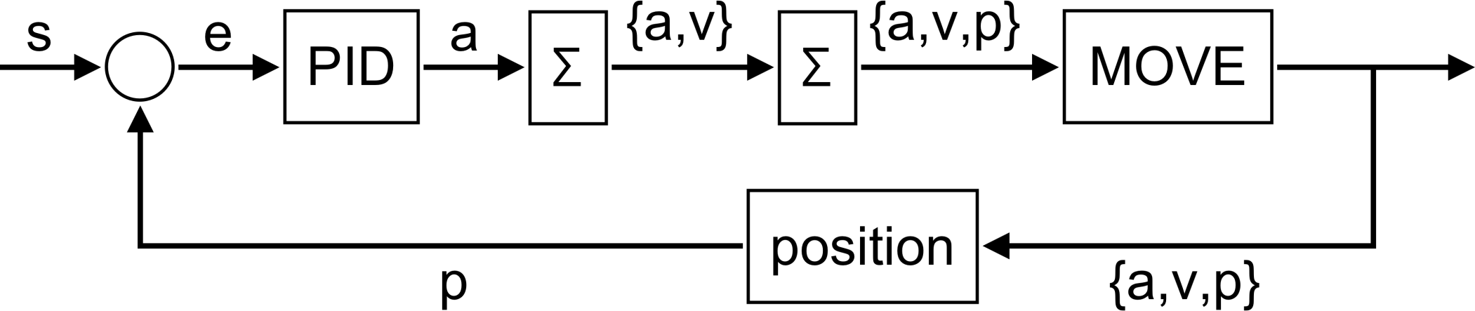
Demo

