Slide 1

Event Application
By : Awan Abdullah – Ali Ihsan
Superviosor: Mr.Osama

Slide 2
Outline
1- Introduction
2- System
2- Progress
3- Questions

Slide 3
Introduction
Objective
develop one application responsible for all activities required to handle events (CRUD), and to handle users joining (enter, leave, timing, certification) without make the attendance register everything by themselves
Problem Statement
1- The need of using one application in order to manage all activities related with events and conferences including create an event, attendees joining, join and leave times and grant an attendance certification.
2-It is difficult to know how much time attenders spent in the event in order to grant a certification.
3-The need of one application works in all platforms (Android, IOS, Web and Desktop)
How It Works ? ->

Slide 4
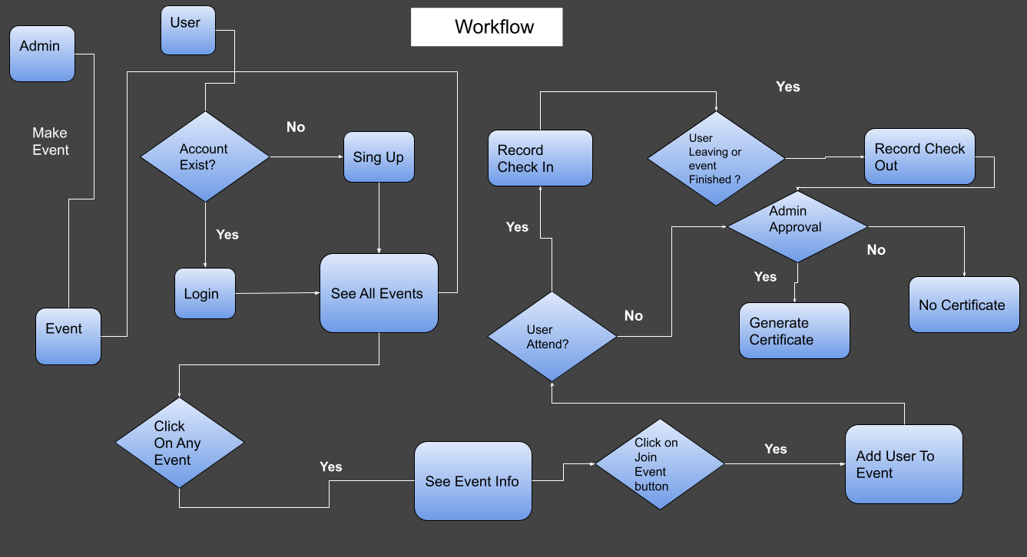
Introduction

Slide 5
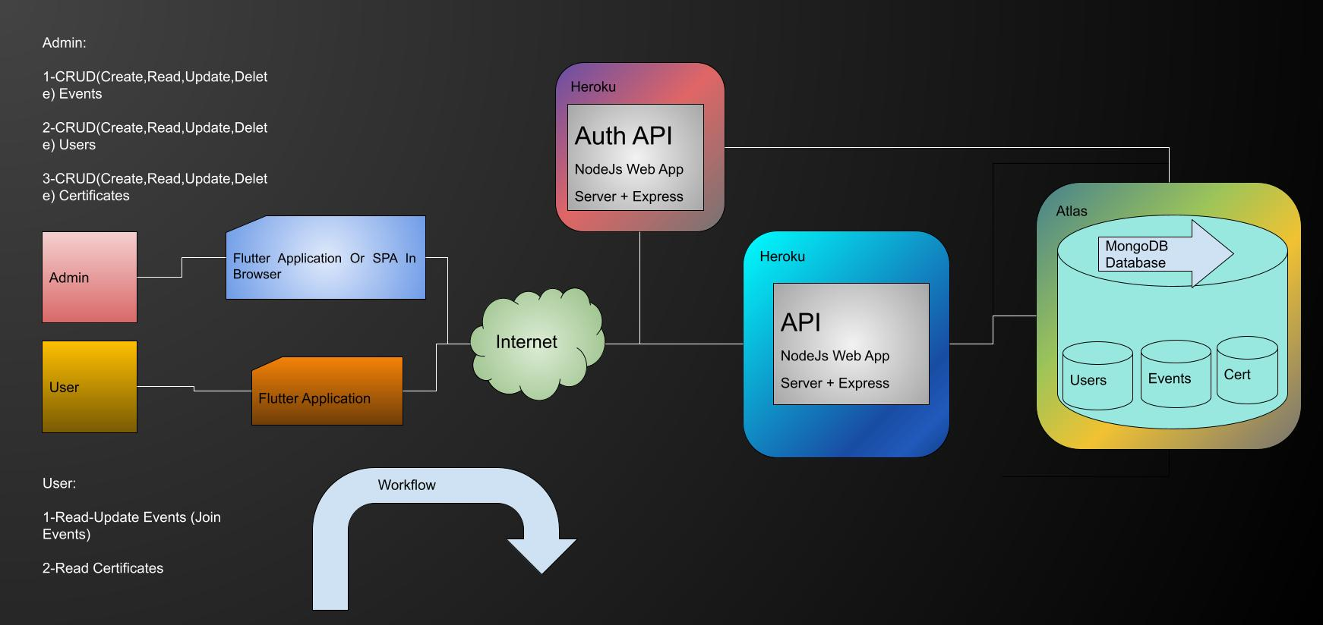
System

Slide 6
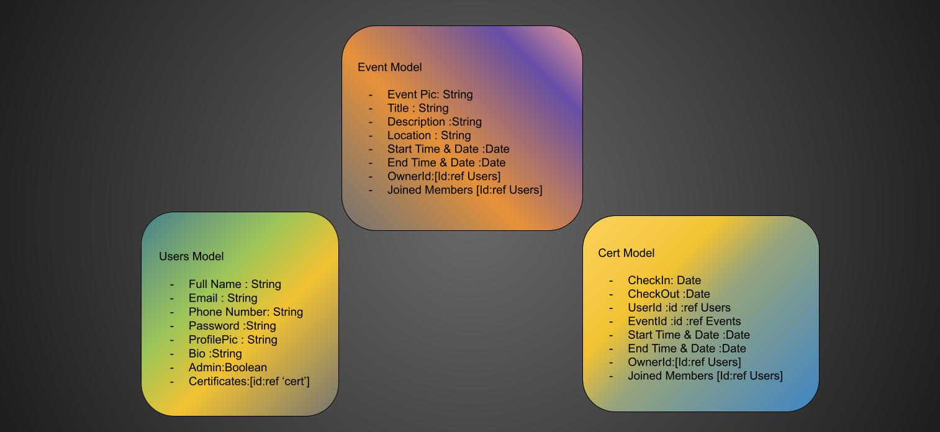
System

Slide 7
Progress
Pratical % 40
Theory : %25
Planing ✅
Table Of Contents ✅
Abstruct ✅
Keywords ✅
1- Introduction ✅
2- Background
3- Methods
4- Results
Backend %55
Todo:
- Certificate Collection
- Images
- Controllers
- Vaildation & Sanitazation
- Middleweres
- QR Code Genrator
Frontend %0

Slide 8
Progress
Code And Demonstration of practical

Slide 9
Questions
Any Questions ?

