Slide 2
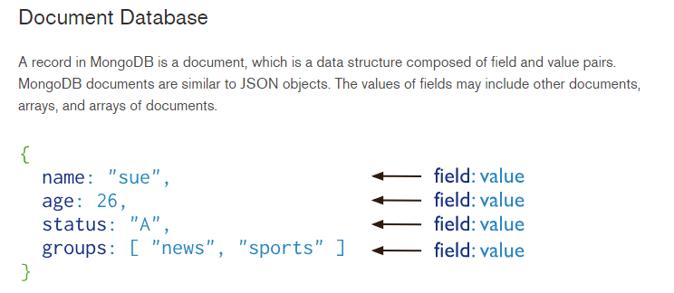
Basics
https://docs.mongodb.com/manual/introduction/#document-database
Terminology
Table = Collection
Row = Document
Column = Field
Comparison with SQL
Dynamic schema
Object oriented
Native Python datatypes
Notes:
Documents (i.e. objects) correspond to native dictionary data type in Python.
Stored in BSON files, Binary JSON (JavaScript Object Notation) format,
Embedded documents and arrays reduce need joins.

Slide 3

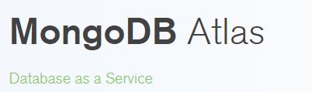
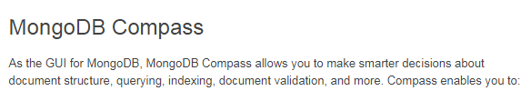
Install and setup
https://www.mongodb.com/download-center#enterprise
https://www.mongodb.com/cloud/atlas
https://www.mongodb.com/download-center?jmp=nav#compass

Slide 4
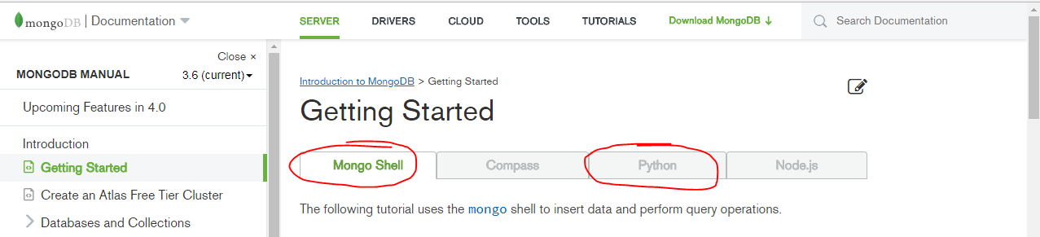

Get started
https://docs.mongodb.com/manual/tutorial/getting-started/
Mongo Shell
https://docs.mongodb.com/manual/mongo/
The mongo shell will attempt to connect to the MongoDB instance running on the localhost interface on port 27017.
Notes:
show dbs
use mflix
db. <tab>
db.getCollectionNames()
db.movies_initial.findOne()

Slide 5

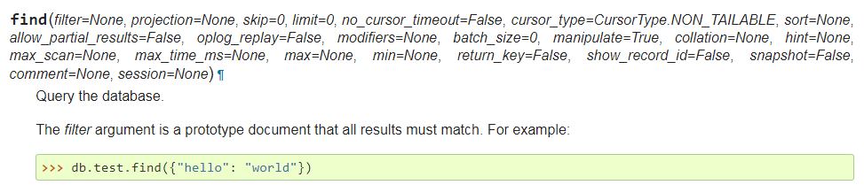
Python
https://api.mongodb.com/python/current/index.htm
Tutorial and examples
https://api.mongodb.com/python/current/api/pymongo/collection.html
Notes:
Filter
Projection

Slide 6
Query language and Aggregation Framework
Query language:
https://docs.mongodb.com/manual/tutorial/query-documents/
Aggregation framework
https://docs.mongodb.com/manual/aggregation/

