Slide 1
Microcontroller
Atmel ATMega328P

Slide 2
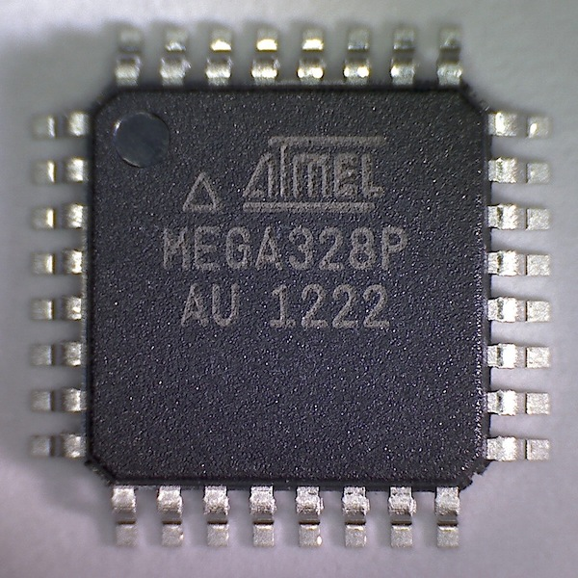
Features
8 Channel 10-bit ADC
USART
Low power (3.3V)
16MHz system clock
Simple instruction set (RISC)
131 Instructions
Interrupts & Timers
$9.78 USD ~ $13.50NZD (excl. Shipping)

Slide 3
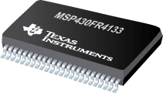
Alternative
Texas Instruments MSP430FR4133
Features:
Ultra-Low-Power
UART
16MHz System Clock
10 Channel 10-bit ADC
16KB FRAM (Ferroelectric RAM)
2KB SRAM
16-Bit RISC Architecture
$14USD ~ $20NZD (excl. Shipping, as at 21/08/16)
IDE:
Code Composer Studio or IAR Embedded Workbench
Development Language:
C

Slide 4
C Flowchart (LOGIC)
START
Set UCSRB to enable UART transmit
Set UCSRC to set asynchronous mode, data frame size, parity and stop bit
Set UBRR to the required baud rate with selected frequency
No
Check if UDR empty.
UDRE == 0;
Transmit Character
Yes
Prepare data (character) for transmission
Yes
Need to transmit another character?
No
END

Slide 5
C Flowchart (Code)
START
UCSR0B |= (1 << TXEN0);
UCSR0C |= (1 << UCSZ01) | (1 << UCSZ00);
UBRR0H = (unsigned char) (MYUBRR>>8);
UBRR0L = (unsigned char) MYUBRR;
True
While(!(1<<UDRE0) && (UCSR0A));
UDR0 = digits[x]
False
uint8_t digits[] = {0bXXXXXXXX, …};
True
while(x < sizeof(digits)/sizeof(digits[0]))
False
END

