Slide 1
Optimal cracking threshold resurfacing policies for pavement management
Allan Ogwang
PhD Qualifying Exam
Civil and Environmental Engineering
July 16, 2015

Slide 2
Contents
Objective
Research motivation
Asphalt pavement
Research outline
Cracking threshold and agency greenhouse gas emissions
Methodology
Case study – Washington State DOT
Next steps
Expected findings

Slide 3
Research Objective
Determine the optimal cracking threshold resurfacing policies to minimize greenhouse gas (GHG) emissions.
Cracking threshold is the maximum cracking level attained by a pavement segment before a resurfacing action is applied.
A pavement segment refers to 0.1 mile long section of a road

Slide 4
Research Motivation
In the next 10 years, GHG emissions by federal agencies to be reduced by 40% from 2008 levels [Obama, 2015]
In California, GHG emissions to be reduced to 1990 levels by 2020 [AB32]
The transportation sector:
Accounts for 28% of emissions in the US
Accounts for 39% of emissions in California
Notes:
In March 2015, President Obama signed an executive order requiring federal agencies to reduce their GHG emissions to 40% below 2008 levels over the next decade.
AB 32 requires California to reduce its GHG emissions to 1990 levels by 2020 – a reduction of approximately 15% below emissions expected under “business as usual” scenario.

Slide 5
Research Motivation
Minimize GHG emissions in the transportation sector
Sources of emissions in the transportation sector:
Vehicle emissions
Vehicle type
Road surface condition (roughness)
Agency Maintenance and Rehabilitation (M&R)
Type of M&R action
Frequency of M&R

Slide 6
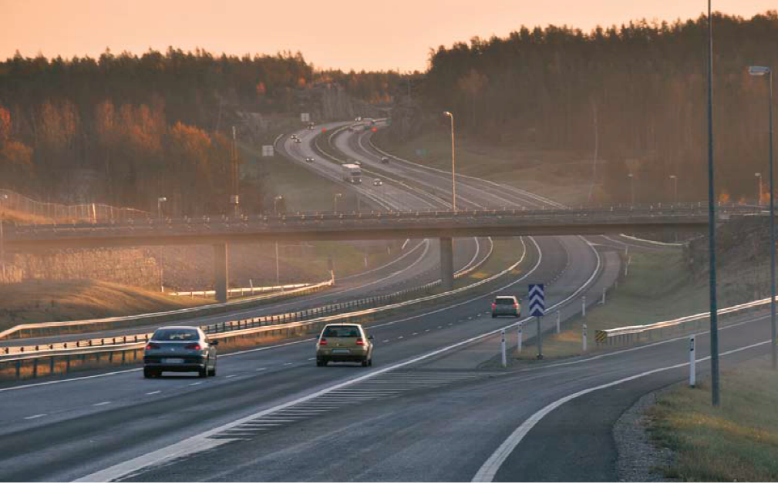
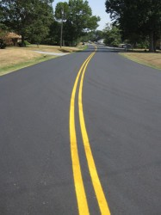
Asphalt Pavement
http://www.eapa.org/userfiles/2/Publications/NVF_en.pdf
Notes:
Asphalt pavement is one of America’s building blocks. The United States has more than 2.6 million miles of paved roads and highways, and 93 percent of those are surfaced with asphalt. Many of which are full-depth asphalt pavements; others are asphalt overlays used to restore the performance of deteriorating concrete pavements.

Slide 7
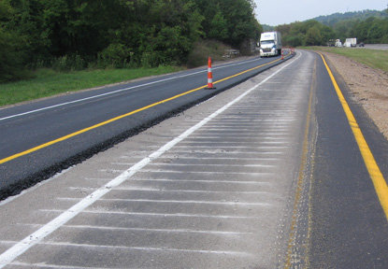
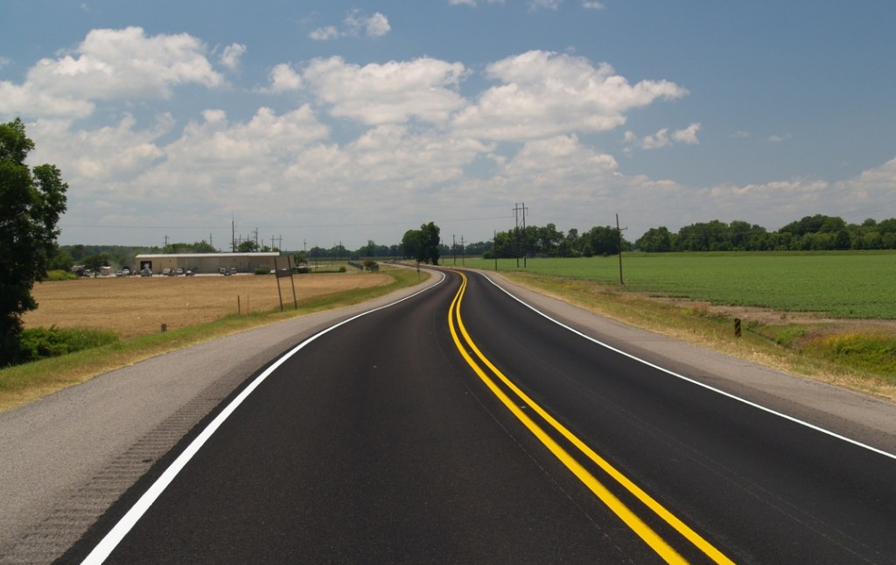
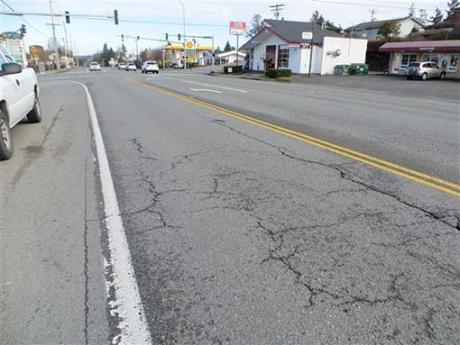
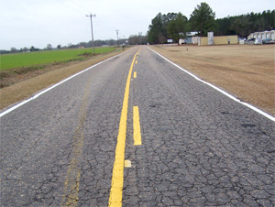
Road condition and M&R action
http://www.site-kconstructionzone.com/?p=3205, http://www.roadscience.net/services/distress-guide, http://asphaltmagazine.com/kentuckys-experience-with-rehabilitating-pcc-pavements-with-asphalt-overlays/ http://www.millergroupusa.com/full_depth_reclamation/index.html

Slide 8
Pavement Condition
Three common distresses
Cracking
Rutting
Roughness
Cracking used as indicator for pavement condition because
Easy to measure (observable)
Leads to other distresses
Notes:
We evaluate pavement condition basing on ..

Slide 9
Pavement Damage
Environmental effects
Temperature
Precipitation
Freezing and thawing process
Traffic loading
Unit of measure: Equivalent single axle loading (ESAL)
Presented as cumulative ESALs from time of resurfacing.

Slide 10
Asphalt pavement performance curve
Cracking threshold
Resurfacing Interval
Resurfacing
Crack Initiation
Crack progression

Slide 11
How resurfacing interval changes
Cracking threshold
Cracking threshold
Resurfacing
Resurfacing

Slide 12
Steps to accomplish research
Quantify the relationship between cracking threshold and agency GHG emissions
Quantify the relationship between cracking threshold and user emissions
Determine expected annual agency costs at various cracking threshold policies
Determine user costs at various cracking threshold policies
Quantify total emissions as a function of total costs

Slide 13
Cracking threshold and Agency GHG emissions

Slide 14
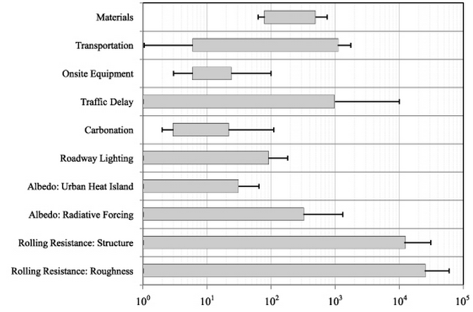
GHG Emissions Scope
Materials
Transportation
Onsite Equipment
Traffic Delay
Carbonation
Roadway Lighting
Albedo: Urban Heat Island
Albedo: Radiative Forcing
Rolling Resistance: Structure
Rolling Resistance: Roughness
Agency
10⁰
10¹
10²
10³
10⁴
10⁵
10⁰
Global Warming Potential Mg CO2eq/lane-km
(Santero and Horvath 2010)

Slide 15
Methodology used
Develop a unifying framework which combines the crack initiation and progression models
Crack evolution
Cracking level (%)
Initiation
Progression
ESALS
Perform Monte-Carlo simulation for pavement segment crack evolution for all segments in the dataset.
During the simulation:
Set the cracking threshold
Set planning period
Vary the explanatory variables in the model

Slide 16
Models used
Crack initiation model
Stochastic duration model (Nakat and Madanat, 2008)
Crack Progression model
Linear regression model (Madanat et. al, 2010)
Explanatory variables include:
Structural properties
Environmental variables
Traffic loading

Slide 17
One time step for one pavement segment
Segment x, time t
Cracked?
C _{x, t} = 0
0 ≤ C _{x, t} ≤ Φ
C _{x, t} > Φ
CI
CP
Overlay
Update (C _{x,( t +1)} , GHGe, #Overlays)

Slide 18
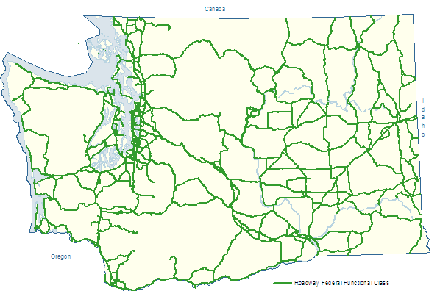
Case Study

Slide 19
Washington State Route System
Pavement network:
Over 20,000 lane miles
Asphalt pavements (55% of network)
In the research dataset:
1,000 segments (@ 0.1 mile long)
All are asphalt pavements segments
Planning horizon: 10 years
Trigger distress: Cracking

Slide 20
Application of methodology on pavement segments in dataset
C1
Cracking Level
C2
S1
S2
S3
S1
S4
T1
T2
T3
Cumulative Traffic Loading (ESALS)

Slide 21
Application of methodology on pavement segments in dataset
10 Years
25%
Cracking Level
6%
Cumulative Traffic Loading (ESALS)

Slide 22
Results
Agency GHG emissions for 10 year period with 95% confidence bounds

Slide 23
Results
5,800 tCO2e

Slide 24
Transportation GHG emissions reduction measures
Improve fuel
Lower carbon content of fuels
Use alternative fuels
Advance vehicle technology
Electric vehicles
Higher efficiency vehicles
Support system efficiency
Improve traffic flow to reduce total system travel time
Increase travel options
Carpools
Vanpooling
Public transit

Slide 25
WSDOT fleet GHG reduction strategies
Strategy | Estimated annual GHG reduction (tCO2e)
Increase vehicle fleet biodiesel use by 410,000 gallons in 2012 | 7,175 tCO2e by 2013
Reduce gas consumption by 5% to save 79,000 gallons annually | 692 tCO2e by 2015
Reduce diesel consumption by 5% to save 108,000 gallons annually | 2,395 tCO2e by 2020
Replace 360 small sedans and small SUVs with hybrid or electric vehicles | 1,714 tCO2e by 2020
Ref: WSDOT – Sustainable Transportation Strategies. http://www.wsdot.wa.gov/SustainableTransportation/strategies.htm Accessed on 6/12/2015.

Slide 26
Policy Implications: GHG reduction strategies
Reduction Strategy | Annual expected GHG reduction (tCO2e)
Increase cracking threshold from 10% to 14% | 64,000
Increase cracking threshold from 12% to 15% | 30,500
All other strategies | 30,000ª
ª Reduction by 2020
Ref: WSDOT – Sustainable Transportation Strategies. http://www.wsdot.wa.gov/SustainableTransportation/strategies.htm Accessed on 6/12/2015.

Slide 27
Summary
We have a model that quantifies the effect of changes in cracking threshold policy on GHG emissions
There are diminishing benefits (GHG emissions reduction) with marginal increase in cracking level.

Slide 28
Next Steps

Slide 29
Next Steps
Quantify the relationship between cracking threshold and user emissions
Determine expected annual agency costs at various cracking threshold policies
Determine user costs at various cracking threshold policies
Quantify total emissions as a function of total costs

Slide 30
Quantify the relationship between cracking threshold and user emissions
Determine vehicle emissions
AADT
Traffic composition
Average fuel consumption
LCA for a gallon of fuel used
Estimate change in user emissions as a function of cracking
Problem: No model relating cracking to fuel consumption
However, model relating roughness to fuel consumption exists.
Solution
Generate IRI values for the respective pavement segments
Use Zaabar and Chatti [2014] fuel consumption model to determine change in fuel consumption
Generate cracking level using same dataset and associate the increment accordingly

Slide 31
Determine expected annual agency costs at various cracking threshold policies
Agency costs are asphalt paving costs to WSDOT
Costs will be discounted to present value
Paving costs may vary for the respective segments depending on previous rehabilitation costs

Slide 32
Determine user costs at various cracking threshold policies
For user costs
No model relating cracking directly to user costs
However, model relating roughness to user costs exists.
To do:
Generate IRI values for roughness using Gayah and Madanat [2013]
Use Zaabar and Chatti model [2014] to determine vehicle operating costs at the various roughness values
Determine cracking level using the same dataset
Develop a relationship between user costs and cracking level for the pavement segments.

Slide 33
Expected Findings
Total Emissions
Total Costs

Slide 34
Expected findings

Slide 35
Thank you
Questions?

Slide 36
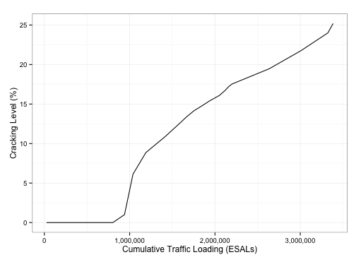
Crack Initiation and Progression
0.37/mESALs
0.53/mESALs
0.71/mESALs
1/mESALs

Slide 37
Pavement segment overlay frequency curve
1.00
0.75
Overlay Frequency (#Overlay/million ESALS)
0.50
0.25
5
10
15
20
Cracking Threshold (%)

Slide 38
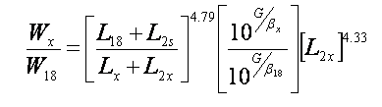
ESAL equation:
W = axle applications inverse of equivalency factors
Lx = axle load being evaluated (kips)
L18 = 18(standard axle load in kips)
L2 = code for axle configuration
G = a function of the ratio of loss in serviceability at time t, to the potential loss taken at a point where pt = 1.5
Pt = terminal serviceability index
β= function that determines the relationship between serviceability and axle load application.
http://www.pavementinteractive.org/article/flexible-pavement-esal-equation/
Notes:
http://www.pavementinteractive.org/article/flexible-pavement-esal-equation/

Slide 39
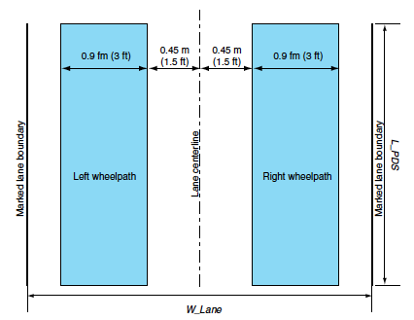
Typical lane section - Caltrans
Lane center-line
Marked lane boundary
Marked lane boundary
Pengcheng Fu, et al. “New Method for Classifying and Quantifying Cracking of Flexible Pavements in Automated Pavement Condition Survey”

Slide 40
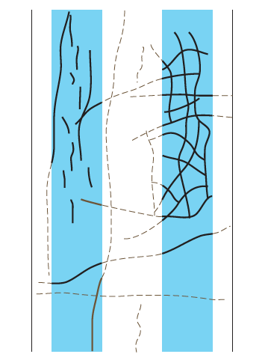
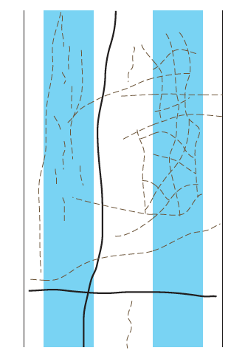
Types of pavement cracking
Pengcheng Fu, et al. “New Method for Classifying and Quantifying Cracking of Flexible Pavements in Automated Pavement Condition Survey”

Slide 41


Crack progression and Initiation models
Crack initiation model
Crack progression model

Slide 42
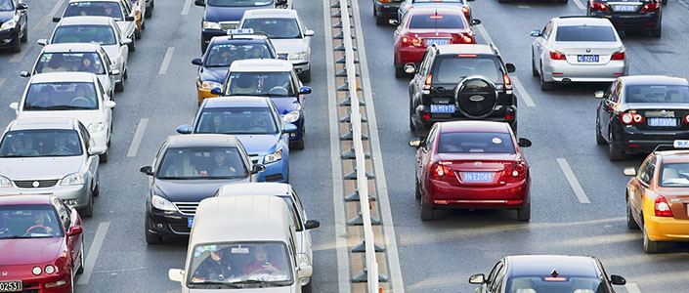
Vehicle Types
Notes:
http://www.lubrita.com/product/passenger_car_motor_oils

