Slide 1
StressNet
Structural Stress Prediction for Tourist Bridges
IoT
AI/ML
Real-Time
Cloud
Power BI
L&T Team 2 | Bridge Health Monitoring System
Aaron Shyjan
Aishvi Tyagi
Alan Chris Dsilva
Gayathri MP

Slide 2
PROBLEM STATEMENT
68%
40+
72hrs
of bridges globally
lack real-time monitoring
major bridge collapses
due to overload since 2000
avg detection delay
with manual inspection
Core Challenges
Crowd surges at tourist bridges create sudden, unpredictable overloads
Temperature-driven thermal expansion silently amplifies structural stress
Reactive maintenance leads to expensive emergency repairs and safety risks

Slide 3
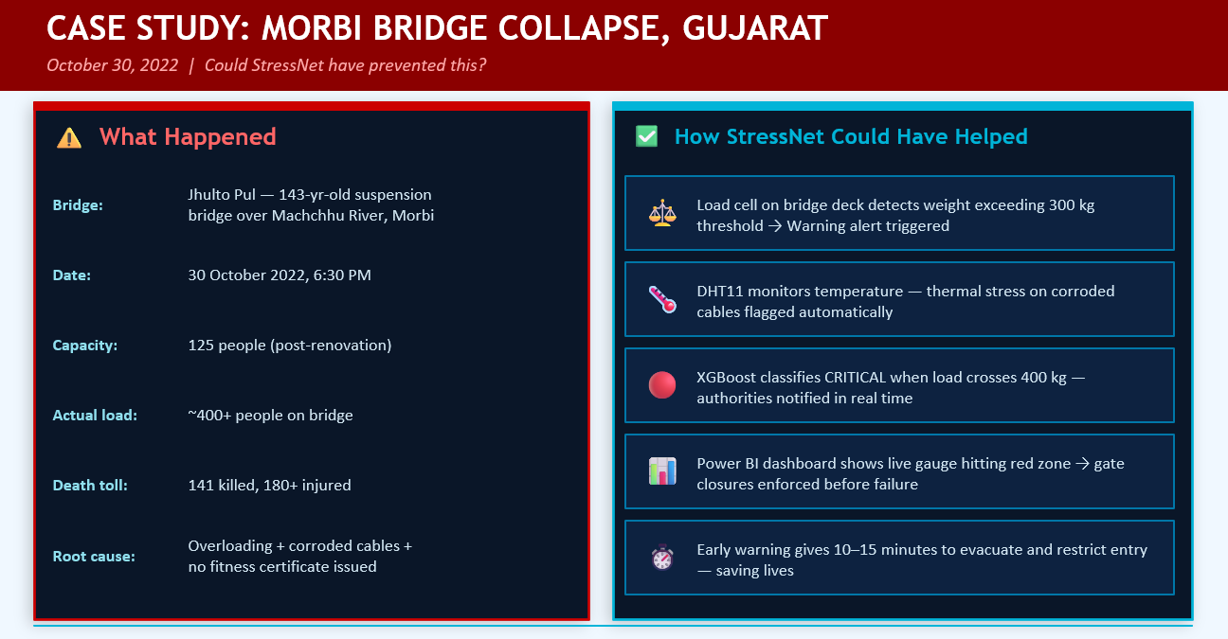

Slide 4




Slide 5
OUR SOLUTION
An end-to-end real-time IoT + AI system that monitors, predicts, and alerts on bridge structural stress — before failure occurs.
📡
☁️
🧠
📊
Sense
Stream
Predict
Visualize
ESP32 + Load Cell,
Temp & Pressure sensors
capture bridge conditions
ThingSpeak cloud
stores & streams
IoT telemetry data
XGBoost ML model
classifies stress:
Normal / Warning / Critical
Power BI dashboard
shows real-time alerts
to stakeholders

Slide 6
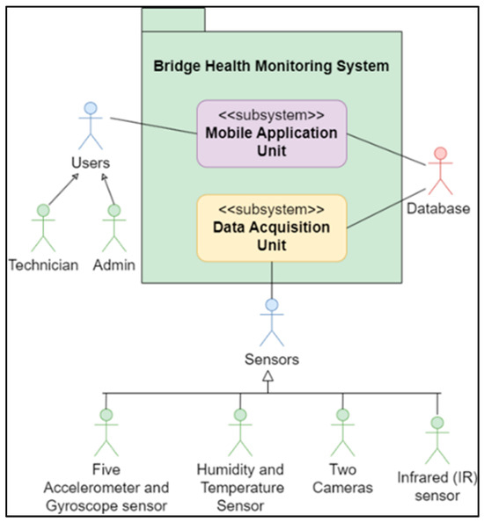
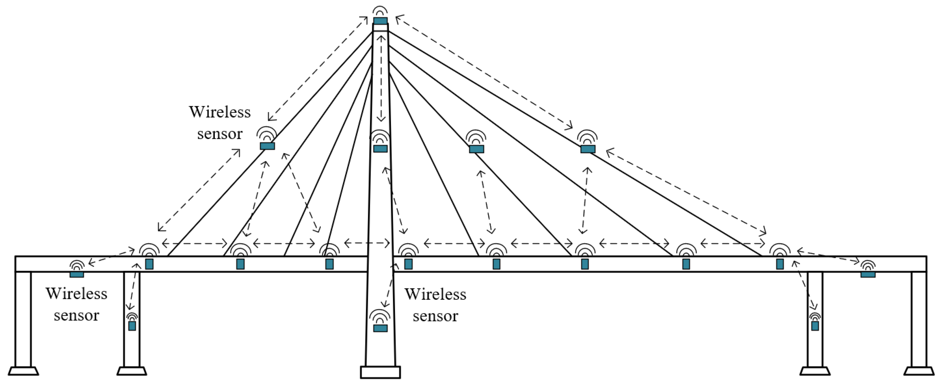
OUR SOLUTION

Slide 7
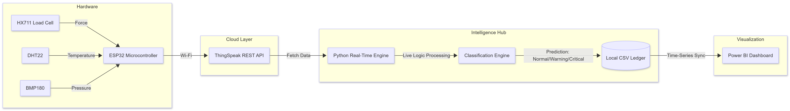
SYSTEM ARCHITECTURE
⟶ Real-time data pipeline flows continuously from sensor → cloud → ML → dashboard

Slide 8
IoT HARDWARE SETUP
🔲
ESP32 Microcontroller
ThingSpeak Channel Fields
Edge compute & WiFi gateway
Field 1
load_kg
⚖️
HX711 + Load Cell
Measures structural load in kg
Field 2
temperature
🌡️
DHT22 Sensor
Field 3
Captures ambient temperature
pressure
📟
Arduino script (smartbridge_esp32.ino)
continuously samples sensors &
transmits data via WiFi to cloud
BMP180 Sensor
Monitors barometric pressure

Slide 9
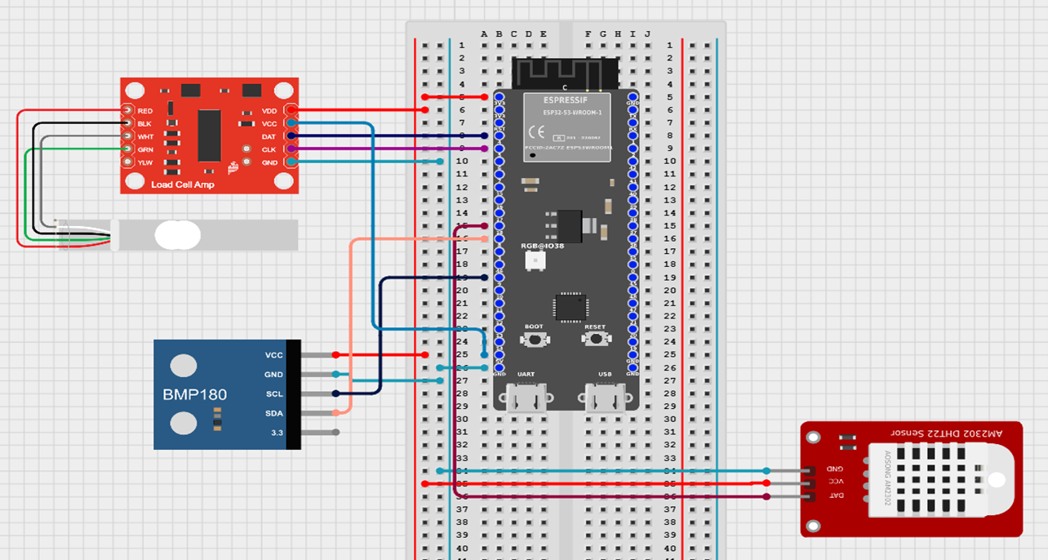
CIRCUIT

Slide 10
MACHINE LEARNING MODEL
XGBoost Classifier
Classification Output
Dataset: 1000 synthetic records (physics-based generation)
Train/Test Split: 800 train / 200 test
Features: load_kg, temperature, pressure
Output Classes: Normal, Warning, Critical
Files: stress_xgboost_model.pkl, label_encoder.pkl
NORMAL
573 records (57.3%)
Load within safe operating parameters. No action required.
266 records (26.6%)
Approaching stress threshold. Monitor closely and restrict access if needed.
WARNING
Class | Precision | Recall | F1-Score | Support
Critical | 0.96 | 1.00 | 0.98 | 46
Normal | 0.98 | 1.00 | 0.99 | 53
Warning | 0..99 | 0.97 | 0.99 | 101
Macro Avg | 0.98 | 0.98 | 0.98 | 200
CRITICAL
161 records (16.1%)
Immediate action required! Restrict bridge access to prevent structural failure.
Overall Accuracy: 98%

Slide 11
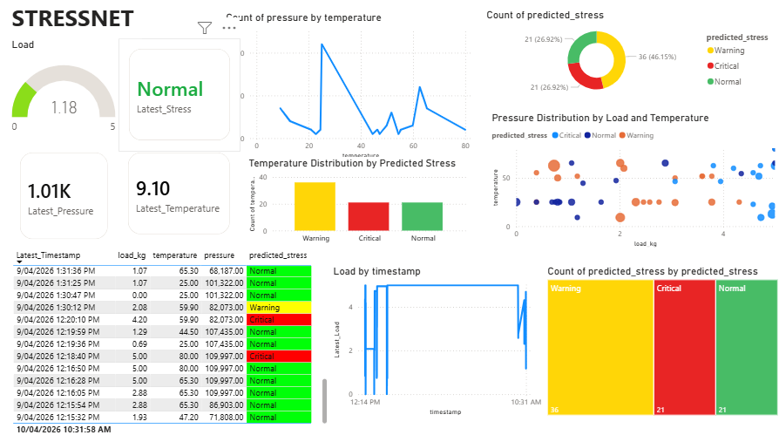
POWER BI DASHBOARD

Slide 12
REAL-TIME INFERENCE PIPELINE
1
Sensor Sampling
2
Cloud Upload
3
Python Polling
ESP32 reads load, temperature & pressure from sensors continuously
Data transmitted via WiFi to ThingSpeak channel fields in real-time
smartbridge_real_time_prediction.py polls ThingSpeak API periodically
4
XGBoost Inference
5
Log & Alert
6
Dashboard Refresh
Latest readings fed into ML model → stress classification returned
Results streamed to stdout + saved to smartbridge_live_predictions.csv
Power BI reads CSV / ThingSpeak, refreshes every 10 seconds automatically

Slide 13
REAL-WORLD IMPACT
👥
Crowd Safety
Continuous monitoring prevents catastrophic failure caused by flash crowds or tourist events exceeding pedestrian density limits.
⚡
Overload Detection
Immediate transition from Warning → Critical gives authorities vital minutes to restrict bridge access before physical yielding occurs.
🌡️
Early Warning System
Correlating temperature with load alerts operators to thermal expansion weaknesses. Maintenance shifts from reactive repair to proactive science.
Transforming bridge safety from reactive emergency response → data-driven proactive management

Slide 14
Thank You
StressNet — Keeping bridges safe, one data point at a time.
📁 github.com/alan61503/L-T---team-2
L&T Team 2 | IoT + AI Bridge Health Monitoring

