Slide 1

計算物理實作 期末報告
N-Body Collision
指導老師：潘國全教授
作者:陳主倫、黃華偉

Slide 2
大綱
DC Method
CCD Method
Sweep frame and Prune
Results & Discussion

Slide 3
DC Direct Calculation Analytic Solution

Slide 4

DC (direct calculation)
Evolution=> Collision＋ Free Motion
Calculation all possible $∆t$c
Calculation all possible ∆𝒕c
Find $∆t$c_min
Find ∆𝒕c_min
Move
$∆t$c_min
(change position)
Move
∆𝒕c_min
(change position)
Collision
(change velocity)
tc_1
$∆t$c_min_1
tc_2
tc_3
tc_4
Time
Free motion
Free motion
Free motion
Free motion

Slide 5
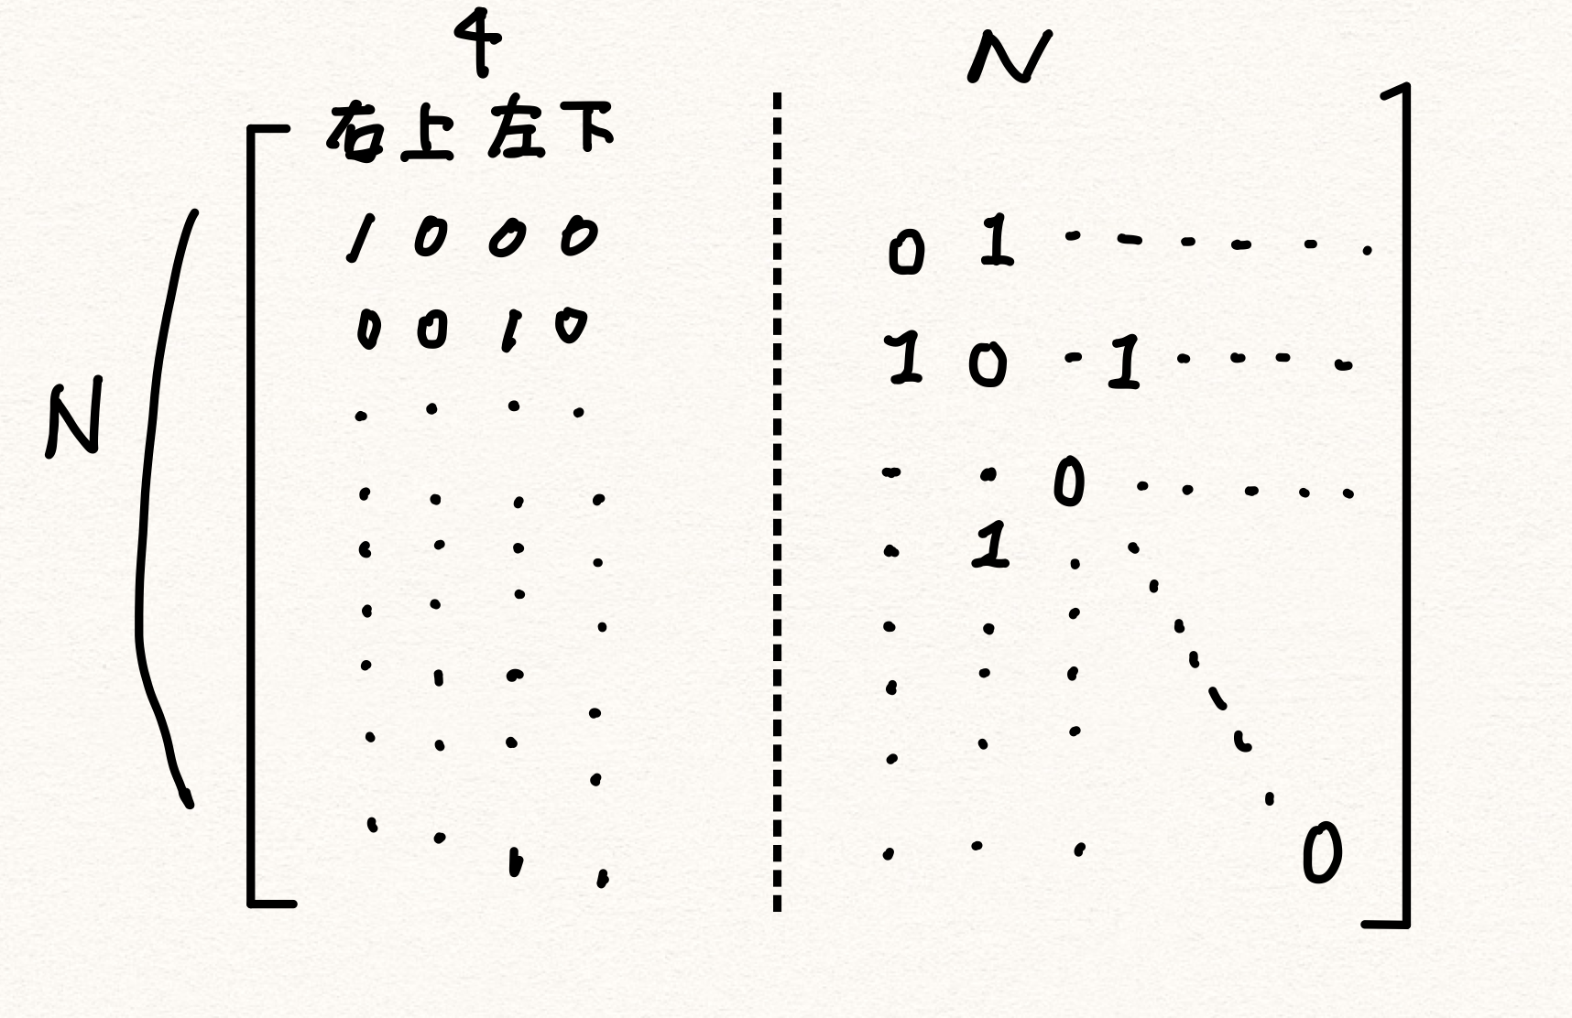

N X (N+2dim) Matrix
RHS NxN matrix
diagonal terms is zero.
it’s symmetry.

Slide 6
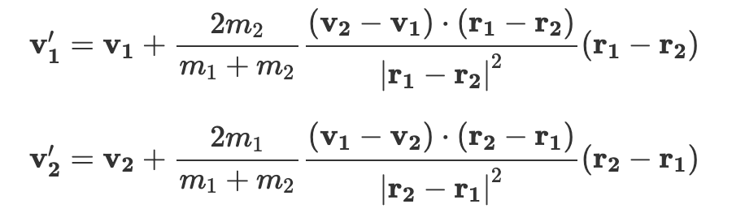
Angle-free two-dimensional elastic collision formula

Slide 7
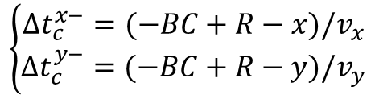

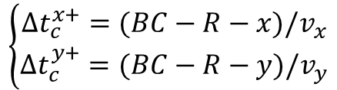





Collision with Boundaries
$$BC$$
$$\overset{⃑}{v}$$
$$v_{y}$$
$$v_{x}$$
$$\left\{\begin{aligned}∆t_{c}^{x+}=(BC−R−x)/v_{x} \\ ∆t_{c}^{y+}=(BC−R−y)/v_{y}\end{aligned}\right.$$
$$R$$
$$x$$
$$\left\{\begin{aligned}∆t_{c}^{x−}=(−BC+R−x)/v_{x} \\ ∆t_{c}^{y−}=(−BC+R−y)/v_{y}\end{aligned}\right.$$

Slide 8








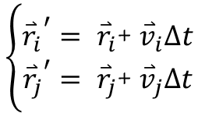
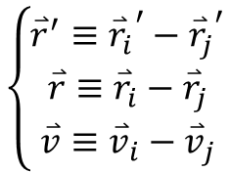



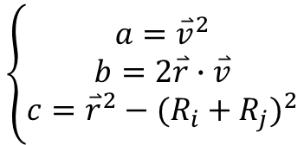
Collision between Balls
$$R_{i}$$
$$R_{j}$$
$$\left\{\begin{aligned}{{\overset{⃑}{r}}_{i}}^{′}= {\overset{⃑}{r}}_{i}\text{+ }{\overset{⃑}{v}}_{i}∆t \\ {{\overset{⃑}{r}}_{j}}^{′}= {\overset{⃑}{r}}_{j}\text{+ }{\overset{⃑}{v}}_{j}∆t\end{aligned}\right.$$
$${\overset{⃑}{v}}_{j}∆t$$
$${\overset{⃑}{v}}_{i}∆t$$
$$\left\{\begin{aligned}{\overset{⃑}{r}}^{′}≡{{\overset{⃑}{r}}_{i}}^{′}−{{\overset{⃑}{r}}_{j}}^{′} \\ \overset{⃑}{r}≡{\overset{⃑}{r}}_{i}−{\overset{⃑}{r}}_{j} \\ \overset{⃑}{v}≡{\overset{⃑}{v}}_{i}−{\overset{⃑}{v}}_{j}\end{aligned}\right.$$
$${{\overset{⃑}{r}}_{i}}^{′}$$
$${{\overset{⃑}{r}}_{j}}^{′}$$
$$|{\overset{⃑}{r}}^{′}|=|\overset{⃑}{r}+\overset{⃑}{v}∆t|$$
$${(R_{i}+R_{j})}^{2}={\overset{⃑}{r}}^{2}+{(\overset{⃑}{v}∆t_{c})}^{2}+2\overset{⃑}{r}∙\overset{⃑}{v}∆t_{c}$$
$${\overset{⃑}{r}}_{i}$$
$${\overset{⃑}{r}}_{j}$$
$$\left\{\begin{aligned}a={\overset{⃑}{v}}^{2} \\ b=2\overset{⃑}{r}∙\overset{⃑}{v} \\ c={\overset{⃑}{r}}^{2}−{(R_{i}+R_{j})}^{2}\end{aligned}\right.$$
$$∆t_{c} =\frac{−b±\sqrt{b^{2}−4ac}}{2a}$$

Slide 9



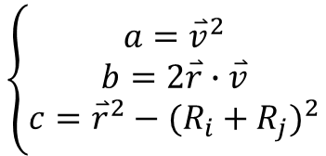

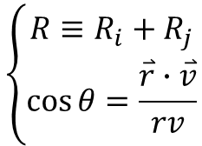







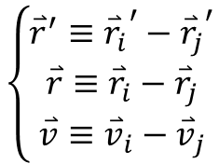


The Physical Meaning of Discriminant
$$\left\{\begin{aligned}a={\overset{⃑}{v}}^{2} \\ b=2\overset{⃑}{r}∙\overset{⃑}{v} \\ c={\overset{⃑}{r}}^{2}−{(R_{i}+R_{j})}^{2}\end{aligned}\right.$$
$$\left\{\begin{aligned}{\overset{⃑}{r}}^{′}≡{{\overset{⃑}{r}}_{i}}^{′}−{{\overset{⃑}{r}}_{j}}^{′} \\ \overset{⃑}{r}≡{\overset{⃑}{r}}_{i}−{\overset{⃑}{r}}_{j} \\ \overset{⃑}{v}≡{\overset{⃑}{v}}_{i}−{\overset{⃑}{v}}_{j}\end{aligned}\right.$$
$$∆t_{c} =\frac{−b±\sqrt{b^{2}−4ac}}{2a}$$
$$\left\{\begin{aligned}R≡R_{i}+R_{j} \\ \cos{θ=\frac{\overset{⃑}{r}∙\overset{⃑}{v}}{rv}}\end{aligned}\right.$$
$$D=b^{2}−4ac=4{\left(\overset{⃑}{r}∙\overset{⃑}{v}\right)}^{2}−4{\overset{⃑}{v}}^{2}\left({\overset{⃑}{r}}^{2}−{\left(R_{i}+R_{j}\right)}^{2}\right)=4v^{2}(R^{2}−r^{2}{(\sin{θ})}^{2})$$
$$D>0$$
$$D=0$$
$$D<0$$
$$R>r\sin{θ}$$
$$R=r\sin{θ}$$
$$R<r\sin{θ}$$
$$R$$
$$R$$
$$R$$
$$r\sin{θ}$$
$$r\sin{θ}$$
$$r\sin{θ}$$

Slide 10
CCD Continuous Collision Detection

Slide 11





CCD (Continuous Collision Detection)
Determine partition
Find overlap
DC
YES
Move
NO
t1
t2
t3
tc
t4
t5
tc
t6
tc
tc
tc
Time
$$∆t$$
$$∆t$$
$$∆t$$
$$∆t$$
$$∆t$$

Slide 12

Collision Detection
d
d $≤$ R1+R2 : Collision
R2
R1
Square root calculation here might spend much time

Slide 13
Sweep frame and Prune

Slide 14
Sweep frame and Prune
Determine partition
Find overlap
with
better efficiency
DC
Different from CCD here!!
YES
Move
NO
t1
t2
t3
tc
t4
t5
tc
t6
tc
tc
tc
Time
$$∆t$$
$$∆t$$
$$∆t$$
$$∆t$$
$$∆t$$

Slide 15
Results & Discussion

Slide 16
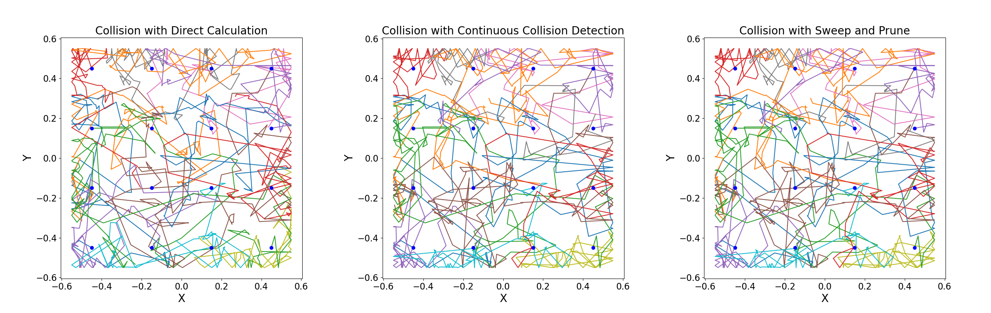

$$Initialize position with equal distance between every nearest particles$$
$$Initialize velocity point randomly with a fixed speed$$
t1
tc
tc
t2
tc
tc
t3
$$∆tc1$$
$$∆tc1$$

Slide 17
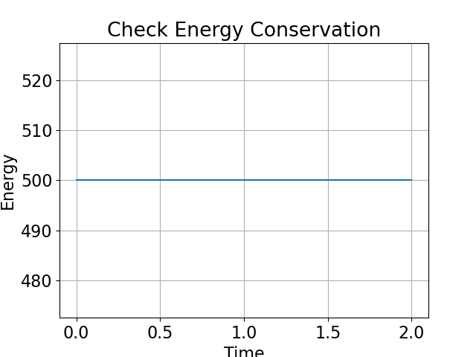
Energy Conservation
Energy conserves for DC method, CCD method and SP method

Slide 18
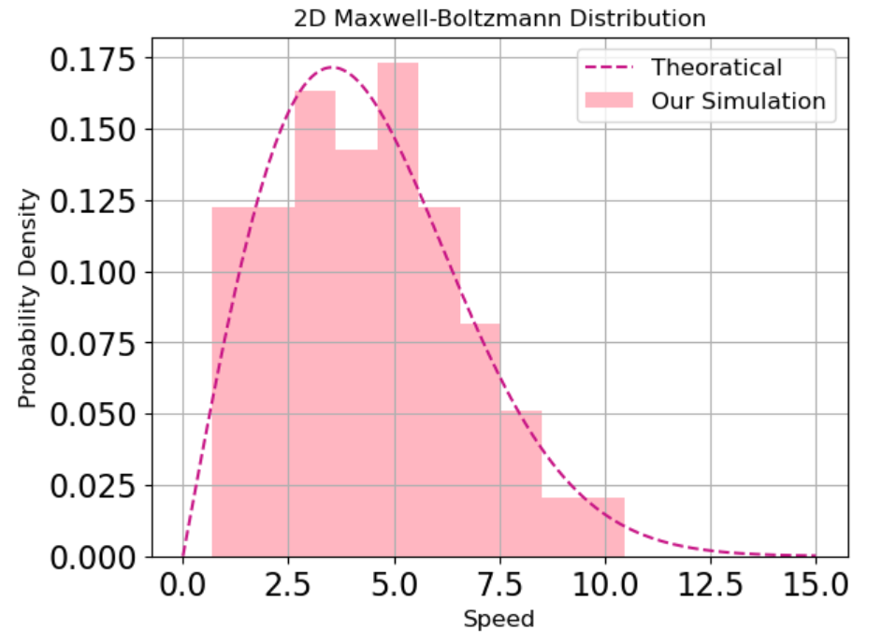
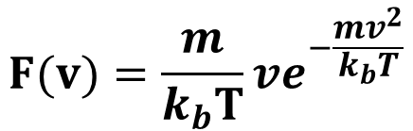
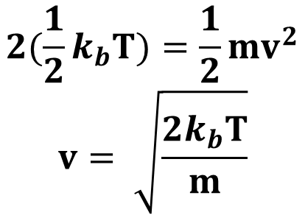
Boltzmann distribution
numbers = 100 # particle numbers
dim = 2 # dimension
boundary = 1.55 # boundary
T = 2400 # total time
Temp = 12.5 # Temperature (k=1)
Computing Time: 15722 s
$$F(v)=\frac{m}{k_{b}T}ve^{−\frac{mv^{2}}{k_{b}T}}$$
$$2(\frac{1}{2}k_{b}T)=\frac{1}{2}mv^{2}$$
$$v= \sqrt{\frac{2k_{b}T}{m}}$$

Slide 19
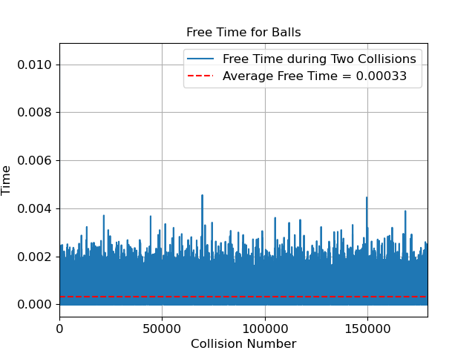






How to choose a good partition for CCD
We guess
$$∆t ≅average free motion time$$
$$is better choice of ∆t$$
t1
tc
t2
t3
tc
t4
tc
t5
t6
$$∆t$$
$$∆t$$
$$∆t$$
$$∆t$$
$$∆t$$

Slide 20
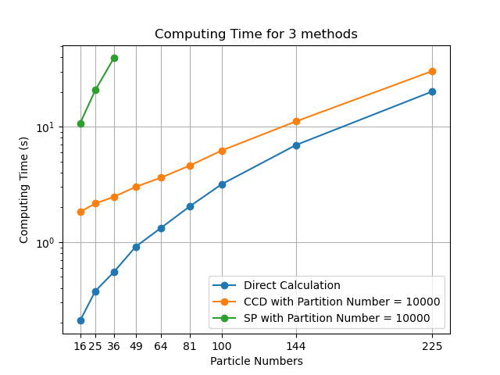



Computing Time for DC, CCD and SP
$$Expect:SP>CCD>DC$$
$$Reality:DC>CCD>SP$$
$$Two possible reason:$$
Choose a worse partition
No optimized in CCD&SP

Slide 21
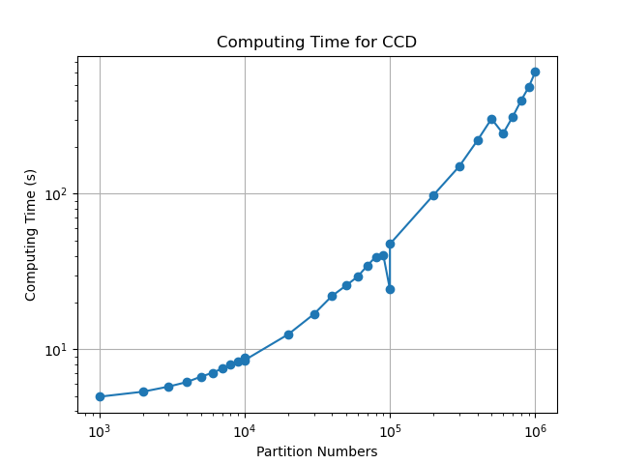

Computing Time for CCD with Different Partition
$$Proper partition occurs$$
$$at some number$$

