Slide 1
Midterm Project
Team 4

Slide 2
開發環境
macOS Catalina 10.16.7
Sublime text 3 with Arduino-like IDE
Platform : Arduino SAM(32bits)
Arduino DUE(Programming port)

Slide 3
Overall Flowchart
Setup
Loop
PUF(Read)
TRNG(Read)
AES
Key expansion
Cipher
Print

Slide 4
Part 0 Setup
Set baud = 9600 times/sec
input :
pinMode(m , INPUT)
output :
pinMode(n , OUTPUT)

Slide 5
Part 1 (PUF data讀取)
PUF with 4096 bits.
TRNG with 8 bits.
.

Slide 6
Part 1 (PUF data讀取)
pinMode=0 -> Read_PUF()
8bits a time, 512 times.
pinMode=1 -> Read_TRNG()
8bits a time, 1 time.

Slide 7
Part 1 (PUF data讀取)
PUF_flag = 0 originally.
PUF_flag = 1 if all the 4096 bits being read.

Slide 8
Part2 (AES-128 coding & 加密演練)
Being activated only if PUF_flag = 1.
AES with 128 bits.
Generate plain text from random()
Generate Key from PUF_data[0:127](changable)

Slide 9
Part2 (AES-128 coding & 加密演練)
int binary_plain text[128] -> char in[16]
int binary_key -> char key[16]

Slide 10
Key expansion
Key 1
Key 2
Key 3

Slide 11
Cipher
Plain text 1
Key 1
Plain text 2
Key 2
Plain text 3
Key 3

Slide 12
Print Out
Serial.print(out[0],HEX)

Slide 13
Summary
Setup
Loop
PUF(Read)
TRNG(Read)
AES
Key expansion
Cipher
Print

Slide 14
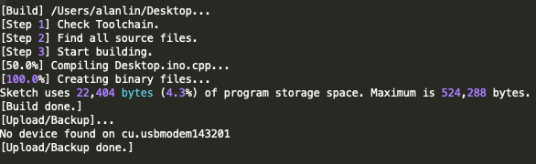
遇到的問題-1

Slide 15
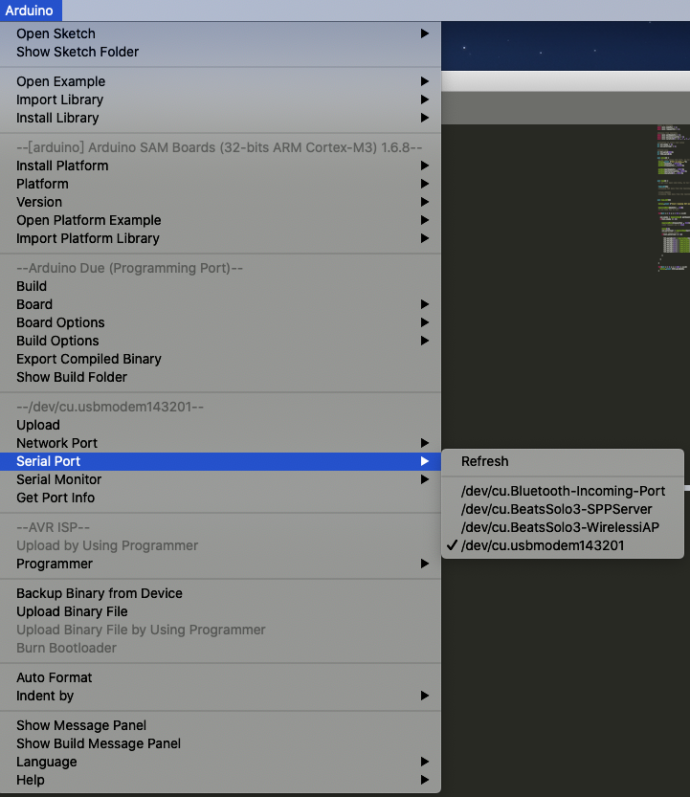
遇到的問題-1

Slide 16
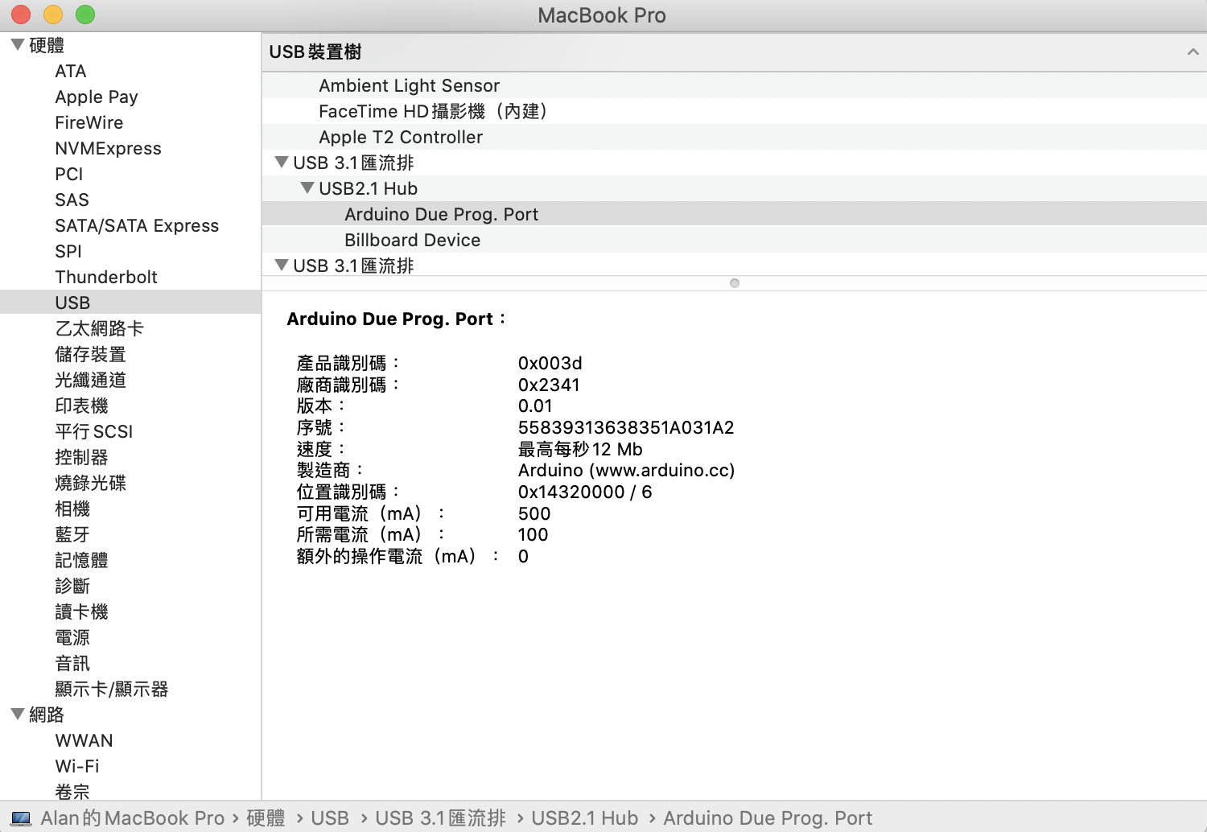
遇到的問題-1

Slide 17

遇到的問題-2

Slide 18
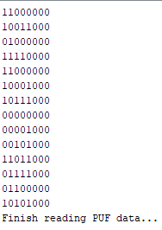
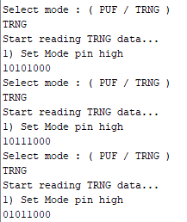
遇到的問題-2

Slide 19
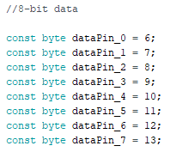
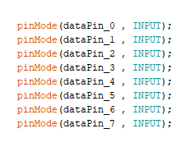
遇到的問題-2

Slide 20
Polling
輪詢（Polling）是一種CPU決策如何提供週邊裝置服務的方式，又稱「程式控制輸入輸出」（Programmed I/O）。輪詢法的概念是：由CPU定時發出詢問，依序詢問每一個週邊裝置是否需要其服務，有即給予服務，服務結束後再問下一個週邊，接著不斷週而復始。
pin
pin
Test chip
MCU on Arduino DUE

Slide 21
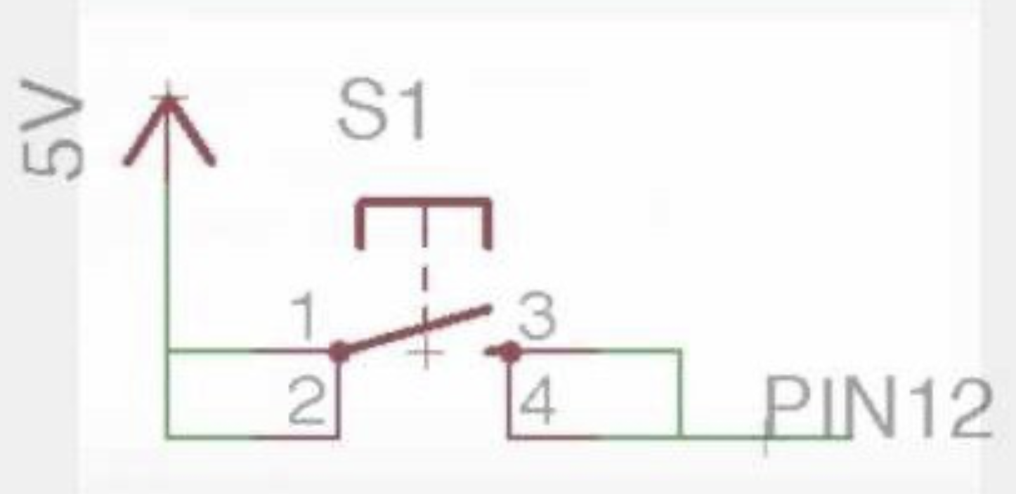
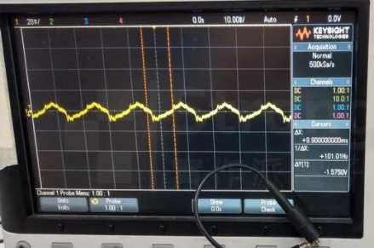
Polling
In setup():
pinMode( mypin , INPUT);
In loop():
if( digital.read ( mypin ) == HIGH){
// do something
}
mypin is a Floating pin !

Slide 22
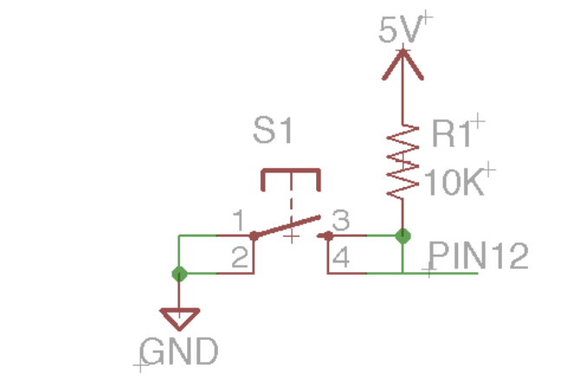
Polling
參考資料：
https://www.baldengineer.com/arduino-internal-pull-up-resistor-tutorial.html
In setup():
pinMode( mypin , INPUT_PULLUP);
In loop():
if( digital.read ( mypin ) == HIGH){
// do something
}

Slide 23
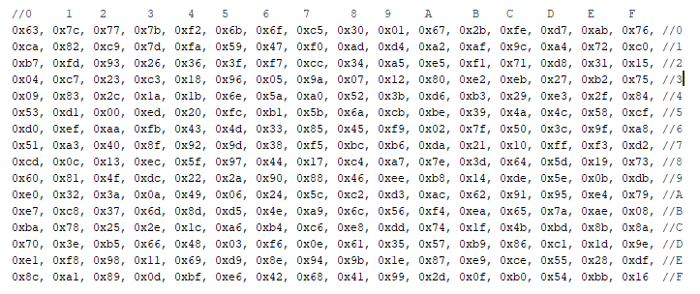
S box generation
Translate rows and column into binary
( row | column ) = ( 8 | 6)
= ( 1000 0110 )

Slide 24
S box generation
Calculate the multiplicative inverse of ( row | column ) in GF(2^8)
initial : p = 1 , q = 1
p * q ≡ 1 mod x^8
( p * ( x + 1 ) ) * ( q / ( x + 1 ) ) ≡ p * q ≡ 1 mod x^8
( p * ( x + 1 )^2 ) * ( q / ( x + 1 )^2 ) ≡ p * q ≡ 1 mod x^8
…
( p * ( x + 1 )^255 ) * ( q / ( x + 1 )^255 ) ≡ ( p * 1 ) * ( q / 1 ) ≡ p * q ≡ 1 mod x^8
( x + 1 )^255 ≡ 1 mod x^8
Generate 255 pairs of ( p , q ) of 8 bits binary number + special solution( p = 0 )

Slide 25
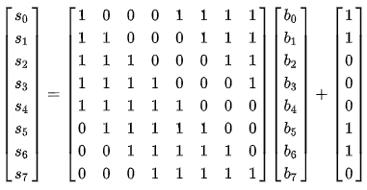
S box generation
Affine transformation
S_box[ p ]
q ( multiplicative inverse of p)

Slide 26
DEMO
http://aes.online-domain-tools.com/
https://www.binaryhexconverter.com/binary-to-hex-converter

