Slide 1



Ablation of “Implicit Quantile Networks for Distributional Reinforcement Learning”
Team members : 鍾承佑 、徐煜倫 、 柯秉志

Slide 2
The evolution to IQN
Contents
The characteristics of IQN
Structure of the project
The NN of IQN
Ablation

Slide 3
The evolution to IQN

Slide 4
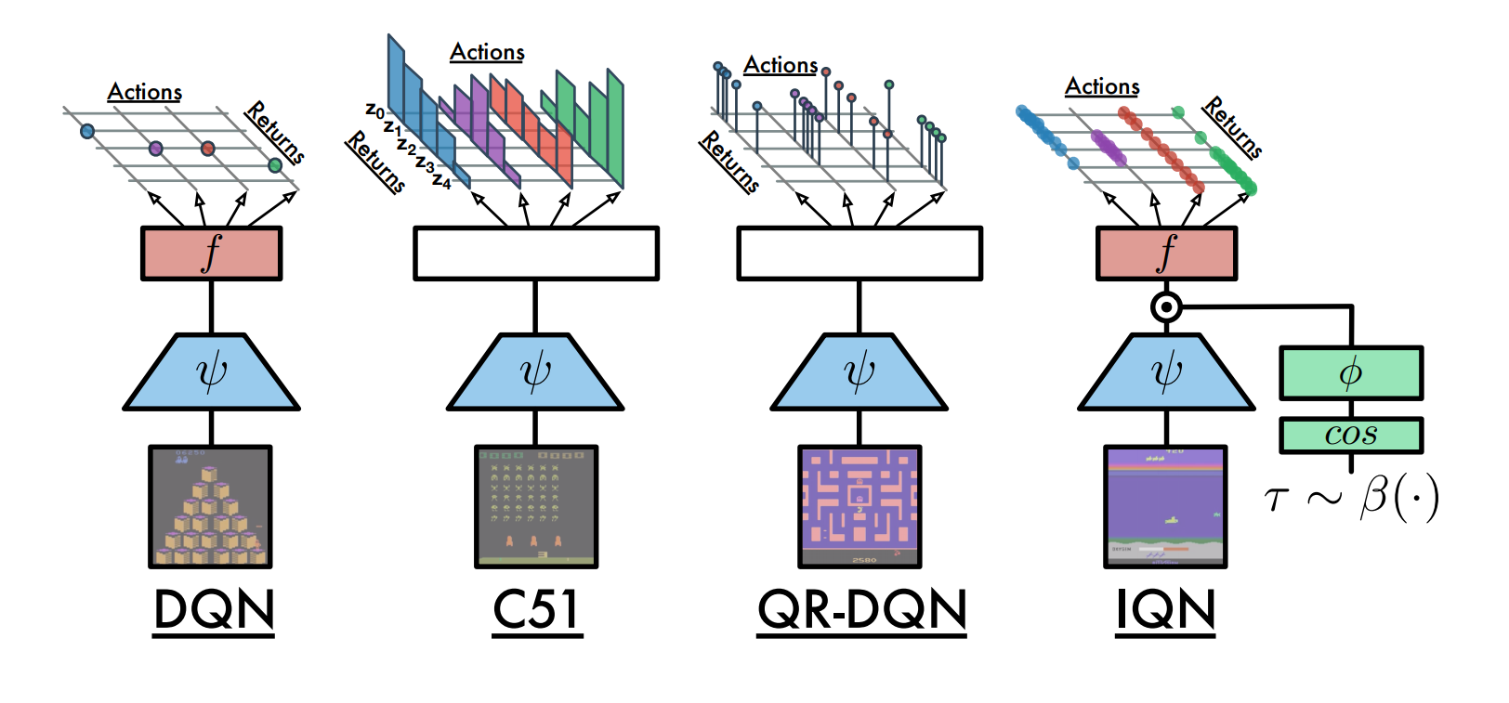
The evolution to IQN – From DQN to C51
distribution
expected value
Change the action value into a distribution
-> we can get more information from a distribution！

Slide 5
The evolution to IQN – From C51 to QR-DQN
Quantile
distribution
Categorical distribution
Change categorical distribution into quantile distribution
-> Solve the issue that C51 needs to set the boundary of its value domain

Slide 6
The evolution to IQN – From QR-DQN to IQN
random points
Fixed points
Estimating the quantile function at random points instead of precisely chosen points
-> By sampling randomly, the quantile distribution fits the true distribution better

Slide 7
The characteristic of IQN

Slide 8
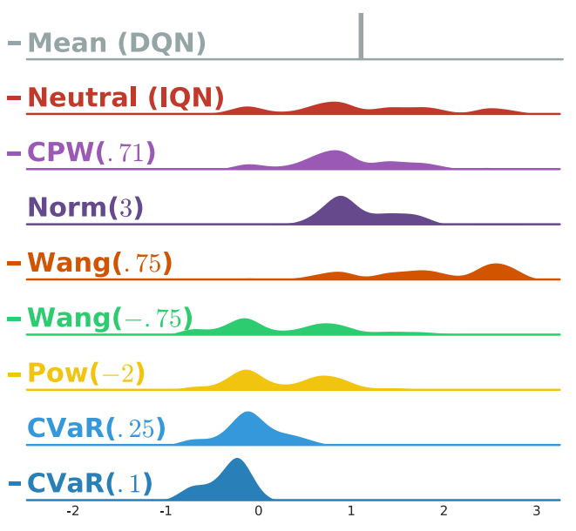

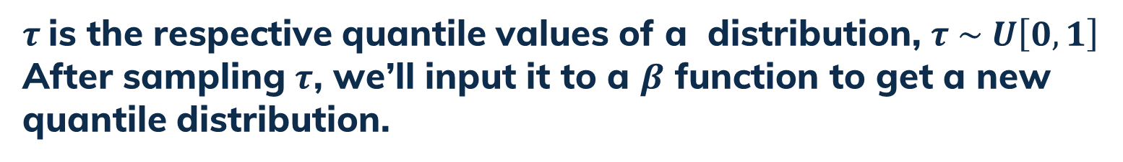
Introduction of functions - 1
1.
$τ$is the respective quantile values of a distribution, $τ \sim U\left[0,1\right]$
After sampling $τ$, we’ll input it to a $β$ function to get a new quantile distribution.
The $β$functions:

Slide 9
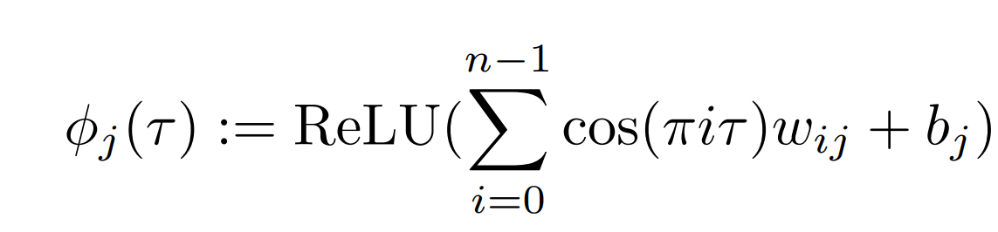
Introduction of functions - 2
2.
The following formula was gained by the experiment result. The configuration yielded the highest performance consistently over multiple seeds.
multiplication

Slide 10
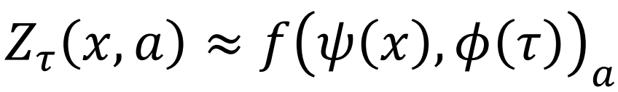
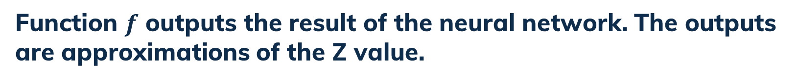
Introduction of functions - 3
3.
Function $f$ outputs the result of the neural network. The outputs are approximations of the Z value.

Slide 11
The NN of IQN

Slide 12
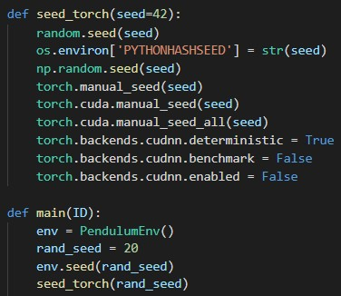
The hyperparameter of NN
n=3
n_prime=3
k_sample=8
k=1
capacity=10000
episode=1000
exploration=1000
batch_size=32
quant_num=64
update_freq=100
epsilon=0.05
learning_rate=1e-4
gamma=0.97

Slide 13


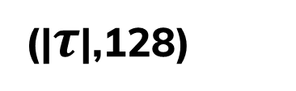
The structure of NN
states
(|state|,128)
(128, 128)
( 128, |actions|x|quantiles| )
Z
$$τ\sim β(∙)$$
cos
(|$τ$|,128)
$$τ$$

Slide 14
Ablation

Slide 15
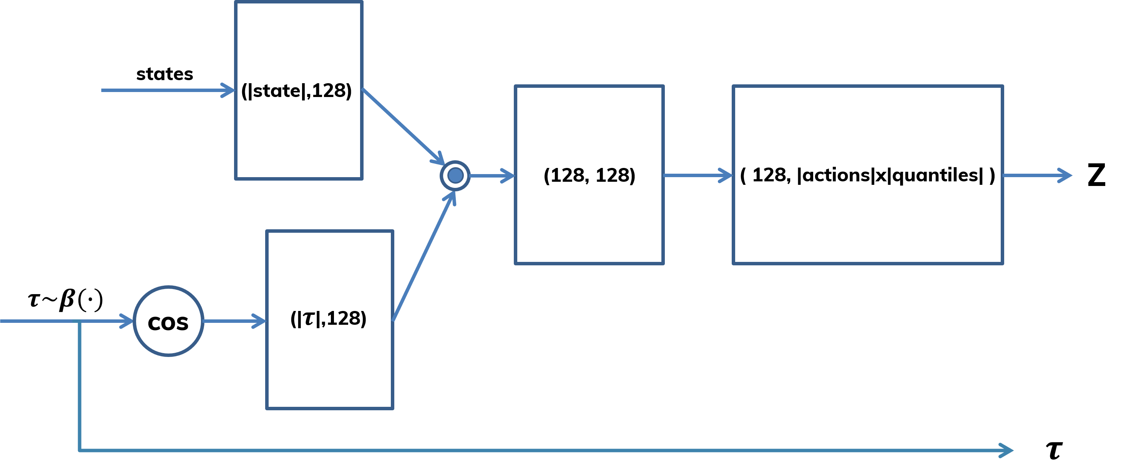

Ablation - tuning
N = N’ = 1
without cos
Fixed Discrete $τ$
Modified $β$
Normal sampling $τ$
Mixture of $\text{ψ}$ and φ

Slide 16

Ablation - tuning
N = N’ = 1
without cos
Fixed Discrete $τ$
Modified $β$
Normal sampling $τ$
Mixture of $\text{ψ}$ and φ

Slide 17


Ablation - tuning
N = N’ = 1
without cos
Fixed Discrete $τ$
Modified $β$
Normal sampling $τ$
Mixture of $\text{ψ}$ and φ

Slide 18
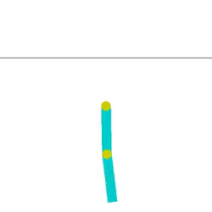
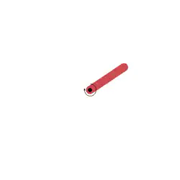
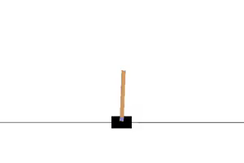
Ablation - environment
CartPole
Acrobot
Pendulum

Slide 19
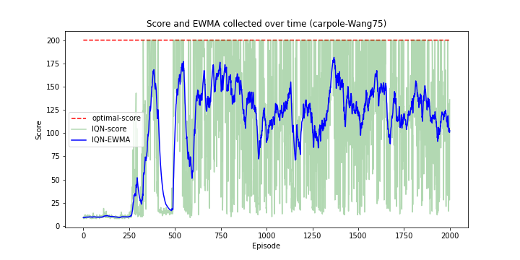
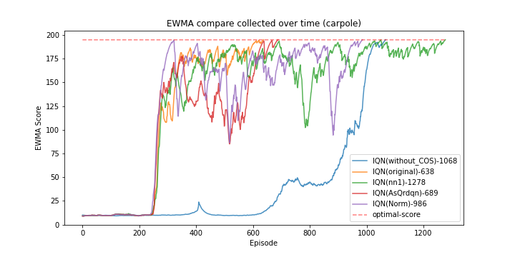
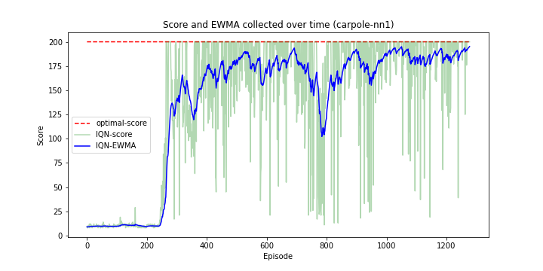
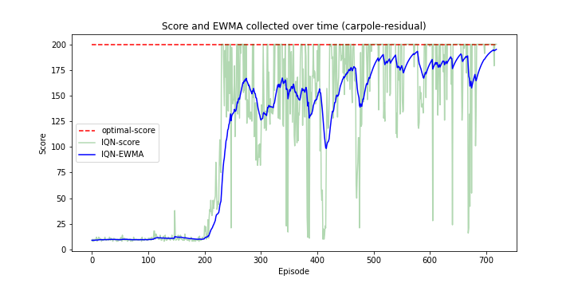
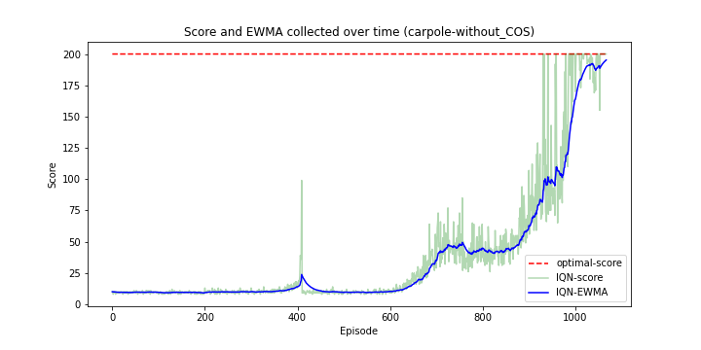
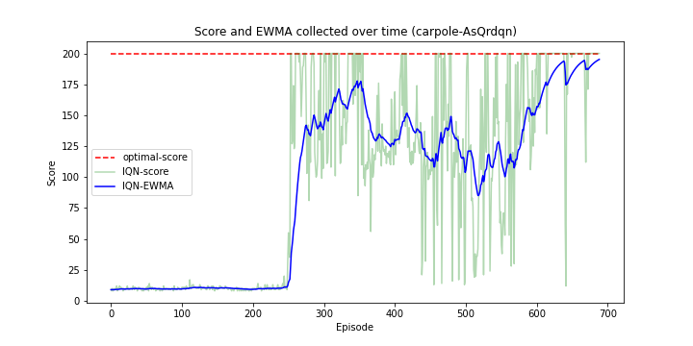
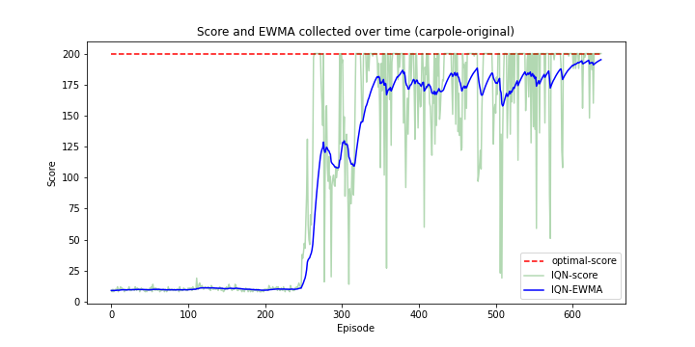
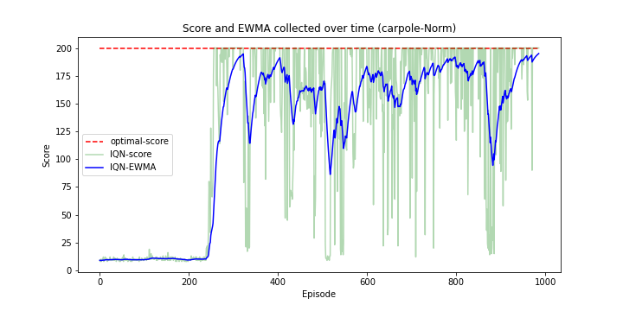
Ablation - Cartpole

Slide 20
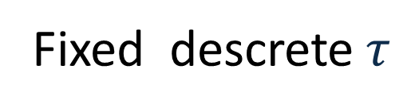
Ablation - Cartpole
Without cos
n = n’ = 1
Original
Fixed descrete$τ$

Slide 21
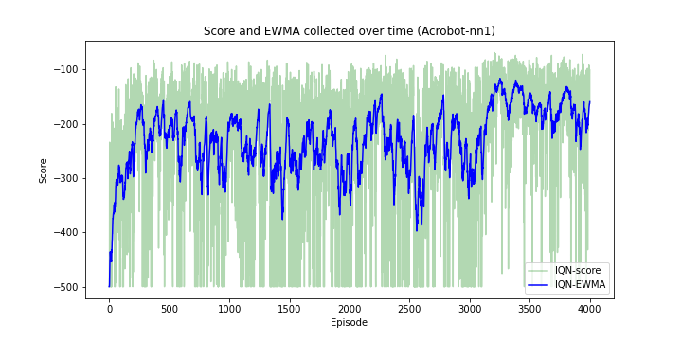
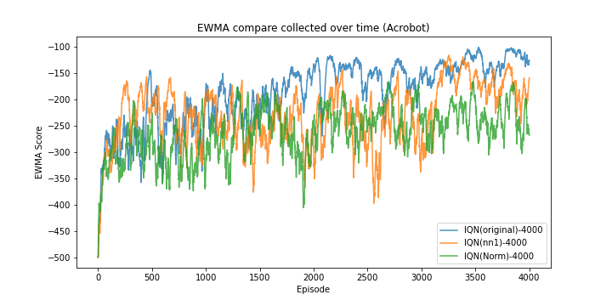
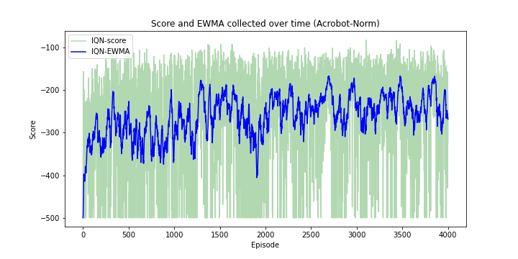
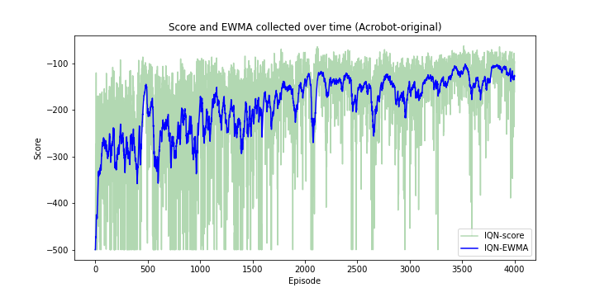
Ablation - Acrobot
n = n’ = 1
Norm
Original

Slide 22
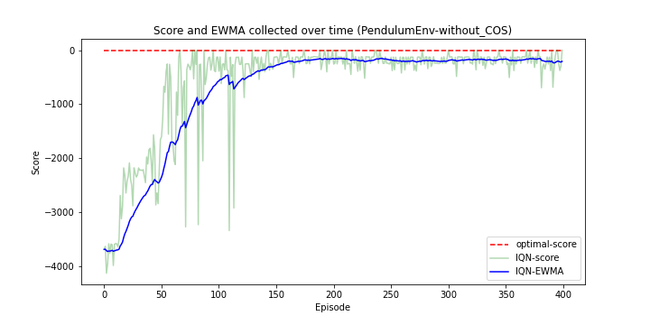
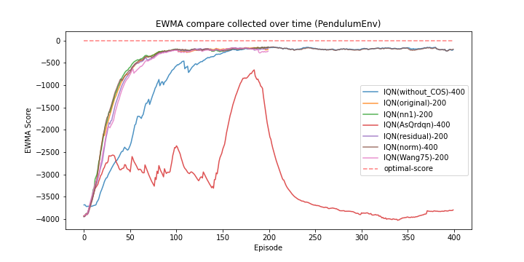
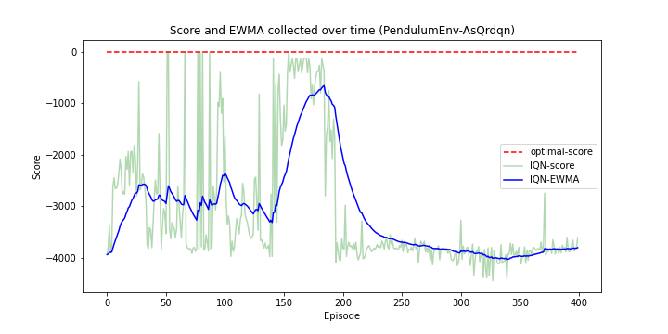

Ablation – Pendulum
Without cos
Fixed descrete$τ$

