Slide 1

Development of a flight control system to perform desired manoeuvres in Flightlab
Fabio Riccardi
Analysis Engineer – Flight Physics

Slide 2
Outline
Introduction
Adopted LTI model of the helicopter
Working flow
General FCS scheme
FCS scheme with yaw dynamic in open-loop
Tuning requirements
Results – General FCS
Results – FCS with yaw dynamic in open-loop
Conclusions

Slide 3
Introduction
The aim of the activity is design a simplified Flight Control System (FCS), to be implemented in Flightlab, in order to perform non-linear simulations of desired maneuvers.
Presently, without an FCS, if a control input is imposed (for example only pedal) from a trim condition, because of the inherently unstable and coupled helicopter dynamics, not only a simple motion around the yaw axis is obtained, but also on the other DoFs.
Obviously in flight this task is accomplished by the pilot and for example a pure yaw rotation can be achieved, applying proper input to all the controls. The goal is reproduce the pilot action in the Flightlab simulations.
The same concept can be applied when it is desired a maneuver on the only longitudinal or lateral plane, for example pull-up or steady turn.

Slide 4
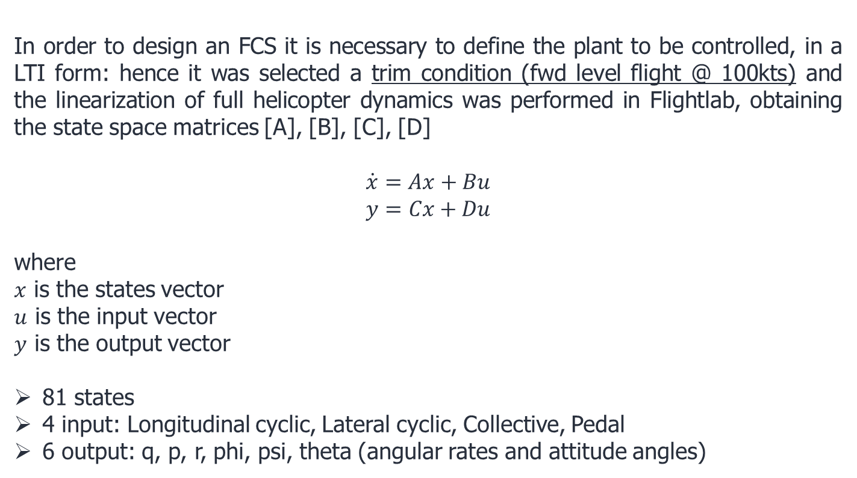

Adopted LTI model of the helicopter (1/3)
In order to design an FCS it is necessary to define the plant to be controlled, in a LTI form: hence it was selected a trim condition (fwd level flight @ 100kts) and the linearization of full helicopter dynamics was performed in Flightlab, obtaining the state space matrices [A], [B], [C], [D]
$$\dot{x}=Ax+Bu$$
$$y=Cx+Du$$
where
$x$ is the states vector
$u$ is the input vector
$y$ is the output vector
81 states
4 input: Longitudinal cyclic, Lateral cyclic, Collective, Pedal
6 output: q, p, r, phi, psi, theta (angular rates and attitude angles)
Trim condition param.
LON=48.84%
LAT=46.71%
COL=41.65%
PED=41.98%
$α$=-0.0318 rad
$β$=-0.0584 rad
$φ$=0 rad
$θ$=-0.0317 rad
$ψ$=0

Slide 5
Adopted LTI model of the helicopter (2/3)
Summary of the Flightlab model adopted for the linearization and extraction of A, B, C, D matrices (named F, G, D, H in Flightlab) used for controller design
#Working-Directory: /mnt/SKYeP2/shared/flightlab/Models/May2017_RevW
#Airloads: Quasi-unsteady airloads
#Inflow: Peters/He's finite state inflow
#Ducted-Fan-Inflow: Enhanced Peters-He fan finite state inflow
#Engine: Ideal engine
#Lag-Damper: Linear
#Retention: Articulation with flap, lag and feat
#Blade: 4 mass segment rigid blade element model
#MBC: Hub hinge d.o.f
#RotorShaft: With/without mast tilt
#RotorcraftCycleStep: Check AirloadsSlv
#Cycle: Rotorcraft solution with 2 DTs (rotorcraft_2dt_cyc.exc)
#Step: Rotorcraft model with two DT (rotorcraft_2dt_op.exc)
#Model-Init: Two-Blade Assembly after simple Engine Init
#CG: [3145.89 0 1610.70] mm for total helicopter. (x=back, y=right,z=up in CAD system)
#Mass: 1900.13 kg. (Total mass of the helicopter)
#Trim: Trim with user-defined GTRIM option
#Trim-type: Ball centered

Slide 6
Adopted LTI model of the helicopter (3/3)
Step response of the LTI model from each input to each output: coupled dynamics

Slide 7
Working flow
The adopted software is Matlab/Simulink, in particular the Control System Toolbox.
Working flow:
Import the Flightlab LTI model of the helicopter
Design the FCS -> Simulink scheme
Define the proper requirements for the FCS parameters tuning function systune
The same control scheme (with the relative tuning of controller blocks) can be implemented in Flightlab CSGE.
Test the controller in Flightlab performing non-linear analysis of the intended manouvers
REMARK: the tuning works best in condition near to the adopted trim condition for the model linearization. Different starting trim for the manouver requires to repeat the process

Slide 8
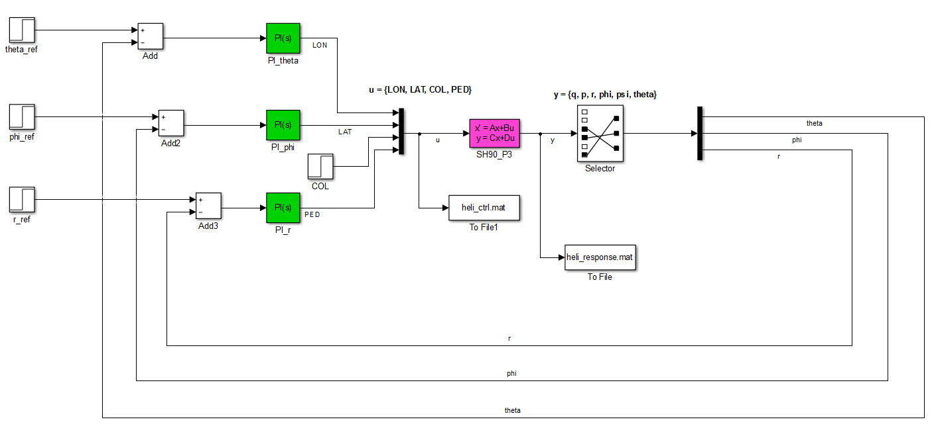
General FCS scheme (1/2)
Only outer loop implemented, for set-point tracking, based on PI controllers

Slide 9
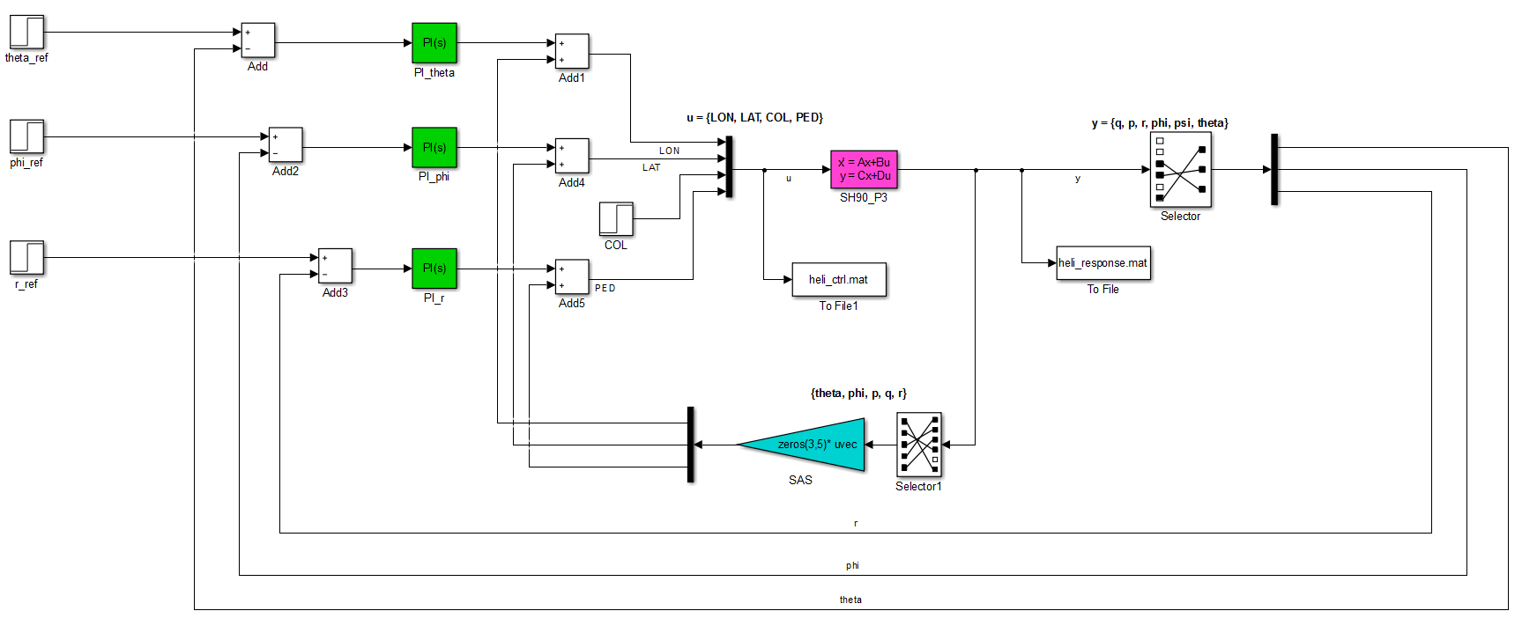
General FCS scheme (2/2)
Implemented outer loop + inner loop for stability augmentation and decoupling, based static output feedback (SAS block)

Slide 10
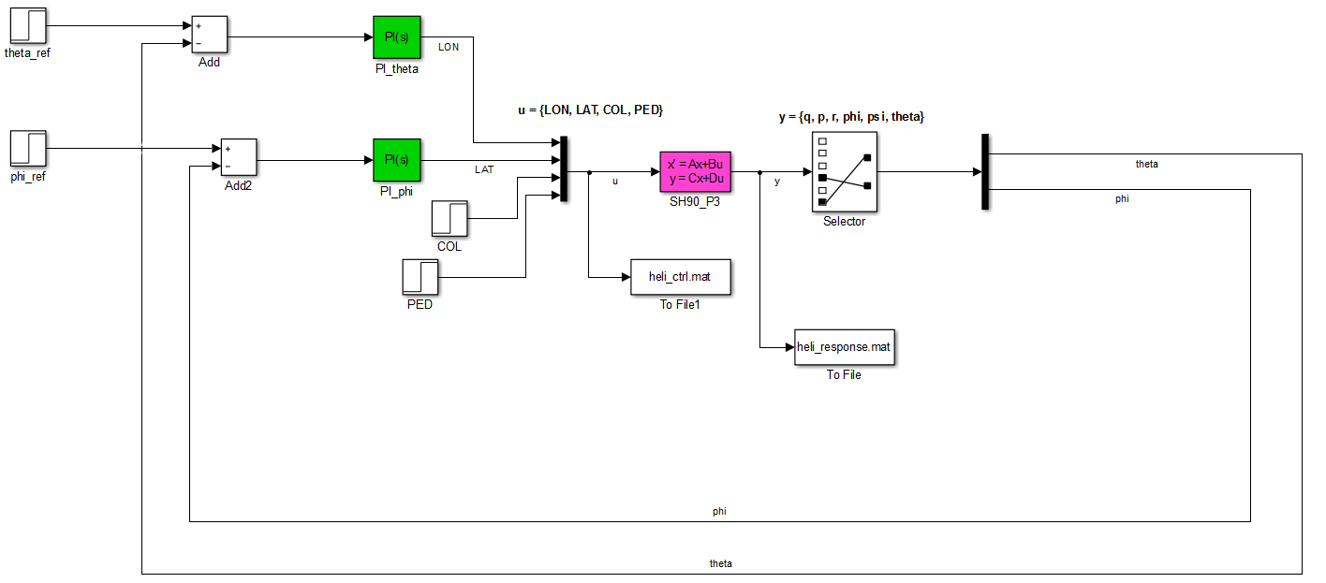
FCS scheme with yaw dynamic in open-loop (1/2)
In this case the yaw loop it is not closed on the controller, hence it can be applied directly a pedal command (as requested in a full pedal yaw maneuver), leaving to the controller the task of maintaining the desired phi and theta attitude angles (equal to the starting trim condition)
Only outer loop implemented

Slide 11
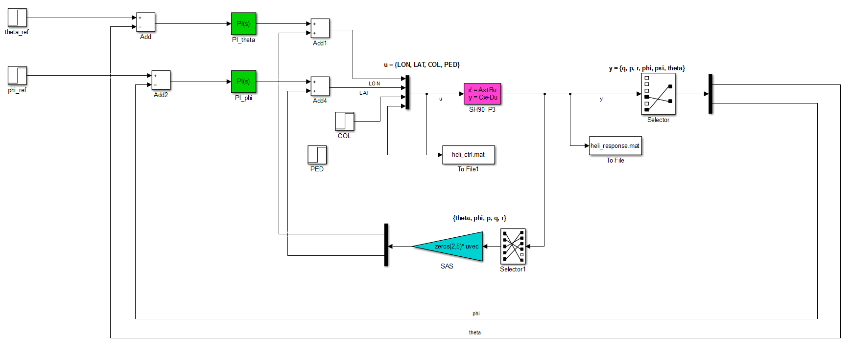
FCS scheme with yaw dynamic in open-loop (2/2)
Outer loop + inner loop implemented

Slide 12
Tuning requirements (1/2)
Track set-point in theta, phi (and r in general scheme) with zero steady-state error, defined rise times, minimal overshoot, and minimal cross-coupling
The response of theta, phi, r to step commands theta_ref, phi_ref, r_ref must resemble a decoupled first-order response with a defined time constant
The maximum mismatch (in percentage) with respect to the reference first order model response can be defined
Impose desired gain and phase margins at plant inputs and outputs
Impose limit on fast dynamics: the magnitude of the closed-loop poles must not exceed a specified value to prevent fast dynamics and jerky transients

Slide 13
Tuning requirements (2/2)
The tracking requirement is the most important and good results was obtained imposing:
first-order response with a 1 sec. time constant
less than 20% mismatch with reference first order model
It was set a gain margin of 5 dB and phase margin of 40 degrees
The magnitude of the closed-loop poles must not exceed 25
The req. 3. was not applied in this initial phase because the obtained control performance with the tuning computed imposing the only req.1 or with req.1 and req.2 together are satisfactory.

Slide 14
Results – General FCS Only outer loop, only tracking req.

Slide 15
Results – General FCS Only outer loop, only tracking req.
Block 1: PI_phi
Kp = 158
Ki = 151
Block 2: PI_theta
Kp = 111
Ki = 56.9
Block 3: PI_r
Kp = 115
Ki = 337

Slide 16
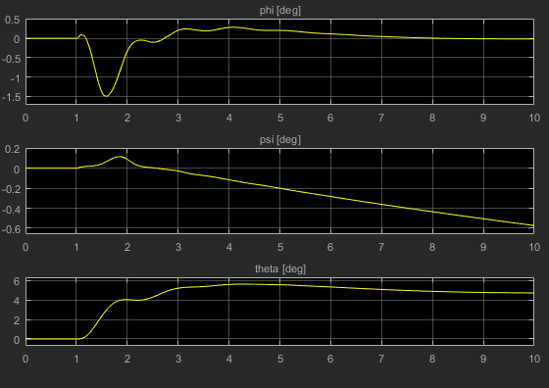
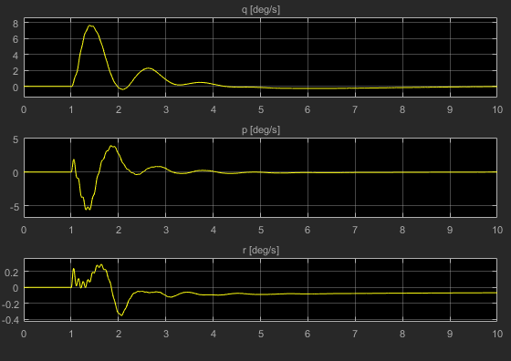
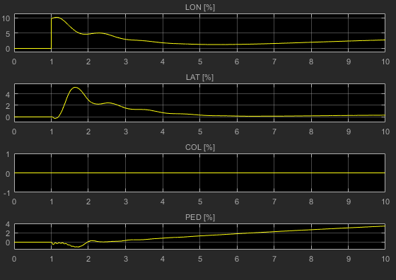
Results – General FCS Only outer loop, only tracking req.
Simulation over 10sec., imposed set-point step of 5° (from t=1sec.) on theta, null set-point on phi and r
The controller performance is not so bad but can be improved adding the inner loop

Slide 17
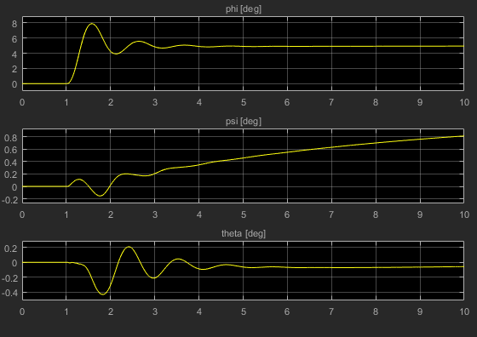
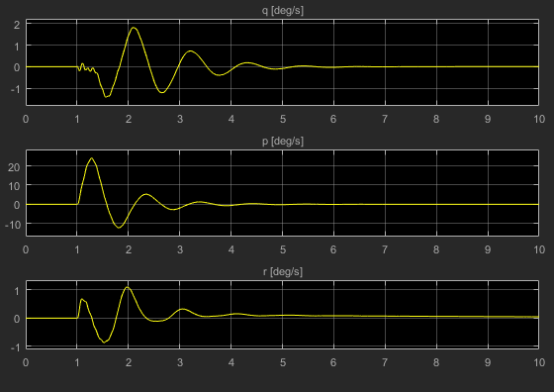
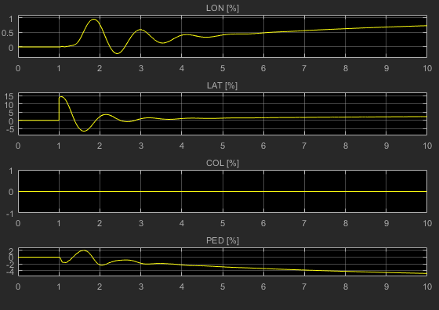
Results – General FCS Only outer loop, only tracking req.
Simulation over 10sec., imposed set-point step of 5° (from t=1sec.) on phi, null set-point on theta and r

Slide 18
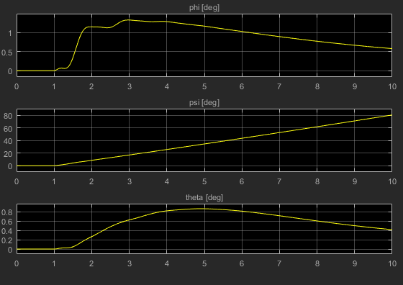
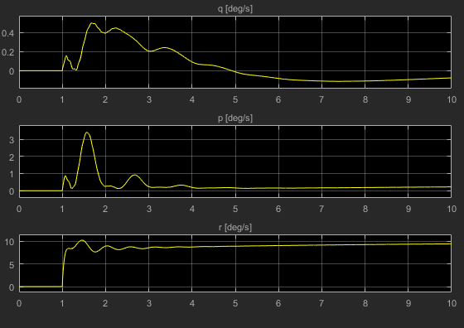
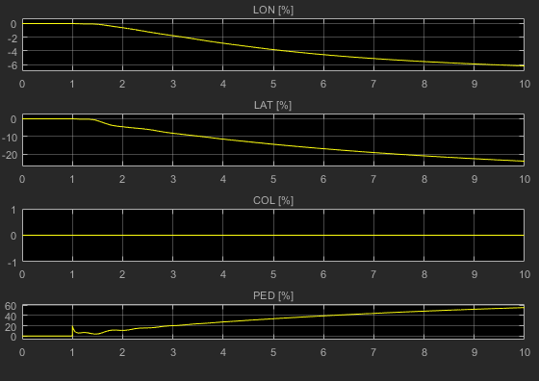
Results – General FCS Only outer loop, only tracking req.
Simulation over 10sec., imposed set-point step of 10°/s (from t=1sec.) on r, null set-point on theta and phi

Slide 19
Results – General FCS Outer loop + inner loop, only tracking req.

Slide 20
Results – General FCS Outer loop + inner loop, only tracking req.
Block 1: PI_phi
Kp = 90.4
Ki = 5.1e+03
Block 2: PI_theta
Kp = 240
Ki = 796
Block 3: PI_r
Kp = -21.6
Ki = 1.22e+05
Block 4: SAS
Static gains =
u1 u2 u3 u4 u5
y1 -778.5 4.379 16.14 -180.4 -17.04
y2 1.284 -5099 -125.5 -43.36 -48.4
y3 -45.51 -4 -26.76 63.23 -1.215e+05

Slide 21
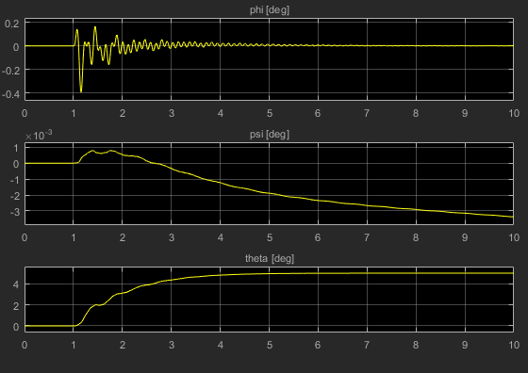
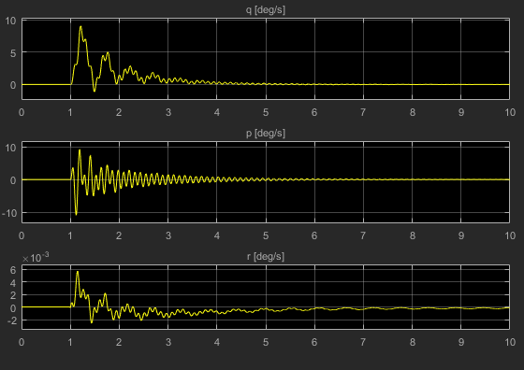
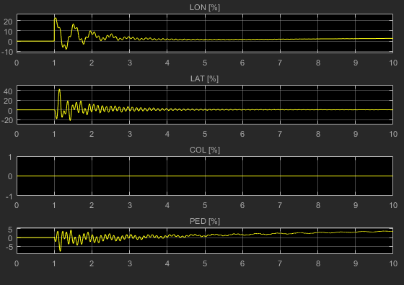
Results – General FCS Outer loop + inner loop, only tracking req.
Simulation over 10sec., imposed set-point step of 5° (from t=1sec.) on theta, null set-point on phi and r
Now the tracking performance is almost perfect but the control action seems to aggressive: add the gain/phase margin req.

Slide 22
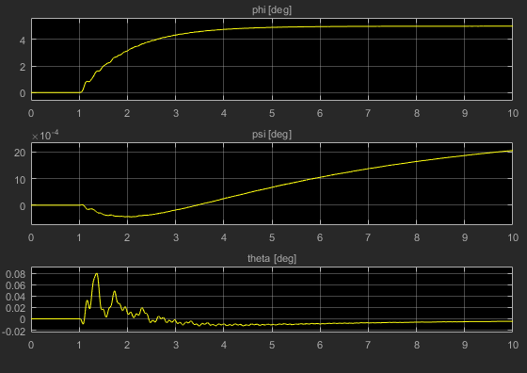
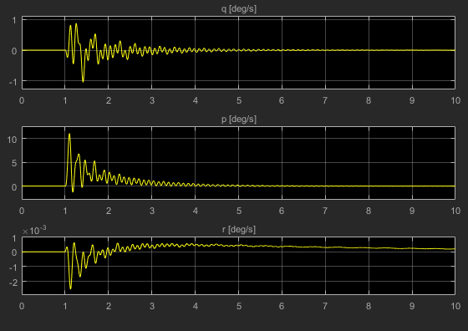
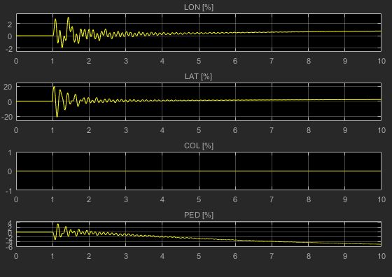
Results – General FCS Outer loop + inner loop, only tracking req.
Simulation over 10sec., imposed set-point step of 5° (from t=1sec.) on phi, null set-point on theta and r

Slide 23
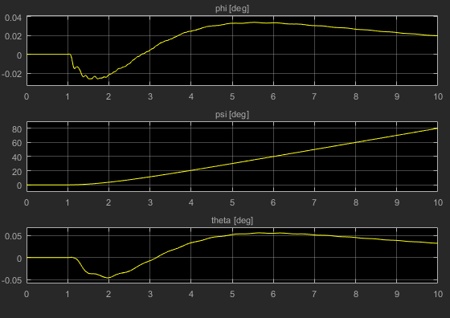
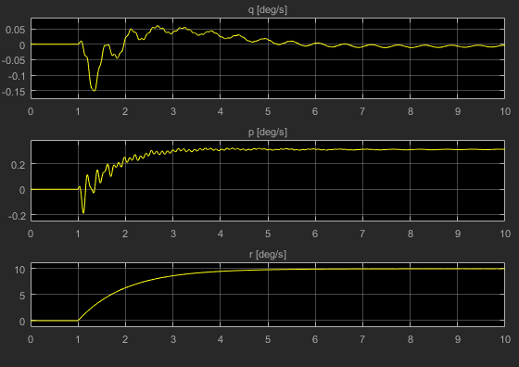
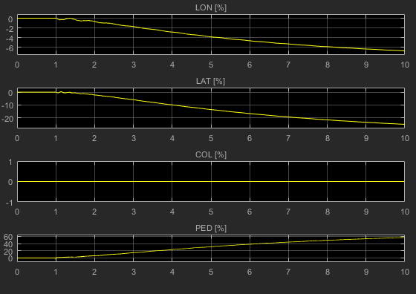
Results – General FCS Outer loop + inner loop, only tracking req.
Simulation over 10sec., imposed set-point step of 10°/s (from t=1sec.) on r, null set-point on theta and phi

Slide 24
Results – General FCS Outer loop + inner loop Tracking and gain/phase margin req.

Slide 25
Results – General FCS Outer loop + inner loop Tracking and gain/phase margin req.
Block 1: PI_phi
Kp = 22.1
Ki = 243
Block 2: PI_theta
Kp = 81.3
Ki = 106
Block 3: PI_r
Kp = -2113
Ki = 2.58e+03
Block 4: SAS
Static gains =
u1 u2 u3 u4 u5
y1 -83.99 2.665 -2.236 -10.16 -18.52
y2 -17.16 -223.8 -36.01 2.342 -35.88
y3 -89.88 -71 181.7 68.07 -2479

Slide 26
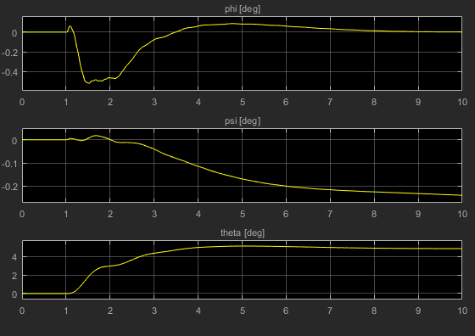
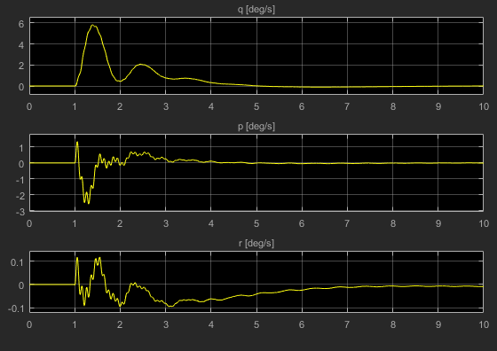
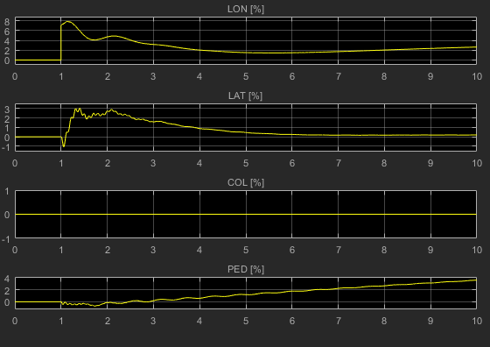
Results – General FCS Outer loop + inner loop Tracking and gain/phase margin req.
Simulation over 10sec., imposed set-point step of 5° (from t=1sec.) on theta, null set-point on phi and r
Now a good compromise between tracking performance and control effort is reached

Slide 27
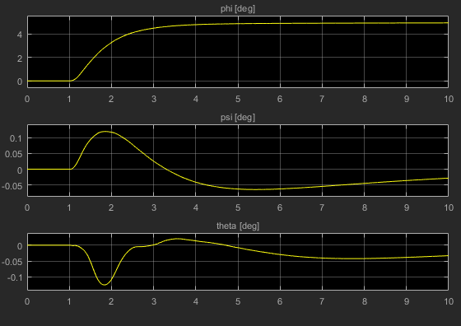
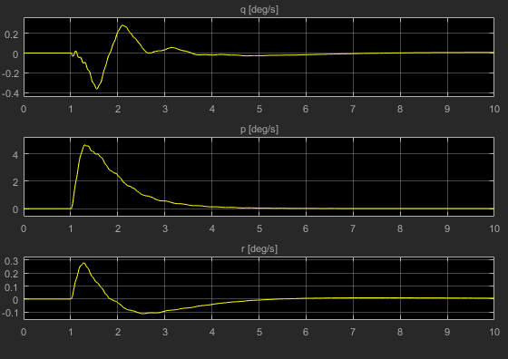
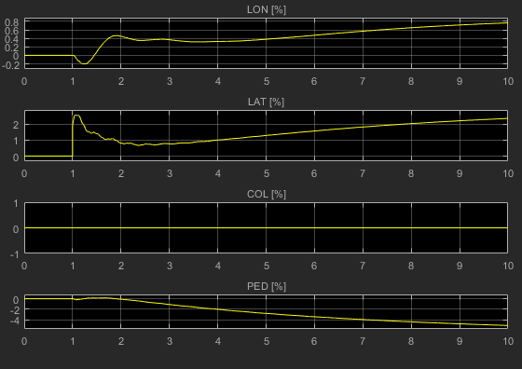
Results – General FCS Outer loop + inner loop Tracking and gain/phase margin req.
Simulation over 10sec., imposed set-point step of 5° (from t=1sec.) on phi, null set-point on theta and r

Slide 28
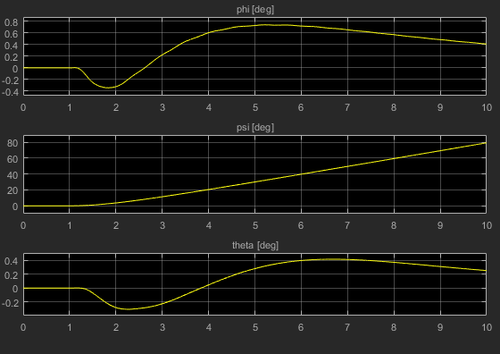
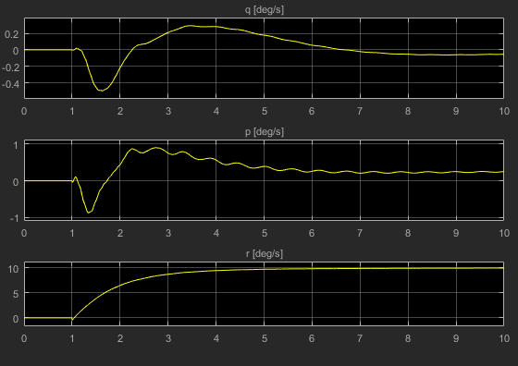
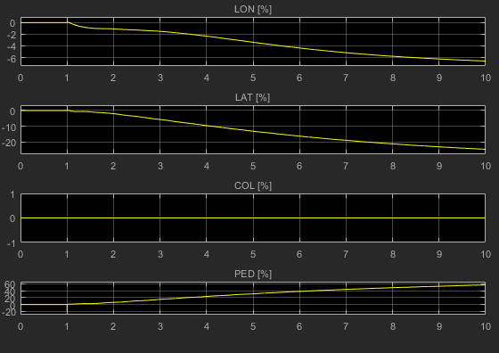
Results – General FCS Outer loop + inner loop Tracking and gain/phase margin req.
Simulation over 10sec., imposed set-point step of 10/s° (from t=1sec.) on r, null set-point on theta and phi

Slide 29
Results – FCS with yaw dynamic in open-loop Only outer loop, only tracking req.

Slide 30
Results – FCS with yaw dynamic in open-loop Only outer loop, only tracking req.
Block 1: PI_phi
Kp = 116
Ki = 41
Block 2: PI_theta
Kp = 103
Ki = 48.5

Slide 31
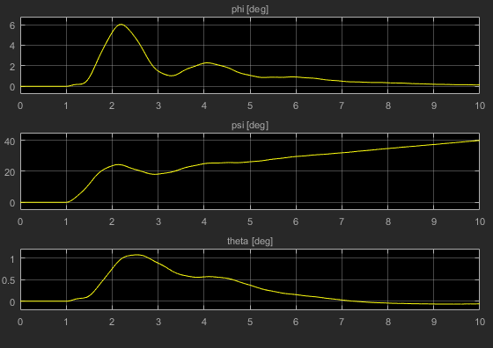
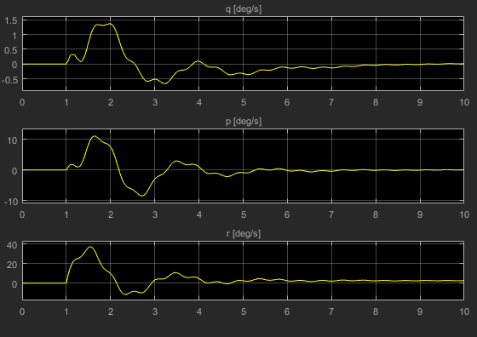
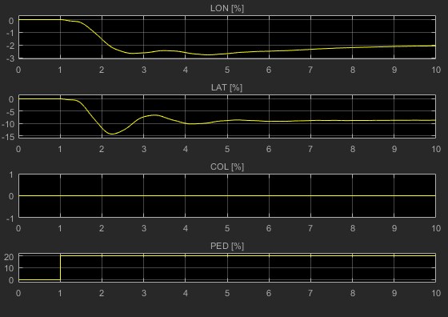
Results – FCS with yaw dynamic in open-loop Only outer loop, only tracking req.
Simulation over 10sec., imposed a pedal step command of 20% (from t=1sec.), null set-point on theta and phi
The controller performance is not so bad but can be improved adding the inner loop

Slide 32
Results – FCS with yaw dynamic in open-loop Outer loop + inner loop, only tracking req.

Slide 33
Results – FCS with yaw dynamic in open-loop Outer loop + inner loop, only tracking req.
Block 1: PI_phi
Kp = 141
Ki = 604
Block 2: PI_theta
Kp = 194
Ki = 801
Block 4: SAS
Static gains =
u1 u2 u3 u4 u5
y1 -780 -0.8222 47.49 -147 26.61
y2 11.86 -603.3 -126 24.84 -6.701

Slide 34
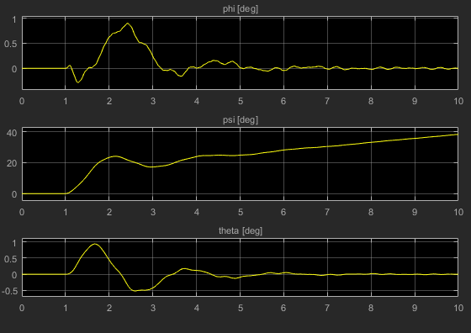
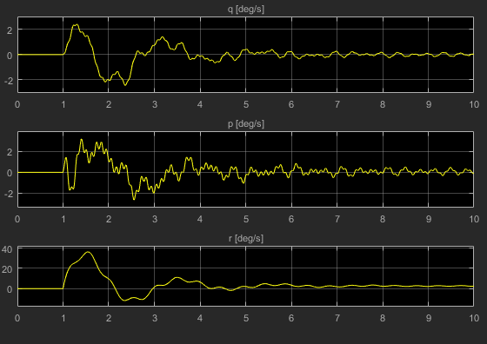
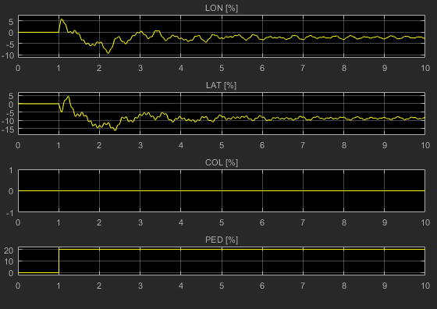
Results – FCS with yaw dynamic in open-loop Outer loop + inner loop, only tracking req.
Simulation over 10sec., imposed a pedal step command of 20% (from t=1sec.), null set-point on theta and phi

Slide 35
Conclusions
The developed procedure in Matlab/Simulink works correctly and the obtained controller performance are satisfactorily
The procedure allows to rapidly create different controller schemes, for example controlling directly the phi angle instead of the r angular velocity or opening other loops instead of the yaw (pitch or roll), depending on the maneuvers in which we are interested
It is possible also to close the loop on the collective control, but it needs to add a vertical velocity (or vertical position) output to the LTI helicopter model (list of the states name in output from Flightlab)
Defining the desired requirements, fundamentally the set-point tracking desired response (the other req. are used for tuning refinement), the optimization function “systune” is able to compute in one shot the tuning of all the controller blocks
If a different starting trim condition is of interest, the new LTI model has to be provided and the procedure can be repeated rapidly
The scheme has to be implemented in Flightlab CSGE and tested: controller performance degradation is expected considering the non-linear model instead of the linearized one, especially in condition far from the linearization trim

