Slide 1

Workplace Trends and Insights: An Exploratory Analysis of FritoLay
By Laura Ahumada and Alan Abadzic

Slide 2
Presentation Overview
MACHINE LEARNING MODELS
ADDITIONAL JOB ROLE RELATED INSIGHTS
GIVEN DATA
TOP FACTORS LEADING TO ATTRITION

Slide 3
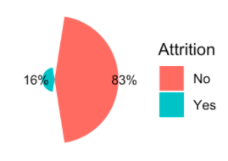
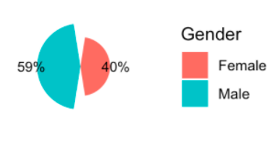
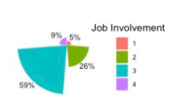
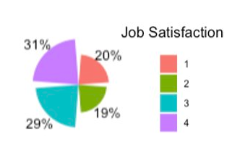
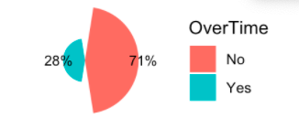
Overview of Data: Categorical

Slide 4
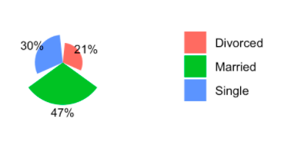
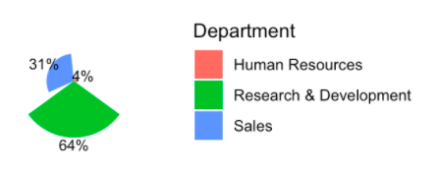

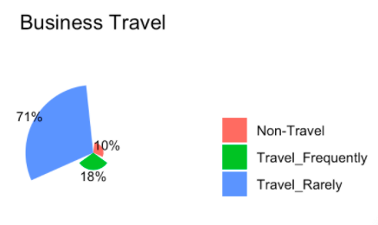
Overview of Data: Categorical

Slide 5
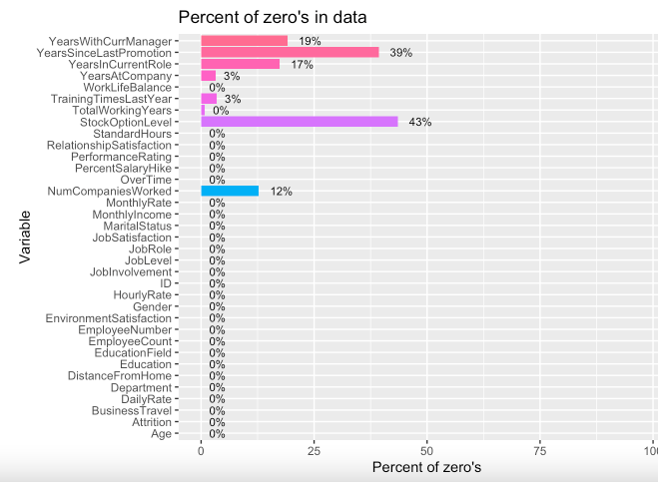
Overview of Data: Continuous
No missing values
27 Numeric Variables
The Zero's in the data seem to be valid
Most of the Zero's in the data represent the new people in the company

Slide 6
Finding the top 3 Factors of attrition
Factor | P-Value
Over time | < 2e-16
Job Involvement | 1.20e-07
Job satisfaction | 4.79e-06
Linear regression model was performed with all the data and the variables with best p-values/most influential, were selected.

Slide 7
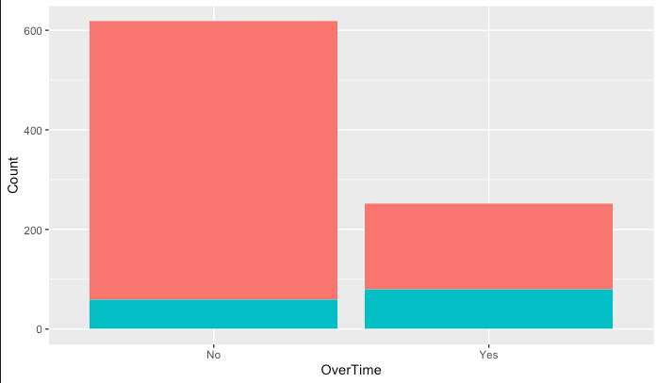

Top Factors of Attrition: Overtime
90.3%
68.3%
9.7%
31.7%

Slide 8
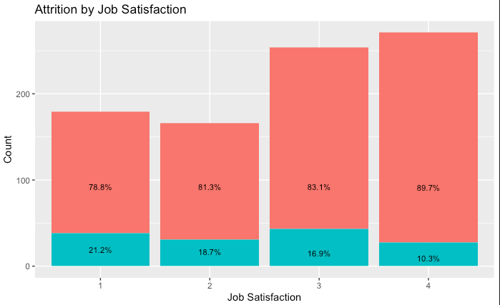
Top Factors of Attrition: Job Satisfaction

Slide 9
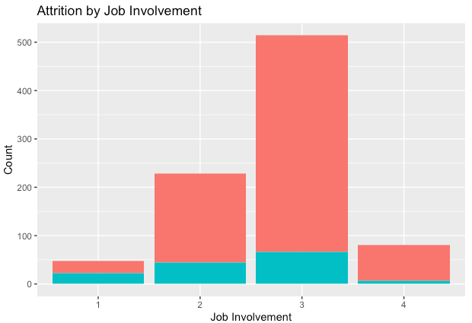
Top Factors of Attrition: Job Involvement
87%
80.7%
91.4%
53.2%
13%
19.3%
46.8%
8.6%

Slide 10
Naïve Bayes model for classifying Attrition
Features used:
Over time
Job Involvement
Job Satisfaction
Monthly Income
Marital Status
Years Since Last Promotion
Monthly Income
Environment Satisfaction
Distance From Home
Work Life Balance
Job Role
Relationship Satisfaction
Confusion Matrix
 | No | Yes
No | 217 | 13
Yes | 3 | 28
Statistic | Score
Accuracy | .92
Sensitivity | 0.61
Specificiy | 0.96
P-Value | 0.0053

Slide 11
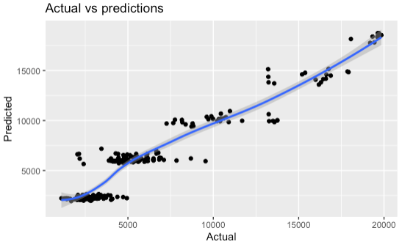
Linear regression model to predict Monthly income
Statistic | Score
RMSE | 1317
R_sq | 0.91
P-Value | < 2.2e-16
Variable | P-value
Total Working Years | 1.5e-08
Job Level | < 2e-16
Distance From Home | 0.122807
Years With Current Manager | 0.000163

Slide 12
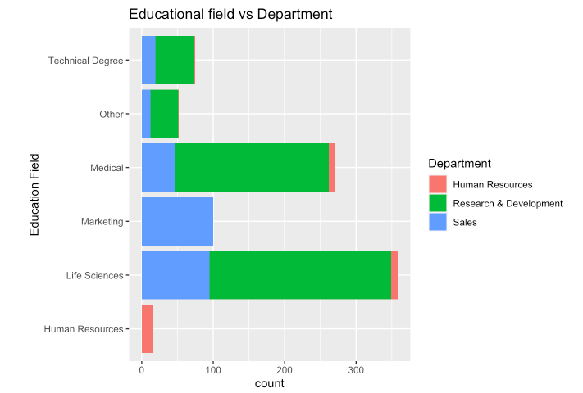
Additional Insights
Education Field vs Department
Those that studied Human Resources all work in HR
All of those that studied Marketing work in Sales

Slide 13
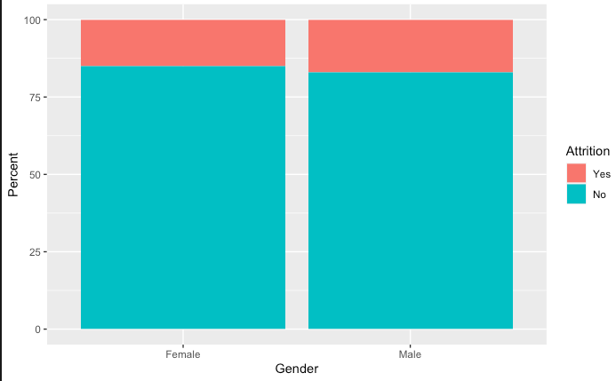
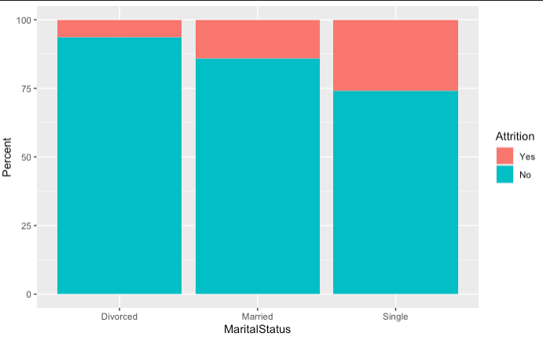
Attrition by Marital Status
Attrition by Gender
6.3%
14.1%
15%
16.9%
26%
93.7%
85.9%
74%
85%
83%

Slide 14
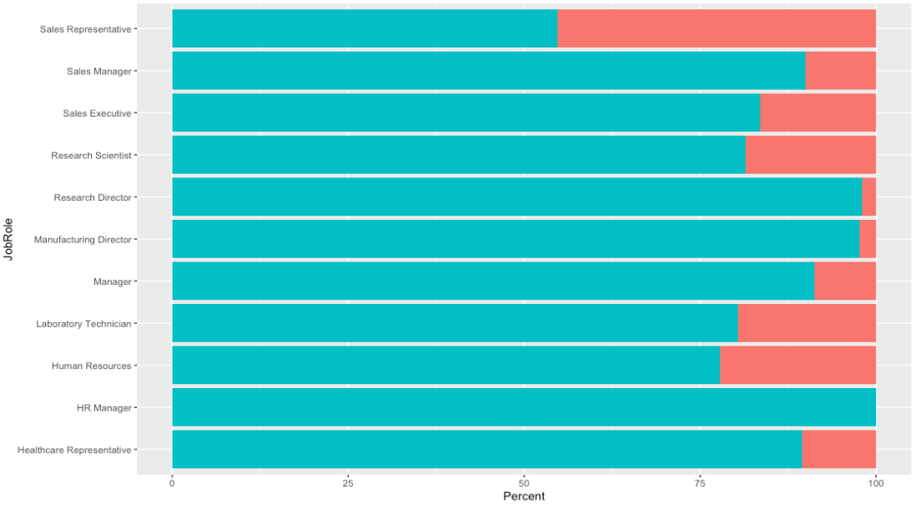
Attrition by role
Role with highest turnover rate
Role with lowest turnover rate

Slide 15
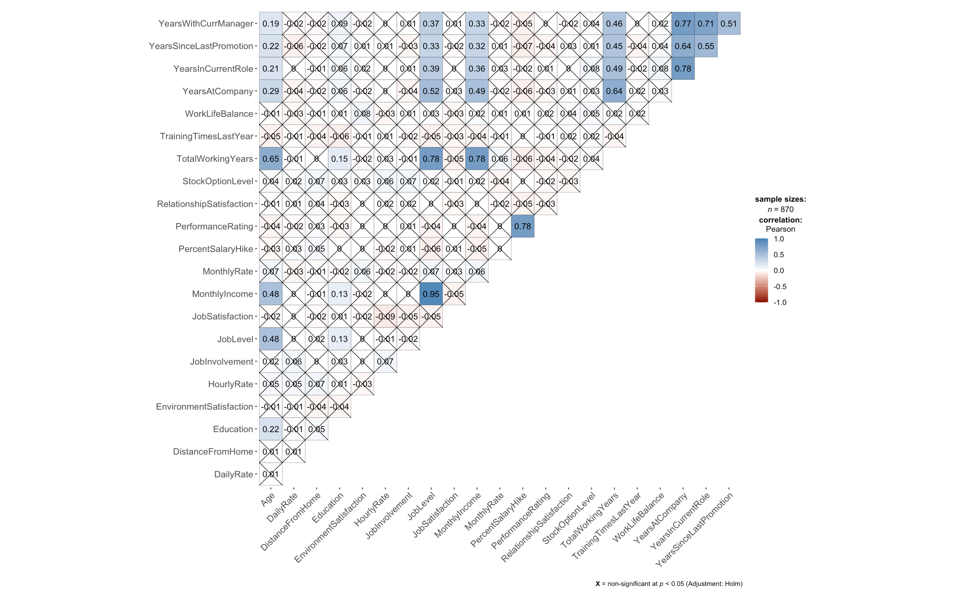
Correlation matrix
Monthly Income vs Total Years working |
Total Working Years vs Job level
Performance Rate vs Percent Salary Hike level
Monthly Income vs Job Level

Slide 16
Thank you!
Any further Question?
Aabadzic@mail.smu.edu 972-202-6916
lahumada@smu.edu 956-854-5750

