Slide 1
Review of Statistics 101
We review some important themes from the course
Introduction
Statistics- Set of methods for collecting/analyzing data (the art and science of learning from data). Provides methods for
Design - Planning/Implementing a study
Description – Graphical and numerical methods for summarizing the data
Inference – Methods for making predictions about a population (total set of subjects of interest), based on a sample

Slide 2
2. Sampling and Measurement
Variable – a characteristic that can vary in value among subjects in a sample or a population.
Types of variables
Categorical
Quantitative
Categorical variables can be ordinal (ordered categories) or nominal (unordered categories)
Quantitative variables can be continuous or discrete
Classifications affect the analysis; e.g., for categorical variables we make inferences about proportions and for quantitative variables we make inferences about means (and use t instead of normal dist.)

Slide 3
Randomization – the mechanism for achieving reliable data by reducing potential bias
Simple random sample: In a sample survey, each possible sample of size n has same chance of being selected.
Randomization in a survey used to get a good cross-section of the population. With such probability sampling methods, standard errors are valid for telling us how close sample statistics tend to be to population parameters. (Otherwise, the sampling error is unpredictable.)
Notes:
See text for discussion of random number table to help select

Slide 4
Experimental vs. observational studies
Sample surveys are examples of observational studies (merely observe subjects without any experimental manipulation)
Experimental studies: Researcher assigns subjects to experimental conditions.
  Subjects should be assigned at random to the conditions (“treatments”)
  Randomization “balances” treatment groups with respect to lurking variables that could affect response (e.g., demographic characteristics, SES), makes it easier to assess cause and effect
Notes:
At least for large n

Slide 5
3. Descriptive Statistics
Numerical descriptions of center (mean and median), variability (standard deviation – typical distance from mean), position (quartiles, percentiles)
Bivariate description uses regression/correlation (quantitative variable), contingency table analysis such as chi-squared test (categorical variables), analyzing difference between means (quantitative response and categorical explanatory)
Graphics include histogram, box plot, scatterplot

Slide 6
Mean drawn toward longer tail for skewed distributions, relative to median.
Properties of the standard deviation s:
  s increases with the amount of variation around the mean
  s depends on the units of the data (e.g. measure euro vs $)
  Like mean, affected by outliers
  Empirical rule: If distribution approx. bell-shaped,
  about 68% of data within 1 std. dev. of mean
  about 95% of data within 2 std. dev. of mean
  all or nearly all data within 3 std. dev. of mean

Slide 7
Sample statistics /
Population parameters
We distinguish between summaries of samples (statistics) and summaries of populations (parameters).
Denote statistics by Roman letters, parameters by Greek letters:
Population mean =μ, standard deviation = σ, proportion  are parameters. In practice, parameter values are unknown, we make inferences about their values using sample statistics.

Slide 8
4. Probability Distributions
Probability: With random sampling or a randomized experiment, the probability an observation takes a particular value is the proportion of times that outcome would occur in a long sequence of observations.
Usually corresponds to a population proportion (and thus falls between 0 and 1) for some real or conceptual population.
A probability distribution lists all the possible values and their probabilities (which add to 1.0)

Slide 9
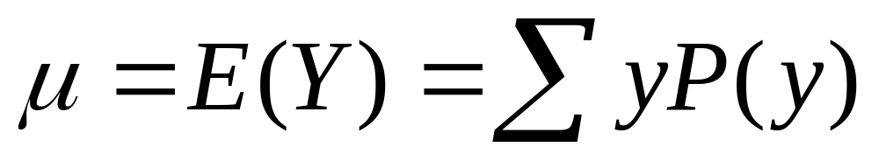
Like frequency dist’s, probability distributions have mean and standard deviation
Standard Deviation - Measure of the “typical” distance of an outcome from the mean, denoted by σ
If a distribution is approximately normal, then:
all or nearly all the distribution falls between
µ - 3σ and µ + 3σ
Probability about 0.68 falls between
µ - σ and µ + σ

Slide 10
Normal distribution
Symmetric, bell-shaped (formula in Exercise 4.56)
Characterized by mean (μ) and standard deviation (σ), representing center and spread
Prob. within any particular number of standard deviations of μ is same for all normal distributions
An individual observation from an approximately normal distribution satisfies:
  Probability 0.68 within 1 standard deviation of mean
  0.95 within 2 standard deviations
  0.997 (virtually all) within 3 standard deviations

Slide 11
Notes about z-scores
z-score represents number of standard deviations that a value falls from mean of dist.
A value y is z = (y - µ)/σ standard deviations from µ
The standard normal distribution is the normal dist with µ = 0, σ = 1 (used as sampling dist. for z test statistics in significance tests)
In inference we use z to count the number of standard errors between a sample estimate and a null hypothesis value.

Slide 12
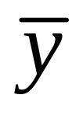
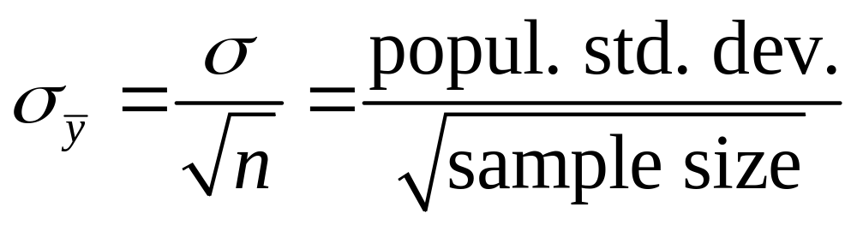
Sampling dist. of sample mean
is a variable, its value varying from sample to sample about population mean µ. Sampling distribution of a statistic is the probability distribution for the possible values of the statistic
Standard deviation of sampling dist of is called the standard error of
For random sampling, the sampling dist of
has mean µ and standard error

Slide 13
Central Limit Theorem: For random sampling with “large” n, sampling dist of sample mean is approximately a normal distribution
Approx. normality applies no matter what the shape of the popul. dist. (Figure p. 93, next page)
How “large” n needs to be depends on skew of population dist, but usually n ≥ 30 sufficient
Can be verified empirically, by simulating with “sampling distribution” applet at www.prenhall.com/agresti. Following figure shows how sampling dist depends on n and shape of population distribution.

Slide 14
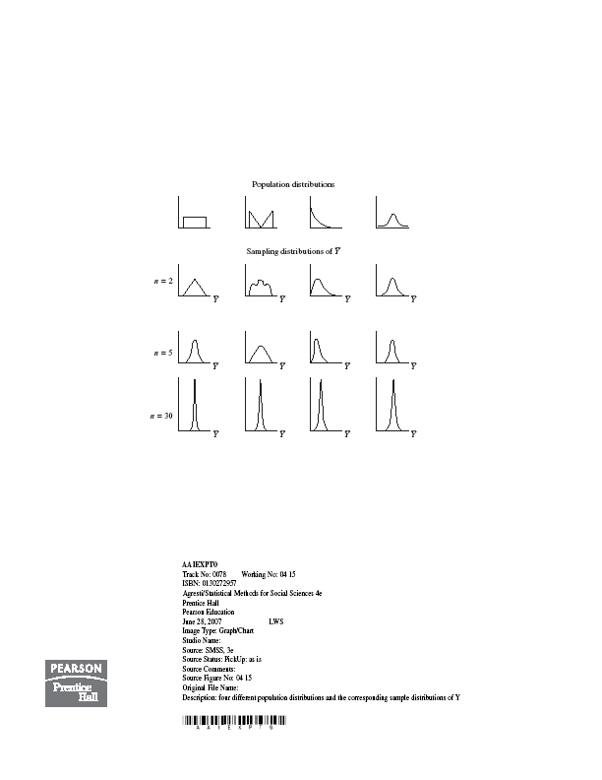

Slide 15
5. Statistical Inference: Estimation
Point estimate: A single statistic value that is the “best guess” for the parameter value (such as sample mean as point estimate of popul. mean)
Interval estimate: An interval of numbers around the point estimate, that has a fixed “confidence level” of containing the parameter value. Called a confidence interval.
(Based on sampling dist. of the point estimate, has form point estimate plus and minus a margin of error that is a z or t score times the standard error)

Slide 16

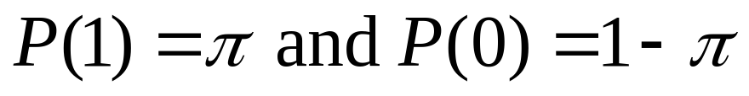
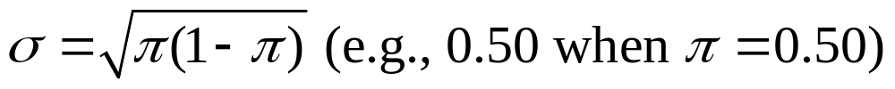
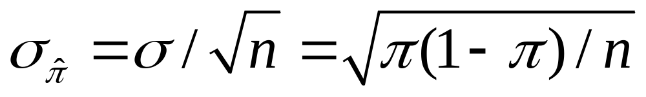
Conf. Interval for a Proportion
(in a particular category)
Sample proportion is a mean when we let y=1 for observation in category of interest, y=0 otherwise
Population prop. is mean µ of prob. dist having
The standard dev. of this prob. dist. is
The standard error of the sample proportion is

Slide 17
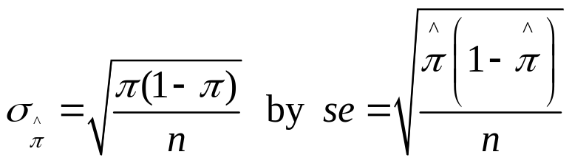

Finding a CI in practice
Complication: The true standard error
itself depends on the unknown parameter!
In practice, we estimate
and then find 95% CI using formula

Slide 18
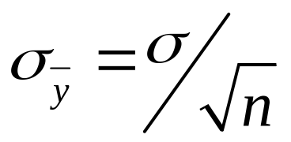
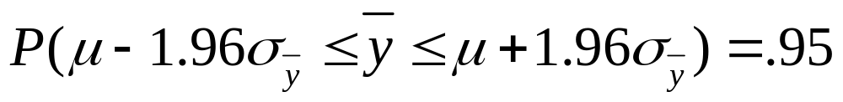
Confidence Interval for the Mean
In large samples, the sample mean has approx. a normal sampling distribution with mean μ and standard error
Thus,
We can be 95% confident that the sample mean lies within 1.96 standard errors of the (unknown) population mean

Slide 19
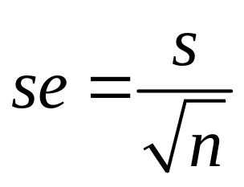
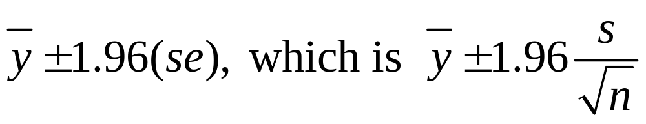
Problem: Standard error is unknown (σ is also a parameter). It is estimated by replacing σ with its point estimate from the sample data:
95% confidence interval for μ :
This works ok for “large n,” because s then a good estimate of σ (and CLT). But for small n, replacing σ by its estimate s introduces extra error, and CI is not quite wide enough unless we replace z-score by a slightly larger “t-score.”

Slide 20
The t distribution (Student’s t)
Bell-shaped, symmetric about 0
Standard deviation a bit larger than 1 (slightly thicker tails than standard normal distribution, which has mean = 0, standard deviation = 1)
Precise shape depends on degrees of freedom (df). For inference about mean,
df = n – 1
More closely resembles standard normal dist. as df increases
(nearly identical when df > 30)
CI for mean has margin of error t(se)

Slide 21
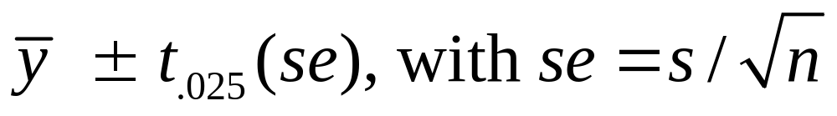
CI for a population mean
For a random sample from a normal population distribution, a 95% CI for µ is
where df = n-1 for the t-score
Normal population assumption ensures sampling dist. has bell shape for any n (Recall figure on p. 93 of text and next page). Method is robust to violation of normal assumption, more so for large n because of CLT.

Slide 22
6. Statistical Inference: Significance Tests
A significance test uses data to summarize evidence about a hypothesis by comparing sample estimates of parameters to values predicted by the hypothesis.
We answer a question such as, “If the hypothesis were true, would it be unlikely to get estimates such as we obtained?”
.

Slide 23
Five Parts of a Significance Test
Assumptions about type of data (quantitative, categorical), sampling method (random), population distribution (binary, normal), sample size (large?)
Hypotheses:
Null hypothesis (H₀): A statement that parameter(s) take specific value(s) (Often: “no effect”)
Alternative hypothesis (H_{a}): states that parameter value(s) in some alternative range of values

Slide 24
Test Statistic: Compares data to what null hypo. H₀ predicts, often by finding the number of standard errors between sample estimate and H₀ value of parameter
P-value (P): A probability measure of evidence about H₀, giving the probability (under presumption that H₀ true) that the test statistic equals observed value or value even more extreme in direction predicted by H_{a}.
  The smaller the P-value, the stronger the evidence against H_{0.}
Conclusion:
  If no decision needed, report and interpret P-value

Slide 25
  If decision needed, select a cutoff point (such as 0.05 or 0.01) and reject H₀ if P-value ≤ that value
  The most widely accepted minimum level is 0.05, and the test is said to be significant at the .05 level if the P-value ≤ 0.05.
  If the P-value is not sufficiently small, we fail to reject H₀ (not necessarily true, but plausible). We should not say “Accept H₀”
  The cutoff point, also called the significance level of the test, is also the prob. of Type I error – i.e., if null true, the probability we will incorrectly reject it.
  Can’t make significance level too small, because then run risk that P(Type II error) = P(do not reject null) when it is false too large

Slide 26
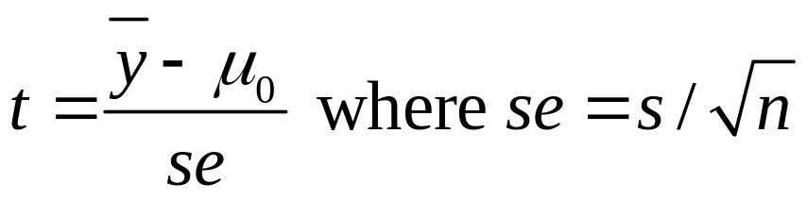
Significance Test for Mean
Assumptions: Randomization, quantitative variable, normal population distribution
Null Hypothesis: H₀: µ = µ₀ where µ₀ is particular value for population mean (typically no effect or change from standard)
Alternative Hypothesis: H_{a}: µ ≠ µ₀ (2-sided alternative includes both > and <), or one-sided
Test Statistic: The number of standard errors the sample mean falls from the H₀ value

Slide 27
Effect of sample size on tests
With large n (say, n > 30), assumption of normal population dist. not important because of Central Limit Theorem.
For small n, the two-sided t test is robust against violations of that assumption. One-sided test is not robust.
For a given observed sample mean and standard deviation, the larger the sample size n, the larger the test statistic (because se in denominator is smaller) and the smaller the P-value. (i.e., we have more evidence with more data)
We’re more likely to reject a false H₀ when we have a larger sample size (the test then has more “power”)
With large n, “statistical significance” not the same as “practical significance”. Should also find CI to see how far parameter may fall from H₀

Slide 28
Significance Test for a Proportion 
Assumptions:
  Categorical variable
  Randomization
  Large sample (but two-sided ok for nearly all n)
Hypotheses:
  Null hypothesis: H₀: π = π₀
  Alternative hypothesis: H_{a}: π ≠ π₀ (2-sided)
  H_{a}: π > π₀ H_{a}: π < π₀ (1-sided)
  (choose before getting the data)

Slide 29
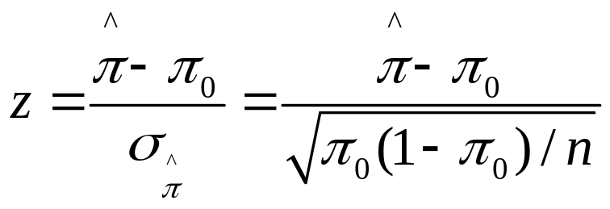
Test statistic:
Note
As in test for mean, test statistic has form
(estimate of parameter – null value)/(standard error)
= no. of standard errors estimate falls from null value
P-value:
  H_{a}: π ≠ π₀ P = 2-tail prob. from standard normal
  H_{a}: π > π₀ P = right-tail prob. from std. normal
  H_{a}: π < π₀ P = left-tail prob. from std. normal
Conclusion: As in test for mean (e.g., reject H₀ if P-value ≤ )

Slide 30
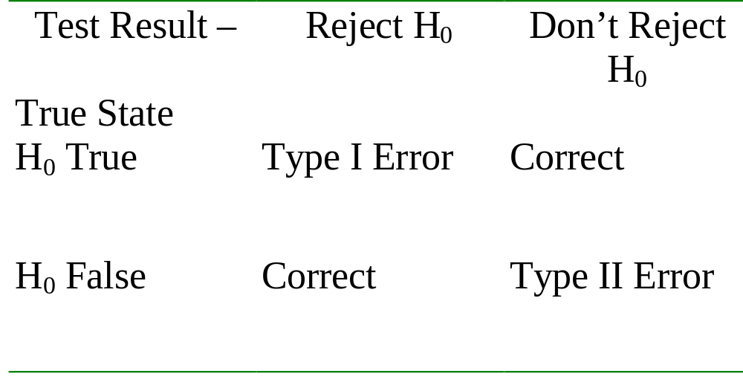
Error Types
Type I Error: Reject H₀ when it is true
Type II Error: Do not reject H₀ when it is false

Slide 31
Limitations of significance tests
Statistical significance does not mean practical significance
Significance tests don’t tell us about the size of the effect (like a CI does)
Some tests may be “statistically significant” just by chance (and some journals only report “significant” results)
Example: Many medical “discoveries” are really Type I errors (and true effects are often much weaker than first reported). Read Example 6.8 on p. 165 of text.

Slide 32
Chap. 7. Comparing Two Groups
Distinguish between response and explanatory variables, independent and dependent samples
Comparing means is bivariate method with quantitative response variable, categorical (binary) explanatory variable
Comparing proportions is bivariate method with categorical response variable, categorical (binary) explanatory variable

Slide 33
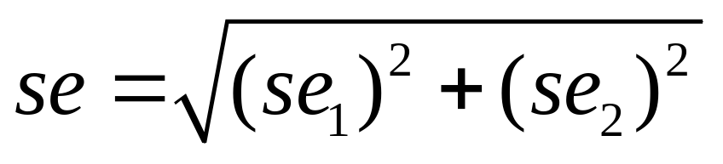
se for difference between two estimates (independent samples)
The sampling distribution of the difference between two estimates (two sample proportions or two sample means) is approximately normal (large n₁ and n₂) and has estimated

Slide 34
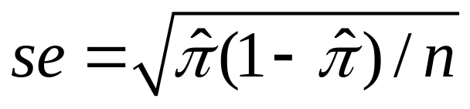
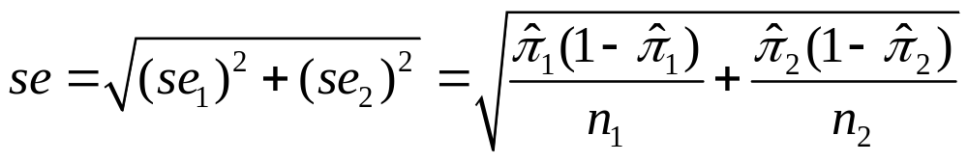
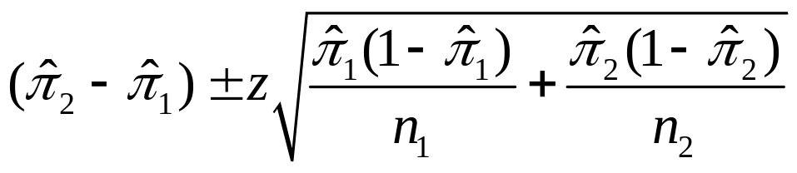
CI comparing two proportions
Recall se for a sample proportion used in a CI is
So, the se for the difference between sample proportions for two independent samples is
A CI for the difference between population proportions is
(as usual, z depends on confidence level, 1.96 for 95% conf.)

Slide 35
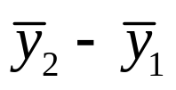
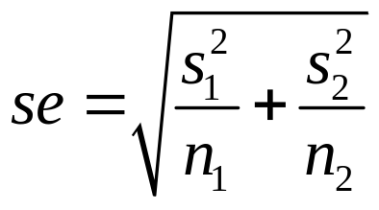
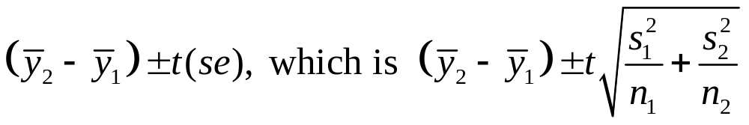
Quantitative Responses:
Comparing Means
Parameter: μ₂-μ₁
Estimator:
Estimated standard error:
  Sampling dist.: Approx. normal (large n’s, by CLT), get approx. t dist. when substitute estimated std. error in t stat.
  CI for independent random samples from two normal population distributions has form
  Alternative approach assumes equal variability for the two groups, is special case of ANOVA for comparing means in Chapter 12

Slide 36
Comments about CIs for difference between two parameters
When 0 is not in the CI, can conclude that one population parameter is higher than the other.
(e.g., if all positive values when take Group 2 – Group 1, then conclude parameter is higher for Group 2 than Group 1)
When 0 is in the CI, it is plausible that the population parameters are identical.
Example: Suppose 95% CI for difference in population proportion between Group 2 and Group 1 is (-0.01, 0.03)
Then we can be 95% confident that the population proportion was between about 0.01 smaller and 0.03 larger for Group 2 than for Group 1.

Slide 37

Comparing Means with Dependent Samples
Setting: Each sample has the same subjects (as in longitudinal studies or crossover studies) or matched pairs of subjects
Data: y_{i} = difference in scores for subject (pair) i
Treat data as single sample of difference scores, with sample mean and sample standard deviation s_{d} and parameter μ_{d} = population mean difference score which equals difference of population means.

Slide 38
Chap. 8. Association between Categorical Variables
Statistical analyses for when both response and explanatory variables are categorical.
Statistical independence (no association): Population conditional distributions on one variable the same for all categories of the other variable
Statistical dependence (association): Population conditional distributions are not all identical

Slide 39
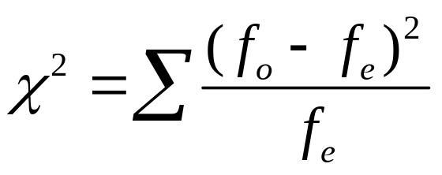
Chi-Squared Test of Independence (Karl Pearson, 1900)
Tests H₀: variables are statistically independent
H_{a}: variables are statistically dependent
Summarize closeness of observed cell counts {f_{o}} and expected frequencies {f_{e}} by
with sum taken over all cells in table.
Has chi-squared distribution with df = (r-1)(c-1)

Slide 40
For 2-by-2 tables, chi-squared test of independence (df = 1) is equivalent to testing H₀: ₁ = ₂ for comparing two population proportions.
Proportion
Population Response 1 Response 2
1 ₁ 1 - ₁
2 ₂ 1 - ₂
H₀: ₁ = ₂ equivalent to
H₀: response independent of population
Then, chi-squared statistic (df = 1) is square of z test statistic,
z = (difference between sample proportions)/se₀.

Slide 41
Residuals:
Detecting Patterns of Association
Large chi-squared implies strong evidence of association but does not tell us about nature of assoc. We can investigate this by finding the standardized residual in each cell of the contingency table,
z = (f_{o}-f_{e})/se,
Measures number of standard errors that (f_{o}-f_{e}) falls from value of 0 expected when H₀ true.
Informally inspect, with values larger than about 3 in absolute value giving evidence of more (positive residual) or fewer (negative residual) subjects in that cell than predicted by independence.

Slide 42
Measures of Association
Chi-squared test answers “Is there an association?”
Standardized residuals answer “How do data differ from what independence predicts?”
We answer “How strong is the association?” using a measure of the strength of association, such as the difference of proportions, the relative risk = ratio of proportions, and the odds ratio, which is the ratio of odds, where
odds = probability/(1 – probability)

Slide 43
Limitations of the chi-squared test
The chi-squared test merely analyzes the extent of evidence that there is an association (through the P-value of the test)
Does not tell us the nature of the association (standardized residuals are useful for this)
Does not tell us the strength of association. (e.g., a large chi-squared test statistic and small P-value indicates strong evidence of assoc. but not necessarily a strong association.)

Slide 44

Ch. 9. Linear Regression and Correlation
Data: y – a quantitative response variable
x – a quantitative explanatory variable
We consider:
Is there an association? (test of independence using slope)
How strong is the association? (uses correlation r and r²)
How can we predict y using x? (estimate a regression equation)
  Linear regression equation E(y) = α + β x describes how mean of conditional distribution of y changes as x changes
  Least squares estimates this and provides a sample prediction equation

Slide 45
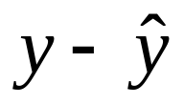

The linear regression equation E(y) =  +  x is part of a model. The model has another parameter σ that describes the variability of the conditional distributions; that is, the variability of y values for all subjects having the same x-value.
For an observation, difference between observed value of y and predicted value of y,
is a residual (vertical distance on scatterplot)
Least squares method mimimizes the sum of squared residuals (errors), which is SSE used also in r² and the estimate s of conditional standard deviation of y

Slide 46
Measuring association: The correlation and its square
  The correlation is a standardized slope that does not depend on units
  Correlation r relates to slope b of prediction equation by
r = b(s_{x}/s_{y})
-1 ≤ r ≤ +1, with r having same sign as b and r = 1 or -1 when all sample points fall exactly on prediction line, so r describes strength of linear association
The larger the absolute value, the stronger the association
Correlation implies that predictions regress toward the mean

Slide 47
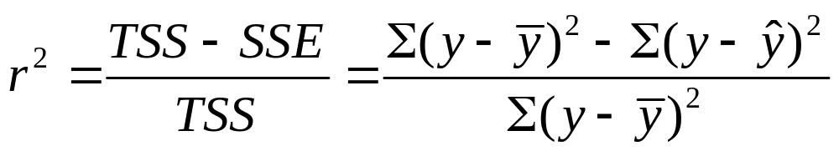
The proportional reduction in error in using x to predict y (via the prediction equation) instead of using sample mean of y to predict y is
Since -1 ≤ r ≤ +1, 0 ≤ r² ≤ 1, and r² = 1 when all sample points fall exactly on prediction line
r and r² do not depend on units, or distinction between x, y
The r and r² values tend to weaken when we observe x only over a restricted range, and they can also be highly influenced by outliers.

Slide 48
Inference for regression model
Parameter: Population slope in regression model (β)
H₀: independence is H₀:  = 0
Test statistic t = (b – 0)/se, with df = n – 2
A CI for  has form b ± t(se)
where t-score has df = n-2 and is from t-table with half the error probability in each tail. (Same se as in test)
In practice, CI for multiple of slope may be more relevant (find by multiplying endpoints by the relevant constant)
CI not containing 0 equivalent to rejecting H₀ (when error probability is same for each)

Slide 49
Software reports SS values (SSE, regression SS, TSS = regression SS + SSE) and the test results in an ANOVA (analysis of variance) table
The F statistic in the ANOVA table is the square of the t statistic for testing H₀:  = 0, and it has the same P-value as for the two-sided test.
We need to use F when we have several parameters in H₀ , such as in testing that all  parameters in a multiple regression model = 0 (which we did in Chapter 11)

Slide 50
Chap. 10. Introduction to Multivariate Relationships
Bivariate analyses informative, but we usually need to take into account many variables.
Many explanatory variables have an influence on any particular response variable.
The effect of an explanatory variable on a response variable may change when we take into account other variables. (Recall admissions into Berkeley example)
When each pair of variables is associated, then a bivariate association for two variables may differ from its “partial” association, controlling for another variable

Slide 51
Association does not imply causation!
With observational data, effect of X on Y may be partly due to association of X and Y with other lurking variables.
Experimental studies have advantage of being able to control potential lurking variables (groups being compared should be roughly “balanced” on them).
When X₁ and X₂ both have effects on Y but are also associated with each other, there is confounding. It’s difficult to determine whether either truly causes Y, because a variable’s effect could be at least partially due to its association with the other variable.

Slide 52
Simpson’s paradox: It is possible for the (bivariate) association between two variables to be positive, yet be negative at each fixed level of a third variable (or reverse)
Spurious association: Y and X₁ both depend on X₂ and association disappears after controlling X₂
Multiple causes more common, in which explanatory variables have associations among themselves as well as with response var. Effect of any one changes depending on what other variables controlled (statistically), often because it has a direct effect and also indirect effects.
Statistical interaction – Effect of X₁ on Y changes as the level of X₂ changes.

Slide 53
Chap. 11. Multiple Regression
y – response variable
x₁, x₂ , … , x_{k} -- set of explanatory variables
All variables assumed to be quantitative (later chapters incorporate categorical variables in model also)
Multiple regression equation (population):
E(y) = α + β₁x₁ + β₂x₂ + …. + β_{k}x_{k}
Controlling for other predictors in model, there is a linear relationship between E(y) and x₁ with slope β_{1.}

Slide 54
Partial effects in multiple regression refer to statistically controlling other variables in model, so differ from effects in bivariate models, which ignore all other variables.
Partial effect of a predictor in multiple regression is identical at all fixed values of other predictors in model (assumption of “no interaction”)
Again, this is a model. We fit it using least squares, minimizing SSE out of all equations of the assumed form. The model may not be appropriate (e.g., if there is severe interaction).
Graphics include scatterplot matrix (corresponding to correlation matrix), partial regression plots

Slide 55
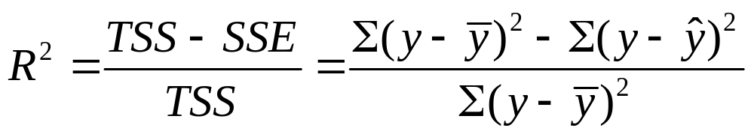
Multiple correlation and R²
The multiple correlation R is the correlation between the observed y-values and predicted y-values.
R² is the proportional reduction in error from using the prediction equation (instead of sample mean) to predict y
0 ≤ R² ≤ 1 and 0 ≤ R ≤ 1.
R² cannot decrease (and SSE cannot increase) when predictors are added to a regression model
The numerator of R² (namely, TSS – SSE) is the regression sum of squares, the variability in y “explained” by the regression model.

Slide 56
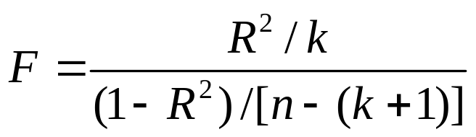
Inference for multiple regression model
To test whether explanatory variables collectively have effect on y, we test
H₀ : ₁ = ₂ = … = _{k} = 0
Test statistic
When H₀ true, F values follow the F distribution
df₁ = k (no. of predictors in model)
df₂ = n – (k+1) (sample size – no. model
parameters)

Slide 57
Inferences for individual regression coefficients
To test partial effect of x_{i} controlling for the other explan. var’s in model, test H₀: _{i} = 0 using test stat.
t = (b_{i} – 0)/se, df = n-(k+1)
CI for _{i} has form b_{i} ± t(se), with t-score also having
df = n-(k+1), for the desired confidence level
Partial t test results can seem logically inconsistent with result of F test, when explanatory variables are highly correlated

Slide 58
Modeling interaction
The multiple regression model
E(y) = α + β₁x₁ + β₂x₂ + …. + β_{k}x_{k}
assumes the partial slope relating y to each x_{i} is the same at all values of other predictors
Model allowing interaction (e.g., for 2 predictors),
E(y) = α + β₁x₁ + β₂x₂ + β₃(x₁x₂)
= (α + β₂x₂) + (β₁ + β₃x₂)x₁
is special case of multiple regression model
E(y) = α + β₁x₁ + β₂x₂ + β₃x₃
with x₃ = x₁x₂

Slide 59
Chap. 12: Comparing Several Groups (ANOVA)
Classification of bivariate methods:
Response y Explanatory x var’s Method
Categorical Categorical Contingency tables (Ch. 8)
(chi-squared, etc.)
Quantitative Quantitative Regression and correlation
(Ch 9 bivariate, 11 multiple regr.)
Quantitative Categorical ANOVA (Ch. 12)
Ch. 12 compares the mean of y for the groups corresponding to the categories of the categorical explanatory variables.

Slide 60
Comparing means across categories of one classification (1-way ANOVA)
The analysis of variance (ANOVA) is an F test of
H₀: μ₁ = μ₂ = ⋅⋅⋅ = μ_{g}
H_{a}: The means are not all identical
The F test statistic is large (and P-value is small) if variability between groups is large relative to variability within groups
F statistic has mean about 1 when null true

Slide 61
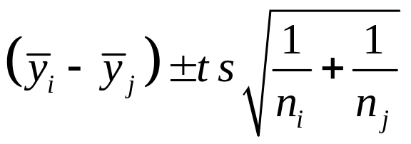
Follow-up Comparisons of Pairs of Means
A CI for the difference (µ_{i} -µ_{j}) is
where s is square root of within-groups variance estimate.
Multiple comparisons: Obtain confidence intervals for all pairs of group mean difference, with fixed probability that entire set of CI’s is correct.
The Bonferroni approach does this by dividing the overall desired error rate by the number of comparisons to get error rate for each comparison

Slide 62
Regression Approach To ANOVA
Dummy (indicator) variable: Equals 1 if observation from a particular group, 0 if not.
Regression model: E(y) = α + β₁z₁ + ... + β_{g-1}z_{g-1}
(e.g., z₁ = 1 for subjects in group 1, = 0 otherwise)
Mean for group i (i = 1 , ... , g - 1): μ_{i} = α + β_{i}
Mean for group g: μ_{g} = α
Regression coefficient β_{i} = μ_{i} - μ_{g} compares each mean to mean for last group
1-way ANOVA: H₀: μ₁= … =μ_{g} corresponds in regression to testing H₀: β₁ = ... = β_{g-1} = 0.

Slide 63
Two-way ANOVA
Analyzes relationship between quantitative response y and two categorical explanatory factors.
A main effect hypothesis states that the means are equal across levels of one factor, within levels of the other factor.
First test H0: no interaction. Testing main effects only sensible if there is no significant interaction; i.e., effect of each factor is the same at each category for the other factor.
You should be able to give examples of population means that have no interaction and means that show a main effect without an interaction.

