Slide 1
11. Multiple Regression
y – response variable
x₁, x₂ , … , x_{k} -- a set of explanatory variables
In this chapter, all variables assumed to be quantitative.
Multiple regression equation (population):
E(y) = α + β₁x₁ + β₂x₂ + …. + β_{k}x_{k}

Slide 2
Parameter Interpretation
α = E(y) when x₁ = x₂ = … = x_{k} = 0.
β₁, β₂ , … , β_{k} are called partial regression coefficients.
Controlling for other predictors in model, there is a linear relationship between E(y) and x₁ with slope β_{1.}
i.e., consider case of k = 2 explanatory variables,
E(y) = α + β₁x₁ + β₂x₂
If x₁ goes up 1 unit with x₂ held constant, the change in E(y) is
[α + β₁(x₁ + 1) + β₂x₂] – [α + β₁x₁ + β₂x₂] = β_{1.}

Slide 3
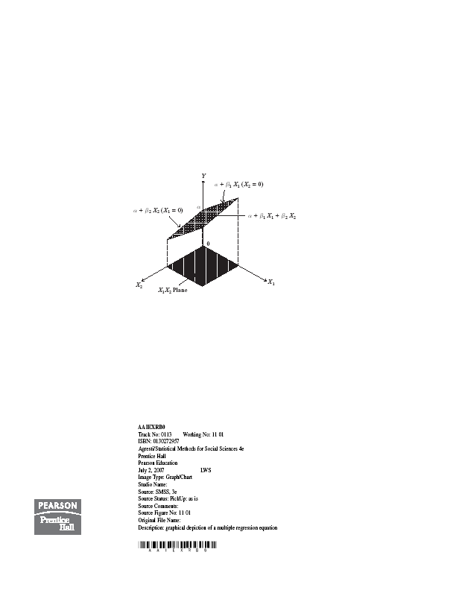

Slide 4
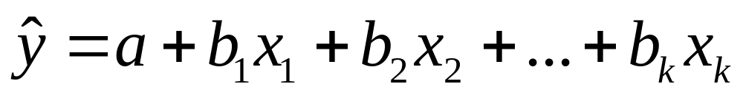
Prediction equation
With sample data, software finds “least squares” estimates of parameters by minimizing
SSE = sum of squared prediction errors (residuals)
= (observed y – predicted y)²
Denote the sample prediction equation by

Slide 5
Example: Mental impairment study
y = mental impairment (summarizes extent of psychiatric symptoms, including aspects of anxiety and depression, based on questions in “Health opinion survey” with possible responses hardly ever, sometimes, often)
x₁ = life events score (composite measure of number and severity of life events in previous 3 years)
x₂ = socioeconomic status (composite index based on occupation, income, and education)
Data set (n = 40) at www.stat.ufl.edu/~aa/social/data.html and p. 327 of text

Slide 6
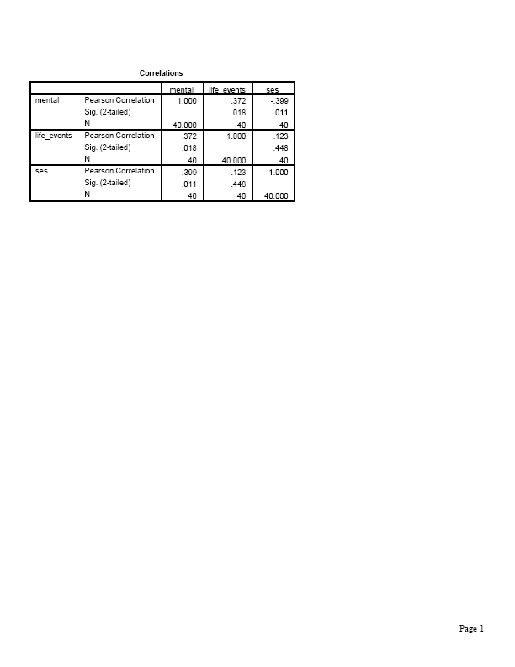
Other predictors in study, not used here, included age, marital status, gender, race
Bivariate regression analyses give prediction equations:
Correlation matrix

Slide 7
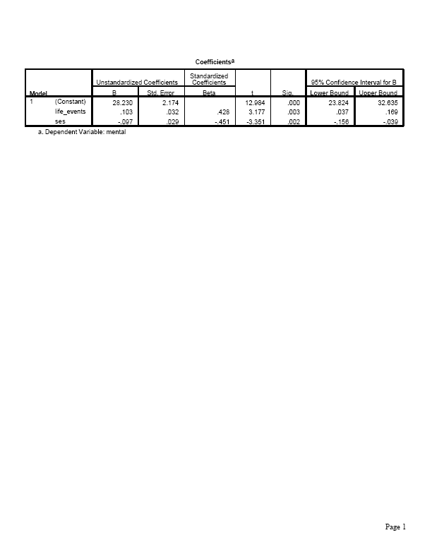
Prediction equation for multiple regression analysis is:

Slide 8
Predicted mental impairment:
increases by for each 1-unit increase in life events, controlling for SES.
decreases by for each 1-unit increase in SES, controlling for life events.
(e.g., decreases by when SES goes from minimum of 0 to maximum of 100, which is relatively large since sample standard deviation of y is 5)

Slide 9
Can we compare the estimated partial regression coefficients to determine which explanatory variable is “most important” in the predictions?
These estimates are unstandardized and so depend on units.
Standardized coefficients” presented in multiple regression output refer to partial effect of a standard deviation increase in a predictor, keeping other predictors constant. (Sec. 11.8).
In bivariate regression, standardized coeff. = correlation. In multiple regression, stand. coeff. relates algebraically to “partial correlations” (Sec. 11.7).

Slide 10
Predicted values and residuals
One subject in the data file has
y = 33, x₁ = 45 (near mean), x₂ = 55 (near mean)
This subject has predicted mental impairment
(near mean)
The prediction error (residual) is
i.e., this person has mental impairment higher than predicted given his/her values of life events, SES.
SSE = smaller than SSE for either bivariate model or for any other linear equation with predictors x_{1 ,} x₂.

Slide 11
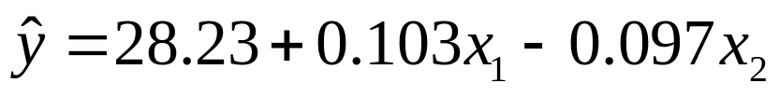
Comments
Partial effects in multiple regression refer to controlling other variables in model, so differ from effects in bivariate models, which ignore all other variables.
Partial effect of x₁ (controlling for x₂) is same as bivariate effect of x₁ when correlation = 0 between x₁ and x₂
(as is true in most designed experiments).
Partial effect of a predictor in this multiple regression model is identical at all fixed values of other predictors in model
Example:
At x₂ = 0,
At x₂ = 100,

Slide 12
This parallelism means that this model assumes no interaction between predictors in their effects on y. (i.e., effect of x₁ does not depend on value of x₂)
Model is inadequate if, in reality
(insert graph)
The model E(y) = α + β₁x₁ + β₂x₂ + …. + β_{k}x_{k}
is equivalently expressed as
y = α + β₁x₁ + β₂x₂ + …. + β_{k}x_{k} + 
where  = y – E(y) = “error” having E() = 0 is population analog of residual e = y – predicted y.

Slide 13
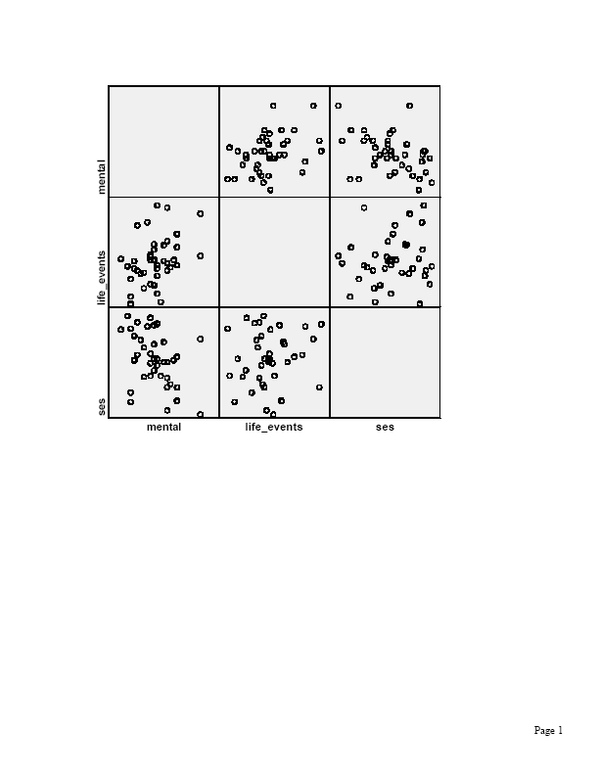
Graphics for multiple regression
Scatterplot matrix: Scatterplot for each pair of variables

Slide 14
Partial regression plots: One plot for each predictor, shows its partial effect controlling for other predictors
Example: With two predictors, show partial effect of x₁ on y (i.e., controlling for x₂) by using residuals after
Regressing y on x₂
Regressing x₁ on x₂
Partial regression plot is a scatterplot with residuals from regressing y on x₂ on vertical axis and residuals from regressing x₁ on x₂ on horizontal axis.
The prediction equation for these points has the same slope as the effect of x₁ in the prediction equation for the multiple regression model.

Slide 15
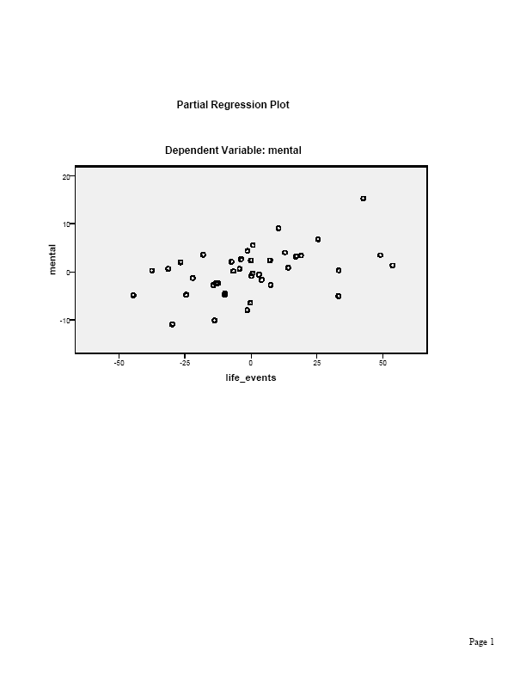

Slide 16
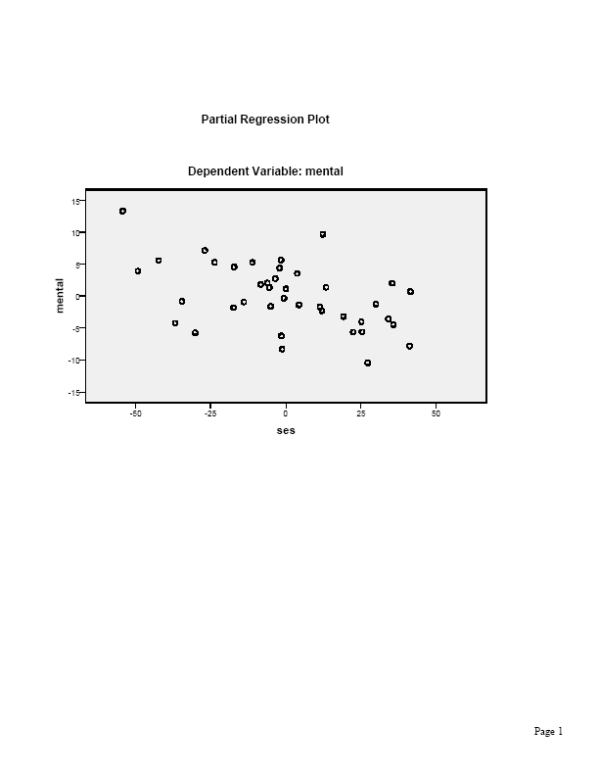

Slide 17
Multiple correlation and R²
How well do the explanatory variables in the model predict y, using the prediction equation?
The multiple correlation, denoted by R, is the correlation between the observed y-values and predicted values
from the prediction equation.
i.e., it is the ordinary correlation between y and an artificial variable whose values for the n subjects in the sample are the predicted values from the prediction equation.

Slide 18
Example: Mental impairment predicted by life events and SES
The multiple correlation is the correlation between the
n = 40 pairs of values of
Subject y Predicted y
1 17
2 19
3 20
……
Software reports R =
(bivariate correlations with y were 0.37 for x₁, -0.40 for x₂)

Slide 19

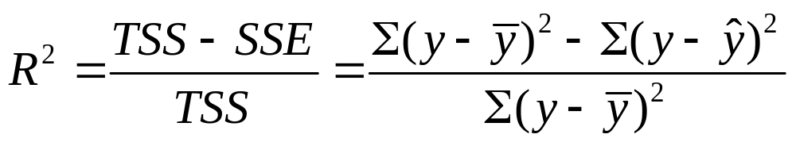
The coefficient of multiple determination R² is the proportional reduction in error obtained by using the prediction equation to predict y instead of using to predict y
Example: Predictor TSS SSE R²
x₁ 1162.4 1001.4
x₂ 1162.4 977.7
x_{1 ,} x₂ 1162.4 768.2
For the multiple regression model,

Slide 20
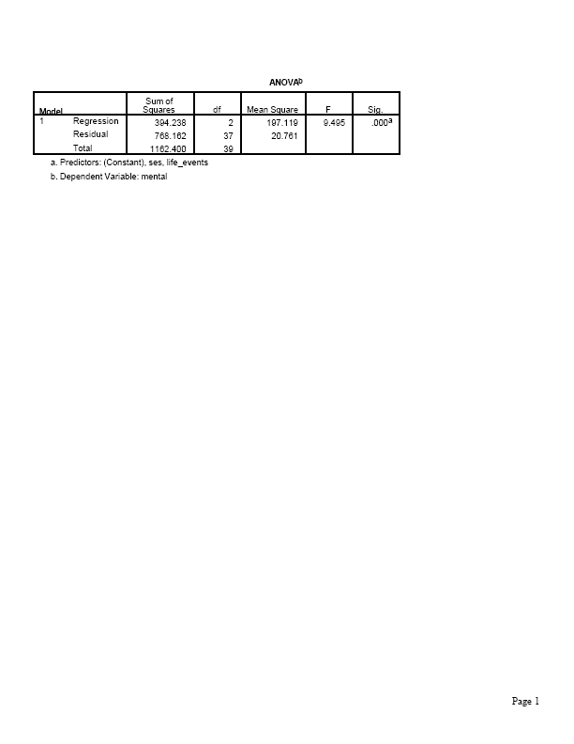

Software provides an ANOVA table with the sums of squares used in R-squared and a Model Summary table with values of R and R-squared.

Slide 21
There is a reduction in error when we use life events and SES together to predict mental impairment (via the prediction equation), compared to using to predict mental impairment.
This is sometimes expressed as “ of the variation in mental impairment is explained by life events and SES.”
The multiple correlation is R =
= the correlation between the 40 values of y and the 40 corresponding predicted y-values from the prediction equation for the multiple regression model.

Slide 22
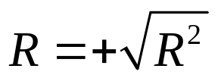
Properties of R and R²
0 ≤ R² ≤ 1
so 0 ≤ R ≤ 1.
The larger their values, the better the set of explanatory variables predict y
R² = 1 when observed y = predicted y, so SSE = 0
R² = 0 when all predicted y = so TSS = SSE.
When this happens, b₁ = b₂ = … = b_{k} = 0 and the correlation r = 0 between y and each predictor.
R² cannot decrease when predictors added to model
With single predictor, R² = r² , R = |r|

Slide 23
The numerator of R², which is TSS – SSE, is called the regression sum of squares. This represents the variability in y “explained” by the model.
R² is additive when each pair of explanatory var’s is uncorrelated (true in many designed experiments, but not in observational studies)
Sample R² tends to be a biased estimate (upwards) of population value of R² , more so for small n. Software also reports adjusted R² which is a less biased estimate (p. 366, Exer. 11.61)

Slide 24
Inference for multiple regression
Based on assumptions
Model E(y) = α + β₁x₁ + β₂x₂ + …. + β_{k}x_{k} is correct
Population conditional distribution of y is normal, at each combination of predictor values
Standard deviation σ of conditional dist. of responses on y is same at each combination of predictor values
(The estimate s of σ is the square root of MSE.)
Sample is randomly selected
Two-sided inference about β parameters is robust to normality and common σ assumptions

Slide 25
Collective influence of explanatory var’s
To test whether explanatory variables collectively have effect on y, we test
H₀ : ₁ = ₂ = … = _{k} = 0
(i.e., y independent of all the explanatory variables)
against
H_{a}: At least one _{i} ≠ 0
(at least one explanatory variable has an effect on y, controlling for the others in the model)
Equivalent to testing
H₀: population multiple correlation = 0 (or popul. R² = 0)
vs. H_{a}: population multiple correlation > 0

Slide 26
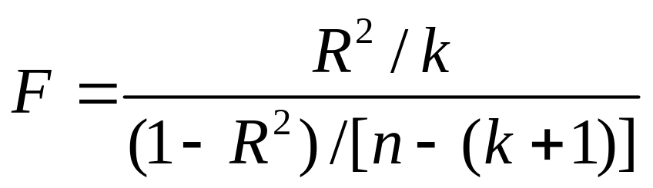
Test statistic (with k explanatory variables)
When H₀ true, F values follow the F distribution
For given n, larger R gives larger F test statistic, more evidence against null hypothesis.
Since larger F gives stronger evidence against null, P-value = right-tail probability above observed value

Slide 27
Properties of F distribution
F can take only nonnegative values
Distribution is skewed right
Exact shape depends on two df values:
df₁ = k
df₂ = n – (k+1)
Mean is approximately 1
F tables report F-scores for right-tail probabilities such as 0.05, 0.01, 0.001

Slide 28
Example: Is mental impairment independent of life events and SES?
H₀ : ₁ = ₂ = 0
(i.e., y independent of x₁ and x₂)
H_{a}: ₁ ≠ 0 or ₂ ≠ 0 or both
Test statistic
df₁ = , df₂ = , P-value =
(From F table, F = 8.4 has P-value = 0.001)

Slide 29
Software provides ANOVA table with result of F test about all regression parameters

Slide 30
There is very strong evidence that at least one of the explanatory variables is associated with mental impairment.
Alternatively, can calculate F as ratio of mean squares from the ANOVA table.
Example: F =

Slide 31
Inferences for individual regression coefficients (Need all predictors in model?)
To test partial effect of x_{i} controlling for the other explan. var’s in model, test H₀: _{i} = 0 using test stat.
t = (b_{i} – 0)/se, df = n-(k+1)
which is df₂ from the F test
CI for _{i} has form b_{i} ± t(se), with t-score from t-table also having
df = n-(k+1), for the desired confidence level
Software provides estimates, standard errors, t test statistics, P-values for tests (2-sided by default)

Slide 32
In SPSS, check “confidence intervals” under “Statistics” in Linear regression dialog box to get CI’s for regression parameters (95% by default)

Slide 33
Example: Effect of SES on mental impairment, controlling for life events
H₀: ₂ = 0, H_{a}: ₂ ≠ 0
Test statistic t = b₂/se =
df = n-(k+1) =
Software reports P-value =
Conclude there is very strong evidence that SES has a negative effect on mental impairment, controlling for life events. (We would reject H₀ at standard significance levels, such as 0.05.)
Likewise for test of H₀: ₁ = 0 (P-value = ), but life events has positive effect on mental impairment, controlling for SES.

Slide 34
A 95% CI for ₂ is b₂ ± t(se), which is
This does not contain 0, in agreement with rejecting H₀ for two-sided H_{a} at 0.05 significance level
Perhaps simpler to interpret corresponding CI of
( , ) for the decrease in mean mental impairment for an increase of 100 units in SES (from minimum of 0 to maximum of 100).
Why bother with F test? Why not go right to the t tests?

Slide 35
A caution: “Overlapping variables” (multicollinearity)
It is possible to get a small P-value in F test of
H₀ : ₁ = ₂ = … = _{k} = 0 yet not get a small P-value for any of the t tests of individual H₀: _{i} = 0
Likewise, it is possible to get a small P-value in a bivariate test for a predictor but not for its partial test controlling for other variables.
This happens when the partial variability explained uniquely by a predictor is small. (i.e., each x_{i} can be predicted well using the other predictors) (picture)
Example:

Slide 36
When multicollinearity occurs,
se values for individual b_{i} may be large
(and individual t statistics not significant)
R² may be nearly as large when drop some predictors from model
It is advisable to simplify the model by dropping some “nearly redundant” explanatory variables.
There is a “variance inflation factor” (VIF) diagnostic for describing extent of multicollinearity (text p. 456).

Slide 37
Modeling interaction between predictors
Recall that the multiple regression model
E(y) = α + β₁x₁ + β₂x₂ + …. + β_{k}x_{k}
assumes the partial slope relating y to each x_{i} is the same at all values of other predictors (i.e., assumes “no interaction” between pairs of predictors)
(recall picture showing parallelism)
For a model allowing interaction between x₁ and x₂ the effect of x₁ may change as x₂ changes.

Slide 38

Simplest interaction model: Introduce cross product terms for predictors
Ex: k = 2 explan var’s: E(y) = α + β₁x₁ + β₂x₂ + β₃(x₁x₂)
is special case of the multiple regression model
E(y) = α + β₁x₁ + β₂x₂ + β₃x₃
with x₃ = x₁x₂ (create x₃ in “transform” menu with “compute variable” option in SPSS)
Example: For mental impairment data, we get
=

Slide 39

SPSS output for interaction model

Slide 40
Fixed x₂ Prediction equation for y and x₁
0
50
100
The higher the value of SES, the weaker the relationship between y = mental impairment and x₁ = life events (plausible for these variables)
(picture)

Slide 41
Comments about interaction model
Note that E(y) = α + β₁x₁ + β₂x₂ + β₃x₁x₂
= (α + β₂x₂) + (β₁ + β₃x₂)x₁
i.e, E(y) is a linear function of x₁
E(y) = (constant with respect to x₁ ) + (coeff. of x₁)x₁
where coefficient of x₁ is (β₁ + β₃x₂).
For fixed x₂ the slope of the relationship between E(y) and x₁ depends on the value of x_{2 .}
To model interaction with k > 2 explanatory variables, take cross product for each pair; e.g., k = 3:
E(y) = α + β₁x₁ + β₂x₂ + β₃x₃ + β₄x₁x₂ + β₅x₁x₃ + β₆x₂x₃

Slide 42
To test H₀: no interaction in model E(y) = α + β₁x₁ + β₂x₂ + β₃x₁x₂, test H₀: β₃ = 0 using test statistic
t = b₃ /se.
Example: t =
P-value = for H_{a} : β₃ ≠ 0
Insufficient evidence to conclude that interaction exists.
With several predictors, often some interaction terms are needed but not others. E.g., could end up using model such as E(y) = α + β₁x₁ + β₂x₂ + β₃x₃ + β₄x₁x₂

Slide 43
Comparing two regression models
How to test whether a model gives a better fit than a simpler model containing only a subset of the predictors?
Example: Compare
E(y) = α + β₁x₁ + β₂x₂ + β₃x₃ + β₄x₁x₂ + β₅x₁x₃ + β₆x₂x₃
to
E(y) = α + β₁x₁ + β₂x₂ + β₃x₃
to test H₀: no interaction by testing H₀: β₄ = β₅ = β₆ = 0.

Slide 44
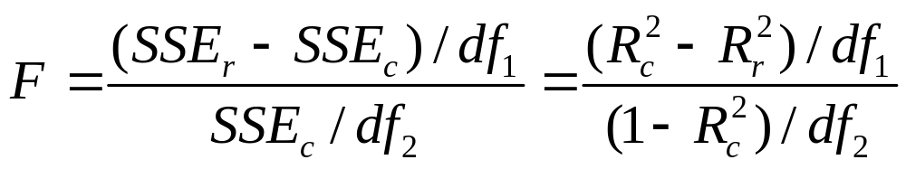
An F test compares the models by comparing their SSE values, or equivalently, their R² values.
The more complex (“complete”) model is better if its SSE is sufficiently smaller (or equivalently if its R² value is sufficiently larger) than the SSE (or R²) value for the simpler (“reduced”) model.
Denote the SSE values for the complete and reduced models by SSE_{c} and SSE_{r.} Denote the R² values by R²_{c} and R²_{r.}
The test statistic for comparing the models is
df₁ = number of extra parameters in complete model,
df₂ = n-(k+1) = df₂ for F test that all β terms in complete model = 0

Slide 45
Example: Mental impairment study (n = 40)
Reduced model: E(y) = α + β₁x₁ + β₂x₂
for x₁ = life events score, x₂ = SES
Complete model: E(y) = α + β₁x₁ + β₂x₂ + β₃x₃
with x₃ = religious attendance (number of times subject attended religious service in past year)
R²_{r} = 0.339, R²_{c} = 0.358
Test comparing models has H₀: β₃ = 0.

Slide 46
Test statistic with df₁ = 1, df₂ = 36.
P-value = .
We cannot reject H₀ at the usual significance levels (such as 0.05). The simpler model is adequate.
Note: Since only one parameter in null hypo., the F test statistic is the square of t = b₃/se for testing H₀: β₃ = 0. The t test also gives P-value = , for H_{a}: β₃ ≠ 0

