Slide 1
3. Descriptive Statistics
Describing data with tables and graphs
(quantitative or categorical variables)
Numerical descriptions of center, variability, position (quantitative variables)
Bivariate descriptions

Slide 2
1. Tables and Graphs
Frequency distribution: Lists possible values of variable and number of times each occurs
Example: Student survey www.stat.ufl.edu/~aa/social/data.html
“political ideology” measured as ordinal variable with 1 = very liberal, 4 = moderate, 7 = very conservative

Slide 3
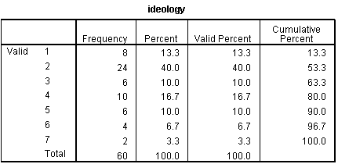

Slide 4
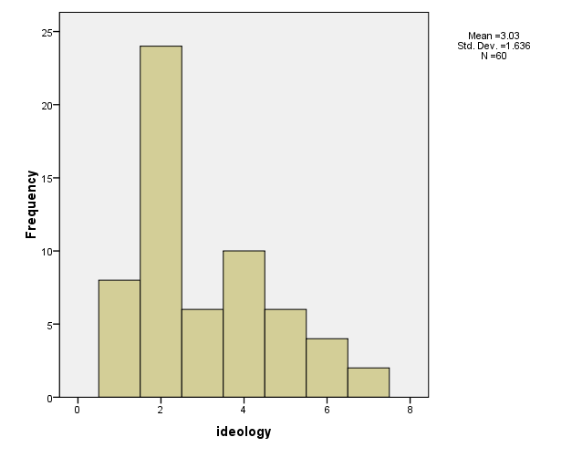
Histogram: Bar graph of frequencies or percentages

Slide 5
Shapes of histograms
Bell-shaped ( )
Skewed right ( )
Skewed left ( )
Bimodal (polarized opinions)
Ex. GSS data on sex before marriage in Exercise 3.73: always wrong, almost always wrong, wrong only sometimes, not wrong at all
category counts 238, 79, 157, 409
Notes:
Draw on board, perhaps add U-shaped

Slide 6
Stem-and-leaf plot
Example: Exam scores (n = 40 students)
Stem Leaf
3 6
4
5 37
6 235899
7 011346778999
8 00111233568889
9 02238
Notes:
Due to John Tukey, EDA, 1977

Slide 7
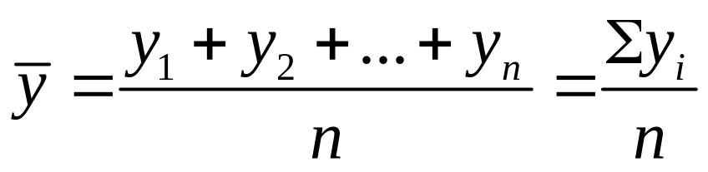
2.Numerical descriptions
Let y denote a quantitative variable, with observations y₁ , y₂ , y₃ , … , y_{n}
a. Describing the center
Median: Middle measurement of ordered sample
Mean:

Slide 8

Example: Annual per capita carbon dioxide emissions (metric tons) for n = 8 largest nations in population size
Bangladesh 0.3, Brazil 1.8, China 2.3, India 1.2, Indonesia 1.4, Pakistan 0.7, Russia 9.9, U.S. 20.1
Ordered sample:
Median =
Mean =
Notes:
Median– average two middle measurements when n even

Slide 9
Properties of mean and median
For symmetric distributions, mean = median
For skewed distributions, mean is drawn in direction of longer tail, relative to median.
Mean valid for interval scales, median for interval or ordinal scales
Mean sensitive to “outliers” (median preferred for highly skewed dist’s)
When distribution symmetric or mildly skewed or discrete with few values, mean preferred because uses numerical values of observations
Notes:
Mean = center of gravity of data. Mode another measure, appropriate for all scales

Slide 10
Examples:
NY Yankees in 2006
mean salary =
median salary =
Direction of skew?
Give an example for which you would expect
mean < median

Slide 11
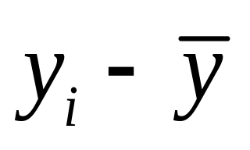
b. Describing variability
Range: Difference between largest and smallest observations
(but highly sensitive to outliers, insensitive to shape)
Standard deviation: A “typical” distance from the mean
The deviation of observation i from the mean is
Notes:
Draw picture showing insensitivity of range to shape

Slide 12
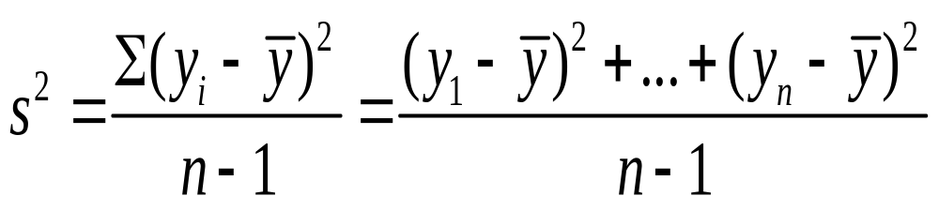

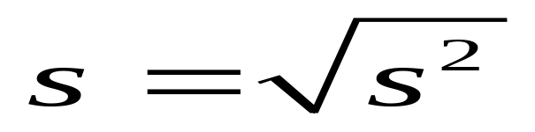
The variance of the n observations is
The standard deviation s is the square root of the variance,

Slide 13
Example:

Slide 14
Properties of the standard deviation:
  s ≥ 0, and only equals 0 if all observations are equal
  s increases with the amount of variation around the mean
  Division by n-1 (not n) is due to technical reasons (later)
  s depends on the units of the data (e.g. measure euro vs $)
  Like mean, affected by outliers
  Empirical rule: If distribution approx. bell-shaped,
  about 68% of data within 1 std. dev. of mean
  about 95% of data within 2 std. dev. of mean
  all or nearly all data within 3 std. dev. of mean

Slide 15
Example: SAT with mean = 500, s = 100
(sketch picture summarizing data)
Example: y = number of close friends you have
Recent GSS data has mean 7, s = 11
Probably highly skewed: right or left?
Empirical rule fails; in fact, median = 5, mode=4
Example: y = selling price of home in Syracuse, NY.
If mean = $130,000, which is realistic?
s=0, s=1000, s= 50,000, s = 1,000,000
Notes:
Show picture of SAT

Slide 16
c. Measures of position
p^{th} percentile: p percent of observations below it, (100 - p)% above it.
p = 50: median
p = 25: lower quartile (LQ)
p = 75: upper quartile (UQ)
Interquartile range IQR = UQ - LQ
Notes:
Draw picture

Slide 17
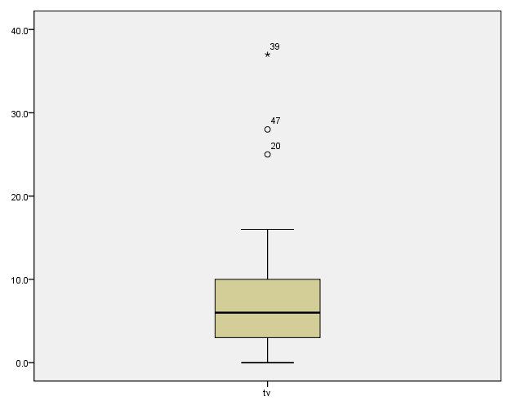
Quartiles portrayed graphically by box plots (John Tukey 1977)
Example: weekly TV watching for n=60 students, 3 outliers

Slide 18
Box plots have box from LQ to UQ, with median marked. They portray a five-number summary of the data:
Minimum, LQ, Median, UQ, Maximum
with outliers identified separately
Outlier = observation falling
below LQ – 1.5(IQR)
or above UQ + 1.5(IQR)
Ex.

Slide 19
Bivariate description
Usually we want to study associations between two or more variables (e.g., how does number of close friends depend on sex, income, education, age, working status, rural/urban, religiosity…)
Response variable: the outcome variable
Explanatory variable: defines groups to compare
Ex.: no. of close friends is a response variable, sex, income, … are explanatory variables
Response = “dependent”
Explanatory = “independent”

Slide 20
Summarizing associations:
Categorical var’s: use contingency tables
Quantitative var’s: use scatterplots
Mixture of categorical var. and quantitative var. (e.g., no. of close friends and sex) can give numerical summaries (mean, std. deviation) or box plot for each group
Ex. General Social Survey (GSS) data
Men: mean = 7.0, s = 8.4
Women: mean = 5.9, s = 6.0
Shape? Inference questions for later chapters?

Slide 21
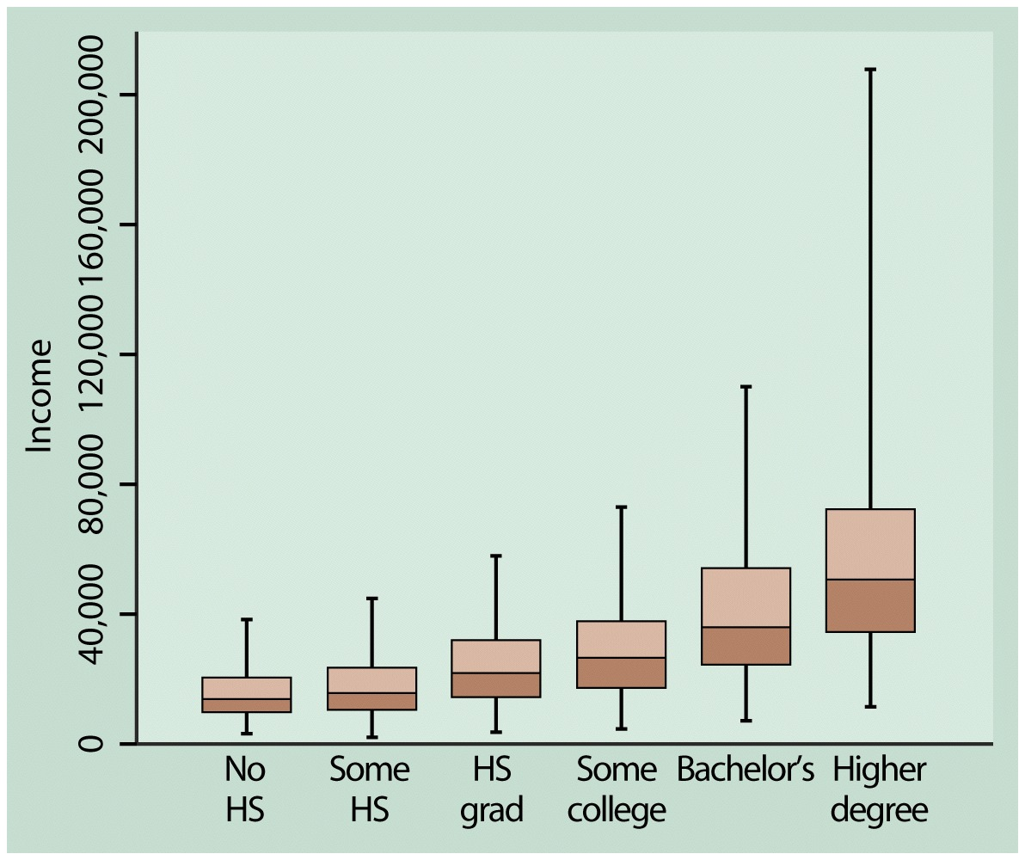
Example: Income by highest degree

Slide 22
Contingency Tables
Cross classifications of categorical variables in which rows (typically) represent categories of explanatory variable and columns represent categories of response variable.
Numbers in “cells” of the table give the numbers of individuals at the corresponding combination of levels of the two variables

Slide 23
Happiness and Family Income (GSS 2008 data)
Happiness
Income Very Pretty Not too Total
-------------------------------
Above Aver. 164 233 26 423
Average 293 473 117 883
Below Aver. 132 383 172 687
------------------------------
Total 589 1089 315 1993

Slide 24
Can summarize by percentages on response variable (happiness)
Example: Percentage “very happy” is
39% for above aver. income
33% for average income
19% for below average income

Slide 25
Scatterplots plot response variable on vertical axis, explanatory variable on horizontal axis
Example: Table 9.13 (p. 294) shows UN data for several nations on many variables, including fertility (births per woman), contraceptive use, literacy, female economic activity, per capita gross domestic product (GDP), cell-phone use, CO2 emissions,
Data available at http://www.stat.ufl.edu/~aa/social/data.html

Slide 26
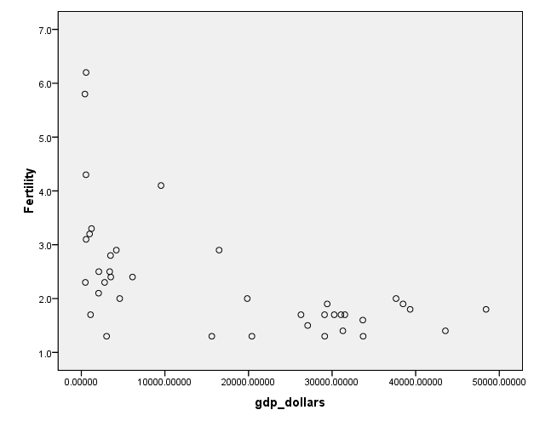

Slide 27
Example: Survey in Alachua County, Florida, on predictors of mental health
(data for n = 40 on p. 327 of text and at www.stat.ufl.edu/~aa/social/data.html)
y = measure of mental impairment (incorporates various dimensions of psychiatric symptoms, including aspects of depression and anxiety)
(min = 17, max = 41, mean = 27, s = 5)
x = life events score (events range from severe personal disruptions such as death in family, extramarital affair, to less severe events such as new job, birth of child, moving)
(min = 3, max = 97, mean = 44, s = 23)

Slide 28
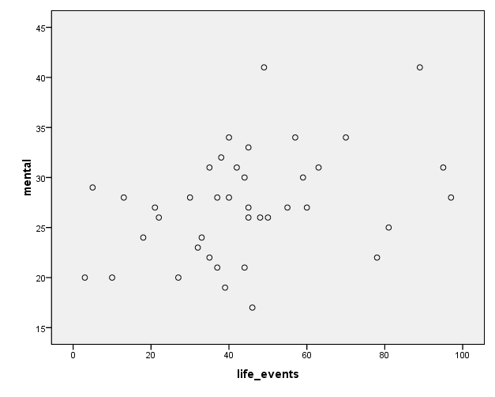

Slide 29
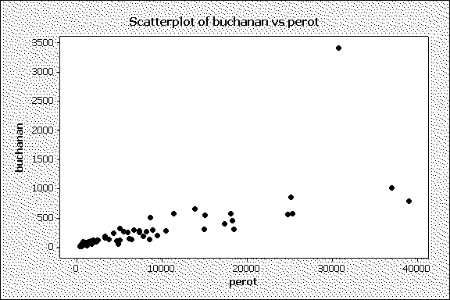
Bivariate data from 2000 Presidential election
Butterfly ballot, Palm Beach County, FL, text p.290

Slide 30
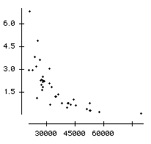
Example: The Massachusetts Lottery
(data for 37 communities, from Ken Stanley)
% income spent on lottery
Per capita income

Slide 31
Correlation describes strength of association
Falls between -1 and +1, with sign indicating direction of association (formula later in Chapter 9)
Examples: (positive or negative, how strong?)
Mental impairment and life events, correlation =
GDP and fertility, correlation =
GDP and percent using Internet, correlation =
The larger the correlation in absolute value, the stronger the association (in terms of a straight line trend)

Slide 32
Regression analysis gives line predicting y using x
Example:
y = mental impairment, x = life events
Predicted y = 23.3 + 0.09x
e.g., at x = 0, predicted y =
at x = 100, predicted y =
Inference questions for later chapters?

Slide 33
Sample statistics /
Population parameters
We distinguish between summaries of samples (statistics) and summaries of populations (parameters).
Common to denote statistics by Roman letters, parameters by Greek letters:
Population mean =μ, standard deviation = σ,
proportion  are parameters.
In practice, parameter values unknown, we make inferences about their values using sample statistics.

