Slide 1
4. Probability Distributions
Probability: With random sampling or a randomized experiment, the probability an observation takes a particular value is the proportion of times that outcome would occur in a long sequence of observations.
Usually corresponds to a population proportion (and thus falls between 0 and 1) for some real or conceptual population.

Slide 2
Basic probability rules
Let A, B denotes possible outcomes
P(not A) = 1 – P(A)
For distinct possible outcomes A and B,
P(A or B) = P(A) + P(B)
P(A and B) = P(A)P(B given A)
For “independent” outcomes, P(B given A) = P(B), so P(A and B) = P(A)P(B).

Slide 3
Happiness (2008 GSS data)
Income Very Pretty Not too Total
-------------------------------
Above Aver. 164 233 26 423
Average 293 473 117 883
Below Aver. 132 383 172 687
------------------------------
Total 589 1089 315 1993
Let A = average income, B = very happy
P(A) estimated by (a “marginal probability”),
P(not A) = 1 – P(A) =
P(B given A) estimated by
(a “conditional probability”)
P(A and B) = P(A)P(B given A) est. by
(which equals , a “joint probability”)

Slide 4
B1: randomly selected person is very happy
B2: second randomly selected person is very happy
P(B1), P(B2) estimated by
P(B1 and B2) = P(B1)P(B2) estimated by
If instead B2 refers to partner of person for B1, B1 and B2 probably not independent and this formula is inappropriate

Slide 5
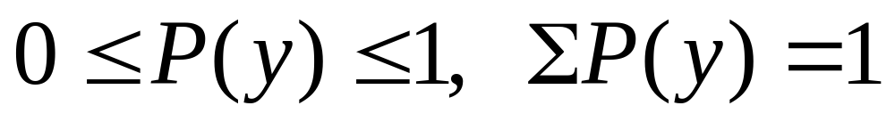
Probability distribution of a variable
Lists the possible outcomes for the “random variable” and their probabilities
Discrete variable: Assign probabilities P(y) to individual values y, with

Slide 6
Example: Randomly sample 3 people and ask whether they favor (F) or oppose (O) legalization of same-sex marriage
y = number who “favor” (0, 1, 2, or 3)
For possible samples of size n = 3,
Sample y Sample y
(O, O, O) 0 (O, F, F) 2
(O, O, F) 1 (F, O, F) 2
(O, F, O) 1 (F, F, O) 2
(F, O, O) 1 (F, F, F) 3

Slide 7
If population equally split between F and O, these eight samples are equally likely and probability distribution of y is
y P(y)
0
1
2
3
(special case of “binomial distribution,” introduced in Chap. 6). In practice, probability distributions are often estimated from sample data, and then have the form of frequency distributions

Slide 8
Example: GSS results on y = number of people you knew personally who committed suicide in past 12 months (variable “suiknew”).
Estimated probability distribution is
y P(y)
0 .895
1 .084
2 .015
3 .006

Slide 9
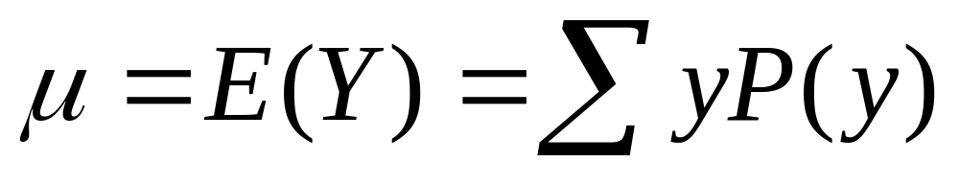
Like frequency distributions, probability distributions have descriptive measures, such as mean and standard deviation
Mean (expected value) -
µ =
represents a “long run average outcome”
(median = mode = 0)

Slide 10
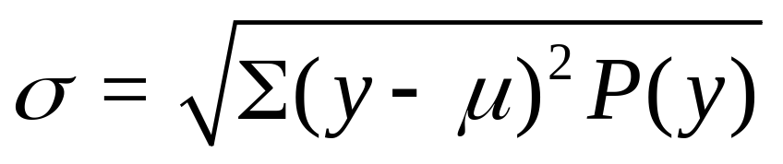
Standard Deviation - Measure of the “typical” distance of an outcome from the mean, denoted by σ
(We won’t need to calculate this formula.)
If a distribution is approximately bell-shaped, then:
all or nearly all the distribution falls between
µ - 3σ and µ + 3σ
Probability about 0.68 falls between
µ - σ and µ + σ

Slide 11
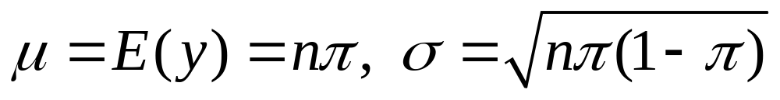
Example: From result later in chapter, if n people are randomly selected from population with proportion  favoring legal same-sex marriage (1-, Oppose), then
y = number in sample who favor it
has a bell-shaped probability distribution with
e.g, with n = 1000,  = 0.50, get µ = , σ =
Nearly all the distribution falls between about
i.e., almost certainly between about 45% and 55% of sample say they favor it.

Slide 12
Continuous variables: Probabilities assigned to intervals of numbers
Ex. When y takes lots of values, as in last example, it is continuous for practical purposes. Then, if probability distribution is approx. bell-shaped,
Most important probability distribution for continuous variables is the normal distribution

Slide 13
Normal distribution
Symmetric, bell-shaped (formula in Exercise 4.56)
Characterized by mean (μ) and standard deviation (σ), representing center and spread
Probability within any particular number of standard deviations of μ is same for all normal distributions
An individual observation from an approximately normal distribution has probability
  0.68 of falling within 1 standard deviation of mean
  0.95 of falling within 2 standard deviations
  0.997 of falling within 3 standard deviations

Slide 14
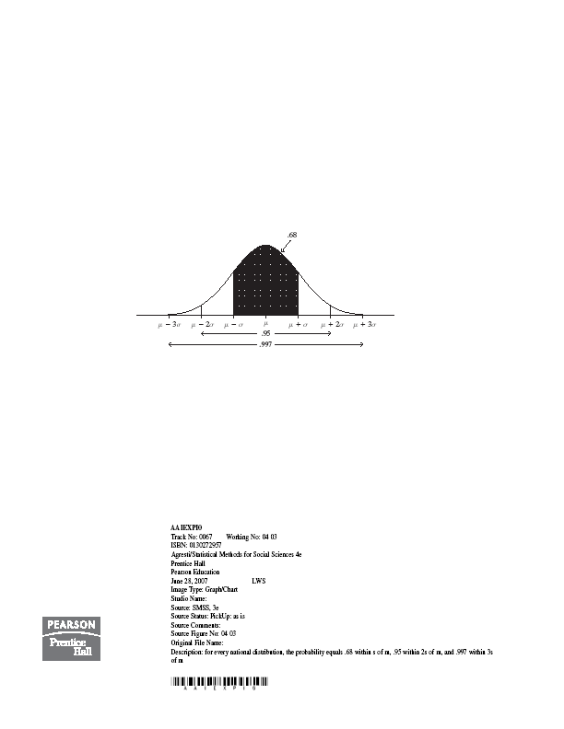

Slide 15
Table A (inside back cover of text) gives probability in right tail above µ + zσ for various values of z.
Second Decimal Place of z
z .00 .01 .02 .03 .04 .05 .06 .07 .08 .09
0.0 .5000 .4960 .4920 .4880 .4840 .4801 .4761 .4721 .4681 .4641
…
….
1.4 .0808 .0793 .0778 .0764 .0749 .0735 .0722 .0708 .0694 .0681
1.5 .0668 .0655 .0643 .0630 .0618 .0606 .0594 .0582 .0571 .0559
…….
……..

Slide 16
Example: What is probability falling between
µ - 1.50σ and µ + 1.50σ ?
z = 1.50 has right tail probability =
Left tail probability = by symmetry
Two-tail probability =
Probability within µ - 1.50σ and µ + 1.50σ is
Example: z = 2.0 gives
two-tail prob. = 2(0.0228) = 0.046,
probability within µ ± 2σ is 1 - 0.046 = 0.954

Slide 17
Example: What z-score corresponds to 99th percentile (i.e., µ + zσ = 99th percentile)?
Right tail probability = 0.01 has z =
99% falls below
If IQ has µ = 100, σ = 16, then 99th percentile is
Note: µ - 2.33σ = 100 – 2.33(16) = 63 is 1st percentile
0.98 = probability that IQ falls between 63 and 137

Slide 18
Example: What is z so that µ ± zσ encloses exactly 95% of normal curve?
Total probability in two tails =
Probability in right tail =
z = 1.96
µ ± 1.96σ contains probability 0.950
(µ ± 2σ contains probability 0.954)
Exercise: Try this for 99%, 90%

Slide 19
Example: Minnesota Multiphasic Personality Inventory (MMPI), based on responses to 500 true/false questions, provides scores for several scales (e.g., depression, anxiety, substance abuse), with
µ = 50, σ = 10.
If distribution is normal and score of ≥ 65 is considered abnormally high, what percentage is this?
z = (65 - 50)/10 = 1.50
Right tail probability =

Slide 20
Notes about z-scores
z-score represents number of standard deviations that a value falls from mean of dist.
A value y is z = (y - µ)/σ
standard deviations from µ
Example: y = 65, µ = 50, σ = 10
z =
The z-score is negative when y falls below µ
(e.g., y = 35 has z = )

Slide 21
The standard normal distribution is the normal distribution with µ = 0, σ = 1
For that distribution, z = (y - µ)/σ = (y - 0)/1 = y
i.e., original score = z-score
µ + zσ = 0 + z(1) = z
(we use standard normal for inference starting in Chapter 6, where certain statistics are scaled to have a standard normal distribution)
If different studies take random samples and calculate a statistic (e.g. sample mean) to estimate a parameter (e.g. population mean), the collection of statistic values often has approximately a normal distribution.

Slide 22
Sampling distributions
Example: y = 1 if favor legal same-sex marriage
y = 0 if oppose
For possible samples of size n = 3,
Sample Mean Sample Mean
(1, 1, 1) 1.0 (1, 0, 0 ) 1/3
(1, 1, 0) 2/3 (0, 1, 0) 1/3
(1, 0, 1) 2/3 (0, 0, 1) 1/3
(0, 1, 1) 2/3 (0, 0, 0) 0

Slide 23
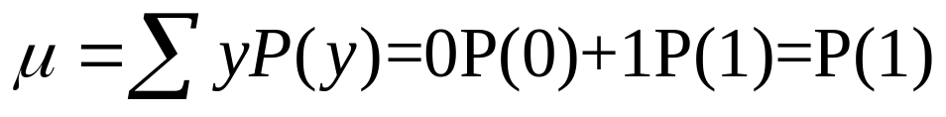
For binary data (0, 1), sample mean equals sample proportion of “1” cases. For population,
is population proportion of “1” cases
(e.g., favoring)
How close is sample mean to µ?
What is the probability distribution of the sample mean?

Slide 24
Sampling distribution of a statistic is the probability distribution for the possible values of the statistic
Ex. Suppose P(0) = P(1) = ½. For random sample of size n = 3, each of 8 possible samples equally likely. Sampling distribution of sample proportion is
Sample proportion Probability
0
1/3
2/3
1 (Try for n = 4)

Slide 25
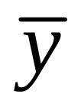
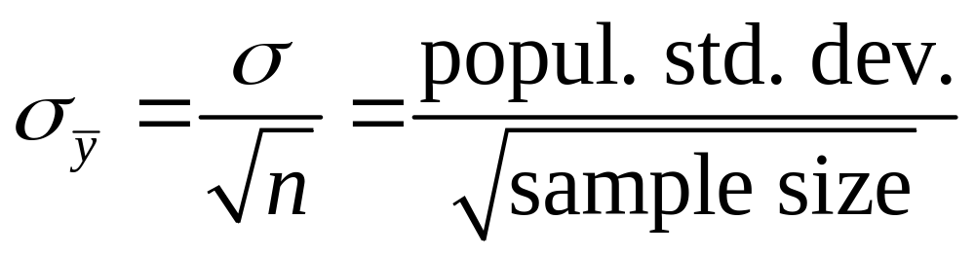
Sampling distribution of sample mean
is a variable, its value varying from sample to sample about the population mean µ
Standard deviation of sampling distribution of is called the standard error of
For random sampling, the sampling distribution of
has mean µ and standard error

Slide 26
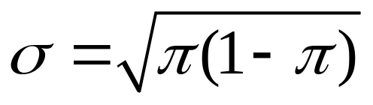
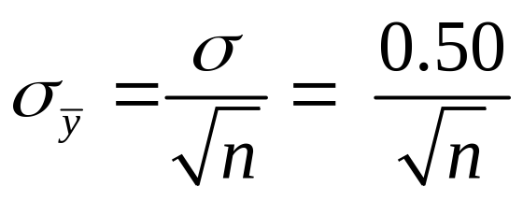
Example: For binary data (y =1 or 0) with
P(Y=1) =  (with 0 <  < 1), can show that
(Exercise 4.55b, and special case
of earlier formula with n = 1)
When  = 0.50, standard error is
n standard error
.289
100 .050
1000 .016

Slide 27
Note standard error goes down as n goes up
(i.e., tends to fall closer to µ)
With n = 1000, standard error = 0.016, so if the sampling dist is bell-shaped, with very high probability the sample proportion falls within 3(0.016) = 0.05 of population prop of 0.50
(i.e., between about 0.45 and 0.55)
Number of times y = 1 is 1000(proportion), so that the count variable has
mean =
standard error =

Slide 28
Ex. Many studies each take sample of n = 1000 to estimate population proportion
We’ve seen the sample proportion should vary from study to study around 0.50 with standard error = 0.016
Flipping a coin 1000 times simulates the process when the population proportion = 0.50.
We can verify this empirically, by simulating using the “sampling distribution” applet at
www.prenhall.com/agresti
Shape? Roughly bell-shaped. Why?

Slide 29
Central Limit Theorem: For random sampling with “large” n, the sampling dist. of the sample mean is approximately a normal distribution
Approximate normality applies no matter what the shape of the population dist. (Figure p. 93, next page)
With the applet, you can test this out using various population shapes, including “custom”
How “large” n needs to be depends on skew of population distribution, but usually n ≥ 30 sufficient

Slide 30
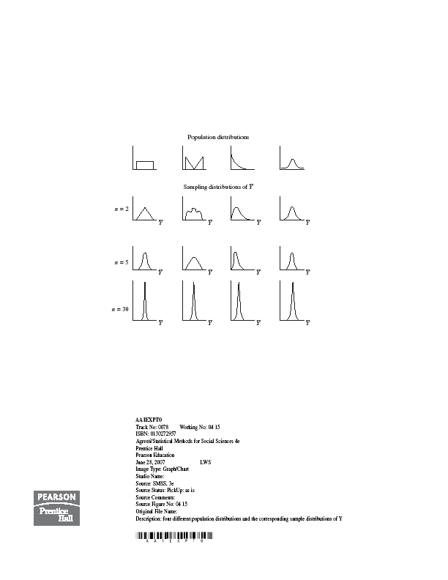

Slide 31
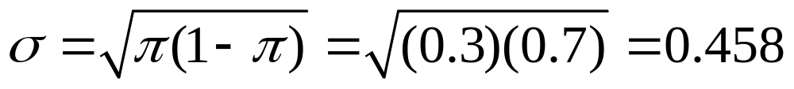

Example: You plan to randomly sample 100 Harvard students to estimate population proportion who have participated in “binge drinking.” Find probability your sample proportion falls within 0.04 of population proportion, if that population proportion = 0.30
(i.e., between 0.26 and 0.34)
y = 1, yes y = 0, no
µ = = 0.30,
By CLT, sampling distribution of sample mean (which is the proportion “yes”) is approx. normal with mean 0.30,
standard error =

Slide 32
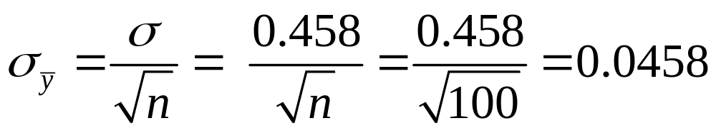
0.26 has z-score z =
0.34 has z-score z =
P(sample mean ≥ 0.34) =
P(sample mean ≤ 0.26) =
P(0.26 ≤ sample mean ≤ 0.34) =
The probability is that the sample proportion will fall within 0.04 of the population proportion
How would this change if n is larger (e.g., 200)?

Slide 33
Note:
Consequence of CLT: When the value of a variable is a result of averaging many individual influences, no one dominating, the distribution is approx. normal (e.g., IQ, blood pressure)
In practice, we don’t know µ, but we can use spread of sampling distribution as basis of inference for unknown parameter value
(we’ll see how in next two chapters)
We have now discussed three types of distributions:

Slide 34
Population distribution – described by parameters such as µ, σ (usually unknown)
Sample data distribution – described by sample statistics such as
sample mean , standard deviation s
Sampling distribution – probability distribution for possible values of a sample statistic; determines probability that statistic falls within certain distance of population parameter

Slide 35
Ex. (categorical): Poll about health care
Statistic = sample proportion favoring the new health plan
What is (1) population dist., (2) sample dist., (3) sampling dist.?
Ex. (quantitative): Experiment about impact of cell-phone use on reaction times
Statistic = sample mean reaction time
What is (1) population dist., (2) sample dist., (3) sampling dist.?

Slide 36
By the Central Limit Theorem (multiple choice)
All variables have approximately normal sample distribution if a random sample has at least 30 observations
Population distributions are normal whenever the population size is large (at least about 30)
For large random samples, the sampling distribution of the sample mean is approx. normal, regardless of the shape of the population distribution
The sampling distribution looks more like the population distribution as the sample size increases
All of the above

