Slide 1
8. Association between Categorical Variables
Suppose both response and explanatory variables are categorical. (For comparing means in Chap. 7, response variable is quantitative, explanatory variable is categorical. Chap. 9 considers both quantitative.)
There is association if the population conditional distribution for the response variable differs among the categories of the explanatory variable
Example: Contingency table on happiness cross-classified by family income (data from 2006 GSS)

Slide 2
Happiness
Income Very Pretty Not too Total
---------------------------------------------
Above 272 (44%) 294 (48%) 49 (8%) 615
Average 454 (32%) 835 (59%) 131 (9%) 1420
Below 185 (20%) 527 (57%) 208 (23%) 920
----------------------------------------------
Response: Happiness, Explanatory: Income
The sample conditional distributions on happiness vary by income level, but can we conclude that this is also true in the population?

Slide 3
Guidelines for Contingency Tables
Show sample conditional distributions: percentages for the response variable within the categories of the explanatory variable.
Clearly define variables and categories.
If display percentages but not the cell counts, include explanatory total sample sizes, so reader can (if desired) recover all the cell count data.

Slide 4
Independence & Dependence
Statistical independence (no association): Population conditional distributions on one variable the same for all categories of the other variable
Statistical dependence (association): Conditional distributions are not all identical
Example of statistical independence:
Happiness
Income Very Pretty Not too
-----------------------------------------
Above
Average
Below

Slide 5
Chi-Squared Test of Independence (Karl Pearson, 1900)
Tests H₀: The variables are statistically independent
H_{a}: The variables are statistically dependent
Intuition behind test statistic: Summarize differences between observed cell counts and expected cell counts
Notation: f_{o} = observed frequency (cell count)
f_{e} = expected frequency
r = number of rows in table, c = number of columns

Slide 6
Expected frequencies (f_{e}):
  Have identical conditional distributions. Those distributions are same as the column (response) marginal distribution of the data.
  Have same marginal distributions (row and column totals) as observed frequencies
  Computed by
  f_{e} = (row total)(column total)/n

Slide 7
Happiness
Income Very Pretty Not too Total
--------------------------------------------------
Above 272 (189.6) 294 (344.6) 49 (80.8) 615
Average 454 (437.8) 835 (795.8) 131 (186.5) 1420
Below 185 (283.6) 527 (515.6) 208 (120.8) 920
--------------------------------------------------
Total 911 1656 388 2955
e.g., first cell has f_{e} =
f_{e} values are in parentheses in this table

Slide 8
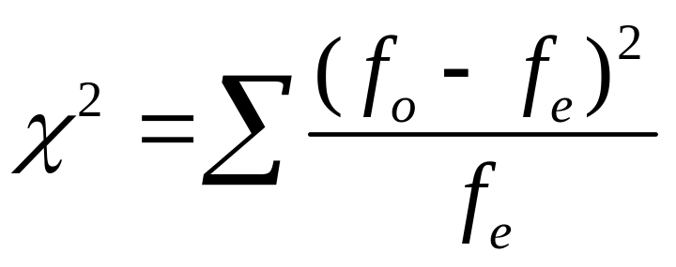
Chi-Squared Test Statistic
Summarize closeness of {f_{o}} and {f_{e}} by
with sum is taken over all cells in the table.
When H₀ is true, sampling distribution of this statistic is approximately (for large n) the
chi-squared probability distribution.

Slide 9
Properties of chi-squared distribution
On positive part of line only
Skewed to right (more bell-shaped as df increases)
Mean and standard deviation depend on size of table through
df = (r – 1)(c – 1)
where r = number of rows, c = number of columns
Larger values incompatible with H₀, so P-value = right-tail prob. above observed test statistic value.

Slide 10
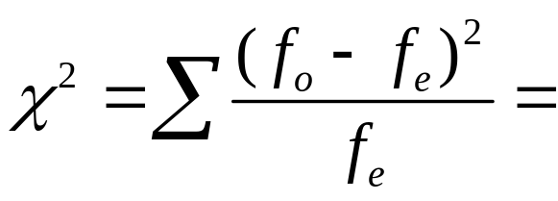
Example: Happiness and family income
df = . P-value = 0.000 (rounded, often reported as P < 0.001). Chi-squared percentile values for various right-tail probabilities are in table on text p. 594.
There is very …. evidence against H_{0:} independence (namely, if H₀ were true, prob. would be of getting this large a test statistic or even larger).
For significance level  = 0.05, we …

Slide 11
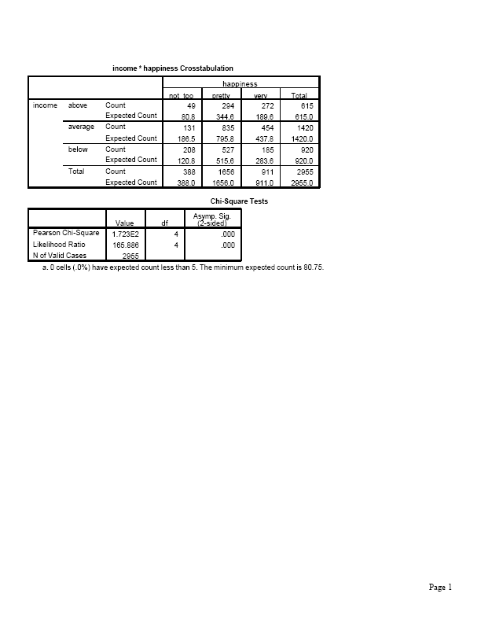
Software output (SPSS)

Slide 12

Comments about chi-squared test
Using chi-squared dist. to approx the actual sampling dist of the test statistic works well for “large” random samples.
For smaller samples, Fisher’s exact test applies
(Sec. 7.5 of text for 2x2 case, which we skipped)
Most software also reports “likelihood-ratio chi squared,” an alternative test statistic with the same large-sample chi-squared distribution as the Pearson chi-squared statistic.
Chi-squared test treats variables as nominal scale (re-order categories, get same result). For ordinal variables, more powerful tests are available.

Slide 13
For 2-by-2 tables, chi-squared test of independence (df = 1) is equivalent to testing H₀: ₁ = ₂ for comparing two population proportions.
Proportion
Population Response 1 Response 2
1 ₁ 1 - ₁
2 ₂ 1 - ₂
H₀: ₁ = ₂ equivalent to
H₀: response independent of population
Then, chi-squared statistic is square of z test statistic,
z = (difference between sample proportions)/se₀.

Slide 14
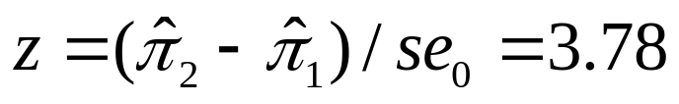
Example (from Chap. 7): College Alcohol Study conducted by Harvard School of Public Health
“Have you engaged in unplanned sexual activities because of drinking alcohol?”
1993: 19.2% yes of n = 12,708
2001: 21.3% yes of n = 8783
Results refer to 2-by-2 contingency table:
Year Yes No Total
1993 2440 10,268 12,708
2001 1871 6912 8783
Pearson ² = , df = , P-value =
Corresponding z test statistic
has .

Slide 15
Residuals:
Detecting Patterns of Association
Large chi-squared implies strong evidence of association but does not tell us about nature of association. We can investigate this by finding the residual in each cell of the contingency table.
Residual = f_{o}-f_{e} is positive (negative) when there are more (fewer) observations in cell than null hypothesis of independence predicts.
Standardized residual z = (f_{o}-f_{e})/se, where se denotes se of f_{o}-f_{e.}. This measures number of standard errors that (f_{o}-f_{e}) falls from value of 0 expected when H₀ true.

Slide 16
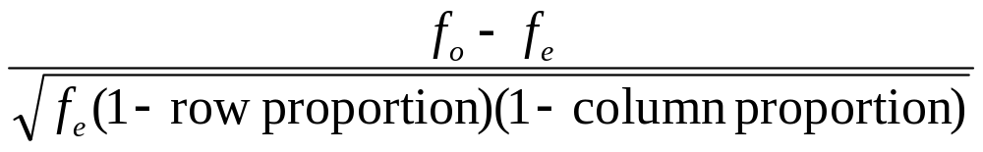

The se value is found using
so the standardized residual equals
Example: For cell with f_{o} = 272, f_{e} = 189.6, row prop. = 615/2955 = 0.208, column prop. = 911/2955 = 0.308, and standardized residual
Number of people with above average income and very happy is … standard errors higher than we would expect if happiness were independent of income.

Slide 17
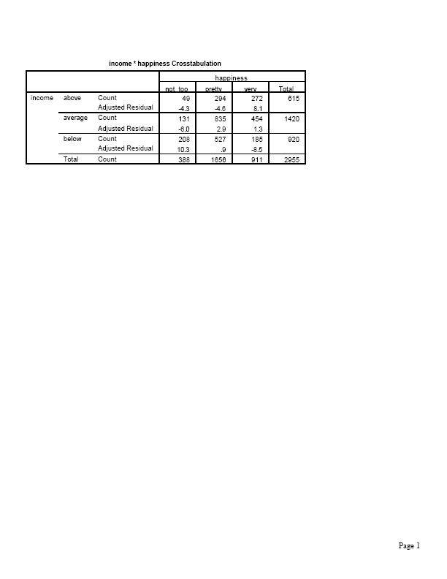
SPSS Output

Slide 18
Likewise, we see …. people in the (below average, not too happy) cell than expected, and ….. in (below average, very happy) and (above average, not too happy) cells than expected.
In cells having |standardized residual| > about 3, departure from independence is noteworthy.
Standardized residuals can be found using software (called adjusted residuals in SPSS).
For 2-by-2 tables, each standardized residual is the same in absolute value (and is a z statistic for comparing two population proportions) and satisfies
z² = ²

Slide 19
Example: “Have you engaged in unplanned sexual activities because of drinking alcohol?”
We found Pearson chi-squared = 14.3, P-value < 0.0002
Standardized residuals are:
Year Yes No
1993 2440 ( ) 10,268 ( )
1871 ( ) 6912 ( )
for which

Slide 20
Practice: More happiness analyses
Happiness and religiosity (attend religious services 1 = at most several times a year, 2 = once a month to nearly every week, 3 = every week to several times a week), 2006 GSS
² = 73.5, df = 4, P-value = 0.000.
Happiness
Religiosity Not too Pretty Very
1 189 (3.9) 908 (4.4) 382 (-7.3)
2 53 (-0.8) 311 (-0.2) 180 (0.8)
3 46 (-3.8) 335 (-4.8) 294 (7.6)

Slide 21
Similar results for variables positively correlated with religiosity, such as political conservatism
Happiness and number of sex partners in previous year (2006 GSS)
Happiness
Sex partners Not too Pretty Very
0 112 (5.9) 329 (-0.9) 154 (-3.2)
1 118 (-7.8) 832 (-1.0) 535 (6.5)
At least 2 57 (3.7) 198 (2.5) 57 (-5.3)

Slide 22
Measures of Association
Chi-squared test answers “Is there an association?”
Standardized residuals answer “How do data differ from what independence predicts?”
We answer “How strong is the association?” using a measure of the effect size, such as the difference of proportions

Slide 23
Example: Opinion about George W. Bush performance as President (9/08 Gallup poll)
Approve Disapprove
Democrats 3% 97%
Republicans 64% 36%
Approve Disapprove
Women 24% 76%
Men 27% 73%
The difference of proportions 0.64 – 0.03 = 0.61 indicates a much ………. association between political party and opinion than the difference
0.27 – 0.24 = 0.03 indicates for gender and opinion.

Slide 24
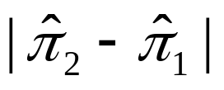
The greater the value of the stronger the association
For r-by-c tables, other summary measures exist (pp. 238-243), but we usually learn more by using the difference of proportions to compare particular levels of one variable in terms of the proportion in a particular category of the other variable.
Example:
Happiness
Income Very Pretty Not too
Above 272 (44%) 294 (48%) 49 (8%)
Average 454 (32%) 835 (59%) 131 (9%)
Below 185 (20%) 527 (57%) 208 (23%)
Comparing those of above average income with those of below average income, the difference in the estimated proportion who are “very happy” is .

Slide 25
Comparisons using ratios
Recall the ratio of proportions can also be useful (“relative risk”)
Example: Comparing proportions who report being very happy, for those of above average income to those of below average income,
0.44/0.20 = 2.2
An alternative measure for comparing proportions, commonly used for logistic regression model for categorical response variables, is the odds ratio.

Slide 26
The “odds”
For two outcomes (“success”, “failure”) for a group,
Odds = P(success)/P(failure) = P(success)/[1 - P(success)]
e.g., if P(success) = 0.80, P(failure) = 0.20,
the odds =
if P(success) = 0.20, P(failure) = 0.80,
the odds =
Probability of success obtained from odds by
Probability = odds/(odds + 1)
e.g., odds = 4.0 has probability =

Slide 27
The odds ratio
For 2 groups summarized in a 2x2 contingency table,
odds ratio = (odds in row 1)/(odds in row 2)
Example: Survey of senior high school students
Alcohol use
Cigarette use Yes No
Yes 1449 46
No 500 281
² = 451.4, df = 1 (P-value = 0.00000…..)
Standardized residuals all +21.2 or – 21.2.

Slide 28
For those who have smoked, the odds of having used alcohol are
For those who have not smoked, the odds of having used alcohol are
The odds ratio =
The estimated odds that smokers have used alcohol are times the estimated odds that non-smokers have used alcohol.

Slide 29
Properties of the odds ratio
Takes same value regardless of choice of response variable.
Example: The estimated odds that alcohol users have smoked are
times estimated odds that non-alcohol users smoked.
Takes nonnegative values, with odds ratio = 1.0 corresponding to “no effect” and odds ratio values farther from 1.0 representing stronger associations.

Slide 30
Can be computed as a cross-product ratio (Yule 1900).
Example:
Alcohol use
Cigarette use Yes No Total
Yes 1449 46 1495
No 500 281 781
odds ratio =
Note the odds ratio is a ratio of odds, not a ratio of proportions like the relative risk. E.g., for alcohol use as response variable,
relative risk =

Slide 31
Limitations of the chi-squared test
The chi-squared test merely analyzes the extent of evidence that there is an association.
Does not tell us the nature of the association (standardized residuals are useful for this)
Does not tell us the strength of association. (e.g., a large chi-squared test statistic and small P-value indicates strong evidence of association but not necessarily a strong association.)

Slide 32
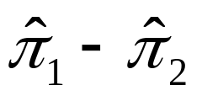
Example: Effect of n on statistical significance
(for a given degree of association)
Response
1 2 1 2 1 2 1 2
Group 1 15 10 30 20 60 40 600 400
Group 2 10 15 20 30 40 60 400 600
² : 2
(df = 1)
P-value: 0.16 0.046 0.005 3.7 x 10⁻¹⁹
Note that = 0.60 – 0.40 = 0.20 in each table
We can obtain a large chi-squared test statistic (and thus a small P-value) for a weak association, when n is quite large.

Slide 33
Example (small P-value does not imply strong association)
Response
1 2
Group 1 5100 4900
Group 2 4900 5100
Chi-squared = 8.0 (df = 1), P-value = 0.005
Note that =
This example shows very strong evidence of association, but the association appears to be quite weak.

