Slide 1
Statistics 101 Course Notes
Introduction to Quantitative Methods for
Psychology and the Behavioral Sciences
Instructor: Alan Agresti
Course syllabus: At top of course home page, which is also at
www.stat.ufl.edu/~aa/harvard
Teaching fellows:
Roee Gutman
Jon Hennessy
Section times on syllabus, office hours to be listed at course home page.

Slide 2
1. Introduction
Data - Information collected to gain knowledge about a field or answer a question of interest.
Data Sources include:
  Surveys
  Experiments
Statistics- Set of methods for collecting/analyzing data (the art and science of learning from data)

Slide 3
Statistics provides methods for:
Design - Planning/Implementing a study
  Sample survey or experiment?
  How to choose people (subjects) for the study, and how many?
Description – Graphical and numerical methods for summarizing the data
Inference – Methods for making predictions about a population (total set of subjects of interest), based on a sample (subset of the sample on which study collects data)

Slide 4
Examples

Slide 5
Parameter – Numerical summary of the population
  Population mean
  Population proportion
Statistic – Numerical summary of the sample
We use the sample statistic to make inferences about the population parameter.

Slide 6
Examples: parameters / statistics

Slide 7
Note:
Populations can be actual sets of people or conceptual (hypothetical)
For good inferences, need sample to be representative of population
Statistical software is used to analyze data

Slide 8
Software applies to data files
Any one row contains observations for particular subject (person) in sample
Any one column contains observations for a particular characteristic (“variable”) measured. The names of the characteristics are at top of file, in first row.

Slide 9
Examples: Go to www.stat.ufl.edu/~aa/social/data.html
The first data file, from a survey of 60 students at Univ. of Florida, looks like:
subject gen age high coll tv veg party ideology abor
1 m 32 2.2 3.5 3 n r 6 n
2 f 23 2.1 3.5 15 y d 2 y
3 f 27 3.3 3.0 0 y d 2 y
4 f 35 3.5 3.2 5 n i 4 y
5 M 23 3.1 3.5 6 n i 1 y

Slide 10
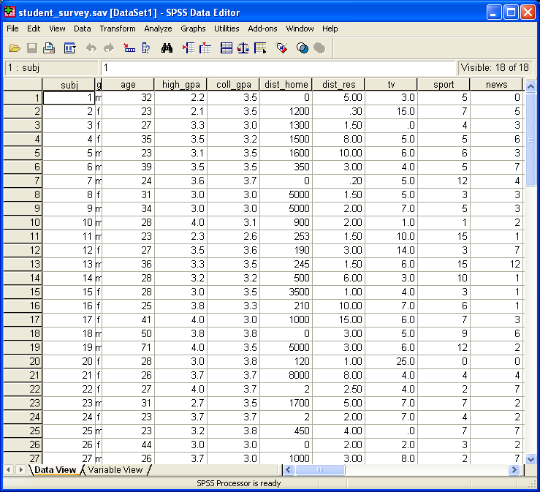
When loaded by SPSS, looks like:

