Slide 1
12. Comparing Groups: Analysis of Variance (ANOVA) Methods
Response y Explanatory x var’s Method
Categorical Categorical Contingency tables
Quantitative Quantitative Regression and correlation
Quantitative Categorical ANOVA
(Where does Ch. 7 on comparing 2 means or 2 proportions fit into this?)
Ch. 12 compares the mean of y for the groups corresponding to the categories of the categorical explanatory variables.
Examples:
y = mental impairment, x’s = treatment type, gender, marital status
y = income, x’s = race, education (<HS, HS, college), type of job

Slide 2
Comparing means across categories of one classification (1-way ANOVA)
Let g = number of groups
We’re interested in inference about the population means
μ₁ , μ₂ , ... , μ_{g}
The analysis of variance (ANOVA) is an F test of
H₀: μ₁ = μ₂ = ⋅⋅⋅ = μ_{g}
H_{a}: The means are not all identical
The test analyzes whether the differences observed among the sample means could have reasonably occurred by chance, if H₀ were true (due to R. A. Fisher).

Slide 3
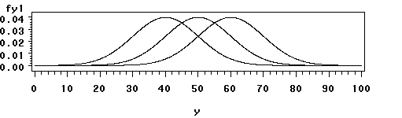
One-way analysis of variance
Assumptions for the F significance test :
  The g population dist’s for the response variable are normal
  The population standard dev’s are equal for the g groups (σ)
  Randomization, such that samples from the g populations can be treated as independent random samples
  (separate methods used for dependent samples)

Slide 4
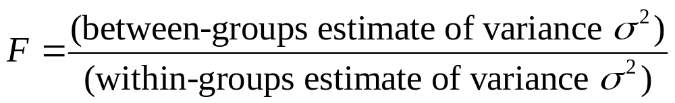
Variability between and within groups
(Picture of two possible cases for comparing means of 3 groups; which gives more evidence against H₀?)
The F test statistic is large (and P-value is small) if variability between groups is large relative to variability within groups
Both estimates unbiased when H₀ is true
(then F tends to fluctuate around 1 according to F dist.)
Between-groups estimate tends to overestimate variance when H₀ false (then F is large, P-value = right-tail prob. small)

Slide 5
Detailed formulas later, but basically
Each estimate is a ratio of a sum of squares (SS) divided by a df value, giving a mean square (MS).
The F test statistic is a ratio of the mean squares.
P-value = right-tail probability from F distribution (almost always the case for F and chi-squared tests).
Software reports an “ANOVA table” that reports the SS values, df values, MS values, F test statistic, P-value.

Slide 6
Exercise 12.12: Does number of good friends depend on happiness? (GSS data)
Very happy Pretty happy Not too happy
Mean 10.4 7.4 8.3
Std. dev. 17.8 13.6 15.6
n 276 468 87
Do you think the population distributions are normal?
A different measure of location, such as the median, may be more relevant. Keeping this in mind, we use these data to illustrate one-way ANOVA.

Slide 7
ANOVA table
Sum of Mean
Source squares df square F Sig
Between-groups 1627 2 813 3.47 0.032
Within-groups 193901 828 234
Total 195528 830
The mean squares are 1627/2 = 813 and 193901/828 = 234.
The F test statistic is the ratio of mean squares, F =
If H₀ true, F test statistic has the F dist with df₁ = 2, df₂ = 828, and P(F ≥ 3.47) = . There is quite strong evidence that the population means differ for at least two of the three groups.

Slide 8
Within-groups estimate of variance
g = number of groups
Sample sizes n₁ , n₂ , … , n_{g ,}, N = n₁ + n₂ + … + n_{g}
This pools the g separate sample variance estimates into a single estimate that is unbiased, regardless of whether H₀ is true. (With equal n’s, s² is simple average of sample var’s.)
The denominator, N – g, is df₂ for the F test.

Slide 9

For the example, this is
which is the mean square error (MSE). Its square root,
s = 15.3, is the pooled standard deviation estimate that summarizes the separate sample standard deviations of 17.8, 13.6, 15.6 into a single estimate.
(Analogous “pooled estimate” used for two-sample comparisons in Chapter 7 that assumed equal variance.)
Its df value is (276 + 468 + 87) – 3 = 828. This is df₂ for F test, because the estimate s² is in denom. of F stat.

Slide 10
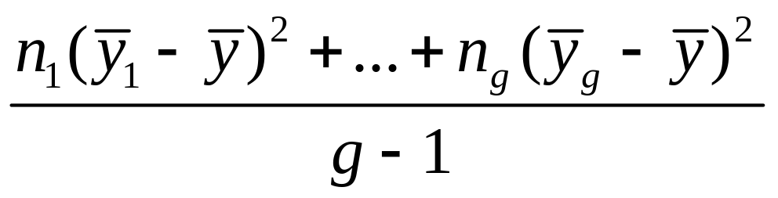

Between-groups estimate of variance where is the sample mean for the combined samples (can motivate using var. formula for sample means)
Since this describes variability among g groups, its df = g – 1, which is df₁ for the F test (since between-groups estimate goes in numerator of F test statistic).
For the example, between-groups estimate = 813, with df = 2, which is df₁ for the F test.

Slide 11
Some comments about the ANOVA F test
F test is robust to violations of normal population assumption, especially as sample sizes grow (CLT)
F test is robust to violations of assumption of equal population standard deviations, especially when sample sizes are similar
When sample sizes small and population distributions may be far from normal, can use the Kruskal-Wallis test, a nonparametric method.
Can implement with software such as SPSS (later)
Why use F test instead of several t tests?

Slide 12
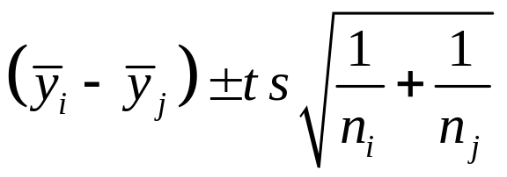
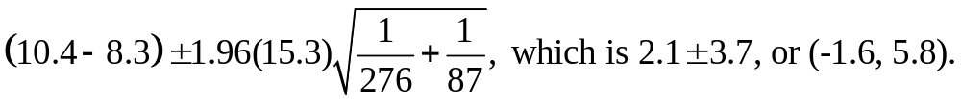
Follow-up Comparisons of Pairs of Means
A CI for the difference (µ_{i} -µ_{j}) is
where t-score is based on chosen confidence level, df = N – g for t-score is df₂ for F test, and s is square root of MSE
Example: A 95% CI for difference between population mean number of close friends for those who are very happy and not too happy is

Slide 13
(very happy, pretty happy): 3.0 ± 2.3
(not too happy, pretty happy): 0.9 ± 3.5
The only pair of groups for whom we can conclude the population mean number of friends differ is “very happy” and “pretty happy”.
i.e., this conclusion corresponds to the summary:
µ_{PH} µ_{NTH} µ_{VH}
________
_________ (note lack of “transitivity” when dealing
in probabilistic comparisons)

Slide 14
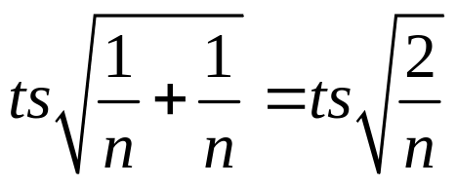
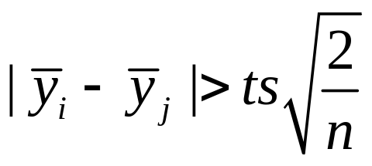
Comments about comparing pairs of means
In designed experiments, often n₁ = n₂ = … = n_{g} = n (say), and then the margin of error for each comparison is
For each comparison, the CI comparing the two means does not contain 0 if
That margin of error called the “least significant difference” (LSD)

Slide 15
If g is large, the number of pairwise comparisons,
which is g(g-1)/2,
is large. The probability may be unacceptably large that at least one of the CI’s is in error.
Example: For g = 10, there are comparisons.
With 95% CIs, just by chance we expect about
= of the CI’s to fail to contain the true difference between population means.
(Similar situation in any statistical analysis making lots of inferences, such as conducting all the t tests for  parameters in a multiple regression model with a large number of predictors)

Slide 16
Multiple Comparisons of Groups
Goal: Obtain confidence intervals for all pairs of group mean difference, with fixed probability that entire set of CI’s is correct.
One solution: Construct each individual CI with a higher confidence coefficient, so that they will all be correct with at least 95% confidence.
The Bonferroni approach does this by dividing the overall desired error rate by the number of comparisons to get error rate for each comparison.

Slide 17
Example: With g = 3 groups, suppose we want the “multiple comparison error rate” to be 0.05. i.e., we want 95% confidence that all three CI’s contain true differences between population means, 0.05 = probability that at least one CI is in error.
Take 0.05/3 = 0.0167 as error rate for each CI.
Use t = instead of t = 1.96 (large N, df)
Each separate CI has form of 98.33% CI instead of 95% CI.
(very happy, not too happy): 2.1 ± 4.5
(very happy, pretty happy): 3.0 ± 2.8
(not too happy, pretty happy): 0.9 ± 4.3

Slide 18
Comments about Bonferroni method
Based on Bonferroni’s probability inequality:
For events E₁ , E₂ , E₃ , …
P(at least one event occurs) ≤ P(E₁ ) + P(E₂ ) + P(E₃ ) + …
Example: E_{i} = event that ith CI is in error, i = 1, 2, 3.
With three 98.67% CI’s,
P(at least one CI in error) ≤ 0.0167 + 0.0167 + 0.0167 = 0.05
Software also gives Tukey multiple comparison method, which is more complex but gives slightly shorter CIs

Slide 19
Regression Approach To ANOVA
Dummy (indicator) variable: Equals 1 if observation from a particular group, 0 if not.
With g groups, we create g - 1 dummy variables:
e.g., for g = 3,
z₁ = 1 if observation from group 1, 0 otherwise
z₂ = 1 if observation from group 2, 0 otherwise
Subjects in last group have all dummy var’s = 0
Regression model: E(y) = α + β₁z₁ + ... + β_{g-1}z_{g-1}
Mean for group i (i = 1 , ... , g - 1): μ_{i} = α + β_{i}
Mean for group g: μ_{g} = α
Regression coefficient β_{i} = μ_{i} - μ_{g} compares each mean to mean for last group

Slide 20

Example: Model E(y) = α + β₁z₁+ β₂z₂
where
y = reported number of close friends
z₁ = 1 if very happy, 0 otherwise (group 1, mean 10.4)
z₂ = 1 if pretty happy, 0 otherwise (group 2, mean 7.4)
z₁ = z₂ = 0 if not too happy (group 3, mean 8.3)
The prediction equation is = 8.3 + 2.1z₁ - 0.9z₂
Which gives predicted means
Group 1 (very happy): 8.3 + 2.1(1) - 0.9(0) = 10.4
Group 2 (pretty happy): 8.3 + 2.1(0) - 0.9(1) = 7.4
Group 3 (not too happy): 8.3 + 2.1(0) - 0.9(0) = 8.3

Slide 21
Test Comparison (ANOVA, regression)
μ_{i} = α + β_{i} μ_{g} = α ⇒ β_{i} = μ_{i} - μ_{g}
1-way ANOVA: H₀: μ₁= … =μ_{g}
Regression approach: Testing H₀: β₁ = ... = β_{g-1} = 0 gives the ANOVA F test (same df values, P-value)
F test statistic from regression (H₀: β₁ = ... = β_{g-1} = 0) is
F = (MS for regression)/MSE

Slide 22
Regression ANOVA table:
Sum of Mean
Source Squares df square F Sig
Regression 1627 2 813 3.47 0.032
Residual 193901 828 234
Total 195528 830
The ANOVA “between-groups SS” is the “regression SS”
The ANOVA “within-groups SS” is the “residual SS” (SSE)
Regression t tests: Test whether means for groups i and g are significantly different:
  H₀: β_{i} = 0 corresponds to H₀: μ_{i} – μ_{g} = 0

Slide 23
Why use regression to perform ANOVA?
Nice to unify various methods as special case of one analysis
(e.g. even methods of Chapter 7 for comparing two means can be viewed as special case of regression with a single dummy variable as indicator for group)
Being able to handle categorical variables in a regression model gives us a mechanism for modeling several predictors that may be categorical or (more commonly, in practice) a mixture of categorical and quantitative.

Slide 24
Two-way ANOVA
Analyzes relationship between quantitative response y and two categorical explanatory factors.
Example: A sample of college students were rated by a panel on their physical attractiveness. Response equals number of dates in past 3 months for students rated in top or bottom quartile of attractiveness, for females and males.
(Journal of Personality and Social Psychology, 1995)
We consider first the various hypotheses and significance tests for two-way ANOVA, and then see how it is a special case of a regression analysis.

Slide 25
“Main Effect” Hypotheses
A main effect hypothesis states that the means are equal across levels of one factor, within levels of the other factor.
H₀ : no effect of gender, H₀ : no effect of attractiveness
Example of population means satisfying these are:
1. No gender effect 2. No attractiveness effect
Gender Gender
Attractiveness Men Women Men Women
More
Less

Slide 26
F test statistics for main effects
Same assumptions as 1-way ANOVA (randomization, normal population dist’s with equal standard deviations in each “group” which is a “cell” in the table)
The test statistic for a factor main effect has form
F = (MS for factor)/(MS error),
a ratio of variance estimates such that the numerator tends to inflate (F tends to be large) when H₀ false.
s = square root of MSE in denominator of F is estimate of population standard deviation for each group
df₁ for F statistic is (no. categories for factor – 1). (This is number of parameters that are coefficients of dummy variables in the regression model corresponding to 2-way ANOVA.)
Estimating sizes of effects more naturally done by viewing as a regression model (later)

Slide 27
Interaction in two-way ANOVA
Testing main effects only sensible if there is “no interaction”; i.e., effect of each factor is the same at each category for the other factor.
Example of population means
1. satisfying no interaction 2. showing interaction
Gender Gender
Attractiveness Men Women Men Women
More
Less
(see graph and “parallelism” representing lack of interaction)
We can test H₀ : no interaction with F = (interaction MS)/(MS error)
Should do so before considering main effects tests

Slide 28
Here’s the actual sample data – sample mean (standard dev., n)
Gender
Attractiveness Men Women
More 9.7 (s =10.0, n = 35) 17.8 (s = 14.2, n = 33)
Less 9.9 (s = 12.6, n = 36) 10.4 (s = 16.6, n = 27)
This suggests interaction, with cell means being approx. equal except for more attractive women (higher), but authors report “none of the effects was significant, due to the large within-groups variance” (data probably also highly skewed to right).

Slide 29
An example for which we have the raw data: Student survey data file
y = number of weekly hours engaged in sports and other physical exercise.
Factors: gender, whether a vegetarian (both categorical, so two-way ANOVA relevant)
We use SPSS with survey.sav data file
On Analyze menu, Compare means option has 1-way ANOVA as a further option
Something weird in SPSS: levels of factor must be coded numerically, even though treated as nominal variables in the analysis!
For gender, I created a dummy variable g for gender
For vegetarian, I created a dummy variable v for vegetarianism

Slide 30
Sample means on sports by factor:
Gender:
Vegetarianism:
One-way ANOVA comparing mean on sports by gender has F =
One-way ANOVA comparing mean on sports by whether a vegetarian has F = .
These are merely squares of t statistic from Chapter 7 for comparing two means assuming equal variability
(df for t is n₁ + n₂ – 2 = 58 = df₂ for F test, df₁ = 1)

Slide 31
One-way ANOVA’s handle only one factor at a time, give no information about possible interaction, how effects of one factor may change according to level of other factor
Sample means
Vegetarian Men Women
Yes
No
Seems to show interaction, but some cell n’s are very small and standard errors of these means are large
In SPSS, to do two-way ANOVA, on Analyze menu choose General Linear Model option and Univariate suboption, declaring factors as fixed (I remind myself by looking at Appendix p. 552 in my SMSS textbook).

Slide 32
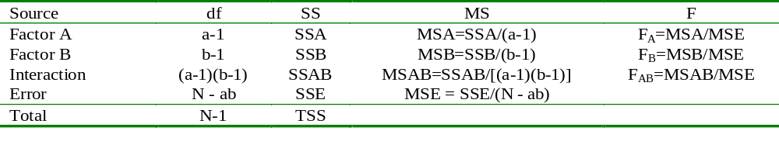
Two-way ANOVA Summary
General Notation: Factor A has a levels, B has b levels
Procedure:
  Test H₀: No interaction based on the F_{AB} statistic
  If the interaction test is not significant, test for Factor A and B effects based on the F_{A} and F_{B} statistics (and can remove interaction terms from model)

Slide 33
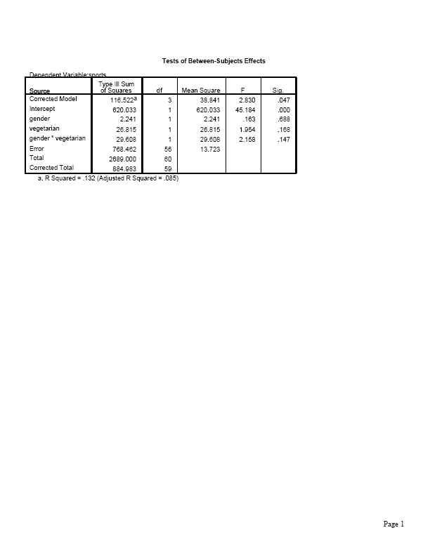
Test of H₀ : no interaction has
F = ,
df₁ = , df₂ = , P-value =

Slide 34
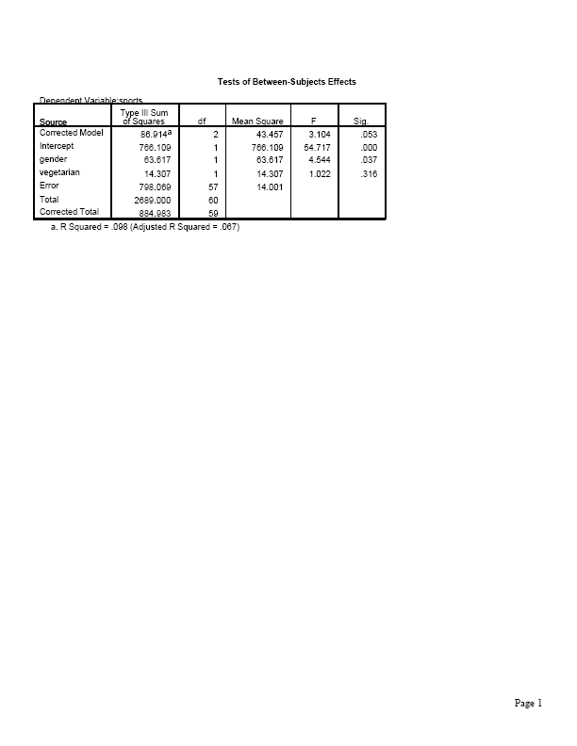
Since interaction is not significant, we can take it out of model and re-do analysis using only main effects.
(In SPSS, click on Model to build customized model containing main effects but no interaction term)
At 0.05 level, gender is significant (P-value = 0.037) but vegetarianism is not (P-value = 0.32)

Slide 35
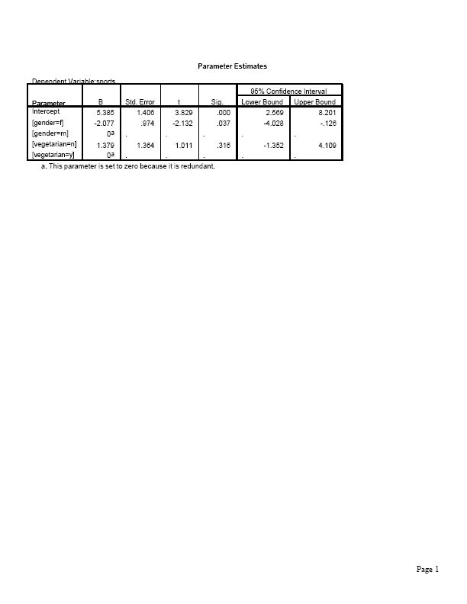
More informative to estimate sizes of effects using regression model with dummy variables g for gender (1=female, 0=male), v for vegetarian (1=no, 0=yes).
Model E(y) = α + β₁g + β₂v
Model satisfies lack of interaction
To allow interaction, we add β₃(v*g) to model

Slide 36
Predicted weekly hours in sports = 5.4 – 2.1g + 1.4v
The estimated means are:
5.4 for male vegetarians (g = 0, v = 0)
5.4 – 2.1 = 3.3 for female vegetarians (g = 1, v = 0)
5.4 + 1.4 = 6.8 for male nonvegetarians (g=0, v =1)
5.4 – 2.1 + 1.4 = 4.7 for female nonveg. (g=1, v=1)
These “smooth” the sample means and display no interaction (recall mean = 3.0 for male vegetarians had only n = 3).
Sample means Model predicted means
Vegetarian Men Women Men Women
Yes 3.0 4.5 5.4 3.3
No 7.0 4.4 6.8 4.7

Slide 37
The “no interaction” model provides estimates of main effects and CI’s
Estimated vegetarian effect (comparing mean sports for nonveg. and veg.), controlling for gender, is .
Estimated gender effect (comparing mean sports for females and males), controlling for whether a vegetarian, is .
Controlling for whether a vegetarian, a 95% CI for the difference between mean weekly time on sports for males and for females is

Slide 38
Comments about two-way ANOVA
If interaction terms needed in model, need to compare means (e.g., with CI) for levels of one factor separately at each level of other factor
Testing a term in the model corresponds to a comparison of two regression models, with and without the term. The SS for the term is the difference between SSE without and with the term (i.e., the variability explained by that term, adjusting for whatever else is in the model). This is called a partial SS or a Type III SS in some software

Slide 39
The squares of the t statistics shown in the table of parameter estimates are the F statistics for the main effects (Each factor has only two categories and one parameter, so df₁ = 1 in F test)
When cell n’s are identical, as in many designed experiments, the model SS for model with factors A and B and their interaction partitions exactly into
Model SS = SS_{A} + SS_{B} + SS_{AxB}
and SS_{A} and SS_{B} are same as in one-way ANOVAs or in two-way ANOVA without interaction term. (Then not necessary to delete interaction terms from model before testing main effects)
When cell n’s are not identical, estimated difference in means between two levels of a factor in two-way ANOVA need not be same as in one-way ANOVA (e.g., see our example, where vegetarianism effect is 1.75 in one-way ANOVA where gender ignored, 1.4 in two-way ANOVA where gender is controlled)
Two-way ANOVA extends to three-way ANOVA and, generally, factorial ANOVA.

Slide 40
For dependent samples (e.g., “repeated measures” over time), there are alternative ANOVA methods that account for the dependence (Sections 12.6, 12.7). Likewise, the regression model for ANOVA extends to models for dependent samples.
The model can explicitly include a term for each subject. E.g., for a crossover study with t = treatment (1, 0 dummy var.) and p_{i} = 1 for subject i and p_{i} = 0 otherwise, assuming no interaction,
E(y) = α + β₁p₁+ β₂ p₂ + … + β_{n-1} p_{n-1} + β_{n} t
The number of “person effects” can be huge. Those effects are usually treated as “random effects” (random variables, with some distribution, such as normal) rather than “fixed effects” (parameters). The main interest is usually in the fixed effects.

Slide 41
In making many inferences (e.g., CI’s for each pair of levels of a factor), multiple comparison methods (e.g., Bonferroni, Tukey) can control overall error rate.
Regression model for ANOVA extends to models having both categorical and quantitative explanatory variables (Chapter 13)
Example: Modeling y = number of close friends, with predictors
g =gender (g = 1, female, g = 0 male),
race (r₁ = 1, black, 0 other; r₂ = 1, Hispanic, 0 other,
r₁ = r₂ = 0, white)
x₁ = number of social organizations a member of
x₂ = age
Model E(y) = α + β₁g+ β₂ r₁ + β₃ r₂ + β₄ x₁ + β₅ x₂

Slide 42
How do we do regression when response variable is categorical (Ch. 15)?
Model the probability for a category of the response variable. E.g., with binary response (y = 1 or 0), model P(y = 1) in terms of explanatory variables.
Need a mathematical formula more complex than a straight line, to keep predicted probabilities between 0 and 1
Logistic regression uses an S-shaped curve that goes from 0 up to 1 or from 1 down to 0 as a predictor x changes

Slide 43
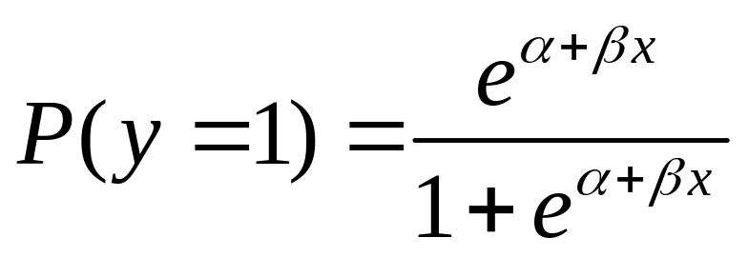
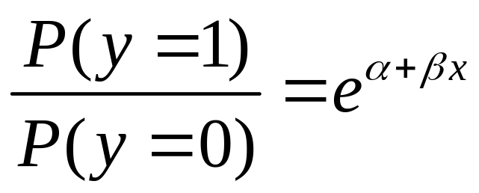
Logistic regression model
With binary response (y = 1 or 0) and a single explanatory variable, model has form
Then the odds satisfies
(exponential function) and odds multiplies by e for each 1-unit increase in x; i.e., e is an odds ratio
i.e., the odds for y = 1 instead of y = 0 at x+1 divided by odds at x.

Slide 44
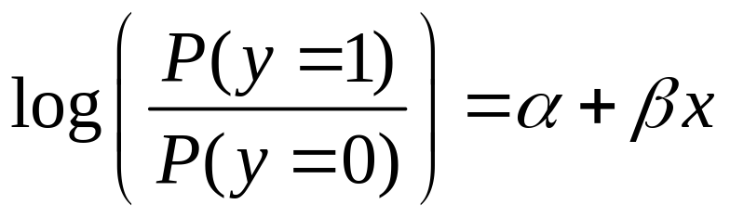
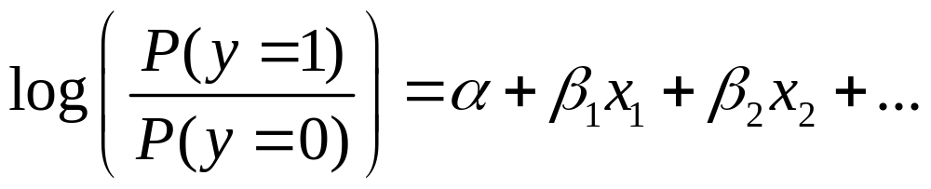
For this model, taking the log of the odds yields a linear equation in x,
The log of the odds is called the “logit,” and this type of model is sometimes called a logit model.
This logistic regression model extends to many predictors

Slide 45
As in ordinary regression, it’s possible to have quantitative and categorical explanatory variables (using dummy variables for categorical ones).
Example: For sample of elderly, y = whether show symptoms of Alzheimer’s disease (1 = yes, 0 = no)
x₁ = score on test of mental acuity
x₂ = physically mobile (1 = yes, 0 = no)
A model without an interaction term implies “parallel S-shaped curves” when fix one predictor, consider effect of other predictor
A model with interaction implies curves have different rate of change (picture)

Slide 46
Binary logistic regression extends also to
logistic regression for nominal responses
logistic regression for ordinal responses
logistic regression for multivariate responses, such as in longitudinal studies (need to then account for samples being dependent, such as by using random effects for subjects in the model)
Details in my book,
An Introduction to Categorical Data Analysis
(2nd ed., 2007, published by Wiley)

