Slide 1
5. Statistical Inference: Estimation
Goal: Use sample data to estimate values of population parameters
Point estimate: A single statistic value that is the “best guess” for the parameter value
Interval estimate: An interval of numbers around the point estimate, that has a fixed “confidence level” of containing the parameter value. Called a confidence interval.

Slide 2
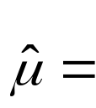
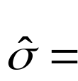

Point Estimators – Most common to use sample values
Sample mean estimates population mean μ
Sample std. dev. estimates population std. dev. σ
Sample proportion estimates population proportion 

Slide 3
Properties of good estimators
Unbiased: Sampling dist of estimator centers around parameter value
Efficient: Smallest possible standard error, compared to other estimators
Notes:
Maximum likelihood gives good point estimates

Slide 4
Confidence Intervals
A confidence interval (CI) is an interval of numbers believed to contain the parameter value.
The probability the method produces an interval that contains the parameter is called the confidence level (close to 1, such as 0.95 or 0.99.
Most CIs have the form
point estimate ± margin of error
with margin of error based on spread of sampling distribution of the point estimator (e.g., margin of error  2(standard error) for 95% confidence)

Slide 5
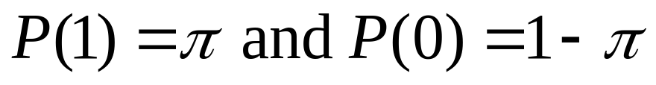
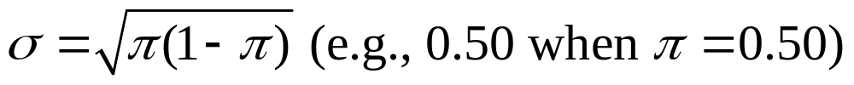
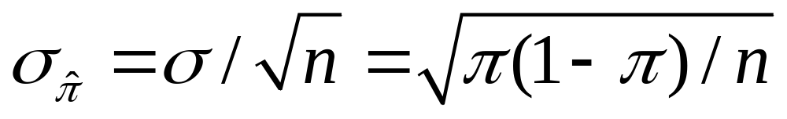
Confidence Interval for a Proportion
(in a particular category)
Sample proportion is a mean when we let y=1 for observation in category of interest, y=0 otherwise
Population proportion is mean µ of prob. dist having
The standard dev. of this prob. dist. is
The standard error of the sample proportion is

Slide 6
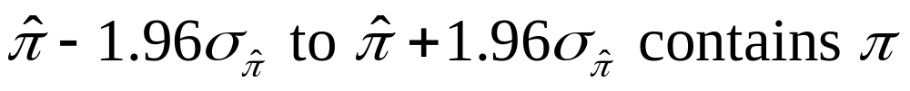
Sampling distribution of sample proportion for large random samples is approximately normal (CLT)
So, with probability 0.95, sample proportion falls within 1.96 standard errors of population proportion 
0.95 probability that
Once sample selected, we’re 95% confident

Slide 7
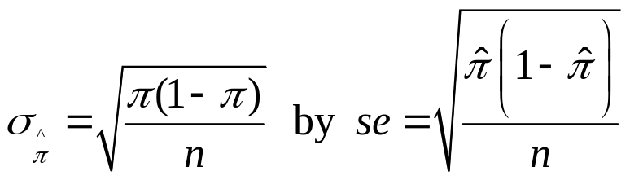

Finding a CI in practice
Complication: The true standard error
itself depends on the unknown parameter!
In practice, we estimate
and then find 95% CI using formula

Slide 8
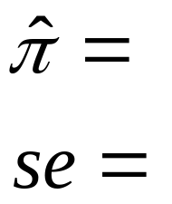
Example: What percentage of 18-22 year-old Americans report being “very happy”?
Recent GSS data: 35 of n=164 “very happy” (others report being “pretty happy” or “not too happy”)
95% CI is
(i.e., “margin of error” = )
which gives ( , ). We’re 95% confident the population proportion who are “very happy” is between and .

Slide 9
Find a 99% CI with these data
0.99 central probability, 0.01 in two tails
0.005 in each tail
z-score is
99% CI is 0.213 ± ???,
or 0.213 ± ???, which gives ( , )
Greater confidence requires wider CI
Recall 95% CI was (0.15, 0.28)

Slide 10
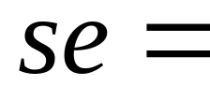
Suppose sample proportion of 0.213 based on n = 656 (instead of 164)
95% CI is
(recall 95% CI with n = 164 was (0.15, 0.28))
Greater sample size gives narrower CI
(quadruple n to halve width of CI)
These se formulas treat population size as infinite (see Exercise 4.57 for finite population correction)

Slide 11
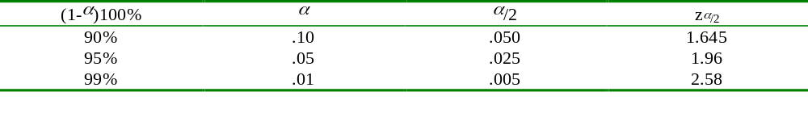
Some comments about CIs
Effects of n, confidence coefficient true for CIs for other parameters also
If we repeatedly took random samples of some fixed size n and each time calculated a 95% CI, in the long run about 95% of the CI’s would contain the population proportion .
(CI applet at www.prenhall.com/agresti)
The probability that the CI does not contain  is called the error probability, and is denoted by .
 = 1 – confidence coefficient

Slide 12
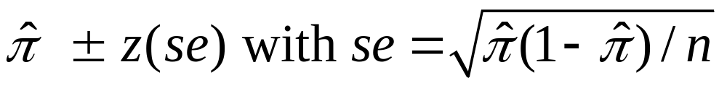
General formula for CI for proportion is
z-value such that prob. for a normal dist within z standard errors of mean equals confidence level
With n for most polls (roughly 1000), margin of error usually about ± 0.03 (ideally)
Method requires “large n” so sampling dist. of sample proportion is approximately normal (CLT)

Slide 13
Otherwise, sampling dist. is skewed
(can check this with sampling distribution applet,
e.g., for n = 30 but  = 0.1 or 0.9)
and sample proportion may then be poor estimate of , and se may then be a poor estimate of true standard error.
Example: Estimating proportion of vegetarians (p. 129)
n = 20, 0 vegetarians, sample proportion = 0/20 = 0.0,
95% CI for population proportion is 0.0 ± 1.96(0.0), or (0.0, 0.0)
Better (due to E. Wilson at Harvard in1927, but not in most statistics books):
Do not estimate standard error but figure out  values
for which

Slide 14
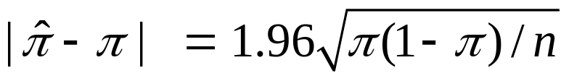

Example: for n = 20 with
solving the quadratic equation this gives for  provides solutions 0 and 0.16, so 95% CI is (0, 0.16)
Agresti and Coull (1998) suggested using ordinary CI (estimate ± z(se)) after adding 2 observations of each type, as a simpler approach that works well even for very small n (95% CI has same midpoint as Wilson CI);
Example: 0 vegetarians, 20 non-veg; change to 2 veg, 22 non-veg, and then we find
95% CI is 0.08 ± 1.96(0.056) = 0.08 ± 0.11, gives (0.0, 0.19).

Slide 15
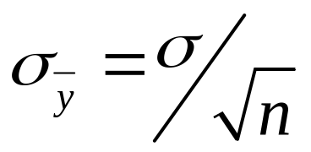
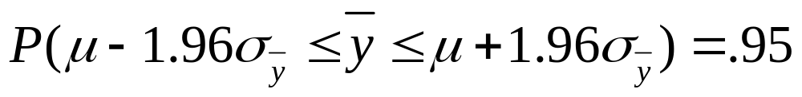
Confidence Interval for the Mean
In large random samples, the sample mean has approx. a normal sampling distribution with mean μ and standard error
Thus,
We can be 95% confident that the sample mean lies within 1.96 standard errors of the (unknown) population mean

Slide 16
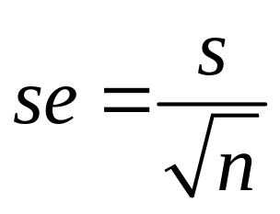
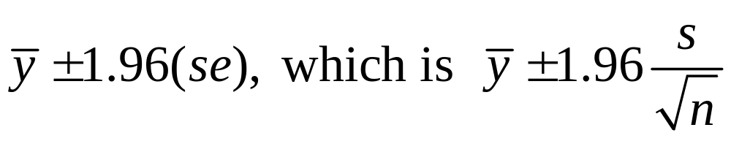
Problem: Standard error is unknown (σ is also a parameter). It is estimated by replacing σ with its point estimate from the sample data:
95% confidence interval for μ :
This works ok for “large n,” because s then a good estimate of σ (and CLT). But for small n, replacing σ by its estimate s introduces extra error, and CI is not quite wide enough unless we replace z-score by a slightly larger “t-score.”

Slide 17
The t distribution (Student’s t)
Bell-shaped, symmetric about 0
Standard deviation a bit larger than 1 (slightly thicker tails than standard normal distribution, which has mean = 0, standard deviation = 1)
Precise shape depends on degrees of freedom (df). For inference about mean,
df = n – 1
Gets narrower and more closely resembles standard normal dist. as df increases
(nearly identical when df > 30)
CI for mean has margin of error t(se)

Slide 18
Part of a t table
Confidence Level
90% 95% 98% 99%
df t.050 t.025 t.010 t.005
1 6.314 12.706 31.821 63.657
10 1.812 2.228 2.764 3.169
30 1.697 2.042 2.457 2.750
100 1.660 1.984 2.364 2.626
infinity 1.645 1.960 2.326 2.576
df =  corresponds to standard normal distribution

Slide 19
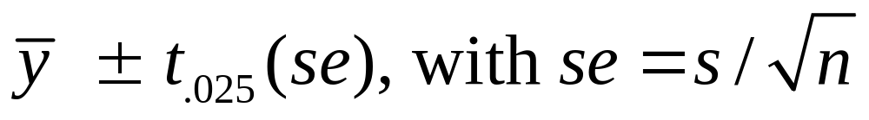
CI for a population mean
For a random sample from a normal population distribution, a 95% CI for µ is
where df = n-1 for the t-score
Normal population assumption ensures sampling distribution has bell shape for any n (Recall figure on p. 93 of text and next page). More about this assumption later.

Slide 20
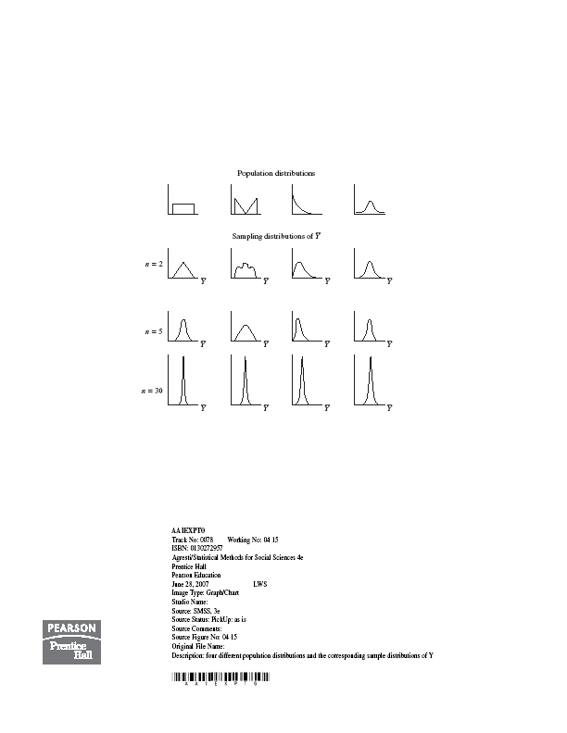

Slide 21
Example: Anorexia study (p.120)
Weight measured before and after period of treatment
y = weight at end – weight at beginning
Example on p.120 shows results for “cognitive behavioral” therapy. For n=17 girls receiving “family therapy” (p. 396),
y = 11.4, 11.0, 5.5, 9.4, 13.6, -2.9, -0.1, 7.4, 21.5, -5.3, -3.8, 13.4, 13.1, 9.0, 3.9, 5.7, 10.7

Slide 22
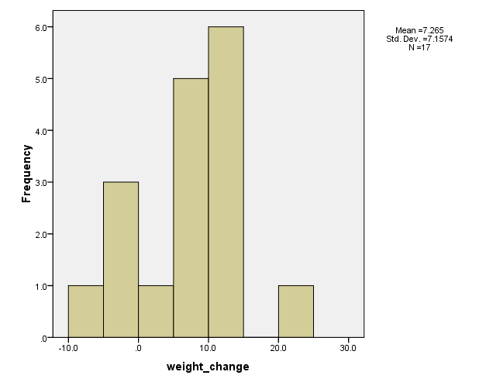

Slide 23

Software reports
---------------------------------------------------------------------------------------
Variable N Mean Std.Dev. Std. Error Mean
weight_change 17 7.265 7.157 1.736
----------------------------------------------------------------------------------------
se obtained as
Since n = 17, df = 16, t-score for 95% confidence is
95% CI for population mean weight change is
We can predict that the population mean weight change was positive (i.e., treatment effective, on average), with value between about 4 and 11 pounds.

Slide 24
Comments about CI for population mean µ
Greater confidence requires wider CI
Greater n produces narrower CI
The method is robust to violations of the assumption of a normal population dist.
(But, be careful if sample data dist is very highly skewed, or if severe outliers. Look at the data.)
t methods developed by W.S. Gosset (“Student”) of Guinness Breweries, Dublin (1908)

Slide 25
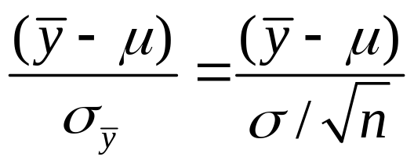
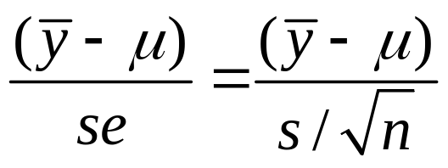
t distribution and standard normal as sampling distributions (normal popul.)
The standard normal distribution is the sampling distribution of
The t distribution is the sampling distribution of

Slide 26
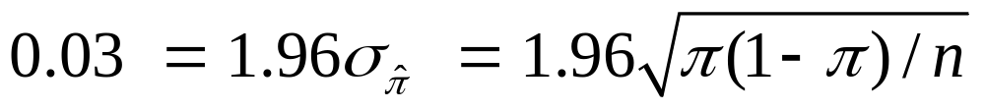
Choosing the Sample Size
Ex. How large a sample size do we need to estimate a population proportion (e.g., “very happy”) to within 0.03, with probability 0.95?
i.e., what is n so that margin of error of 95% confidence interval is 0.03?
Set 0.03 = margin of error and solve for n

Slide 27
Solution
Largest n value occurs for  = ???, so we’ll be “safe” by selecting n = .
If only need margin of error 0.06, require
(To double precision, need to quadruple n)

Slide 28
What if we can make an educated “guess” about proportion value?
If previous study suggests popul. proportion roughly about 0.20, then to get margin of error 0.03 for 95% CI,
It’s “easier” to estimate a population proportion as the value gets closer to 0 or 1 (close election difficult)
Better to use approx value for  rather than 0.50 unless you have no idea about its value

Slide 29
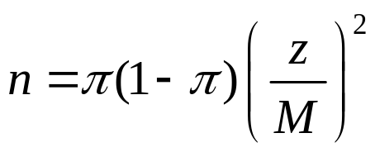
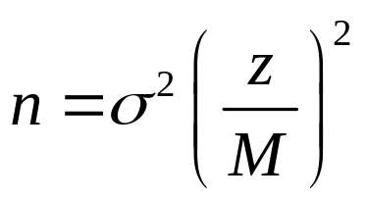
Choosing the Sample Size
Determine parameter of interest (population mean or population proportion)
Select a margin of error (M) and a confidence level (determines z-score)
Proportion (to be “safe,” set π = 0.50):
Mean (need a guess for value of σ):

Slide 30
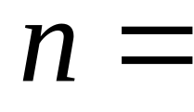
Example: n for estimating mean
Future anorexia study: We want n to estimate population mean weight change to within 2 pounds, with probability 0.95.
Based on past study, guess σ = 7
Note: Don’t worry about memorizing formulas such as for sample size. Formula sheet given on exams.

Slide 31
Some comments about CIs and sample size
We’ve seen that n depends on confidence level (higher confidence requires larger n) and the population variability (more variability requires larger n)
In practice, determining n not so easy, because (1) many parameters to estimate, (2) resources may be limited and we may need to compromise
CI’s can be formed for any parameter.
(e.g., see pp. 130-131 for CI for median)

Slide 32
Confidence interval methods were developed in the 1930s by Jerzy Neyman (U. California, Berkeley) and E. S. Pearson (University College, London)
The point estimation method mainly used today, developed by Ronald Fisher (UK) in the 1920s, is maximum likelihood. The estimate is the value of the parameter for which the observed data would have had greater chance of occurring than if the parameter equaled any other number.
(picture)
The bootstrap is a modern method (Brad Efron) for generating CIs without using mathematical methods to derive a sampling distribution that assumes a particular population distribution. It is based on repeatedly taking samples of size n (with replacement) from the sample data distribution.

