Slide 1

CREDIT CARD FRAUD
DETECTION
Presented by:
ALAN BABU
AMEEYA RANJAN SETHY
ANUBHAB RAY
EBRAHIM SOHAIL HARIS

Slide 2
TABLE OF CONTENTS
DATA AND ITS NORMALIZATION
THE MODEL
TRAINING THE MODEL
PROBLEM WITH THE TRAINING
UNDERSAMPLING
OVERSAMPLING AND SMOTE
SUMMARY
REFERENCES

Slide 3
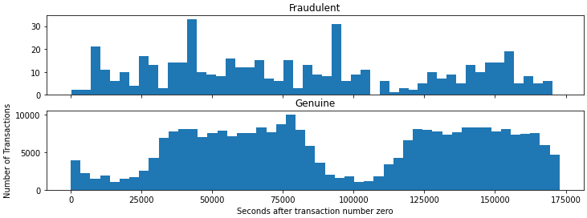
DATA AND ITS NORMALIZATION
“You can have data without information, but you cannot have information without data”
-Daniel Keys Moran
We obtain data from Kaggle
The dataset consists of 30 features for a transaction and 1 additional column giving the truth value
Out of the 30 features we drop the time feature as it does not give information about the fraud
28 of the left out 29 features already have a mean of about 0 and standard deviation of about 1, so it is unnecessary that we normalize these features.
The other 1 feature is the amount of transaction and it is normalized using StandardScaler in sklearn.preprocessing
Then we split the data into test and train

Slide 4
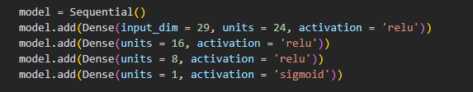
THE MODEL
We solve the fraud detection problem with the help of neural networks
The sequential type neural networks is defined as follows:
Clearly the model has 4 inner layers with 24,16,8 and 1 units having relu activation for the former 3 layers and sigmoid activation for the final layer.
The neural network having 1265 trainable parameters is pictorially represented below:

Slide 5
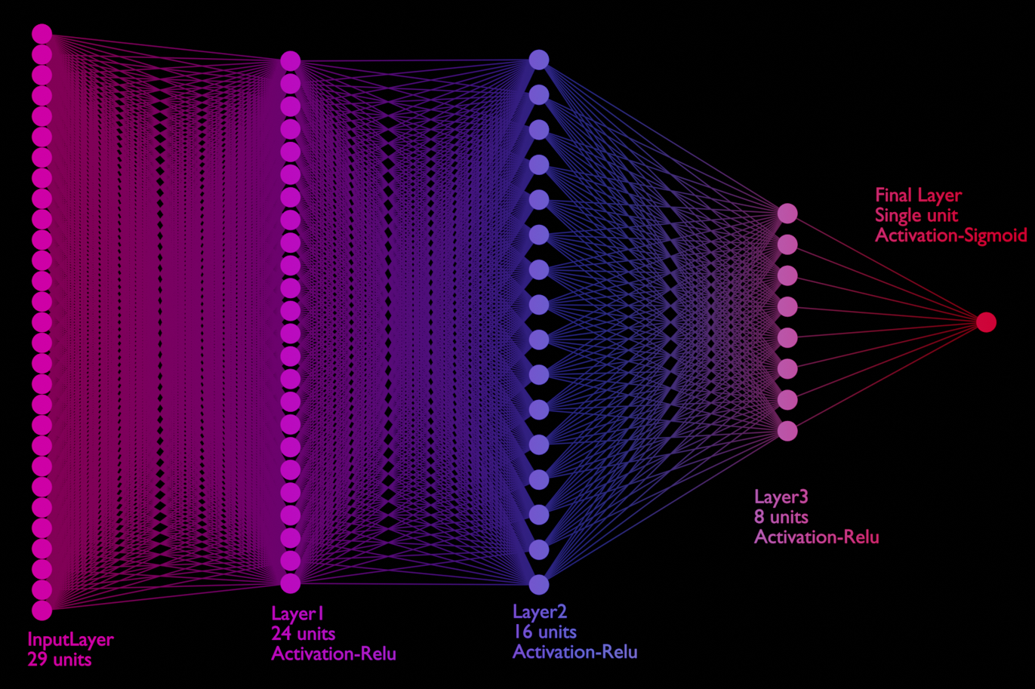

Slide 6
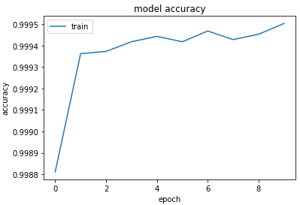
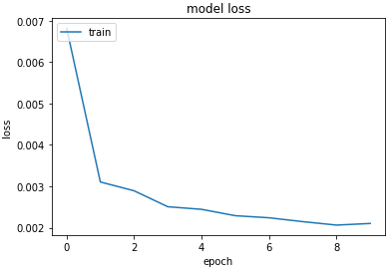

TRAINING THE MODEL
We train the model using the adam optimizer and binary cross entropy loss
We plot the accuracy and loss as a function of epochs as shown:
We have a convincing enough model due to low loss and high accuracy.
We also check for other commonly used metrics for classification problem such as precision recall and f1 score for further validation on test data which is reported here:

Slide 7
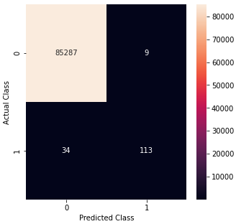
The low f1 score and recall lets us know that there is some problem with our model even though we got very high accuracy. Let us explore this problem further
Problems with the training
“problems are not stop signs, they are guidelines”
-Robert H Schuller
We analyze the problem using a confusion matrix for the test data using a heat map as shown:
The misclassified fraud data is 34 and is comparable to the correctly classified fraudulent transaction of 113. This is overshadowed by the large correctly classified genuine transaction leading to high accuracy
Hence we can correctly conclude that imbalance in the dataset is the actual problem and we shall see some fix to this in the coming section

Slide 8
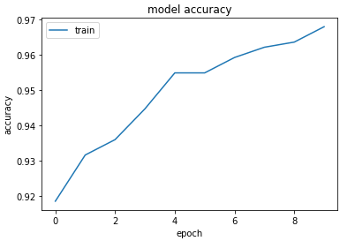
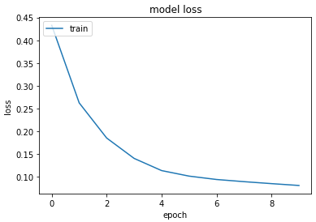
UNDERSAMPLING
We fix the imbalance in the data by using a technique called undersampling
An example in understanding undersampling
+
-
-
Take all points
+
Randomly choose fewer amount
We undersample the data before splitting. After both are done, we now train it the same way we trained the previous dataset. The plots for loss and accuracy as a function of epoch is plotted again:

Slide 9
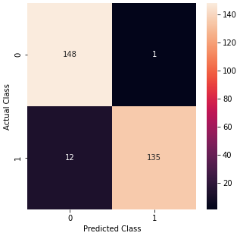

The confusion matrix is now plotted after the trained model is used to predict for test data
Clearly the misclassified data in proportion to classified data is reduced significantly
Let us also analyze the performance metrics in this case as well:
The f1 score climbed from 84 to 95 percent which is really great. But still we have about 5% misclassification, which is not a minor problem in fraud detection
One of the reason for this is because in undersampling we reduce the amount of information we have significantly, making the model much weaker. Once again we attempt to solve this problem.

Slide 10
OVERSAMPLING AND SMOTE
Over sampling is the opposite of undersampling and we explain using an example again :
-
+
-
Copy or synthesize to create more data
+
Take all points
Instead of copying the same data over and over again for oversampling we use a very famous method called SMOTE(Synthentic Minority Oversampling Technique) where, as its name suggests we synthesize artificial data using existing one. This really help in training

Slide 11
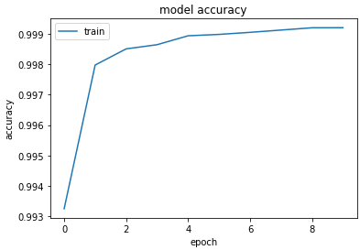
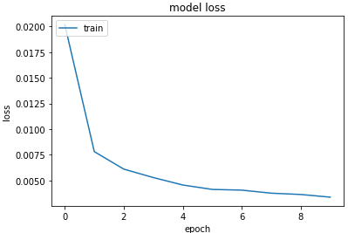
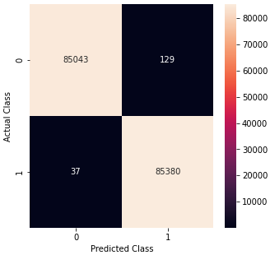
We split the data again after oversampling and train it again. We plot the loss and accuracy as a function of epochs again:
Again we have excellent accuracy and low loss for training data.
Let us predict for the test data using the model and plot the confusion matrix:
This time the misclassified data is in extremely low proportions compared to correctly classified points.

Slide 12

Let us check all the performance metrics for this case:
As can be seen from above, the f1 score and accuracy both have now become extremely good. Reaching almost 1.
We have finally created a good model!!!

Slide 13
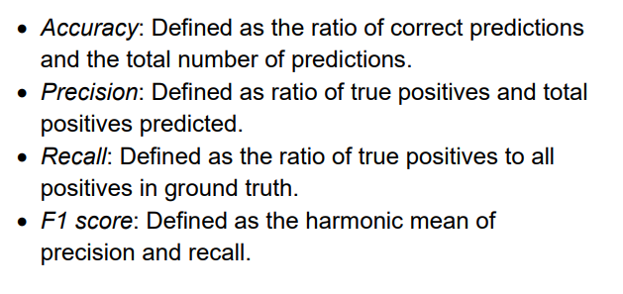
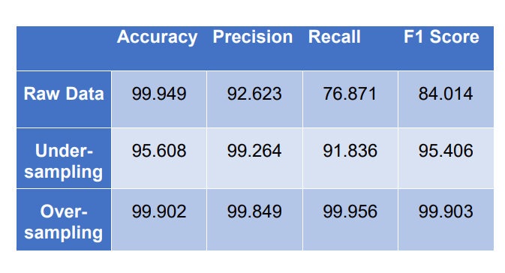
SUMMARY
We succeeded in designing and training a very viable model for detection of fraudulent transactions
Let us define a few performance metrics we saw above:
We now summarize our results from each training we did and the results we got in a table:

Slide 14
REFERENCES
1. Neural Model You-Tube Playlist https://www.youtube.com/playlist?list=PLeo1K3hjS3uu7CxAacxVndI4bE_o3BDtO
2. Dataset link from Kaggle https://www.kaggle.com/datasets/arockiaselciaa/creditcardcsv
3. Scikit-learn official User Guide https://scikit-learn.org/stable/user_guide.html
4. https://www.google.com/amp/s/www.geeksforgeeks.org/ml-credit-card-fraud-detection/amp/
5. SMOTE related https://machinelearningmastery.com/smote-oversampling-for-imbalanced-classification/
6. Metrics https://towardsdatascience.com/accuracy-precision-recall-or-f1-331fb37c5cb9

