Slide 1


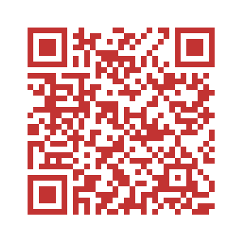
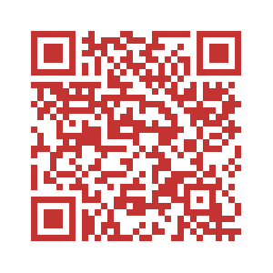
International Microbiome Centre Bioinformatics Platform
Fall courses
R Bootcamp for biologists
16s sequencing analysis
August 12-14, 2019
October 7-9, 2019
No experience necessary, open to all, spaces limited
Knowledge of basic R programing is a pre-requisite for this course
For details
bit.ly/2JcT4wb
or contact:
Alana Schick
a.schick@ucalgary.ca
For details
Bit.ly/30fRssg
or contact:
Hena Ramay hena.ramay@ucalgary.ca

