Slide 1



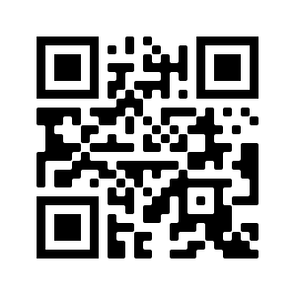
International Microbiome Centre Bioinformatics Platform
Upcoming Course
Introduction to R for Biologists
March 9-10, 2020,
Foothills Campus
No experience necessary, open to all, spaces limited
Participants will learn how to import, subset, and manipulate data in R, how to make publication-quality plots in R, and how to use R for data analysis
For details
tiny.cc/z7e2iz
or contact:
Alana Schick
a.schick@ucalgary.ca

