Slide 1

SMART WASTE CLASSIFICATION
for Recycling Using Deep Learning
CNN-based image classification • 6 waste categories • TensorFlow / Keras
Alan | Data Science Portfolio Project
Notes:
Introduce the project: an end-to-end deep learning system that classifies waste images into recyclable categories to support smarter recycling.

Slide 2


Project Overview
The Problem
Manual waste sorting is slow, inconsistent, and error-prone — leading to contamination of recyclables and more waste sent to landfills.
6
The Solution
Waste Categories Classified
A Convolutional Neural Network (CNN) automatically identifies the waste category from an image and suggests the correct recycling bin — improving accuracy and speed of sorting.
98%+
Peak Prediction Confidence
Notes:
Frame the motivation: sorting errors reduce recycling efficiency; deep learning offers a scalable, consistent alternative.

Slide 3






Waste Categories
The model classifies images into six standard recycling classes
Paper
Plastic
Glass
Metal
Cardboard
Trash
Notes:
Six categories mirror the standard TrashNet taxonomy used for training.

Slide 4


Dataset
Thousands of labeled waste images across 6 categories
Images resized to 224 × 224 pixels for model input
Split into training and validation sets (80/20)
TrashNet
Kaggle Dataset
Publicly available and widely used as a benchmark for waste-sorting research
Notes:
Describe the TrashNet dataset as the source of labeled training images.

Slide 5




Technologies Used
Python
TensorFlow / Keras
OpenCV
Core programming language
Deep learning framework
Image processing
NumPy & Matplotlib
Jupyter / Colab
Streamlit
Data handling & visualization
Experimentation environment
Interactive web app
Notes:
Walk through the technology stack, emphasizing TensorFlow/Keras as the deep learning backbone.

Slide 6
Deep Learning Model
Transfer learning with MobileNetV2 for high accuracy and efficiency
Input Image
MobileNetV2
Global Avg
Pooling
Dense (128)
+ Dropout 0.3
Dense (6)
224×224×3
Pretrained on ImageNet
(frozen base)
Feature vector
ReLU activation
Softmax output
Base architecture: Custom CNN, with optional transfer learning via MobileNetV2 or EfficientNetB0 for higher accuracy.
Training: Adam optimizer, sparse categorical cross-entropy loss, 10 epochs with base layers frozen.
Notes:
Explain the model: MobileNetV2 backbone frozen, custom classification head trained on top for 6-way classification.

Slide 7
Project Workflow
1
Collect the waste image dataset
2
Preprocess and resize images (224×224)
3
Split into training, validation, and testing sets
4
Train the CNN model
5
Evaluate using accuracy and confusion matrix
6
Predict the waste category for new images
7
Display recycling category and confidence score
Notes:
Walk through the seven-step pipeline from data collection to final prediction display.

Slide 8

Expected Output
The Streamlit app returns a category prediction with confidence
Model Output
Plastic
Input: Image of a Waste Item
Predicted Category
98.4%
Confidence Score
plastic_bottle.jpg
Suggested Bin: Recyclable Plastic Bin
Notes:
Show a real example of input and output as demonstrated in the deployed Streamlit app.

Slide 9
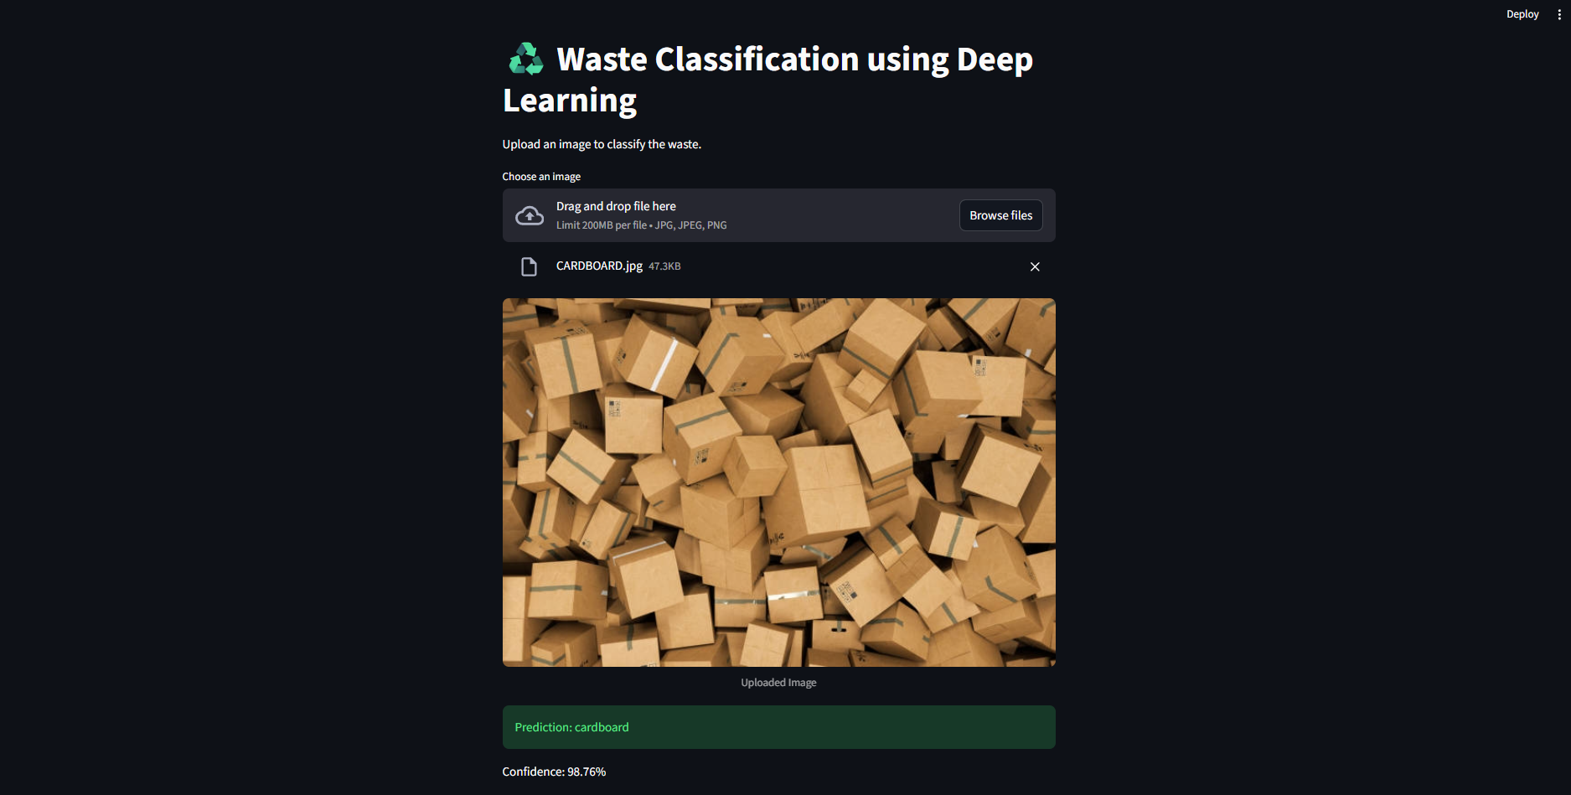
Notes:
Overview of the GitHub repository layout for reproducibility.

Slide 10
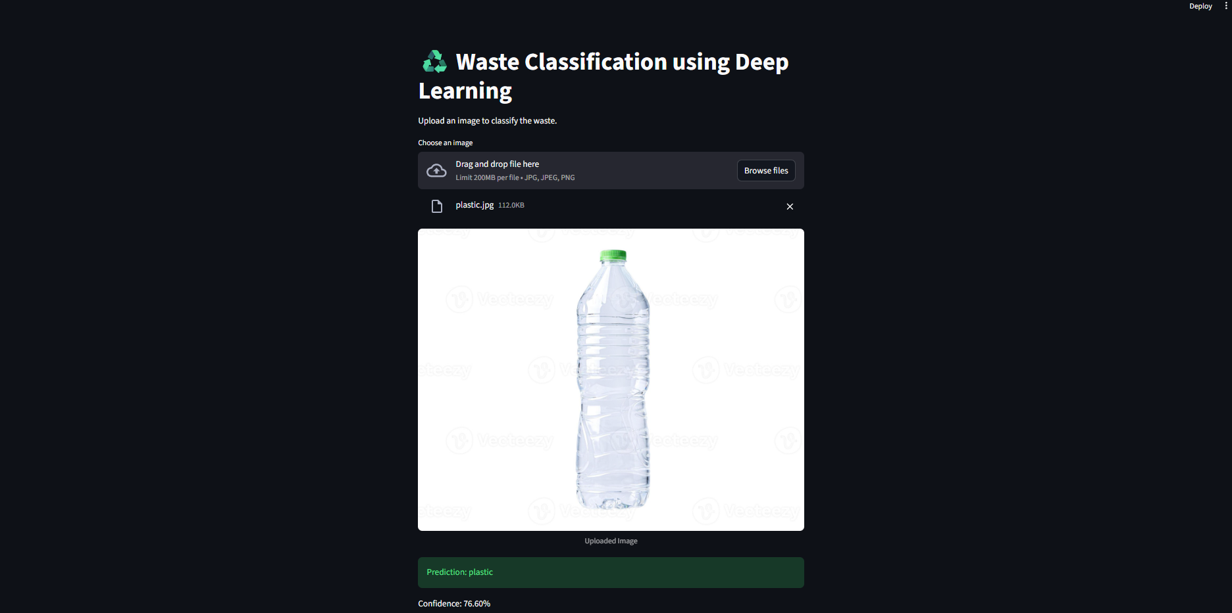

Slide 11
Skills Demonstrated
Image preprocessing
CNN architecture design
Model training & evaluation
Transfer learning
Image classification
Deep learning with TensorFlow/Keras
Notes:
Summarize the practical machine learning skills this project demonstrates.

Slide 12

Resume Summary
Developed a deep learning-based waste classification system using TensorFlow and CNN to identify recyclable waste categories from images. The model classifies waste into six categories and assists in improving waste segregation for sustainable recycling.
Thank You
Full code, dataset details, and setup instructions available on GitHub
Waste-Classification-Using-Deep-Learning
Notes:
Close with the resume-ready summary and a pointer to the GitHub repository.

