Slide 1
— AI-NATIVE CUSTOMER COMMUNICATION PLATFORM
Acorn OS
The communication layer for the AI era.
Compose once · Personalize intelligently · Deliver everywhere
CCM · CXM · IXM · AIXM unified
Prepared for — <client> · <date>
Notes:
Open with the category, not the features. Acorn OS isn't a better document tool — it's the operating system for every customer communication. Plant one sentence: "Every statement, bill, claim and notice becomes a secure, interactive, measurable experience." Pause on the tagline. Then a hook question to the room: how many of your customer communications are still one-way PDFs no one can act on? Set expectation: 15 minutes, then a live look at the working product.

Slide 2
Acorn OS
— THE PROBLEM
Most CCM is a document factory with AI sprinkled on top like digital parsley.
Static
Siloed
Slow
Risky
One-way documents
Channels don't talk
Every change waits on IT
Compliance & accessibility bolted on
PDFs and print streams the customer can read but never act on. The work ends where the outcome should begin.
Email, SMS, print and portal each run on different tools, with no shared preference, consent or journey.
A one-line wording update becomes a ticket, a release, and weeks of lead time.
Audit trails, WCAG and proof-of-delivery are afterthoughts — and afterthoughts are where lawsuits live.
02 / 15
Notes:
Name the pain the buyer lives with every day. Legacy CCM — Quadient, OpenText Exstream, Precisely — was engineered to mass-produce documents . AI got bolted on as a feature, not a foundation. The result is on screen: static output, channel silos, IT bottlenecks, and compliance treated as remediation. The "digital parsley" line usually earns a laugh — use it, then turn serious: this architecture structurally cannot get you to interactive, outcome-driven communication. Ask which of these four hurts most today and let them pick — it tells you where to lean.

Slide 3
Acorn OS
— THE SHIFT
From producing documents to driving outcomes.
THE OLD SCORECARD
THE ACORN OS SCORECARD
✕ Documents produced
✓ Customer understood
✕ Pages printed
✓ Payment completed
✕ Batches delivered
✓ Renewal secured
✕ SLA met
✓ Call avoided
Every template declares its intended outcome. Every journey and dashboard measures progress toward it.
03 / 15
Notes:
This is the reframe that moves the conversation from cost of production to business outcome — and it's the frame a CFO buys. A document is a means; the outcome is the point. In Acorn OS every template declares an intended outcome (payment, renewal, dispute resolved, "understood") and the platform measures the funnel to it. Line to land: "You already spend millions producing communications — the only question is whether they produce results." If the room is operations-led, this is where you win their sponsor; if it's finance-led, this is the whole pitch.

Slide 4
Acorn OS
— WHAT IT IS
Four disciplines, unified into one AI-native platform.
CCM
CXM
IXM
AIXM
CREATE
ORCHESTRATE
INTERACT
INTELLIGENCE
Compose, manage content, approve, and produce — batch or on-demand — with full version control.
Personalized journeys across every channel, with preference, consent and next-best-action built in.
The document itself becomes interactive — pay, dispute, sign, ask — inside the communication.
Governed AI across the whole lifecycle: authoring, migration, compliance, accessibility, analytics.
Usually four separate vendors. In Acorn OS: one core, one data model, one chain of custody.
04 / 15
Notes:
Acorn OS unifies four things that are normally four different purchases and four integration projects: CCM (create & manage), CXM (orchestrate the journey), IXM (make the document interactive), and AIXM (AI across the lifecycle). Competitors own one or two and bolt on the rest. Don't drill into the acronyms — the payload is unification : one place, one governance model, one audit trail. Every seam you remove is an integration you don't maintain and a compliance gap you don't have. If they're currently stitching a CCM vendor to a CDP to a separate accessibility service, that's your wedge.

Slide 5
Acorn OS
— THE PRINCIPLE
Compose once. Personalize intelligently. Deliver everywhere.
Make every communication interactive, compliant, accessible, measurable and outcome-driven.
05 / 15
Notes:
This is the product philosophy in one breath — the sentence you want them repeating internally after you leave. Compose the master once ; the platform renders it to an interactive web document, an accessible tagged PDF, email, SMS, print, and even a voice script — each personalized per customer, in the customer's language, on the customer's preferred channel, with failover. One source of truth, every channel, no re-authoring. Let this slide breathe — don't rush it. If you only get one idea to stick, make it this one.

Slide 6
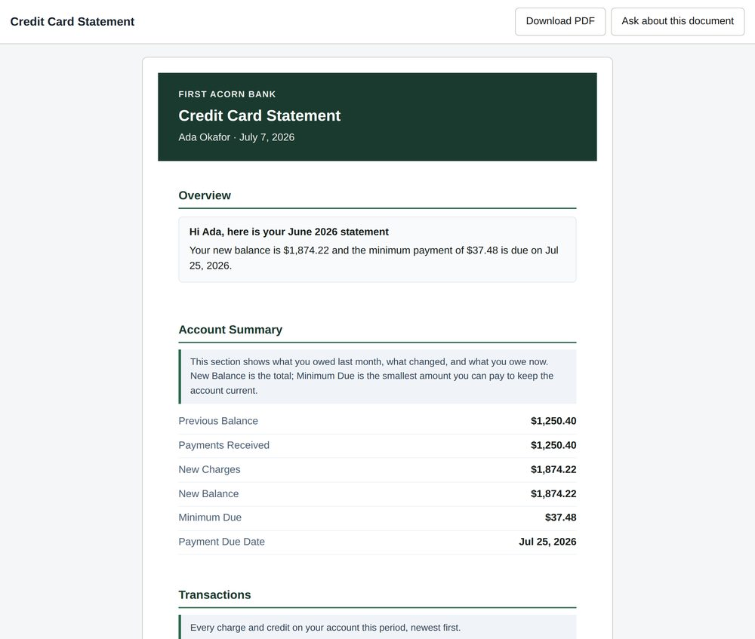
Acorn OS
— PRODUCT — THE INTERACTIVE DOCUMENT
The document becomes the experience.
✓
Act inside the communication. Pay, dispute, upload, e-sign, update details — no portal to go find, no call to make.
✓
Understand it. Expandable sections, plain-language explanations, and guided next steps built into the page.
✓
Ask it anything. An embedded assistant answers from this document's approved content — and every tap is measured.
LIVE VIEWER · A REAL INTERACTIVE STATEMENT
06 / 15
Notes:
This is the demo moment. If the room is live, switch to the running viewer and do this for real — it lands ten times harder than the mock. The statement is not a dead PDF: the customer can pay, dispute, go paperless, e-sign, or simply ask a question and get an answer grounded in their own document. Every one of those interactions is captured. This is what converts a cost center into self-service and call deflection . Key line: "The center of the experience is the communication itself — not a portal the customer has to log into and hunt through." Tie back to their contact-center volume if you know it.

Slide 7
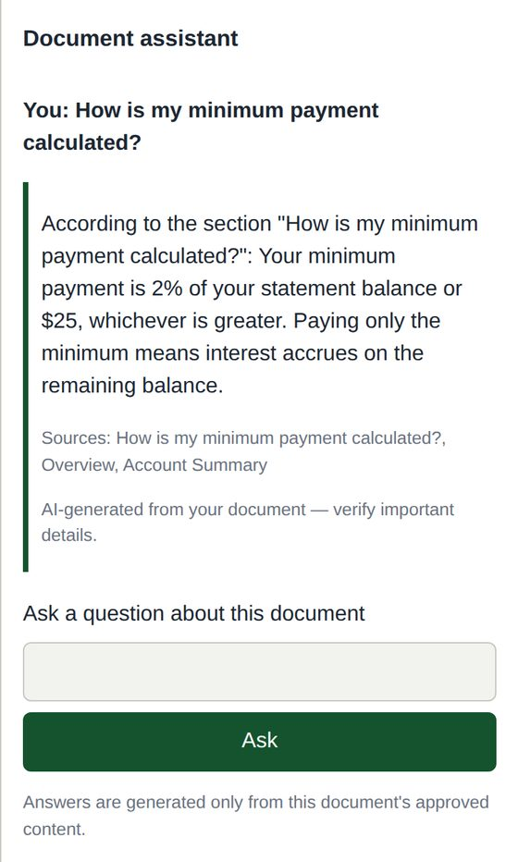
Acorn OS
— PRODUCT — AI, GOVERNED
AI that leaves fingerprints, receipts, and an audit trail.
✓
Grounded. Answers only from the document and approved knowledge — cites its sources every time.
✓
Never guesses. Unsure? It says so and routes to a human — no hallucinated legal language.
✓
Every action logged. Prompts, models, citations and confidence — to a tamper-evident audit trail.
✓
Your data stays yours. Bring your own model; no tenant data trains models by default.
GROUNDED ANSWER · CITED SOURCES · PROVENANCE
07 / 15
Notes:
Regulated buyers are afraid of generative AI hallucinating on a legal disclosure — this slide is your answer, and it's often what gets you past the risk committee. The embedded assistant answers only from approved content and the specific document, cites its sources, and when it's unsure it refuses to guess and hands to a human . Every AI action is grounded, cited, confidence-scored and audited; no tenant data trains models by default. Contrast sharply with "AI features" bolted onto legacy tools that have no grounding and no audit. Line to use: "Our AI leaves receipts — you can prove what it did, why, and where it got the answer."

Slide 8
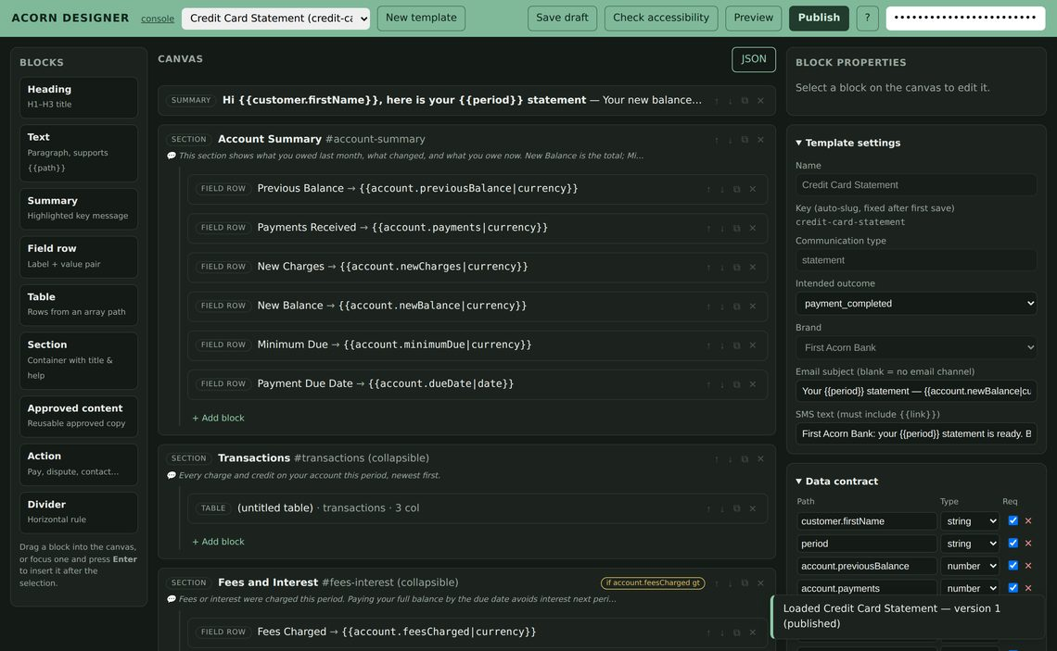
Acorn OS
— PRODUCT — AUTHOR & CONTROL
Business teams author. Governance is enforced, not hoped for.
✓
Author without a ticket. Drag-and-drop designer with an AI assistant that drafts copy — a human always approves.
✓
Segregation of duties. The author can't approve their own work; compliance and legal sign off before anything ships.
✓
Accessibility gate. A communication that fails WCAG can't be published — the system enforces it, not a policy PDF.
✓
Every change versioned. Comparable, reversible, with a record of who changed what and when.
TEMPLATE DESIGNER · BLOCKS, DATA CONTRACT, INTENDED OUTCOME
08 / 15
Notes:
Two audiences win on this slide — sell to both. Business users get a modern drag-and-drop designer with an AI assistant that drafts copy they approve: no more IT tickets for a wording change, no more six-week release for a rate update. Compliance gets teeth: segregation of duties (author ≠ approver, enforced), and an accessibility gate that literally blocks publication of anything that fails WCAG. Governance stops being a policy document nobody reads and becomes something the platform enforces at publish time. If legal or risk is in the room, slow down here — this is their slide.

Slide 9
Acorn OS
— MEASURE WHAT MATTERS
Every template declares an outcome. Every dashboard measures it.
Understood
Paid
Renewed
Disputed & resolved
Signed
Self-served
Call avoided
1
100%
∞
OUTCOME PER TEMPLATE
INTERACTIONS CAPTURED
CHANNELS, ONE MEASURE
Report payment lift and call deflection — not pages produced.
09 / 15
Notes:
Come back to outcomes — this is the ROI narrative and the slide your champion screenshots for their CFO. Instead of "we produced four million statements," the report becomes payment completion, call deflection, paperless adoption, renewal rate, dispute-resolution time. The platform ties each communication to its declared outcome and shows the funnel — composed → delivered → viewed → acted → outcome. Frame the value math with their numbers if you have them: even a few points of call deflection on their statement volume pays for the platform. Don't invent client results — this is about the metrics the platform is built to move.

Slide 10
Acorn OS
— WHY ACORN OS WINS
Built AI-native. Not retrofitted.
Capability
Legacy CCM suites
Acorn OS
AI
Bolted-on feature
Native core, governed & audited
The document
Static output
Interactive experience
Accessibility
Services engagement
Enforced at publish (WCAG 2.2)
Agent / MCP
—
Native MCP server & client
Measures
Documents produced
Business outcomes
Quadient · OpenText · Smart Communications · Precisely · Messagepoint · Doxim are strong at high-volume production. The AI-native, outcome-first, interactive core is the ground they were not built on.
10 / 15
Notes:
Name the competitors directly — the buyer is almost certainly evaluating one of them, and dodging the comparison reads as weakness. Quadient, OpenText Exstream, Smart Communications, Precisely EngageOne, Messagepoint, Doxim: mature, credible, genuinely strong at high-volume batch production and print. Concede that openly — it builds trust. Then the gap: their AI is bolted on, the document is still static, accessibility is a professional-services line item, and there is no agent/MCP story at all. Acorn OS was built AI-native, interactive-first, accessible-by-default, and agent-ready from day one. You're not asking them to rip-and-replace overnight — pivot straight to the migration slide next to de-risk it.

Slide 11
Acorn OS
— TRUST
Compliant and accessible by design — not by services engagement.
COMPLIANCE
ACCESSIBILITY
Prove everything
By default
✓
Complete chain of custody for every communication
✓
WCAG 2.2 AA as the product baseline
✓
Proof of delivery, access, content, approval, version, AI changes & customer action
✓
Accessible tagged PDF & screen-reader-ready documents
✓
Block-on-fail gates — non-compliant work can't publish
✓
Hash-chained, tamper-evident audit log
✓
The Acorn.Access widget in every interactive document
✓
Legal hold, retention & right-to-erasure built in
11 / 15
Notes:
For regulated industries this is frequently the deciding slide . Every communication carries a complete chain of custody — you can prove exactly what was sent, to whom, when, using which data, which template and content versions, and which approvals, all against a tamper-evident, hash-chained audit log . Accessibility isn't a remediation project billed by the hour; it's enforced at publish time . If the buyer is a bank, insurer, healthcare or government body, connect to their world: ADA/Section 508 and the growing wave of accessibility litigation and DOJ Title II rules — the cost they're trying to avoid is real and rising. Offer to walk their compliance team through an evidence pack in the follow-up.

Slide 12
Acorn OS
— GETTING THERE
Migration is a modernization engine — not a lift-and-shift of old problems.
1
Ingest
2
Rationalize
3
Verify
1
2
3
AI reads your legacy estate
1,400 variants → ~80 canonical
Parallel-run before cutover
Inspire, Exstream, DOC1, PDFs and print streams — parsed into modern, editable templates.
AI detects near-duplicate disclosures and collapses them into parameterized, governed content.
New output is diffed against the old on real data, so you prove equivalence before you switch.
Start with one high-value communication. Expand across the estate. Migration becomes the moment you clean up — not carry forward — decades of drift.
12 / 15
Notes:
De-risk the switch — this dissolves the number-one objection: "we have thousands of templates, we can't move." The Migration Studio uses AI to ingest legacy templates, PDFs and print streams, detect and collapse near-duplicates (a bank's 1,400 disclosure variants become ~80 canonical, parameterized templates), extract the variable data mappings, and generate first-draft modern templates. Parallel-run verification diffs new output against old on production data so you prove equivalence before cutover — the regulator-friendly path. This is also our land-and-expand motion: land one high-value communication, prove the outcome, expand across the estate. Migration becomes the cleanup they've wanted for years, not a risk.

Slide 13
Acorn OS
— FITS YOUR ESTATE
Deploy anywhere. Integrate with everything.
ANY-PREMISE
INTEGRATE WITH ANYTHING
Runs where your data must live
Communication data never arrives clean
SaaS
Private cloud
Hybrid
REST · OpenAPI
GraphQL
MCP · agents
Customer VPC
Webhooks
Kafka · CloudEvents
SFTP · CDC
The same product, deployed into your boundary when regulation or data residency requires it.
CRM · core banking · claims · FHIR
13 / 15
Notes:
Kill the infrastructure and integration objections in one slide. Regulated clients often can't use pure multi-tenant SaaS — so we deploy the same product into their private cloud or their own VPC, with data residency respected. And communication data never arrives clean: we ingest from anything — files, streams, databases, CRMs, core banking, claims systems, FHIR for healthcare. The forward-looking hook is MCP : Acorn OS is both an MCP server (their AI agents can safely operate approved capabilities, fully audited) and an MCP client (it can pull grounding from their systems). No incumbent has that. If IT/architecture is in the room, this is where they relax.

Slide 14
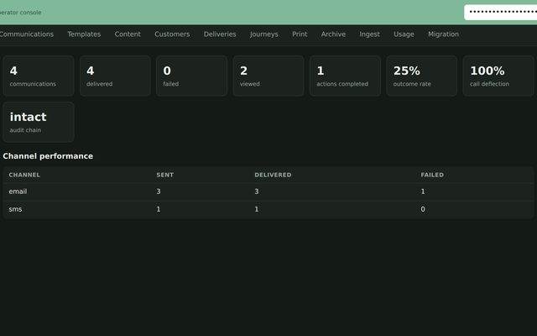
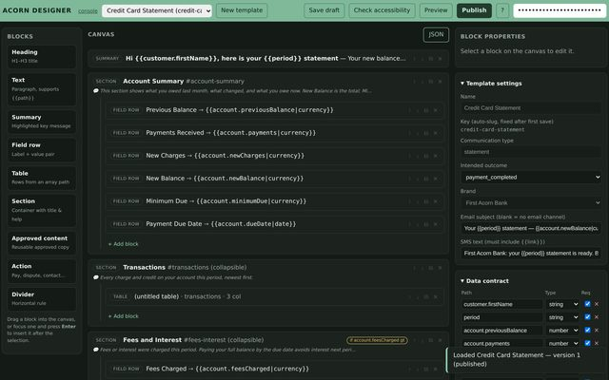
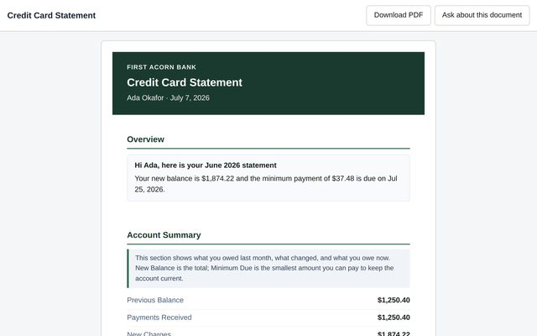
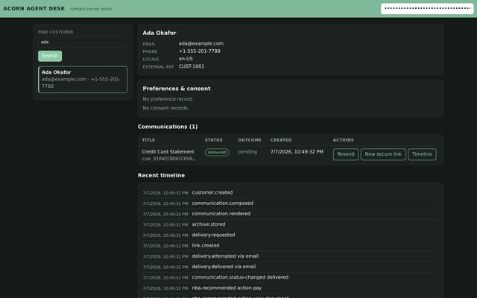
Acorn OS
— NOT SLIDEWARE
A working, tested platform — running today.
21+
214
4
6
BOUNDED CONTEXTS, ONE CORE
AUTOMATED TESTS PASSING
API SURFACES · REST · GRAPHQL · MCP · WEBHOOKS
RENDER FORMATS · HTML · PDF · EMAIL · SMS · TEXT · VOICE
OPERATOR CONSOLE — OUTCOMES & AUDIT CHAIN
TEMPLATE DESIGNER — AUTHOR & GOVERN
INTERACTIVE VIEWER — THE CUSTOMER EXPERIENCE
AGENT DESK — FULL AUDITED TIMELINE
14 / 15
Every screen in this deck is the running product — ask for the live walkthrough.
Notes:
This slide separates you from vaporware — and from competitors who demo mockups. Everything in this deck is backed by a working, tested reference platform , not renders. The full communication lifecycle runs end to end: compose once, render to interactive HTML, accessible PDF and voice, deliver with automatic failover, view, pay, prove with an evidence pack, and archive to tamper-evident storage. 214 automated tests, a live grounded assistant, four API surfaces including MCP. Be honest about maturity if asked — this is a reference platform engineered to production shape, with the industrial substrate (managed Postgres, real send providers, SSO) as the deployment step. Then offer the live walkthrough — console, designer, and a real interactive statement — as the immediate next action.

Slide 15
Acorn OS
— NEXT STEP
Let's compose your first outcome.
A time-boxed pilot on one high-value communication.
Pick your highest-volume or highest-pain communication. We migrate it, make it interactive and accessible, deliver it, and measure the outcome — together.
1
Pick the communication
2
Migrate & make it interactive
3
Measure the outcome
Acorn OS · the communication layer for the AI era · <name> <email>
15 / 15
Notes:
Close with a small, concrete, low-risk yes . Do not ask them to replace their CCM platform today — ask for one communication . Propose a time-boxed pilot: pick the highest-volume or highest-pain piece (a statement, a dunning notice, an EOB, a welcome pack), we migrate it, make it interactive and accessible, deliver it, and measure the outcome — payment lift, call deflection, or paperless adoption. Agree the success metric before you start — that's what turns a pilot into a rollout. End by restating the vision so it's the last thing they hear: "This is the communication layer for the AI era — and the first oak starts with one acorn." Then name the specific next action and owner before you leave the room.

