Slide 1
King County Housing Analysis
Final Project
Alan Casper

Slide 2
Questions
What are the main predictors of the house price?
What predictors should be converted to factors?
How much should I pay for the following house:
4+ bed, 3+ bath
> 4000 sqft. living, > 5000 lot
> 5 condition, > 7 grade

Slide 3
Data Wrangling
Waterfront, view, and zipcode were all converted to factors because they are categorical variables.
The waterfront and view numeric columns were then removed.
Both the numeric and factor zipcode columns were removed because longitude and latitude are more exact.
sqft_living15 and sqft_lot15 were removed because they are highly coorelated with sqft_living and sqft_lot.
The square root of sqft_living and the log of sqf_living were added as columns.
The log of price was also added as a column.

Slide 4
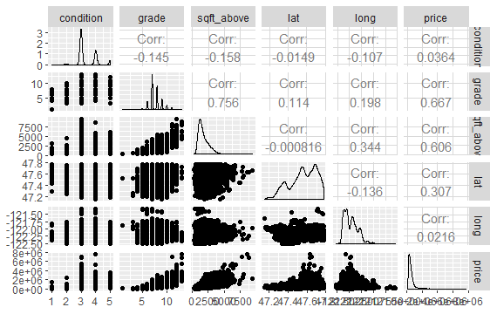
Data Exploration / Hypothesis Visuals
In data exploration we noticed a few interesting patterns:
Grade and sq. ft. above are highly correlated with each other.
Grade and sq. ft. above are highly correlated with price.
Latitude and longitude have relatively low correlations with price.
ggpairs(house[,c(10:12,16:17,2)])
Hypothesis:
Latitude and longitude are major price predictors. The motto of most realtors is: “location, location, location”

Slide 5
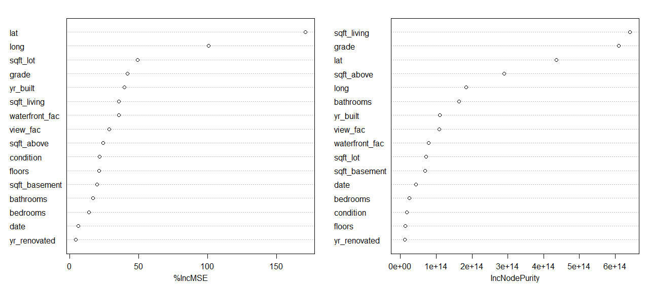
Variable Selection
Highly correlated variables
Var1 | Var2 | value
sqft_living | sqft_above | 88%
sqft_living | grade | 76%
grade | sqft_above | 76%
bathrooms | sqft_living | 75%
price | sqft_living | 70%
As expected lat and long are two important variables. sqft_living, grade, sqft_above are also among the important variables. The variables provided in the instructions for the assignment were used:
bedrooms, bathrooms, sqft_living, sqft_lot, floors, waterfront_fac, view_fac, condition, grade, sqft_above,
sqft_living.sqrt, sqft_living.log
Knowing sqft_living15 and sqft_lot15 are very similar variables to sqft_living and sqft_lot, they were removed.

Slide 6
Model Selection
The random forest model outperformed the linear model in RMSE, R-squared, and MAE and was therefore selected as the final model.
Linear Model
Resampling results:
RMSE = 202625.5
R-squared = .6959
MAE = 126240.6
Model on all data:
R-squared = .6968
Random Forest
Resampling results:
RMSE = 133841.3
R-squared = .8684
MAE = 69831.13
Model on all data:
R-squared = .8682

Slide 7
Conclusions / Model Results
879307.5
sqft_living | 4000
sqft_above | 4000
sqft_lot | 5000
bedrooms | 4
bathrooms | 3
floors | 2
condition | 5
grade | 7
waterfront_fac | 0
view_fac | 1
sqft_living.sqrt | sqrt(4000)
sqft_living.log | log(4000)
Predicted Price
$837,198
Inputs

Slide 8
Challenges
The King County dataset did not require heavy cleaning or transformations.
Challenge 1:
The Random Forest model was used to predict the log price of homes. It is a slow algorithm and took a long time to process. This lengthened the amount of time it took to finish the project.
Challenge2:
There were many price outliers that were significantly affecting model accuracy. These outliers were removed.

Slide 9
Appendix
Notes:
This code on the left is the code used for the final mode.
Used sapply instead of lapply to scale data because it was easier to create the prediction data frame later.
Removed houses with prices over 1.5 * interquartile range over the 75th percentile of prices. These outliers were greatly affecting the model.
R code
# create features house = house %>% mutate(sqft_living.sqrt = sqrt(sqft_living), sqft_living.log = log(sqft_living), price.log = log(price)) # numeric columns to be scaled cols = c('bedrooms', 'bathrooms', 'sqft_living', 'sqft_lot', 'floors', 'condition', 'grade', 'sqft_above', 'sqft_living.sqrt', 'sqft_living.log') cols # scale numeric columns house[,cols] = sapply(house[,cols], scale) # calculate outlier price with interquartile range outlierprice <- quantile(house$price, .75) + ((quantile(house$price, .75) - quantile(house$price, .25)) * 1.5) # calculate new random forest model to predict log of price new_rf_model <- randomForest(price.log ~ bedrooms + bathrooms + sqft_living + sqft_lot + floors + waterfront_fac + view_fac + condition + grade + sqft_above + sqft_living.sqrt + sqft_living.log, data=filter(house,price<outlierprice)) new_rf_model summary(new_rf_model)
Attachments:

