Slide 1
Company Report

Slide 2
Project Requirements
Promotion Analysis Page Requirements
Remove “Promotion” from the promotion names in the “Promotion Name” column
Add logo and title
Add card visuals for:
Sales Quantity
Return Quantity
Net Quantity
Sales Amount
Return Amount
Cost of Goods
Net Profit
Add slicers for:
Year
Is Workday?
Continent
Region / Country
State / Province
Product Category
Product Sub Category

Slide 3
Project Requirements (continued)
Promotion Analysis Page Requirements (continued)
Create a visualization that shows the breakouts of Net Quantity by Promotion Name & Promotion Year
Create a visualization that shows the relationship between the average sales per day, and the returns as a percentage of quantity sold
Create a table that contains the following information:
Promotion Name
Start Year
Sales Quantity
Return Quantity
Net Quantity
Average Quantity Per Day
Return Quantity Ratio
Sales Amount
Return Amount
Cost of Goods Sold
Net Profits
Create a visualization that shows the breakouts of Average Sales Quantity Per Day by Promotion Name & Year

Slide 4
Project Requirements
Product Details Page Requirements
Allow ability to see which promotion was selected on the Promotion Analysis page.
Same Card Visuals as the Promotion Analysis page
Same Slicers as the Promotion Analysis Page
Create Matrix Table with:
Product Hierarchy
Sales Quantity
Return Quantity
Net Quantity
Average Quantity Ratio
Return Quantity Ratio
Sales Amount
Cost of Goods Sold
Net Profits

Slide 5
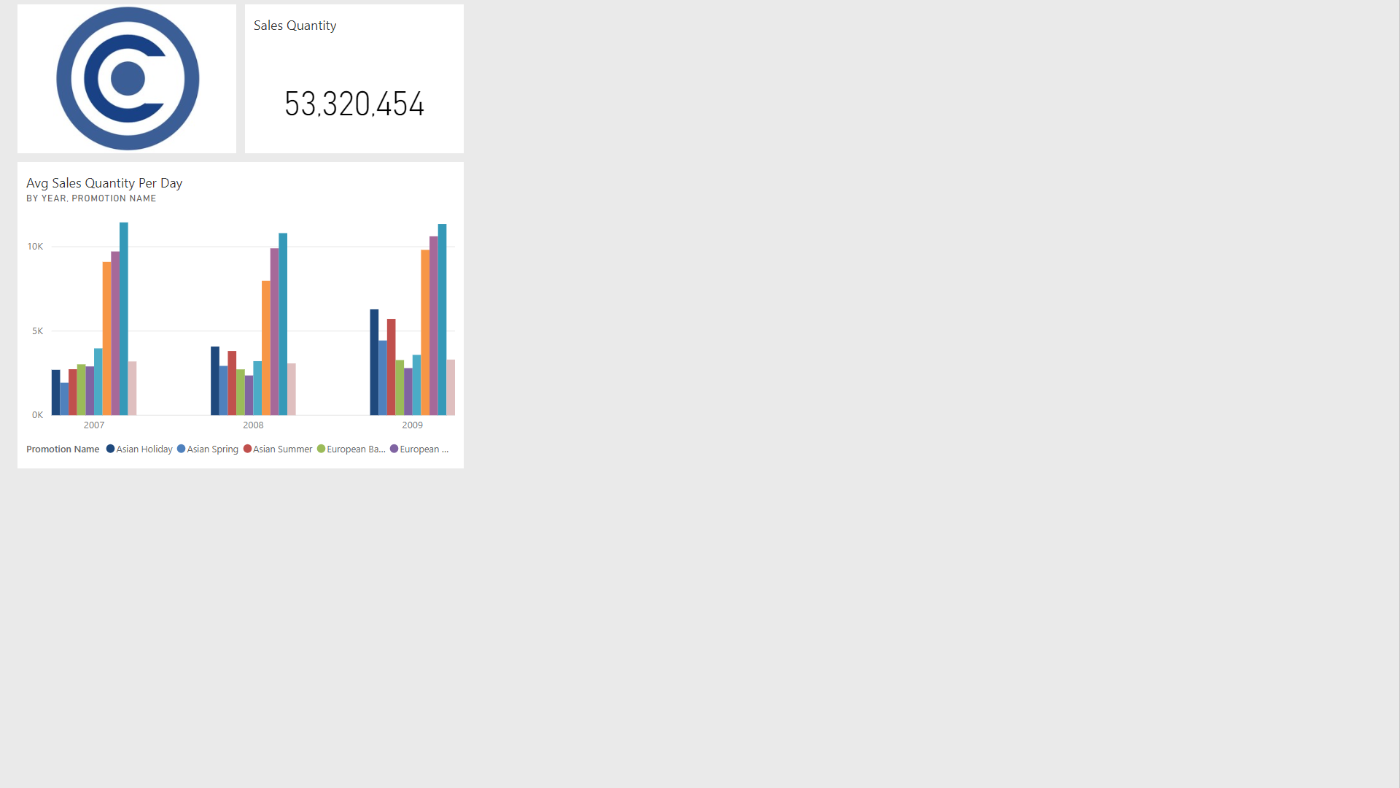
PowerBI.com Dashboard

Slide 6
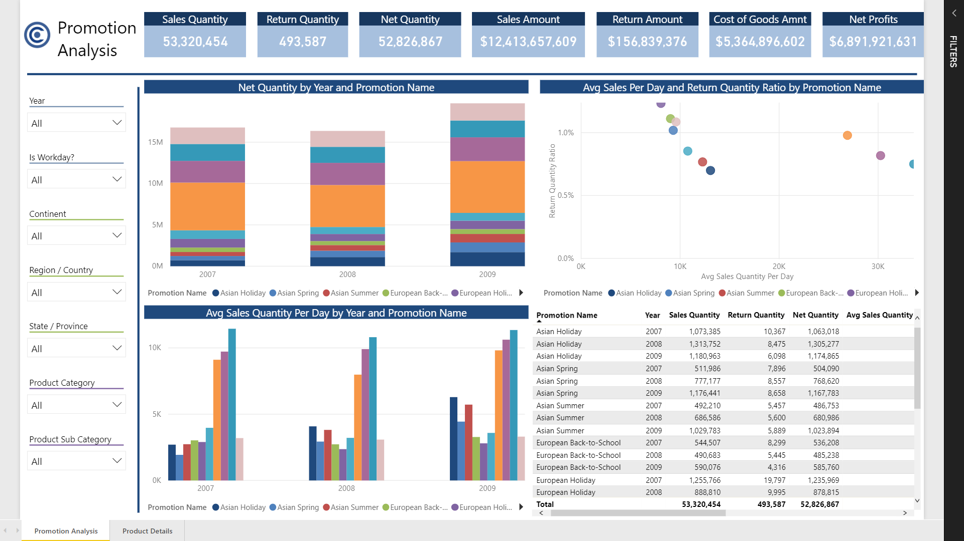
Promotion Analysis Page

Slide 7
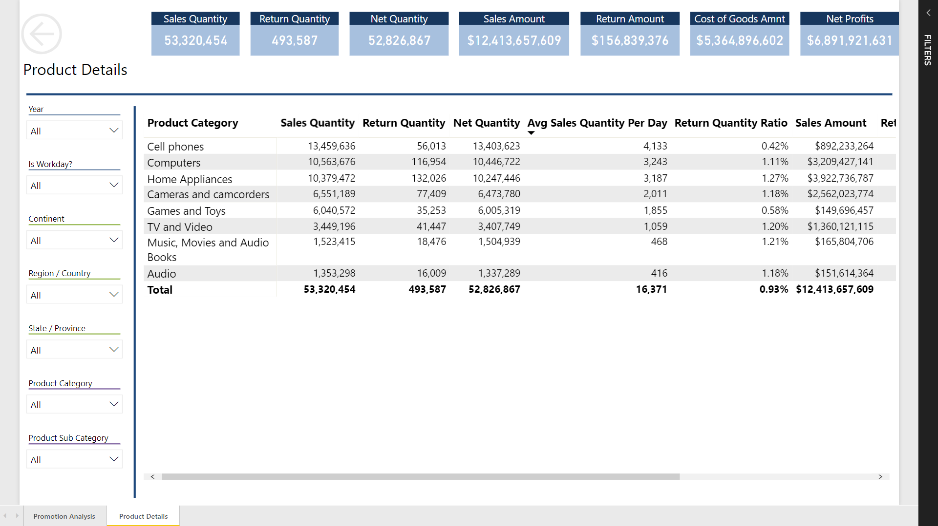
Product Table Page

Slide 8
Questions and Answers
1. The “North America Holiday” promotion had the highest average sales comparatively to lowest returns.
2. The “North America Holiday” promotion had the highest average sales overall.
3. The “Asian Holiday” promotion had the lowest return ratio overall.
4. The “North America Spring” promotion had a lower average sales quantity per day than the non-promotion period.

Slide 9
Recommendations
The promotions with high average sales quantities per day and low return ratios could be used as templates for current and future promotions.
The North America Holiday Promotion should be used as a template for future promotions in North America because of its high average sales quantities per day.
The Asian Holiday promotion could be used as a template for future Asia promotions because of its low return ratio.

