Slide 1
Fundamentals of Programming (part1)
Introduction to Internet and World Wide Web

Slide 2
Learning Objectives
What is the Internet?
How does the Internet work?
What is the World Wide Web?
How does the World Wide Web work?
To understand the difference between Internet and World Wide Web
To understand the evolution of the Web
Notes:
Students will be divided into groups to find out all the information they can about these topics:
History of Internet
What is Internet
What is World Wide Web
What is HTTP protocol
They will write their findings into given flip charts and presented to the rest of the class. After which, the video will be shown and teacher will emphasized on the important points (in the slide after the video)

Slide 3

History of Internet

Slide 4
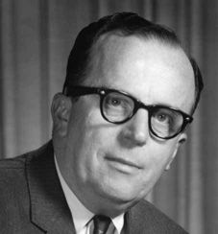
History of Internet
Internet is more than 50 years old, born in 1962
J.C.R Licklider is considered the father of Internet
ARPANET (Advance Research Projects Agency Network) was the initial name of Internet
A collection of computers or network devices connected together

Slide 5

How fast is the Internet speed now?
Hands On
Time
Notes:
Broadband speed is defined as at least 25 Mbps downstream (from the Internet to the user's computer) and 3 Mbps upstream (from the user's computer to the Internet)
Fiber optic speed is about 1Gpbs or more

Slide 6
Tell me about Dial up
What is it?
Technology to transmit digital data over phone line
How fast is it?
Up to maximum of 56Kbps
Notes:
I believe you all heard of Dial up. Do you know it use to be what speed? 56 Kbps as compared to 1 Gbps. 1 kilo bit is like 2^10 bit and Mega is 2^20 and Giga is 2^30 bit. Let me draw it out for us. So imagine 1 ascii alphabet is 7 bit. last time, 56 000 bit is like 56000/7 = 8000 letters transmitted across per sec. that is y a song takes me 30min to be download while now, it is almost like instant.

Slide 7
What is Internet?

Slide 8

What am I?
A computer that is connected directly to the Internet (or “wire” in the video)
Server

Slide 9

Files on the server’s hard drive
A collection of web pages is called a website
What are web pages?

Slide 10
How am I identified?
Through my IP (internet protocol) address
E.g. 67.205.46.248
I’m not the only one with IP address, any device that is directly or indirectly connected has one too!
Server

Slide 11
IP Address (IPv4)
Four numbers separated by periods (.)
Each ranges from 0 to 255
192.50.48.202
Subnet Number
Network ID Number
Host(Computer)
Number

Slide 12
Why is IP address seldom used directly?
Because it is difficult to remember only numbers. Thus each server is usually given a name.
E.g. facebook.com
Server

Slide 13
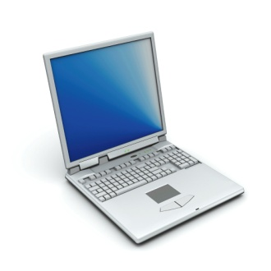
Domain Name Service
A network service that maps domain names to IP addresses
Domain Name Server
74.125.235.5
google.com

Slide 14
Domain Name
.com for Commercial organisations
.edu for Educational institutions; universities, etc
.net for Network resources organisations
.org for Other non-profit making organisations
.edu.sg (sg is the country code for Singapore)
www.nyp.edu.sg
Reference: http://www.sgnic.org/ for
DNS Information

Slide 15

How does information travel?
Through packet switching
(information is divided into smaller bits at the source and transmitted through the network and reassembled at the destination)
Internet

Slide 16
What is World Wide Web

Slide 17

What am I?
Service that uses Internet and Protocol (HTTP) to publish and share information
World Wide Web
HTTP
Web Client
Web Server
Web Client
Web Client

Slide 18

How do you access information on WWW?
Through web browsers
A software application that interpret and display the web information to the users
World Wide Web

Slide 19

What is HTTP?

Slide 20

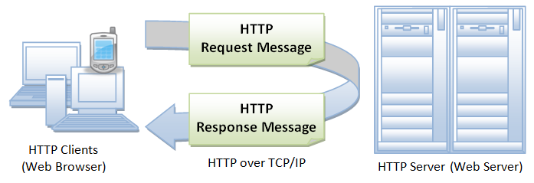
What am I?
A set of rules for exchanging files/information on the WWW

Slide 21
Uniform Resource Locator (URL)
Address of a file (or resource) accessible on the WWW
A URL contains the following:
Name of the protocol used to access the resource (e.g. http)
Domain name (e.g. www.nyp.edu.sg)
A directory/file location on the computer (optional, e.g. home.htm)

Slide 22
Uniform Resource Locator (URL)
http://www.nyp.edu.sg/SIT/bt_main.html
Use HTTP protocol
Directory Name
Domain Name
Web Page
Document Name
Notes:
In cmd, type nslookup www.google.com
Then the return address can be paste on browser directly e.g 64.233.170.106

Slide 23
Steps to setup a website
NYP wants a website.
Get a web server that is connected to the Internet.
The purchased web server will have a unique IP address (E.g. 202.0.127.11)
Purchase a domain name (E.g. www.nyp.edu.sg) and tag it to that IP address.
Design and create the website using HTML, CSS, Javascript, etc and upload it to the web server.
The public can now key in the URL http://www.nyp.edu.sg in their web browser (aka their web client) to see the website.

Slide 24
Summary
Internet is a collection of inter-connected devices to transmit and receive information.
Information are broken down in packets (small pieces) and transmitted over the Internet, and later reassembled when all of them reaches the recipient.
Each device connected to the internet is identified by IP address.
Each server can use a domain name to identify themselves as well. The mapping from domain name to IP address is performed by a domain name service (DNS).
World wide web (WWW) uses the uniform resource locator (URL) and the hyper text transfer protocol (HTTP) to identify the location of a webpage.
World wide web (WWW) also uses the internet to transmit the information.

Slide 25

Learning Objectives
What is the Internet?
How does the Internet work?
What is the World Wide Web?
How does the World Wide Web work?
To understand the difference between Internet and World Wide Web
To understand the evolution of the Web

